Slide 1
Basic statistics for Machine Learning
- Nitin kapse

Slide 2
Major types of data
Numerical
Categorical
Ordinal

Slide 3
Numerical
Represents some sort of quantitative measurement
Heights of people, page load times, stock prices, etc.
Discrete Data
Integer based; often counts of some event.
How many purchases did a customer make in a year?
How many times did I flip “heads”?
Discrete data can be numeric like numbers of apples but it can also be categorical like red or blue, or male or female, or good or bad.
Continuous Data
Has an infinite number of possible values
How much time did it take for a user to check out?
How much rain fell on a given day?
Temperatures are continuous. It can be 23 degrees, 23.1 degrees, 23.100004 degrees.

Slide 4
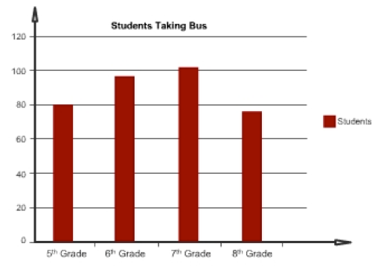
Categorical
Qualitative data that has no inherent mathematical meaning
Gender, Yes/no (binary data), Race, State of Residence, Product Category, Political Party, etc.
You can assign numbers to categories in order to represent them more compactly, but the numbers don’t have mathematical meaning.

Slide 5
Ordinal
A mixture of numerical and categorical
Categorical data that has mathematical meaning
Example: movie ratings on a 1-5 scale.
Ratings must be 1, 2, 3, 4, or 5
But these values have mathematical meaning; 1 means it’s a worse movie than a 2.

Slide 6
Mean
AKA Average
Sum / number of samples
Example:
Number of children in each house on my street: 0, 2, 3, 2, 1, 0, 0, 2, 0
The MEAN is (0+2+3+2+1+0+0+2+0) / 9 = 1.11

Slide 7
Median
Sort the values, and take the value at the midpoint.
Example:
0, 2, 3, 2, 1, 0, 0, 2, 0
Sort it:
0, 0, 0, 0, 1, 2, 2, 2, 3
Median is 1

Slide 8
Median (cont…)
If you have an even number of samples, take the average of the two in the middle.
Median is less susceptible to outliers than the mean
Example: mean household income in the US is $72,641, but the median is only $51,939 –because the mean is skewed by a handful of billionaires.
Median better represents the “typical” American in this example.

Slide 9
References

