Slide 1
Data Science

Slide 2
Data Science
Skill of extracting of knowledge from data
Using knowledge to predict the unknown
Improve business outcomes with the power of data
Employ techniques and theories drawn from broad areas of mathematics, statistics and information technology
Investigate complex business problems and use data to provide solutions

Slide 3
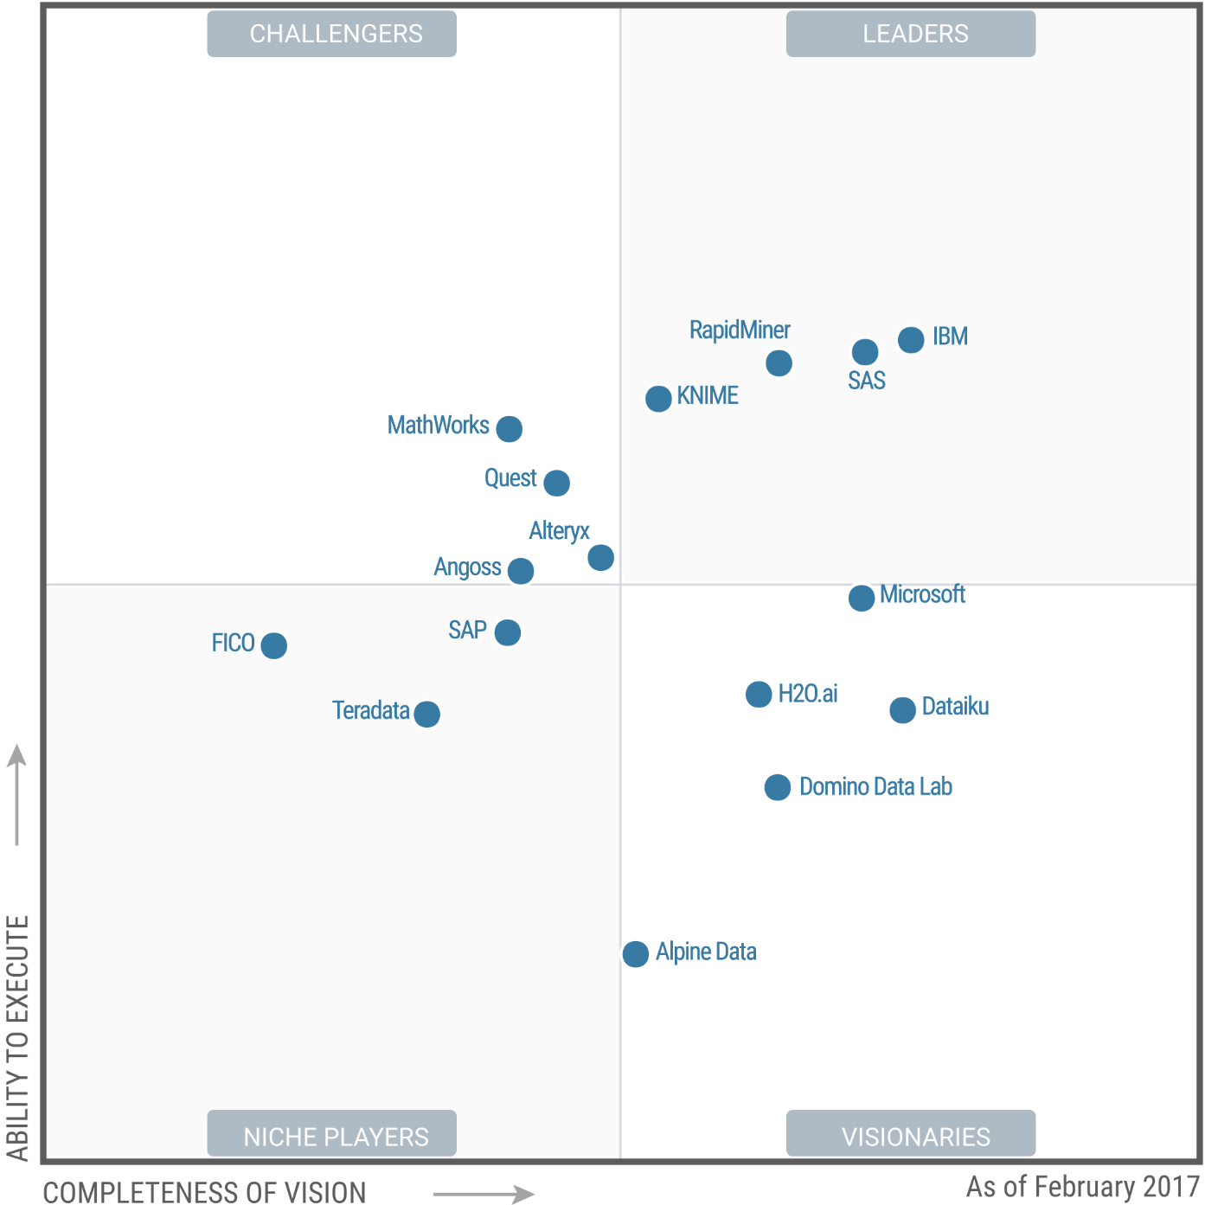
Market Leaders
Source: Gartner (February 2017)

Slide 4
Entity
A thing that exists about which we research and predict in data science
Entity has a business context
Customer of a business
Patient at a hospital. The same person can be a patient and a customer but the business context is different
Car: Entity can be a non-leaving things

Slide 5
Characteristics
Every entity has a set of characteristics. These are unique properties
Properties too have a business context
Customer: Age, income group, gender, education
Patient: Age, Blood Pressure, Weight, Family history
Car: Make, Model, Year, Engine

Slide 6
Environment
Environment points to the eco-system in which the entity exists or functions
Environment is shared among entities. Multiple entities belong to the same environment
Environment affects an entity’s behavior
Customer: Country, City Workplace
Patient: City, Climate
Car: Use (City/Highway), Climate

Slide 7
Event
A significant business activity in which an entity participates
Events happens in a said environment
Customer: Browsing, store visit, sales call
Patient: Doctor visit, blood test
Car: Smog test, comparison test

Slide 8
Behavior
What an entity does during an event
Entities may have different behaviors in different environments
Customer: Phone Calls vs email, Clickstream, response to offers
Patient: Nausea, light-headed, cramps
Car: Skid, acceleration, stopping distances

Slide 9
Outcome
The result of an activity deemed significant by the business
Outcome values can be
Boolean (yes/no, pass/fail)
Continuous (a numeric value)
Class (identification of type)
Customer: Sale (Boolean), sale value (continuous)
Patient: Blood Pressure value (continuous). Diabetes type (class)
Car: Smog level (class), stopping distances (continuous), smog passed (Boolean), car type (class)

Slide 10
Observation
A measurement of an event deemed significant by the business
Captures information about
Entities involved
Characteristics of the entities
Behavior
Environment in which the behavior happens
Outcomes
An observation is also called a system of record
Customer: A phone call record, a buying transaction, an email offer
Patient: A doctor visit record, a test result, a data capture from a monitoring device
Car: Service record, smog test result

Slide 11
Dataset
A collect of observations
Each observation is typically called a record
Each record has a set of attributes that point to characteristics, behavior or outcomes
A dataset can be
Structured (database records, spreadsheet)
Unstructured (twitter feeds, news paper articles)
Semi-structured (email0
Data scientists collect and work on datasets to learn about entities and predict their future behavior/outcomes.

Slide 12
Relationships
Attributes in a dataset exhibit relationships
Relationships “model” the real world and have a logical “explanation”
For attributes A and B the relationships can be
When A occurs B also occurs
When A occurs B does not occur
When A increase B also increases
When A increases B descreases

Slide 13
Relationships - Examples
Customer
As age goes up, spending capacity goes up (AGE and REVENUE)
Urban customers buy more internet bandwidth (LOCATION and BANDWIDTH)
Patient
Older patients have more prevalence of Diabetes (AGE and DISEASE LEVEL)
Overweight patients typically have higher cholesterol level (WEIGHT and HDL)
Car
The more cylinders a car has, the mileage tends to be lower (CYLINDERS and MILEAGE)
Sport cars have more insurance rate (TYPE and RATES)

Slide 14
Relationships
Consistent vs Incidental Patterns in Data
Correlations
Signals and noise

Slide 15
What is Learning
Learning implies learning about relationships
It involves
Taking a domain
Understanding the attributes that represent the domain
Collecting data
Understanding relationships between the attributes
Model is the outcome of learning

Slide 16
Model
A simplified, approximated representation of a real world phenomenon
Captures key attributes and their relationships
Mathematical model - represents relationships as an equation
Blood Pressure
BP = 56 + (AGE * .8) + (WEIGHT * .14) + (LDL * .009)
Decision Tree Model - represents the outcome as a decision tree
Buying a music CD
If AGE < 25 and GENDER=MALE, buy BEYONCE-CD = YES
Accuracy of models depends on strength of relationships between attributes

Slide 17
Prediction
A model can be used to predict unknown attributes
BP = 56 + (AGE * .8) + (WEIGHT * .14) + (LDL * .009)
The above model represents the relationships between BP, AGE, WEIGHT and LDL
If 3 of the 4 attributes are known, the model can be used to predict the 4th
The above equation can be considered the prediction algorithm
Relationships can be a lot more complex, leading to complex models and prediction algorithms

Slide 18
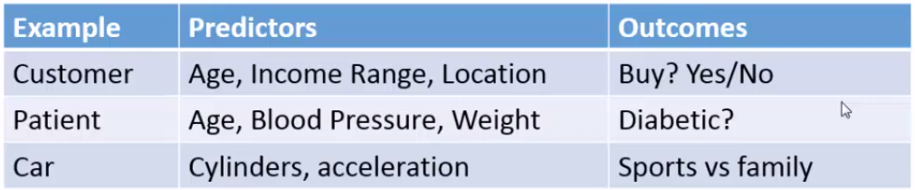
Predictors and Outcomes
Outcomes are attributes that you want to predict
Predictors are attributes that are used to predict outcomes
Learning is all about building models that can be used to predict outcomes (outputs) using the predictors (inputs)

Slide 19
So What is Data Science?
Picking a problem in a specified domain
Understanding the problem domain (entities and attributes)
Collect datasets that represents the entities
Discover relationships (Learning)
When computers are used for this purpose, its called machine learning
Build models that represent relationships
Uses past data where all predictors and outcomes are known
Use models for predicting outcomes
Current/future data - predictors known, outcomes unknown

Slide 20
Data Science Example - Website shopper
Problem: Predict if the shopper will buy a smartphone
Data: Past purchase history of shoppers
Shoppers characteristics (age, gender income etc)
Seasonal information
Others
Build Model
Decision model based on shopper and seasonal entities
Built every week
Prediction
When a new shopper is browsing, predict if the shopper will buy
Action
Offer chat help

Slide 21
Types of Analytics
Types of Analytics | Description
Descriptive | Understand what happened
Exploratory | Find out why something is happening
Inferential | Understand a population from a sample
Predictive | Forecast what is going to happen
Casual | What happens to one variable when you change another
Deep | Use of advanced techniques to understand large and multi-source datasets

Slide 22
Exploratory Data Analytics Goals
Understand the predictors and targets in the dataset
Spreads
Correlations
Uncover the patterns and trends
Find key variables and eliminate unwanted variables
Detect outliers
Validate previous data ingestion processes for possible mistakes
Test assumptions and hypothesis

Slide 23
Tools used for EDA (Exploratory Data Analytics)
Correlation matrices
Boxplots
Scatterplots
Principle Component Analysis
Histograms

Slide 24
References
http://www.kdnuggets.com/2017/05/ibm-data-science-platforms-gartner.html

