Slide 1
Machine Learning
Nitin Kapse

Slide 2
Overview
Data contains attributes
Attributes show relationships (correlation) between entities
Learning - understanding relationships between entities
Machine Learning - a computer analyzing the data and learning about relationships
Machine Learning results in a model built using data
Models can be used for grouping and prediction

Slide 3
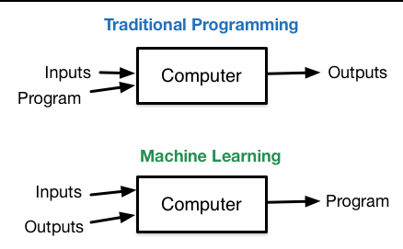
Machine Learning vs. Traditional Programming

Slide 4
What is Machine Learning
Here is technical definition
A computer program is said to learn from experience E with respect to some class of tasks T and performance measure P if its performance at tasks in T, as measured by P, improves with experience E
Simple definition of machine learning
The vast majority of machine learning algorithms are concerned with just one simple task: drawing lines. In particular, machine learning is all about drawing lines through data
Machine learning is just pattern recognition. ML algorithms learn patterns by drawing lines through training data, and then generalizes the patterns it sees to new data

Slide 5
Machine Learning
"Machine learning is a subfield of computer science that evolved from the study of pattern recognition and computational learning theory in artificial intelligence. Machine learning explores the study and construction of algorithms that can learn from and make predictions on data. Such algorithms operate by building a model from example inputs in order to make data-driven predictions or decisions, rather than following strictly static program instructions.“
"Machine learning is the science of getting computers to act without being explicitly programmed. In the past decade, machine learning has given us self-driving cars, practical speech recognition, effective web search, and a vastly improved understanding of the human genome. Machine learning is so pervasive today that you probably use it dozens of times a day without knowing it."

Slide 6
Data for machine learning
Machines only understand numbers
Text data need to be converted to equivalent numerical representation for ML algorithms to work
Number representation
(Excellent, Good, Bad can be converted to 1,2,3)
Boolean variables
3 new indicator variables called Rating-Excellent, Rating-Good, Rating-Bad with values 0/1

Slide 7
Machine Learning Algorithms
Binary Classification | linear SVMs, logistic regression, decision trees, naive Bayes
Multiclass Classification | decision trees, naive Bayes
Regression | linear least squares, Lasso, ridge regression, decision trees
Collaborative filtering | linear least squares
Clustering | K-Means
Dimensionality reduction | singular value decomposition (SVD), principal component analysis (PCA)

Slide 8
Classification
The first step in many machine learning algorithms is to obtain labeled training data. In our example, this means getting a large number of images of fruit each labeled as either being an apple or an orange. From these images, we can extract the color and size information and then see how they correlate with being an apple or an orange
we can apply this strategy to much more exciting problems, such as classifying tumors as malignant or benign, marking emails as spam or not spam, or analyzing fingerprints for security systems. This type of machine learning—drawing lines to separate data—is just one subfield of machine learning, called classification. Another subfield, called regression, is all about drawing lines that describe data.

Slide 9
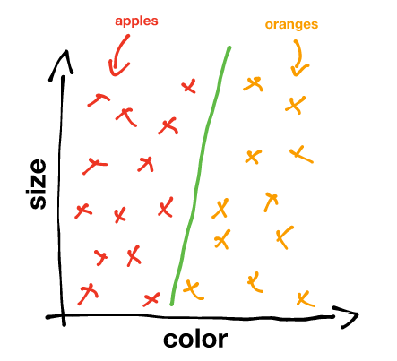
Classification
Green line represents Decision Boundary

Slide 10
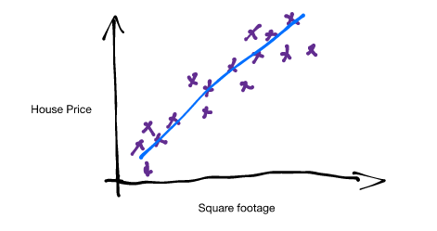
Regression
Say we have some labeled training data. In particular, let’s say we have the price of various houses versus their square footage. If we visualize the information as a graph, it looks like this:
Sky blue line represents predictor

Slide 11
The Predictor
The mathematical form of a linear predictor looks something like this:
In our example of predicting house prices based on square footage, since we’re only considering one variable our model only needs one input feature, or just one x:
This equation is probably more recognizable in this form:
y = mx + b

Slide 12
Cost Functions
The key to determining what parameters to choose to best approximate the data is to find a way to characterize how “wrong” our predictor is. We do this by using a cost function (or a loss function). A cost function takes a line and a set of data, and returns a value called the cost. If the line approximates the data well the cost will be low, and if the line approximates the data poorly the cost will be high.
The best predictor will minimize the output of the cost function, or in other words, it will minimize the cost. To visualize this, let’s look at the three predictor functions below:

Slide 13
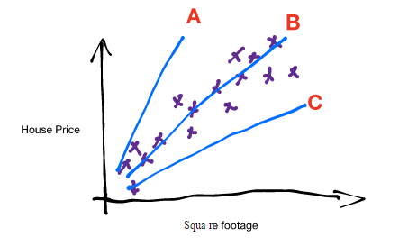
Cost Function

Slide 14
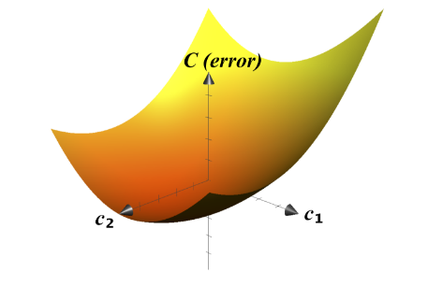
Gradient Descent
When we graph the cost function (with only two variables) it will look something like this:

Slide 15
References
http://www.kdnuggets.com/2017/05/machine-learning-crash-course-part-1.html

