Slide 1
Machine Learning Basics
Nitin Kapse

Slide 2
Machine Learning
Machine learning algorithms can be divided into 3 broad categories —
Supervised learning
Unsupervised learning
Reinforcement learning

Slide 3
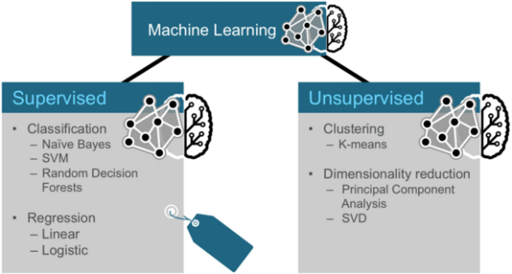
ML Algorithms

Slide 4
Supervised Learning
Supervised learning is useful in cases where a property (label) is available for a certain dataset (training set), but is missing and needs to be predicted for other instances.

Slide 5
Unsupervised Learning
Unsupervised learning is useful in cases where the challenge is to discover implicit relationships in a given unlabeled dataset (items are not pre-assigned).

Slide 6
Reinforcement Learning
Reinforcement learning falls between supervised and unsupervised learning — there is some form of feedback available for each predictive step or action, but no precise label or error message.
For each training example, there is a target label in supervised learning; there are no labels at all in unsupervised learning; the reinforcement learning consists of time-delayed and sparse labels – the future rewards.

Slide 7
Examples of Machine Learning
ML Model | Examples
Supervised learning | Fraud detection
Unsupervised learning | Social network applications, language prediction
Semi-supervised Learning | Image categorization, Voice recognition
Reinforcement learning | Artificial Intelligence (AI) applications

Slide 8
ML Model and Problems
ML Model | Problems | Algorithms
Supervised Learning | Classification, Regression, Anomaly Detection | Logistic Regression, Back Propagation Neural Network
Unsupervised Learning | Clustering, Dimensionality reduction | k-Means , Apriori algorithm
Semi-Supervised Learning | Classification, Regression | Self training, Semi-supervised Support Vector Machines (S3VMs)

Slide 9
Three Categories of Techniques for Machine Learning
Classification: Gmail uses a machine learning technique called classification to designate if an email is spam or not, based on the data of an email: the sender, recipients, subject, and message body. Classification takes a set of data with known labels and learns how to label new records based on that information.
Clustering: Google News uses a technique called clustering to group news articles into different categories, based on title and content. Clustering algorithms discover groupings that occur in collections of data.
Collaborative Filtering: Amazon uses a machine learning technique called collaborative filtering (commonly referred to as recommendation), to determine which products users will like based on their history and similarity to other users.

Slide 10
Classification
Classification is a family of supervised machine learning algorithms that designate input as belonging to one of several pre-defined classes. Some common use cases for classification include:
credit card fraud detection
email spam detection
Classification data is labeled, for example, as spam/non-spam or fraud/non-fraud. Machine learning assigns a label or class to new data.

Slide 11
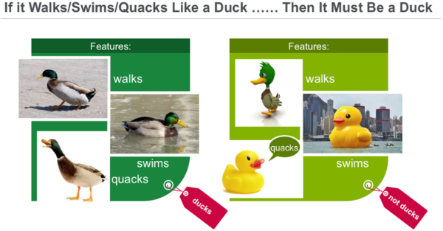
Cont..
You classify something based on pre-determined features. Features are the “if questions” that you ask. The label is the answer to those questions. In this example, if it walks, swims, and quacks like a duck, then the label is "duck."

Slide 12
Clustering
In clustering, an algorithm groups objects into categories by analyzing similarities between input examples. Clustering uses include:
Search results grouping
Grouping of customers
Anomaly detection
Text categorization

Slide 13
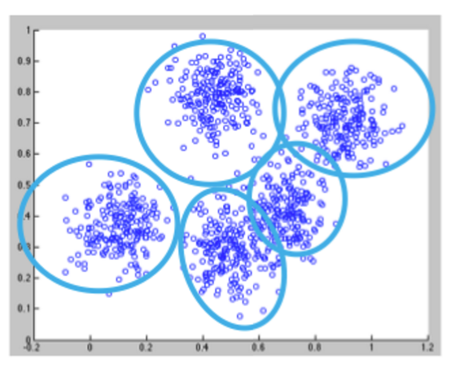
Cont..
Clustering uses unsupervised algorithms, which do not have the outputs in advance.
Clustering using the K-means algorithm begins by initializing all the coordinates to centroids. With every pass of the algorithm, each point is assigned to its nearest centroid based on some distance metric, usually Euclidean distance. The centroids are then updated to be the “centers” of all the points assigned to it in that pass. This repeats until there is a minimum change in the centers.

Slide 14
Collaborative Filtering
Collaborative filtering algorithms recommend items (this is the filtering part) based on preference information from many users (this is the collaborative part). The collaborative filtering approach is based on similarity; people who liked similar items in the past will like similar items in the future. The goal of a collaborative filtering algorithm is to take preferences data from users, and to create a model that can be used for recommendations or predictions.
Ted likes movies A, B, and C. Carol likes movies B and C. We take this data and run it through an algorithm to build a model. Then when we have new data such as Bob likes movie B, we use the model to predict that C is a possible recommendation for Bob.

Slide 15
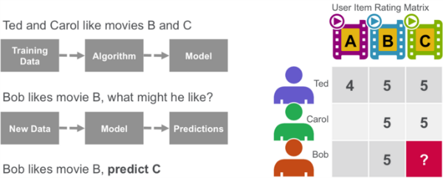
Cont…

Slide 16
Decision Trees → Part of Classification Algorithms
Decision trees create a model that predicts the class or label based on several input features. Decision trees work by evaluating an expression containing a feature at every node and selecting a branch to the next node based on the answer. A decision tree for predicting survival on the Titanic is shown below. The feature questions are the nodes, and the answers “yes” or “no” are the branches in the tree to the child nodes.
Q1: is sex male?
yes
Q2: is age > 9.5?
No
Is sibsp >2.5?
No
died

Slide 17
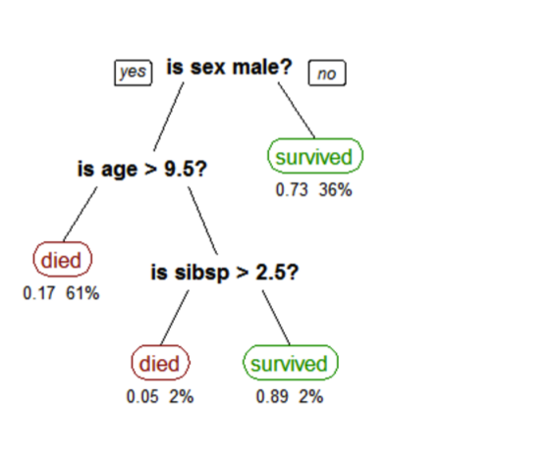
Cont…
A tree showing survival of passengers on the Titanic ("sibsp" is the number of spouses or siblings aboard). The figures under the leaves show the probability of survival and the percentage of observations in the leaf.

Slide 18
References
http://www.kdnuggets.com/2016/08/10-algorithms-machine-learning-engineers.html
https://mapr.com/blog/apache-spark-machine-learning-tutorial/
https://mapr.com/blog/churn-prediction-sparkml/

