Slide 1
Supervised Learning
Nitin Kapse

Slide 2
Supervised Learning
Trying to predict unknown data attributes (outcomes) based on known attributes (predictors) for an entity
Model built based on training data (past data) where outcomes and predictors are known
Model used to predict future outcomes
Regression (Continuous outcome values)
Classification (outcome classes → It can binary or multiclass)

Slide 3
Cont…
Classification → It take input (feature vectors) to predict the outcome
Binary classification:
It is used when you have two distinct categories to predict. For example you can use it to predict if a transaction is fraudulent or not.
Algorithms available in Spark for doing binary classification are logistic regression, decision trees and random forests, Linear support vector machines (SVM)
Multiclass classification
When you have more than two distinct categories you use multiclass classification.
Available algorithms for multiclass classification are logistic regression, decision trees, random forests and naive bayes.
Regression
When you would like to predict a continuous instead of binary variable you use linear regression.
Algorithms available are linear, ridge, lasso regression, decision trees and random forests.

Slide 4
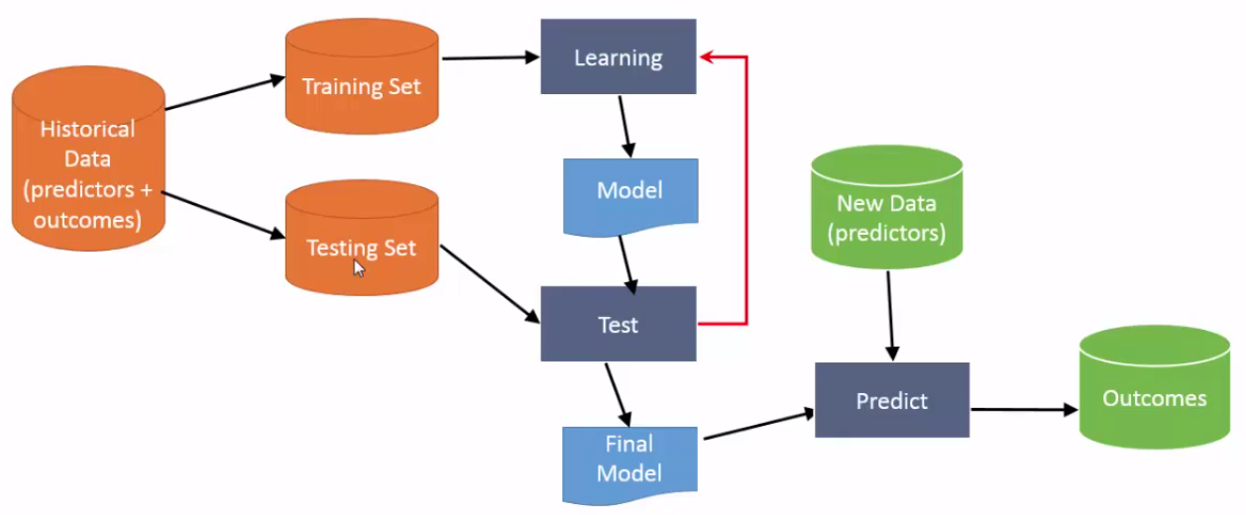
Supervised Learning Process

Slide 5
Training and Testing Data
Historical Data contains both predictors and outcomes
Split as training and testing data
Training data is used to build the model
Testing data is used to test the model
Apply model on training data
Predict the outcome
Compare the outcome with the actual value
Measure accuracy
Training and Test fit best practices
70-30 split
Random selection of records. Should maintain data spread in both datasets

Slide 6
Supervised Learning Algorithms
Decision Trees
Naïve Bayes Classification
Ordinary Least Squares Regression (Alternate Least Squares [ALS])
Logistic Regression
Support Vector Machines
Ensemble Methods

Slide 7
Decision Tree
A decision tree is a decision support tool that uses a tree-like graph or model of decisions and their possible consequences, including chance-event outcomes, resource costs, and utility.
From a business decision point of view, a decision tree is the minimum number of yes/no questions that one has to ask, to assess the probability of making a correct decision, most of the time. As a method, it allows you to approach the problem in a structured and systematic way to arrive at a logical conclusion.

Slide 8
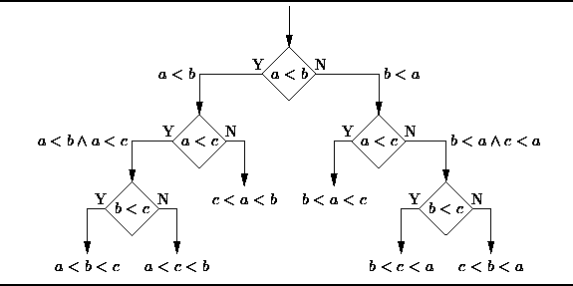

Slide 9
Naïve Bayes Classification
Naïve Bayes classifiers are a family of simple probabilistic classifiers based on applying Bayes’ theorem with strong (naïve) independence assumptions between the features. The featured image is the equation — with P(A|B) is posterior probability, P(B|A) is likelihood, P(A) is class prior probability, and P(B) is predictor prior probability.
Some of real world examples are:
To mark an email as spam or not spam
Classify a news article about technology, politics, or sports
Check a piece of text expressing positive emotions, or negative emotions?
Used for face recognition software.

Slide 10
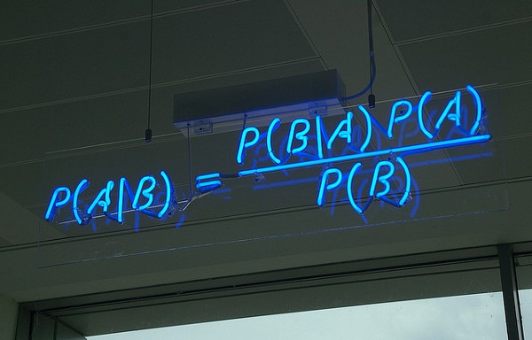

Slide 11
Ordinary Least Squares Regression
Least squares is a method for performing linear regression. You can think of linear regression as the task of fitting a straight line through a set of points. There are multiple possible strategies to do this, and “ordinary least squares” strategy go like this — You can draw a line, and then for each of the data points, measure the vertical distance between the point and the line, and add these up; the fitted line would be the one where this sum of distances is as small as possible.
Linear refers the kind of model you are using to fit the data, while least squares refers to the kind of error metric you are minimizing over.

Slide 12
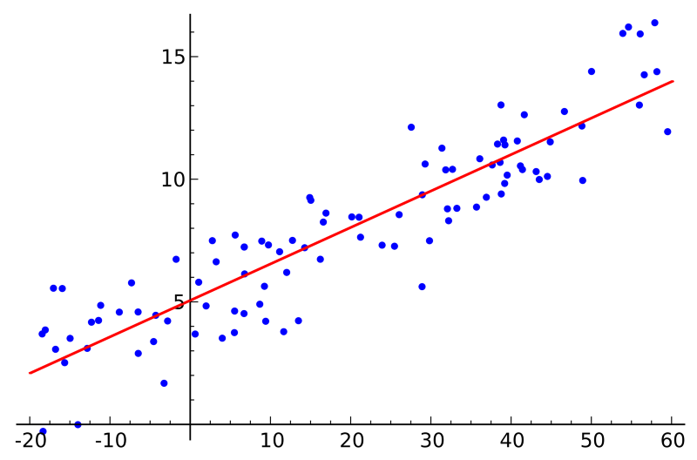

Slide 13
Logistic Regression
Logistic regression is a powerful statistical way of modeling a binomial outcome with one or more explanatory variables. It measures the relationship between the categorical dependent variable and one or more independent variables by estimating probabilities using a logistic function, which is the cumulative logistic distribution.
In general, regressions can be used in real-world applications such as:
Credit Scoring
Measuring the success rates of marketing campaigns
Predicting the revenues of a certain product
Is there going to be an earthquake on a particular day?

Slide 14
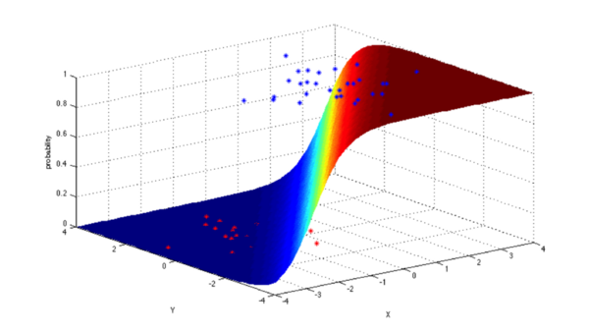

Slide 15
Support Vector Machines
SVM is binary classification algorithm. Given a set of points of 2 types in N dimensional place, SVM generates a (N — 1) dimensional hyperlane to separate those points into 2 groups. Say you have some points of 2 types in a paper which are linearly separable. SVM will find a straight line which separates those points into 2 types and situated as far as possible from all those points.
SVM are dependent on the decision planes concept that define the decision boundaries. The decision plane separates the object set consisting of distinct class memberships. A schematic example is illustrated below. In this, the objects belong to either RED or GREEN class. A boundary line of separation separates the RED and GREEN objects. Any new object that falls to the left is labeled as RED and it is labeled as GREEN if it falls to the left.
In terms of scale, some of the biggest problems that have been solved using SVMs (with suitably modified implementations) are display advertising, human splice site recognition, image-based gender detection, large-scale image classification

Slide 16
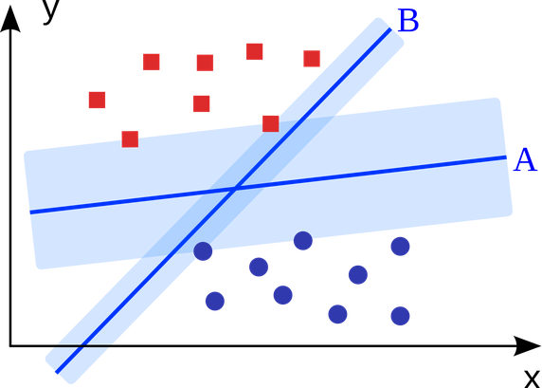

Slide 17
Ensemble Methods
Ensemble methods are learning algorithms that construct a set of classifiers and then classify new data points by taking a weighted vote of their predictions. The original ensemble method is Bayesian averaging, but more recent algorithms include error-correcting output coding, bagging, and boosting.

Slide 18
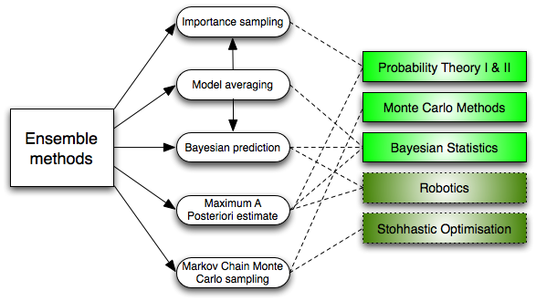

Slide 19
Ensemble Methods
So how do ensemble methods work and why are they superior to individual models?
They average out biases: If you average a bunch of democratic-leaning polls and republican-leaning polls together, you will get an average something that isn’t leaning either way.
They reduce the variance: The aggregate opinion of a bunch of models is less noisy than the single opinion of one of the models. In finance, this is called diversification — a mixed portfolio of many stocks will be much less variable than just one of the stocks alone. This is why your models will be better with more data points rather than fewer.
They are unlikely to over-fit: If you have individual models that didn’t over-fit, and you are combining the predictions from each model in a simple way (average, weighted average, logistic regression), then there’s no room for over-fitting.

Slide 20
References
http://www.kdnuggets.com/2016/08/10-algorithms-machine-learning-engineers.html/1
https://www.eduonix.com/blog/software-development/learn-run-machine-learning-algorithms-using-spark/

