Slide 1
Unsupervised Learning
Nitin Kapse

Slide 2
Unsupervised Learning
Finding hidden structure/similarity/grouping in data
Observations group based on similarity exhibited by entities
Similarity between entities could be by
Distance between values
Presence/Absence
Types
Clustering
Association Rules Mining
Collaborative Filtering

Slide 3
Unsupervised Learning Algorithms
Clustering Algorithm
Principal Component Analysis (PCA)
Singular Value Decomposition (SVD)
Independent Component Analysis
Associate Rules mining
Collaborative Filtering

Slide 4
Clustering Algorithms
Clustering is the task of grouping a set of objects such that objects in the same group (cluster) are more similar to each other than to those in other groups.
Every clustering algorithm is different, and here are a couple of them:
Centroid-based algorithms
Connectivity-based algorithms
Density-based algorithms
Probabilistic
Dimensionality Reduction
Neural networks / Deep Learning

Slide 5
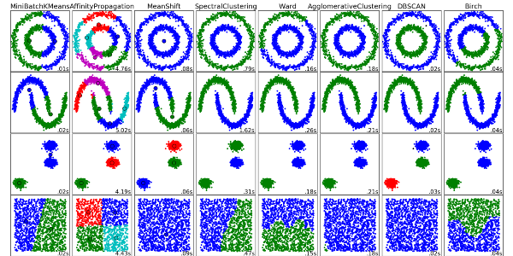
Clustering Algorithms

Slide 6
Principal Component Analysis
PCA is a statistical procedure that uses an orthogonal transformation to convert a set of observations of possibly correlated variables into a set of values of linearly uncorrelated variables called principal components.
Some of the applications of PCA include compression, simplifying data for easier learning, visualization. Notice that domain knowledge is very important while choosing whether to go forward with PCA or not. It is not suitable in cases where data is noisy (all the components of PCA have quite a high variance).

Slide 7
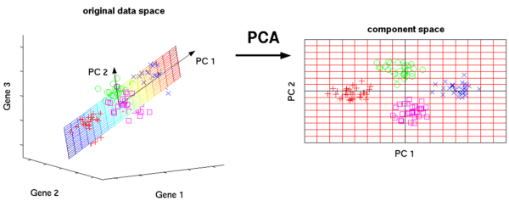
Principal Component Analysis

Slide 8
Singular Value Decomposition
In linear algebra, SVD is a factorization of a real complex matrix. For a given m * n matrix M, there exists a decomposition such that M = UΣV, where U and V are unitary matrices and Σ is a diagonal matrix.
PCA is actually a simple application of SVD. In computer vision, the 1st face recognition algorithms used PCA and SVD in order to represent faces as a linear combination of “eigenfaces”, do dimensionality reduction, and then match faces to identities via simple methods; although modern methods are much more sophisticated, many still depend on similar techniques.

Slide 9
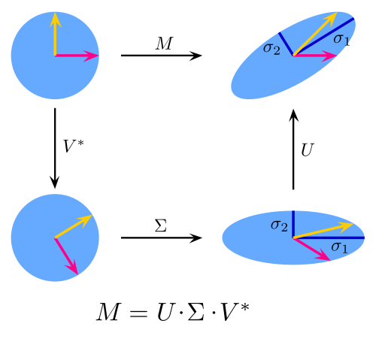
Singular Value Decomposition

Slide 10
Independent Component Analysis
ICA is a statistical technique for revealing hidden factors that underlie sets of random variables, measurements, or signals. ICA defines a generative model for the observed multivariate data, which is typically given as a large database of samples. In the model, the data variables are assumed to be linear mixtures of some unknown latent variables, and the mixing system is also unknown. The latent variables are assumed non-gaussian and mutually independent, and they are called independent components of the observed data.
ICA is related to PCA, but it is a much more powerful technique that is capable of finding the underlying factors of sources when these classic methods fail completely. Its applications include digital images, document databases, economic indicators and psychometric measurements.

Slide 11
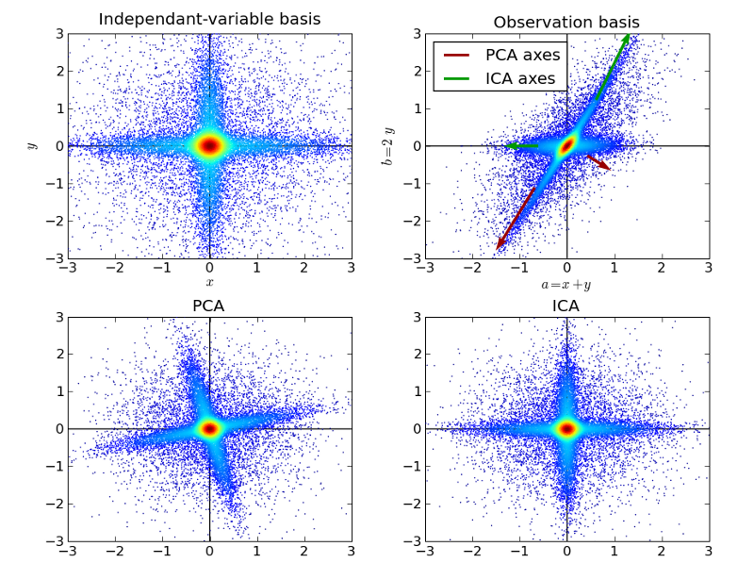
Independent Component Analysis

Slide 12
References
http://www.kdnuggets.com/2016/08/10-algorithms-machine-learning-engineers.html/1

