Slide 1
Machine Learning Algorithm Selection

Slide 2
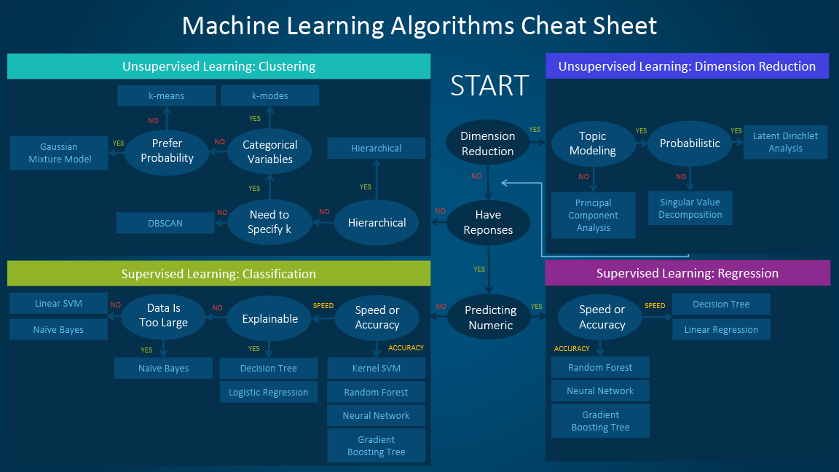
Machine Algorithm Cheat Sheet

Slide 3
References
http://www.kdnuggets.com/2017/06/which-machine-learning-algorithm.html

