Slide 1
Regression Analysis

Slide 2
Regression Analysis
Method of investing functional relationship between variables
Estimate the value of dependent variables from the values of independent variables using a relationship equation
Used when the dependent and independent variables are continuous and have some correlation
Goodness of Fit analysis is important

Slide 3
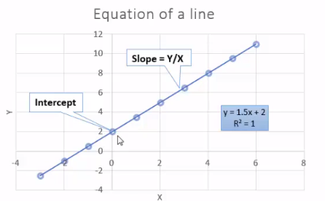
Linear Equation
X is the independent variable
Y is the dependent variable
Compute Y from X using
Y = mX + C
Coefficients:
m = Slope = Y/X
C = Intercept = value of Y when X = 0

Slide 4
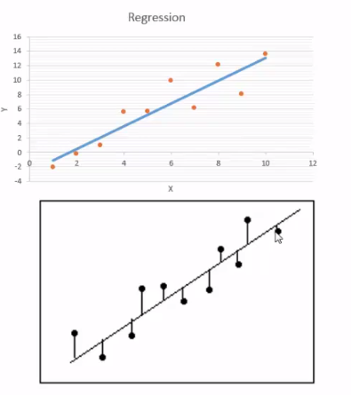
Fitting a line
Given a scatter plot of Y vs X, fit a straight line through the points so that the sum of square of vertical distances between the points and the line (called residuals) is minimized
Best line = least residuals
A line can always be fitted for any set of points
The equation of the line becomes the predictor for Y

Slide 5
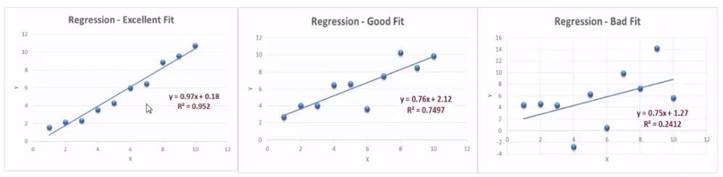
Goodness of Fit
R-squared measures how close the data is to the fitted line
R-squared varies from 0 to 1. The higher the value, better the fit
You can always fit a line. Use R-squared to see how good the fit is
Higher correlation usually leads to better fit

Slide 6
Multiple Regression
When there are more than one independent variable that is used to predict the dependent variable
The equation Y = C + m1*X1 + m1*X2 + … + mp*Xp
Same process used for prediction as a single independent variable
Different predictors have different levels of impact on the dependent variable

Slide 7
Using Linear Regression for ML
ML technique to predict continuous data - supervised learning
Predictors and outcomes provided as input
Data analyzed (training) to come up with a linear equation
Coefficients
Intercept
R-squared
Linear equation represents to model
Model used for prediction
Typically fast for model building and prediction

Slide 8
Summary - Linear Regression
Advantages
Fast
Low cost
Excellent for linear relationships
Relatively accurate continuous variables
Shortcomings
Only numeric/continuous variables
Cannot model non-linear / fuzzy relationships
Sensitive to outliers
Used in
Oldest predictive model used in a wide variety of applications to predict continuous values

Slide 9
References
http://spark.apache.org/docs/latest/ml-guide.html
http://go.databricks.com/hubfs/notebooks/Pop._vs._Price_LR.html

