Slide 1
Decision Trees

Slide 2
Overview
The simplest, easy to understand and easy to explain ML technique
Predictor variables are used to build a tree that would progressively predict the target variable
Trees start with a root node that start the decision making process
Branch nodes refine the decision process
Leaf nodes provide the decisions
Training data is used to build a decision tree to predict the target
The tree becomes the model that is used to predict on new data

Slide 3
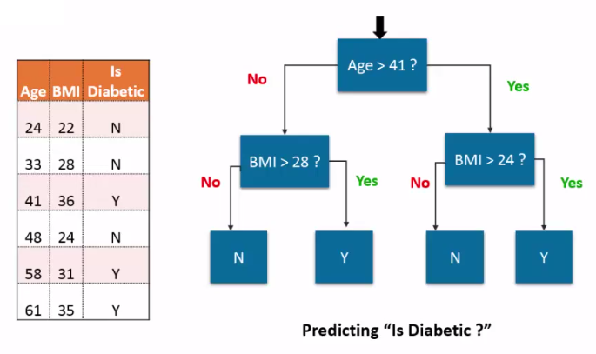
Example

Slide 4
Choosing the right Predictors
The depth of trees are highly influenced by the sequence in which the predictors are chosen for decisions
Using predictors with high selectivity gives faster results
ML implementations automatically make decisions on the sequence/preference of predictors

Slide 5
Summary - Decision Trees
Advantages
Easy to interpret and explain
Works with missing data
sensitive to local variations
Fast
Shortcomings
Limited Accuracy
Bias builds up pretty quickly
Not good with large predictors
Used in
credit approvals
Situations with legal needs to explain decisions
Preliminary categorization

Slide 6
References

