Slide 1
Naïve Bayes

Slide 2
Naïve Bayes’ Theorem
Probability of an event A = P(A) is between 0 and 1
Bayes’ theorem gives the conditional probability of an event A given event B has already occurred
P(A/B) = P(A intersect B) * P(A) / P(B)
Example
There are 100 patients
Probability of a patient having diabetes is P(A) = 0.2
Probability of patient having diabetes (A) given that patient’s age is > 50 P(B) is P(A/B) = 0.4

Slide 3
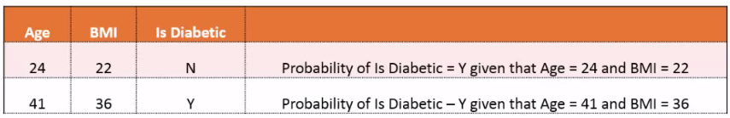
Naïve Bayes Classification
Application of Bayes’ theorem to ML
The target variable becomes event A
The predictors become events B1 - Bn
We try to find P(A/B1-Bn)

Slide 4
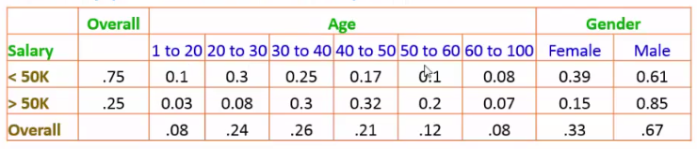
Model Building and Prediction
The model generated stores the conditional probability of the target for every possible value of the predictor.
When a new prediction needs to be done, the conditional probabilities are applied using Bayes’ formula to find probability
To predict for Age = 25
P (Salary < 50K / Age=25) = 0.3 * 0.75 / 0.24 = ~ 0.92
P (Salary > 50K / Age=25) = 0.08 * 0.25 / 0.24 = ~ 0.08

Slide 5
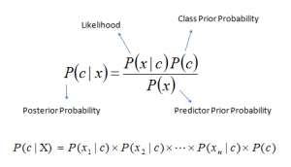
Formulae
Bayes theorem provides a way of calculating posterior probability P(c|x) from P(c), P(x) and P(x|c). Look at the equation below:
Here,
P(c|x) is the posterior probability of class (target) given predictor (attribute).
P(c) is the prior probability of class.
P(x|c) is the likelihood which is the probability of predictor given class.
P(x) is the prior probability of predictor.

Slide 6
Naïve Bayes Example
Let’s understand it using an example. Below I have a training data set of weather and corresponding target variable ‘Play’. Now, we need to classify whether players will play or not based on weather condition. Let’s follow the below steps to perform it.
Step 1: Convert the data set to frequency table
Step 2: Create Likelihood table by finding the probabilities like Overcast probability = 0.29 and probability of playing is 0.64.

Slide 7
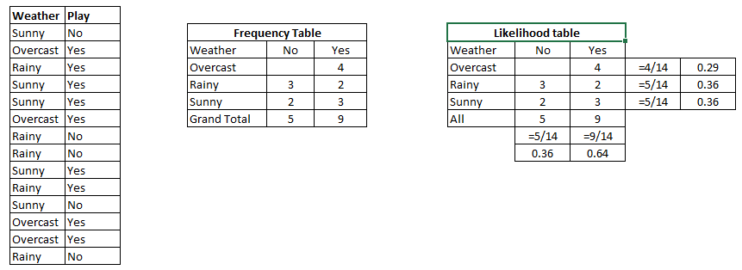

Slide 8
Step 3: Now, use Naive Bayesian equation to calculate the posterior probability for each class. The class with the highest posterior probability is the outcome of prediction.
Problem: Players will pay if weather is sunny, is this statement is correct?
We can solve it using above discussed method, so P(Yes | Sunny) = P( Sunny | Yes) * P(Yes) / P (Sunny)
Here we have P (Sunny |Yes) = 3/9 = 0.33, P(Sunny) = 5/14 = 0.36, P( Yes)= 9/14 = 0.64
Now, P (Yes | Sunny) = 0.33 * 0.64 / 0.36 = 0.60, which has higher probability.
Naive Bayes uses a similar method to predict the probability of different class based on various attributes. This algorithm is mostly used in text classification and with problems having multiple classes.

Slide 9
Summary - Naïve Bayes
Advanges
Simple and fast
Works well with noisy and missing data
Provides probabilities of the result
very good with categorical data
Shortcomings
Limited Accuracy
Expects predictors to be independent
Not good with large numeric features
Used in
Medical diagnosis
Spam filtering
document classification
Sport predictions

Slide 10
References
https://www.analyticsvidhya.com/blog/2017/09/common-machine-learning-algorithms/

