Slide 1
K-Means Clustering

Slide 2
Overview
Unsupervised Learning technique
Popular method for grouping data into subsets based on the similarity
Partitions n observations with m variables into k clusters where by each observation belongs to only one cluster
How it works
An m dimensional space is created
Each observation is plotted based on this space and based on the variable values
Clustering is done by measuring the distance between points and grouping them
Multiple types of distance measure available like Euclidian, Manhattan, Minkowski and Hamming distance

Slide 3
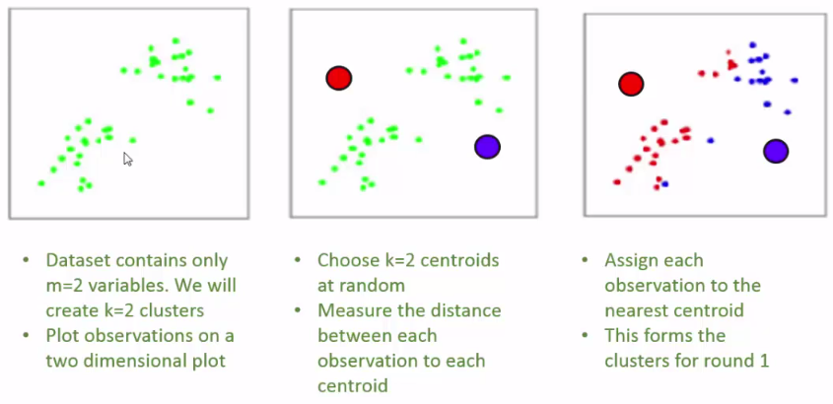
Clustering - Stages

Slide 4
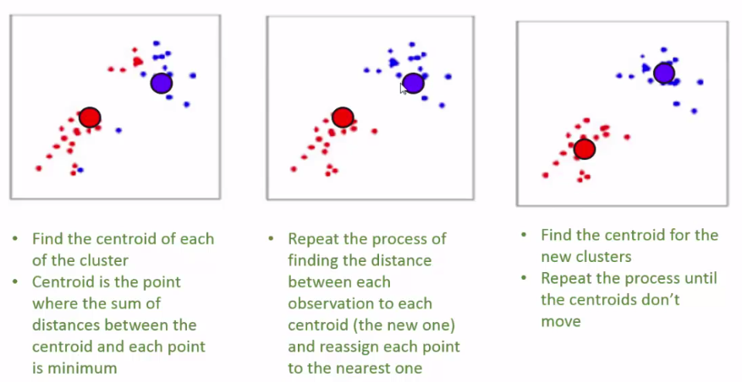
Cont…

Slide 5
Summary - K-Means Clustering
Advantages
Fast
Efficient with large number of variables
Explainable
Shortcomings
k needs to be known
The initial centroid position has influence on clusters formation
Used in
Preliminary grouping of data before other classification
General grouping
Geographical clustering

Slide 6
References

