Slide 1
Neural Network Regression

Slide 2
Neural Network Regression
The neural networks are utilized for regression, classification or unsupervised learning.
They group the data that is not labeled, classify that data or forecast continuous values after supervised training.
The neural networks normally use a form of logistic regression in the final layer of the net to change continuous data into variables like 1 or 0.

Slide 3
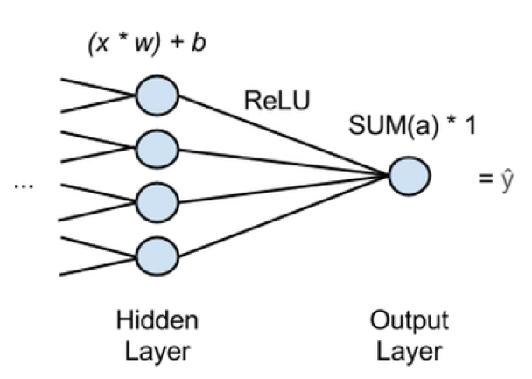
NNR Example

Slide 4
Cont…
In the previous figure, ‘x’ is the input, features passed forward from the previous layer of the network.
Into every node of last hidden layer, many x’s will be fed and every x will be multiplied by w, a corresponding weight.
To a bias, the products’ sum is added and moved to an activation function. An activation function is a ReLU (rectified linear unit), used commonly as it does not saturate on the shallow gradients like the sigmoid activation functions do.
ReLU provides an output, activation a for each hidden node and the activations are added going into output node which passes the sum of activations.
This implies, a neural network that performs regression contains single output node and this node will multiply the sum of activations of previous layer by 1.
The network’s estimate, ‘y hat’ will be the result. ‘Y hat’ is the dependent variable that all the x’s map to. You can use the neural network in this way to obtain the function relating x(number of independent variables) to y (a dependent variable) that you are trying to predict.

Slide 5
References
http://www.kdnuggets.com/2017/06/machine-learning-algorithms-used-self-driving-cars.html

