Slide 1
Text Pre-Processing

Slide 2
Understanding how ML algorithm work
ML Algorithms work with
numbers (continuous data)
classes (discrete/categorical data)
ML algorithms don’t work with text
All textual data need to be converted into numbers or classes
This is one of the main responsibilities of data pre-processing

Slide 3
Text Cleansing
Remove punctuation
Remove white space
Convert to lower case
Remove numbers
Remove stop words
Stemming
Remove other commonly used words

Slide 4
TF-IDF Overview (Term Frequency and Inverse Document Frequency)
Text Documents are becoming inputs to ML more and more
News items for classification
Email messages for spam detection
Text search
Text needs to be converted to equivalent numeric representation before ML can be used
The most popular technique is used Term Frequency - Inverse Document Frequency (TF-IDF)
TF-IDF output is table where rows represent documents and columns represent words
Each cell provides a count/value that indicate the “strength’ of the word with respect to the document

Slide 5
TF-IDF formulae
Text Frequency (given a word w1 and Document d1)
= (# of times w1 occurs in d1) / (# of words in d1)
Inverse Document Frequency (given a word w1)
= log e (Total # of docs / Total docs with w1)
TF-IDF = TF * IDF

Slide 6
TF-IDF steps
Original documents
Doc1 = “This is a sampling of good words”
Doc2 = “He said again and again the same word after word”
Doc3 = “words can really hurt”
After cleansing
Doc1 = “sampling good word”
Doc2 = “again again same word word”
Doc3 = “word real hurt”

Slide 7
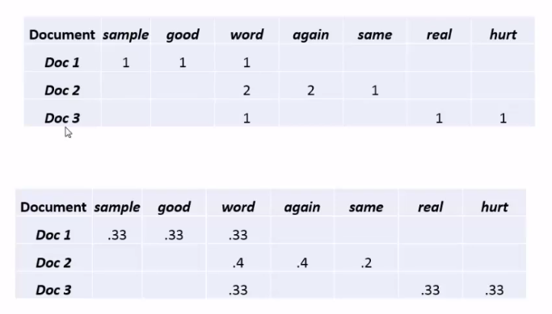
TF-IDF (contd.)

Slide 8
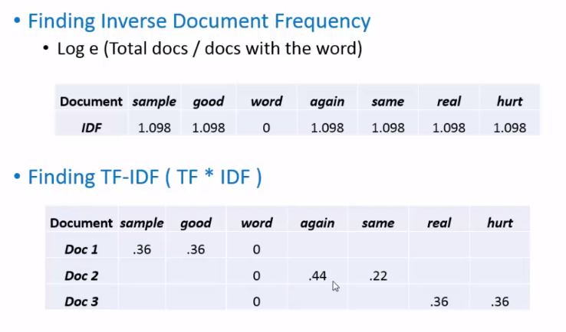
TF-IDF (contd.)

Slide 9
References

