Slide 1
Machine Learning with Spark

Slide 2
Overview
Spark Machine Learning libraries make ML practical and easy
Contain algorithms and utilities
Packages
spark.mllib → original APIs built on RDDs
spark.ml → new higher level API built on DataFrames (Spark SQL) and pipelines
http://spark.apache.org/docs/latest/ml-pipeline.html
Special data types
Local vector
Labeled Point

Slide 3
SPARK MLlib
ML Algorithms: common learning algorithms such as classification, regression, clustering, and collaborative filtering
Featurization: feature extraction, transformation, dimensionality reduction, and selection
Pipelines: tools for constructing, evaluating, and tuning ML Pipelines
Persistence: saving and load algorithms, models, and Pipelines
Utilities: linear algebra, statistics, data handling, etc.

Slide 4
SPARK ML DataFrame API
“Spark ML” is used to refer to the MLlib DataFrame-based API. This is majorly due to the org.apache.spark.ml Scala package name used by the DataFrame-based API, and the “Spark ML Pipelines” term we used initially to emphasize the pipeline concept.
DataFrames provide a more user-friendly API than RDDs. The many benefits of DataFrames include Spark Datasources, SQL/DataFrame queries, Tungsten and Catalyst optimizations, and uniform APIs across languages.
The DataFrame-based API for MLlib provides a uniform API across ML algorithms and across multiple languages.
DataFrames facilitate practical ML Pipelines, particularly feature transformations. See the Pipelines guide for details.

Slide 5
Local Vector
A vector of double values
Dense Vector
(1.0,3.0.4.50)
Sparse Vector
Original: (1.0, 0.0, 0.0,2.0,0.0)
Representation: (5,(0,3),(1.0,2.0))

Slide 6
Labeled Point
Represents a Data point in ML
Contains a ‘label’ (the target variable) and a list of ‘features’ (the predictors)
LabeledPoint(1.0, Vectors.dense(1.0,0.0,3.0)

Slide 7
Pipelines
A pipelines consist of a series of transformations and actions that need to be performed to create a model
DataFrame (the source0
Transformers (data transformations)
Estimators (model building)
Parameters (common parameters across algorithms)

Slide 8
Typical Spark ML workflow
Load data into RDD
Transform RDD
Filtering features
Strings to float
Indicator variables
Centering and Scaling
Convert to LabeledPoint and create a DataFrame (label, features)
Split training and testing
Create model
Perform predictions

Slide 9
Compare Results

Slide 10
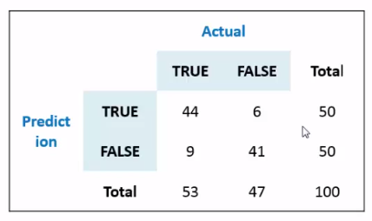
Confusion Matrix
Plots the predictions against the actuals for the test data

Slide 11
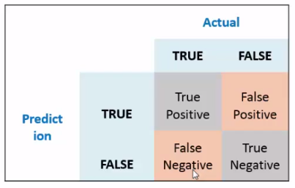
Prediction Types
The importance of prediction types vary by the domain
True Positive (TP) and True Negative (TN) are the correct predictions
False Negative (FN) can be critical in medical field

Slide 12
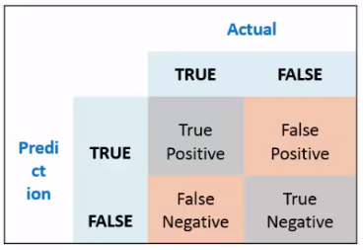
Confusion Matrix metrics
Accuracy
Measures the accuracy of the prediction
Accuracy = (TP + TN) / (TP + TN + FP + FN)
Sensitivity
Hit rate or recall
Sensitivity = TP / (TP + FN)
Specificity
True negative rate
Specificity = TN / (TN + FP)
Precision
Precision = TP / (TP + FP)

Slide 13
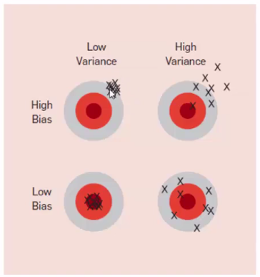
Bias and Variance
Bias happens when the model “skews” itself to certain aspects of the predictors while ignoring others. It is the error between predictions and actuals.
Variance refers to the stability of a model - keep predicting consistency for new datasets. It is the variance between predictions for different data sets.

Slide 14
Types of Errors
In-sample error is the prediction error when the model is used to predict on the training dataset it is built upon.
Out-of-sample error is the prediction error when the model is used to predict on a new dataset.
Over fitting refers to the situation where the model has very low in-sample error but very out-of-sample error. The model has “overfit” itself to the training data.

Slide 15
References
https://mapr.com/blog/churn-prediction-sparkml/

