Slide 1
USING THE SPARK ML PACKAGE

Slide 2
Spark ML Package
The ML package is the newer library of machine learning routines.
Spark ML provides a uniform set of high-level APIs built on top of DataFrames.

Slide 3
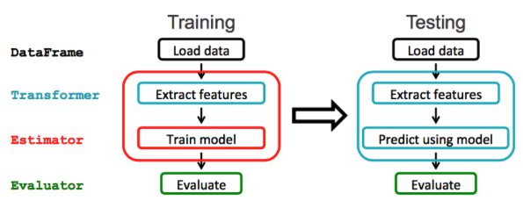
ML Pipeline

Slide 4
ML Concept
Use an ML Pipeline to pass the data through transformers in order to extract the features and an estimator to produce the model.
DataFrame: This ML API uses DataFrame from Spark SQL as an ML dataset, which can hold a variety of data types. E.g., a DataFrame could have different columns storing text, feature vectors, true labels, and predictions.
Transformer: A Transformer is an algorithm which transforms one DataFrame into another DataFrame. We will use a transformer to get a DataFrame with a features vector column.
Estimator: An Estimator is an algorithm which can be fit on a DataFrame to produce a Transformer (e.g., training/tuning on a DataFrame and producing a model).
Pipeline: A Pipeline chains multiple Transformers and Estimators together to specify a ML workflow.
Parameter: All Transformers and Estimators now share a common API for specifying parameters.

Slide 5
FEATURE EXTRACTION AND PIPELINING
The ML package needs data to be put in a (label: Double, features: Vector) DataFrame format with correspondingly named fields. We set up a pipeline to pass the data through 3 transformers in order to extract the features: 2 StringIndexers and a VectorAssembler.
We use the StringIndexers to convert the String Categorial feature intlplan and label into number indices. Indexing categorical features allows decision trees to treat categorical features appropriately, improving performance.

Slide 6
DataFrame
Machine learning can be applied to a wide variety of data types, such as vectors, text, images, and structured data. This API adopts the DataFrame from Spark SQL in order to support a variety of data types.
DataFrame supports many basic and structured types; see the Spark SQL datatype reference for a list of supported types. In addition to the types listed in the Spark SQL guide, DataFrame can use ML Vector types.
A DataFrame can be created either implicitly or explicitly from a regular RDD. See the code examples below and the Spark SQL programming guide for examples.
Columns in a DataFrame are named. The code examples below use names such as “text,” “features,” and “label.”

Slide 7
Transformers
A Transformer is an abstraction that includes feature transformers and learned models. Technically, a Transformer implements a method transform(), which converts one DataFrame into another, generally by appending one or more columns. For example:
A feature transformer might take a DataFrame, read a column (e.g., text), map it into a new column (e.g., feature vectors), and output a new DataFrame with the mapped column appended.
A learning model might take a DataFrame, read the column containing feature vectors, predict the label for each feature vector, and output a new DataFrame with predicted labels appended as a column.

Slide 8
Estimators
An Estimator abstracts the concept of a learning algorithm or any algorithm that fits or trains on data. Technically, an Estimator implements a method fit(), which accepts a DataFrame and produces a Model, which is a Transformer. For example, a learning algorithm such as LogisticRegression is an Estimator, and calling fit() trains a LogisticRegressionModel, which is a Model and hence a Transformer.

Slide 9
Properties of pipeline components
Transformer.transforms() and Estimator.fit()s are both stateless. In the future, stateful algorithms may be supported via alternative concepts.
Each instance of a Transformer or Estimator has a unique ID, which is useful in specifying parameters

Slide 10
Pipeline
In machine learning, it is common to run a sequence of algorithms to process and learn from data. E.g., a simple text document processing workflow might include several stages:
Split each document’s text into words.
Convert each document’s words into a numerical feature vector.
Learn a prediction model using the feature vectors and labels.
MLlib represents such a workflow as a Pipeline, which consists of a sequence of PipelineStages (Transformers and Estimators) to be run in a specific order.

Slide 11
References
https://mapr.com/blog/churn-prediction-sparkml/
http://spark.apache.org/docs/latest/ml-features.html

