Slide 1
Cancer Detection using Histopathological slides
Deep Learning Approach
Nitin Mahajan
Milestone Report # 1
Data Science Career Track
Specialization: Deep Learning

Slide 2
GOAL
Classify histological slides of lymph nodes of patients to predict whether they have cancer or not using Deep Learning

Slide 3
Data Source
https://www.kaggle.com/c/histopathologic-cancer-detection/data

Slide 4
Data Description
Train_labels.csv files with labels 0 for normal and 1 for cancer.
220,025 images for training.
1309081 Images with ‘0’ label (Normal)
89117 Images with ‘1’ label (Cancer)
57,458 images for testing.

Slide 5
Data Wrangling
Data Sampling
10,000 images for normal tissue
10,000 images for cancerous tissue
Training Data splitting
8,000 images for training on each class (normal, cancer)
2,000 images for validation on each class (normal, cancer)

Slide 6
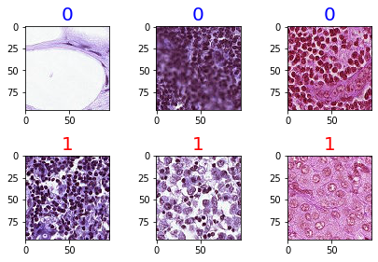
Images
Normal
Cancer

Slide 7
MACHINE & RESOURCES
FOR BUILDING CONVOLUTIONAL NEURAL NETWORK MODELS
Machine:
Apple MacBook Pro
Processor: 2.6GHz 6-Core Intel Core i7
Memory: 16GB 2400 MHz DDR4
Modules and libraries: Python and Keras with TensorFlow in backend
Reading Material: Deep Learning with Python (Francois Chaollet), Udemy Course – AZ Machine Learning and other online resources.

Slide 8
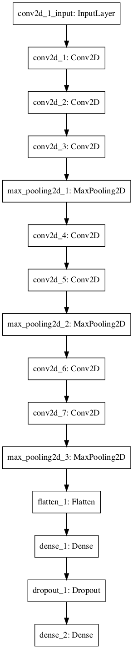
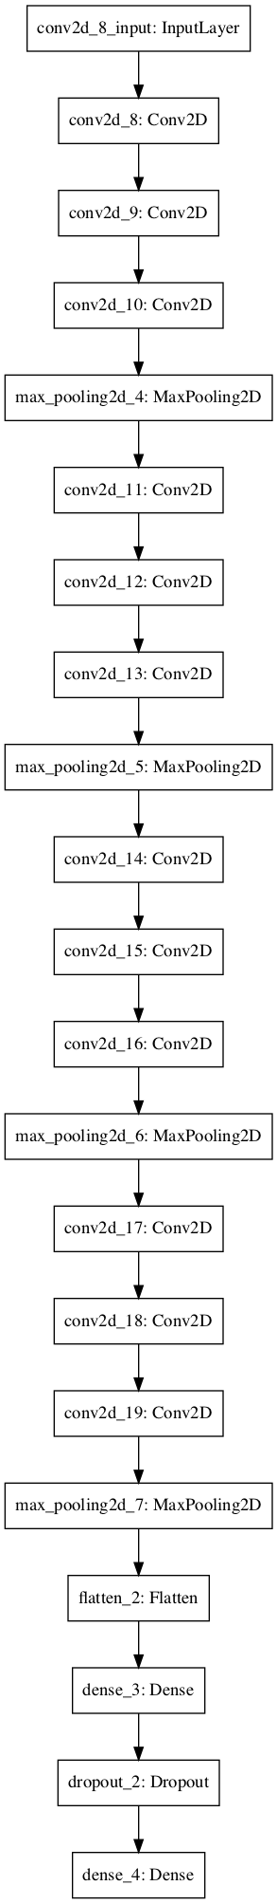
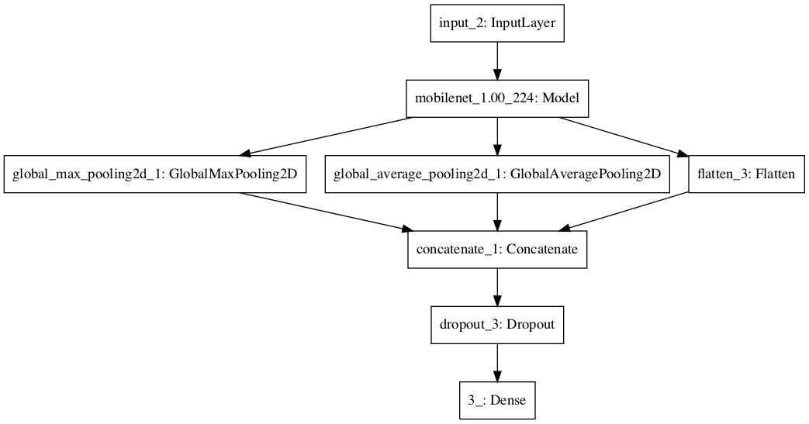
Models and Transfer Learning
Model 1
Model 2
Model 8 (#MobileNet)

Slide 9
Model Performance
 | val_loss | val_acc | roc_auc_scores
Model1 | 0.740433 | 0.839625 | 0.922942
Model2 | 0.590117 | 0.845375 | 0.920965
Model8 (MobileNet) | 0.134585 | 0.908625 | 0.968650

Slide 10
Confusion Matrix
Model1
Cancer
1586 | 414
227 | 1773
True Label
Normal
Cancer
Normal
Predicted Label
Model2
Cancer
1654 | 346
284 | 1716
True Label
Normal
Cancer
Normal
Predicted Label
Model8
Cancer
1835 | 165
192 | 1808
True Label
Normal
Cancer
Normal
Predicted Label

Slide 11
Model Performance
 | Precision |  | Recall |  | f1-score
 | Cancer | Normal | Cancer | Normal | Cancer | Normal
Model1 | 0.87 | 0.81 | 0.79 | 0.89 | 0.83 | 0.85
Model2 | 0.85 | 0.83 | 0.83 | 0.86 | 0.84 | 0.84
Model8 | 0.91 | 0.92 | 0.9 | 0.9 | 0.91 | 0.91

Slide 12
Conclusion
Above results clearly demonstrates Model 8(MobileNet) performed the best.

