Slide 1
Containerization

Slide 2
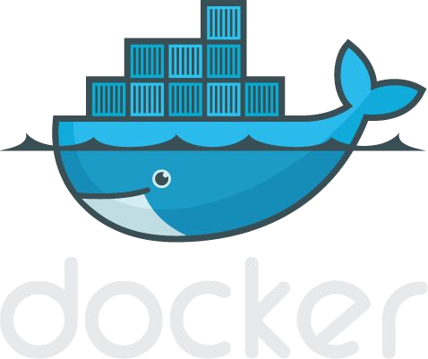
Welcome to Container Engine - Dockers

Slide 3



Container Engine (Docker)
Container
Container
Container
nginx
java
mongoDB
BIN/LIBS
tomcat
BIN/LIBS
Debian
Ubuntu
RedHat
Container Engine (Docker)

Slide 4
Container Engine (Docker)
Container
Container
Container
nginx
java
mongoDB
BIN/LIBS
tomcat
BIN/LIBS
Debian
Ubuntu
RedHat
Container Engine (Docker)
Host Operating System
Infrastructure- CPU, Memory, HDD

Slide 5
Container Engine (Docker)
Container
Container
Container
nginx
java
mongoDB
BIN/LIBS
tomcat
BIN/LIBS
Debian
Ubuntu
RedHat
Container Engine (Docker)
Host Operating System
Infrastructure- CPU, Memory, HDD

Slide 6
Virtual Machines vs Containers
App1
Container
Container
Container
BIN/LIBS
BIN/LIBS
BIN/LIBS
nginx
java
mongoDB
GUEST OS
GUEST OS
GUEST OS
BIN/LIBS
tomcat
BIN/LIBS
VIRTUAL HARDWARE
VIRTUAL HARDWARE
VIRTUAL HARDWARE
Debian
Ubuntu
RedHat
HYPERVISIOR(Hyper-V, Xen)
Container Engine (Docker)
Host Operating System
Host Operating System
Infrastrcture-CPU,Memory,HDD
Infrastructure- CPU, Memory, HDD

Slide 7




Docker components
Docker Image
The basis of a Docker container. Represents a full application
Docker Container
The standard unit in which the application service resides and executes
Docker Engine
Creates, ships and runs Docker containers deployable on a physical or virtual, host locally, in a datacenter or cloud service provider
Registry Service (Docker Hub(Public) or Docker Trusted Registry(Private))
Cloud or server based storage and distribution service for your images

Slide 8
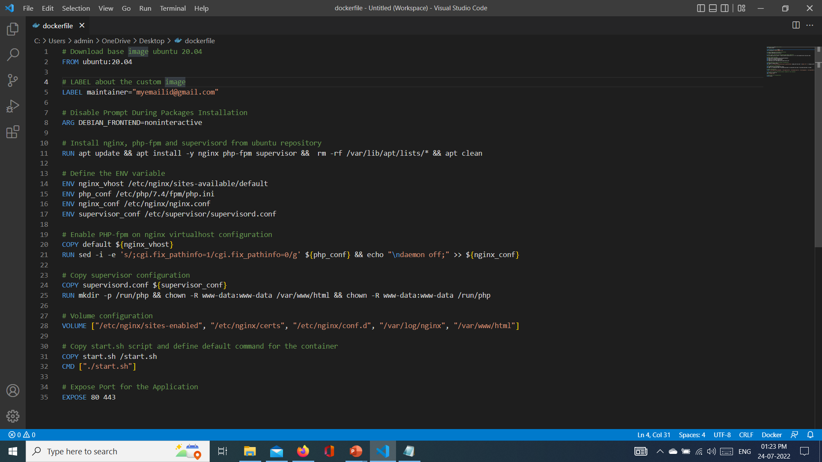
Dockerfile
A Dockerfile is a text document
It contains all the commands a user could call on the command line to assemble an image
Docker can build images automatically by reading the instructions from a Dockerfile
$ docker build -f /path/to/a/Dockerfile

Slide 9
docker commands

Slide 10
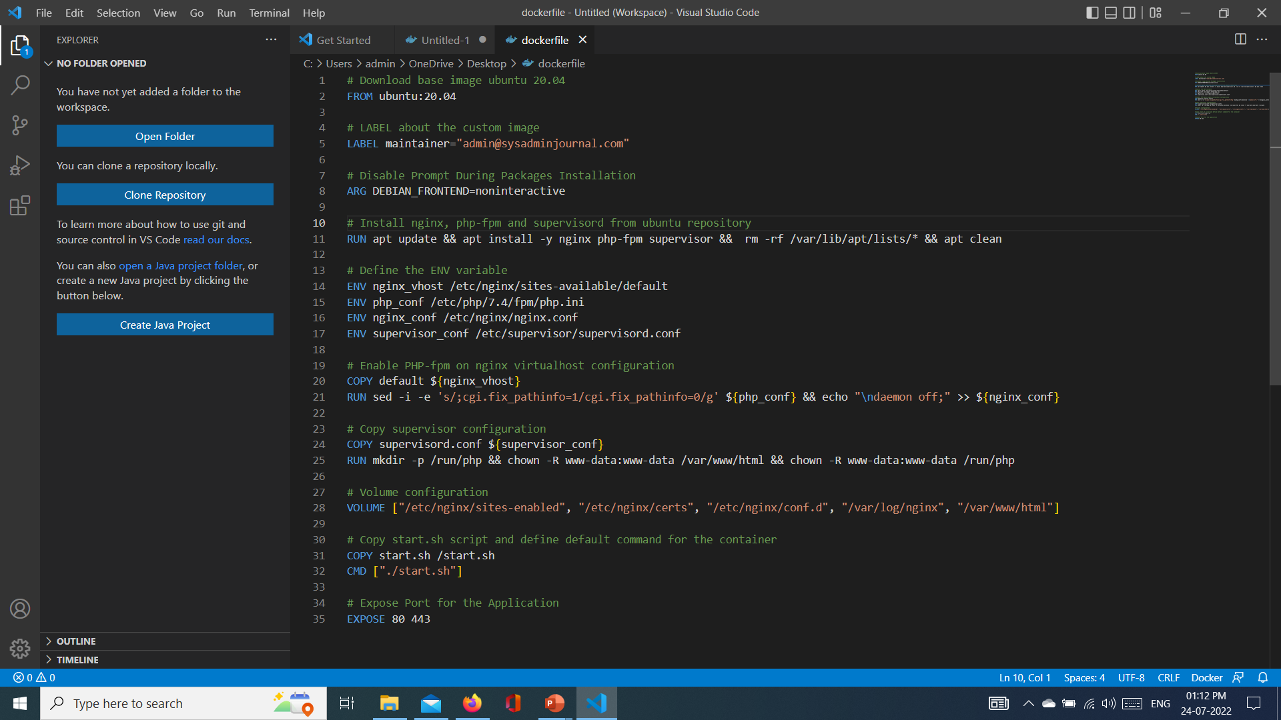
Docker command - FROM
Set the base-image for the new image that you want to create
The FROM instruction will initialize the new build-stage and must be located at the top of the Dockerfile
Needs to be the first instruction of every Dockerfile
  Usage: FROM <image>
ex: FROM ubuntu

Slide 11
Docker command - LABEL
With this instruction, you can add additional information about your Docker image, such as the version, description, maintainer, etc.
The LABEL instruction is a key-value pair that
allows you to add multiple labels and
multi-line values
  Usage: LABEL <image>
  Ex:
    LABEL version="1.0"
    LABEL description="This text illustrates / that label-values can span multiple lines."

Slide 12

Docker command - ENV
The ENV instruction is used to define an environment variable that can be used during the build stage and can be replaced inline in many as well
Usage:
ENV <key>=<value> ...
Ex:
ENV MY_NAME="John Doe"
ARG DEBIAN_FRONTEND=noninteractive
RUN apt-get update && apt-get install -y

Slide 13

Docker command - ADD
The ADD instruction copies new files or directories from <src> and adds them to the filesystem of the container at the path <dest>.
Usage:
    ADD <src>... <dest>
    ADD ["<src>",... "<dest>"]
    Ex:
    ADD hom* /mydir/
    ADD test.txt relativeDir/

Slide 14
Docker command - COPY
The COPY instruction copies new files or directories from <src> and adds them to the filesystem of the container at the path <dest>.
Usage:
    COPY <src>... <dest>
    COPY ["<src>",... "<dest>"]
    Ex:
    COPY hom* /mydir/
    COPY test.txt relativeDir/

Slide 15
ADD vs COPY
docker ADD
docker COPY
ADD <src>... <dest>..
  ADD http://foo.com/bar.go /tmp/main.go
  ADD http://foo.com/bar.go /tmp/
  ADD /foo.tar.gz /tmp/
In this case, a file named /tmp/bar.go will be added to the container's filesystem.
If the <src> argument is a local file in a recognized compression format (tar, gzip, bzip2, etc) then it is unpacked at the specified <dest> in the container's filesystem.
COPY <src>... <dest>..
COPY doesn't support URLs as a <src> argument so it can't be used to download files from remote locations.
Anything that you want to COPY into the container must be present in the local build context.

Slide 16
Docker command - RUN
Executes any commands on the current image and commit the results
Usage:
  RUN <command>
  RUN ["executable", "param1", "param2"]
  Ex:
    RUN apt-get update –y
    RUN ["/bin/bash", "-c", "echo hello"]

Slide 17
Docker command - CMD
The CMD instruction is used to define the default command to execute when running the container.
And the Dockerfile must only contain one CMD instruction, and if there is multiple CMD, the last CMD instruction will be run.
Usage:
  CMD ["executable","param1","param2"]
  CMD ["param1","param2"]
  CMD command param1 param2
  Ex:
    FROM ubuntu
    CMD echo "This is a test." | wc -

Slide 18
Docker command - ENTRYPOINT
The ENTRYPOINT instruction is used to define the first and default command that will be executed when the container is running.
Define the command to start your application with the ENTRYPOINT instruction.
Usage:
  ENTRYPOINT <command> param1 parma2
  ENTRYPOINT ["executable", "param1", "param2"] (exec form)
  Ex:
    ENTRYPOINT echo “This is my Entry Point in my Container”
    ENTRYPOINT echo [“wc”, “-l”]

Slide 19
Docker command - USER
The USER instruction is used to define the default user or gid when running the image. The RUN, CMD, and ENTRYPOINT follow the USER instruction in the Dockerfile.
Usage:
  USER <user>[:<group>]
  Ex:
    FROM microsoft/windowsservercore
    # Create Windows user in the container
    RUN net user /add patrick
    # Set it for subsequent commands
    USER patrick

Slide 20
Docker command – WORKDIR
The WORKDIR instruction is used to define the default working directory of your Docker image.
The RUN, CMD, ENTRYPOINT, and ADD instructions follow the WORKDIR instruction.
You can add multiple WORKDIR instruction on your Dockerfile, and if there is doesn't exist, it will be created automatically.
Usage:
  WORKDIR /path/to/workdir
  Ex:
    ENV DIRPATH=/path
    WORKDIR $DIRPATH/$DIRNAME
    RUN pwd

Slide 21
Docker command – EXPOSE
This instruction is used to expose the container port on the specific network ports at runtime.
The default protocol exposed is TCP, but you can specify whether the TCP or UDP.
Usage:
  EXPOSE <port> [<port>/<protocol>...]
  Ex:
  EXPOSE 80/tcp

Slide 22



Docker Bridge Networking and Port Mapping
Docker host 1
Host port
Container port
Cntnr1
10.0.0.8
:80
$ docker container run -p 8080:80 ...
Bridge
172.14.3.55
:8080
L2/L3 physical network

Slide 23
Docker Bridge Networking and Port Mapping
80
8080
27017
Container
Container
Container
nginx
java
mongoDB
BIN/LIBS
tomcat
BIN/LIBS
Debian
Ubuntu
RedHat
90
9090
27017
Container Engine (Docker)
Host port
Container port
$ docker container run -p 9090:8080 ...

