Slide 1
Angular-js Advanced Day2

Slide 2
Scope
Scope is an object that refers to the application model.
It is an execution context for expressions.
Scopes are arranged in hierarchical structure which mimic the DOM structure of the application.
Scopes can watch expressions and propagate events.

Slide 3
Scope characteristics
Scopes provide APIs ($watch) to observe model mutations.
Scopes provide APIs ($apply) to propagate any model changes through the system into the view from outside of the "Angular realm" (controllers, services, Angular event handlers).
Scopes can be nested to limit access to the properties of application components while providing access to shared model properties. Nested scopes are either "child scopes" or "isolate scopes". A "child scope" (prototypically) inherits properties from its parent scope. An "isolate scope" does not.
Scopes provide context against which expressions are evaluated. For example {{username}} expression is meaningless, unless it is evaluated against a specific scope which defines the username property.
Scope is the glue between application controller and the view. During the template linking phase the directives set up $watch expressions on the scope. The $watch allows the directives to be notified of property changes, which allows the directive to render the updated value to the DOM.
Both controllers and directives have reference to the scope, but not to each other. This arrangement isolates the controller from the directive as well as from the DOM. This is an important point since it makes the controllers view agnostic, which greatly improves the testing story of the applications.

Slide 4
Show example for Scope Hierarchy

Slide 5
Retrieving Scopes from the DOM.
Scopes are attached to the DOM as $scope data property, and can be retrieved for debugging purposes.
The location where the root scope is attached to the DOM is defined by the location of ng-app directive. Typically ng-app is placed on the <html> element, but it can be placed on other elements as well, if, for example, only a portion of the view needs to be controlled by Angular.
To examine the scope in the debugger:
Right click on the element of interest in your browser and select 'inspect element'. You should see the browser debugger with the element you clicked on highlighted.
The debugger allows you to access the currently selected element in the console as $0 variable.
To retrieve the associated scope in console execute: angular.element($0).scope() or just type $scope

Slide 6
Scope Life Cycle
When the browser calls into JavaScript the code executes outside the Angular execution context, which means that Angular is unaware of model modifications. To properly process model modifications the execution has to enter the Angular execution context using the $applymethod. Only model modifications which execute inside the $apply method will be properly accounted for by Angular. For example if a directive listens on DOM events, such as ng-click it must evaluate the expression inside the $apply method.
After evaluating the expression, the $apply method performs a $digest.
In the $digest phase the scope examines all of the $watchexpressions and compares them with the previous value.
This dirty checking is done asynchronously. This means that assignment such as $scope.username="angular" will not immediately cause a $watch to be notified, instead the $watch notification is delayed until the$digest phase.
This delay is desirable, since it coalesces multiple model updates into one $watch notification as well as guarantees that during the $watch notification no other $watches are running.
If a $watch changes the value of the model, it will force additional$digest cycle.

Slide 7
Scope Life Cycle-Contd…
Creation
The root scope is created during the application bootstrap by the $injector. During template linking, some directives create new child scopes.
Watcher registration
During template linking, directives register watches on the scope. These watches will be used to propagate model values to the DOM.
Model mutation
For mutations to be properly observed, you should make them only within the scope.$apply(). Angular APIs do this implicitly, so no extra $apply call is needed when doing synchronous work in controllers, or asynchronous work with $http, $timeout or $intervalservices.
Mutation observation
At the end of $apply, Angular performs a $digest cycle on the root scope, which then propagates throughout all child scopes. During the $digest cycle, all $watched expressions or functions are checked for model mutation and if a mutation is detected, the $watch listener is called.
Scope destruction
When child scopes are no longer needed, it is the responsibility of the child scope creator to destroy them via scope.$destroy() API. This will stop propagation of $digest calls into the child scope and allow for memory used by the child scope models to be reclaimed by the garbage collector.

Slide 8
Scope $watch Performance Considerations
Dirty checking the scope for property changes is a common operation in Angular and for this reason the dirty checking function must be efficient.
Care should be taken that the dirty checking function does not do any DOM access, as DOM access is orders of magnitude slower than property access on JavaScript object.
Dirty checking can be done with three strategies: -
By reference,
by collection contents,
and by value.
The strategies differ in the kinds of changes they detect, and in their performance characteristics.

Slide 9
1) Watching by reference
scope.$watch(watchExpression, listener)
detects a change when the whole value returned by the watch expression switches to a new value. If the value is an array or an object, changes inside it are not detected. This is the most efficient strategy(performance-wise).
The watchExpression is called on every call to $digest() and should return the value that will be watched. (watchExpressionshould not change its value when executed multiple times with the same input because it may be executed multiple times by$digest(). That is, watchExpression should be idempotent.
The listener is called only when the value from the current watchExpression and the previous call to watchExpression are not equal (with the exception of the initial run, see below). Inequality is determined according to reference inequality, strict comparison via the !== Javascript operator (unless objectEquality == true…to be discussed in coming slides)
The watch listener may change the model, which may trigger other listeners to fire. This is achieved by rerunning the watchers until no changes are detected. The rerun iteration limit is 10 to prevent an infinite loop deadlock.
If you want to be notified whenever $digest is called, you can register a watchExpression function with no listener. (Be prepared for multiple calls to your watchExpression because it will execute multiple times in a single $digest cycle if a change is detected.)
After a watcher is registered with the scope, the listener fn is called asynchronously (via $evalAsync) to initialize the watcher.
In rare cases, this is undesirable because the listener is called when the result of watchExpression didn't change. To detect this scenario within the listener fn, you can compare the newVal and oldVal. If these two values are identical (===) then the listener was called due to initialization.

Slide 10
Basic Example
----------------------------------------------------------------------------------------------------------------
------------------------------------------------------------------------------------------------------------------
function MyController($scope) {
$scope.myVar = 1;
var watchDetachment=$scope.$watch('myVar', function() {
console.log('hey, myVar has changed!');
});
$scope.buttonClicked = function() {
$scope.myVar = 2; // This will trigger $watch expression to kick in };
$scope.removeWatchBtnClick=function(){
watchDetachment();
}
Returns a de-registration function for all listeners.

Slide 11
2) Watching collection contents
scope.$watchCollection(Obj, listener)
detects changes that occur inside an array or an object: When items are added, removed, or reordered. The detection is shallow - it does not reach into nested collections. Watching collection contents is more expensive than watching by reference, because copies of the collection contents need to be maintained. However, the strategy attempts to minimize the amount of copying required.
Shallow watches the properties of an object and fires whenever any of the properties change (for arrays, this implies watching the array items; for object maps, this implies watching the properties). If a change is detected, the listener callback is fired.
The obj collection is observed via standard $watch operation and is examined on every call to $digest() to see if any items have been added, removed, or moved.
The listener is called whenever anything within the obj has changed. Examples include adding, removing, and moving items belonging to an object or array.
listener | function(newCollection, oldCollection, scope) | a callback function called when a change is detected. The newCollection object is the newly modified data obtained from the objexpression The oldCollection object is a copy of the former collection data. Due to performance considerations, theoldCollection value is computed only if thelistener function declares two or more arguments. The scope argument refers to the current scope.

Slide 12
Basic Example
----------------------------------------------------------------------------------------------------------------
------------------------------------------------------------------------------------------------------------------
function MyController($scope) {
$scope.names = ['igor', 'matias', 'misko', 'james'];
var watchDetachment=$scope.$scope.$watchCollection (‘names',
function(newNames, oldNames,scope) {
if(newNames!==oldNames){
console.log('hey, Names collection has changed!');
console.log(scope.id);
}
});
$scope.buttonClicked = function() {
$scope.names.pop();
// This will trigger $watchCollection expression to kick in
};
$scope.removeWatchBtnClick=function(){
watchDetachment();
}
}
Returns a de-registration function for all listeners.

Slide 13
3) Watching by value
scope.$watch (watchExpression, listener, true)
detects any change in an arbitrarily nested data structure. It is the most powerful change detection strategy, but also the most expensive. A full traversal of the nested data structure is needed on each digest, and a full copy of it needs to be held in memory.
When objectEquality == true, inequality of the watchExpression is determined according to the angular.equals function. To save the value of the object for later comparison, the angular.copy function is used. This therefore means that watching complex objects will have adverse memory and performance implications.
The watch listener may change the model, which may trigger other listeners to fire. This is achieved by rerunning the watchers until no changes are detected. The rerun iteration limit is 10 to prevent an infinite loop deadlock.
After a watcher is registered with the scope, the listener fn is called asynchronously (via $evalAsync) to initialize the watcher.
objectEquality(optional) | boolean | Compare for object equality using angular.equals instead of comparing for reference equality. (default: false)

Slide 14
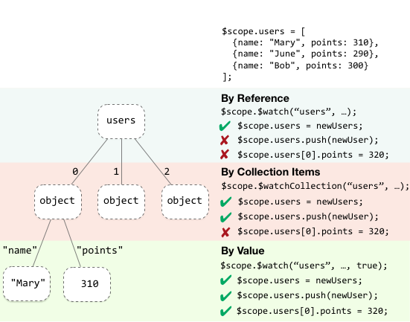

Slide 15
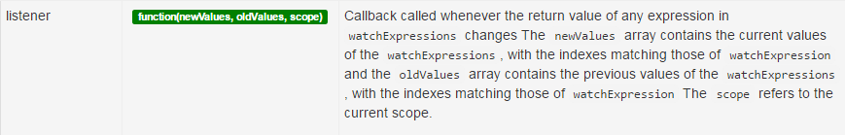
One more Method for collective change detection
$watchGroup(watchExpressions, listener);
A variant of $watch() where it watches an array of watchExpressions. If any one expression in the collection changes the listener is executed.
The items in the watchExpressions array are observed via standard $watch operation and are examined on every call to $digest() to see if any items changes.
The listener is called whenever any expression in the watchExpressions array changes.
Returns a de-registration function for all listeners.

