Slide 1
Solving Combinatorial Puzzles with Quantum Variational Algorithms
Submitted in the partial fulfillment for the award of the degree of
BACHELOR OF ENGINEERING
IN
COMPUTER SCIENCE ENGINEERING
specialization in Internet Of Things
Submitted by:
Anurag Pushkar (22BIT70030)
Lakshay Yadav (22BIT70026)
Nishant Kumar(22BIT70021)
Nitin Yadav (22BIT70028)
Under the Supervision of:
Mr. Ankur Sharma (E13693)
Department of AIT-CSE
DISCOVER . LEARN . EMPOWER

Slide 2
Outline
Introduction to Project
Problem Formulation
Objectives of the work
Hardware requirement
Methodology to be used
Literature Review
Conclusion
Future Scope
References

Slide 3
Introduction to Combinatorial Puzzles with Quantum Variational Algorithms
Combinatorial puzzles like Sudoku, N-Queens, and Graph Coloring are computationally hard problems (NP-complete). Classical algorithms often become inefficient as problem sizes increase.
Why It’s Important?
Quantum–Classical Hybrid Methods combine the strengths of both computing paradigms.
Quantum Variational Algorithms (VQAs), such as QAOA and VQE, efficiently explore large solution spaces.
Enable faster optimization and potential quantum advantage for difficult combinatorial tasks.
Can provide approximate solutions with reduced computation time compared to classical methods.
Represent a promising direction for solving real-world optimization and decision problems.

Slide 4
Problem Formulation
Objective: Efficiently solve complex combinatorial puzzles
(e.g., Sudoku, N-Queens, Graph Coloring) using quantum–classical
hybrid approaches.
Challenge:
These puzzles involve exponentially large search spaces.
Classical algorithms (backtracking, constraint satisfaction, heuristics)
become inefficient as size increases.
Goal:
Map the puzzle into a quantum optimization problem.
Represent possible solutions as quantum states.
Use Variational Quantum Algorithms (VQAs) such as QAOA and VQE to
find low-energy (optimal) solutions.
Outcome:
Achieve faster convergence or better approximations than classical solvers for
NP-hard combinatorial problems.

Slide 5
Objectives of the Work
To explore Quantum Variational Algorithms (VQAs) — QAOA and VQE — for solving combinatorial puzzles.
To formulate combinatorial problems (Sudoku, N-Queens, Graph Coloring) as quantum optimization tasks.
To analyze and compare the efficiency of quantum–classical hybrid methods with classical algorithms.
To demonstrate how quantum approaches can provide faster or more scalable solutions.
To contribute toward the practical application of quantum computing in NP-hard problem domains.

Slide 6
Software requirements
Operating System:
(Windows 10/11, Linux (Ubuntu), or macOS for compatibility with quantum SDKs.)
Programming Language:
Python 3.x – primary language for implementing and testing VQAs.
Quantum Computing Frameworks / SDKs:
Qiskit – for building, simulating, and executing quantum circuits on IBM Quantum devices.
Cirq – alternative framework for Google Quantum processors.
PennyLane – for hybrid quantum–classical optimization and integration with ML tools.
Optimization and Scientific Libraries:
NumPy and SciPy – for numerical computations and optimization routines.
Matplotlib / Seaborn – for result visualization and performance analysis.
NetworkX – for representing puzzles like graph coloring as graph structures.
Development Environment:
Jupyter Notebook – for interactive coding, visualization, and experiment tracking.
VS Code / PyCharm – for larger project management and debugging.
Cloud Access Tools:
IBM Quantum Experience or AWS Braket – for executing circuits on real quantum hardware.

Slide 7
Limitations of existing Quantum Models
Although theoretical and small-scale empirical results of quantum methods are more promising, the quantum methods are not yet practical.
Static schedules of parameters (fixed circuit depth and non-adaptive choice of angles) tend to get stuck in barren plateaus/local minima, in particular as the instance size increases. The current quantum computer, or Qu computer, firmware has some limitations and their numbers are limited to NISQ constraints: a limited qubit count, finite coherence time and gate-induced errors restrict the accessible circuit depth and so the expressivity and size of the solved problems.

Slide 8
Methodology Used
Problem Selection & Formulation
Select combinatorial puzzles such as Sudoku, N-Queens, and Graph Coloring.
Express each puzzle as a constraint satisfaction or optimization problem.
Convert constraints into a Hamiltonian (cost function) form suitable for quantum optimization.
Data Collection / Input Generation
Use predefined puzzle datasets or generate problem instances programmatically.
Represent problem parameters (e.g., board size, graph nodes, constraints) in matrix or binary form.
No external real-world data required — data is synthetic and structured based on puzzle definitions.
Algorithm Implementation
Implement Quantum Variational Algorithms (VQAs) such as QAOA
and VQE using Qiskit or PennyLane.
Map problem Hamiltonians to quantum circuits.
Use classical optimizers (e.g., COBYLA, SPSA, or Adam) for parameter tuning in the hybrid loop.

Slide 9
Methodology Used
Simulation & Execution
Run experiments on quantum simulators (not real hardware).
Perform multiple runs to compare results and evaluate convergence behavior.
Performance Evaluation
Analyze solution quality (number of satisfied constraints or minimum energy).
Compare quantum–classical hybrid results with classical algorithms (e.g., backtracking or heuristic solvers).
Visualize performance metrics using plots and graphs.

Slide 10
Literature Review
Combinatorial Problems:
Studies highlight that puzzles like Sudoku, N-Queens, and Graph Coloring are NP-complete, making classical algorithms inefficient for large instances.
Quantum Approaches:
Research shows that Quantum Approximate Optimization Algorithm (QAOA) and Variational Quantum Eigensolver (VQE) can address optimization problems by mapping them to Ising Hamiltonians.
Hybrid Quantum-Classical Methods:
Works by Farhi et al. (2014) and Peruzzo et al. (2014) introduced QAOA and VQE as variational quantum algorithms, combining quantum state preparation with classical parameter optimization.
Applications:
Recent studies demonstrate the use of QAOA and VQE in graph coloring, Max-Cut, and constraint satisfaction problems, showing improved scalability on quantum simulators.
Gap Identified:
Limited research applies these quantum algorithms specifically to combinatorial puzzles, motivating exploration in this area.
​

Slide 11
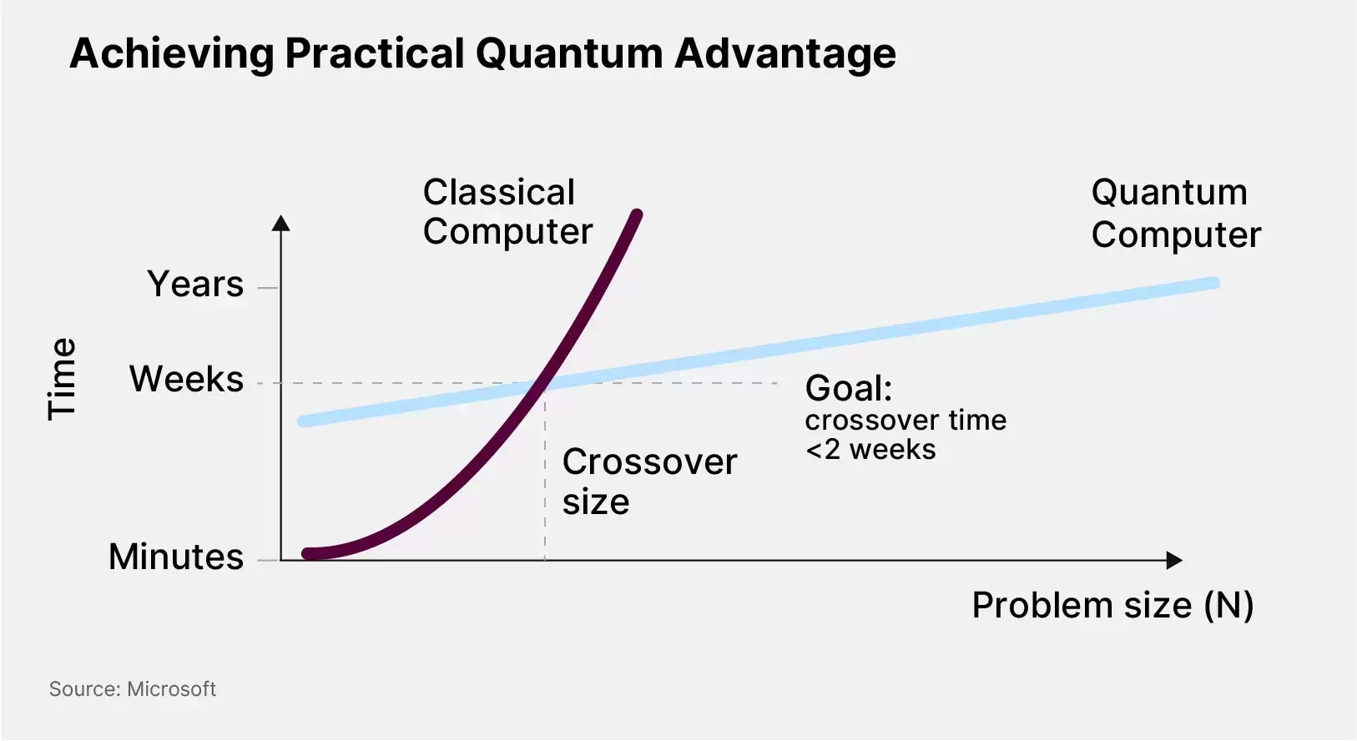
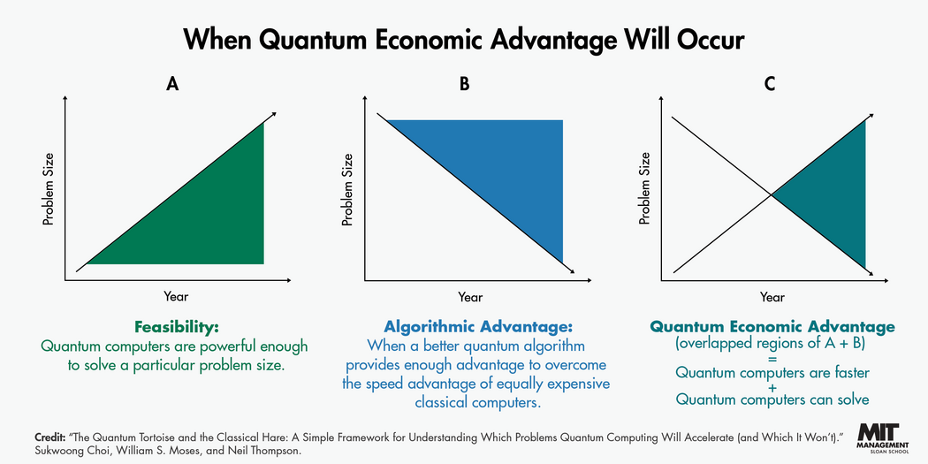
Literature Review
Despite impressive progress in quantum algorithms, much of today’s research still lives in a “quantum promise land” — rich in theory but waiting for hardware to catch up. While quantum computing continues to make headlines, the practical realization of large-scale, fault-tolerant systems remains more aspirational than operational.
In other words, quantum advantage looks great on paper, but in practice, it tends to vanish faster than we can actually build the hardware to run it.
Figure: Latency vs Model Type
AquaSentinel's Contribution:​
  First fully integrated solution combining AIoT sensing, cloud storage/analytics, and AI-driven anomaly detection
  Provides end-to-end intelligence from data collection to predictive management insights

Slide 12
Conclusion
Combinatorial puzzles like Sudoku, N-Queens, and Graph Coloring are
computationally challenging (NP-complete), making classical solutions
Inefficient for large instances.
Quantum-Classical Hybrid Methods, especially QAOA and
VQE, provide a promising approach to tackle these problems by
Combining quantum state exploration
with classical optimization.
Simulation results indicate that
quantum variational algorithms can produce competitive
or faster approximate solutions compared to classical methods.
While quantum computing hardware is still evolving,
hybrid algorithms allow us to experiment and learn about potential
quantum advantages today.
Overall, this study demonstrates the practical potential of VQAs in
solving complex combinatorial puzzles and sets the stage for
future real-hardware implementations.

Slide 13
Future Scope
Real Quantum Hardware: Test QAOA and VQE on actual quantum processors as hardware becomes more reliable.
Larger Problem Instances: Extend experiments to bigger puzzles and graphs beyond the limits of classical simulation.
Algorithm Improvement: Explore advanced variational algorithms and better classical optimizers to enhance solution quality.
Integration with AI/ML: Combine quantum optimization with machine learning for adaptive problem-solving.
Practical Applications: Apply hybrid quantum algorithms to real-world optimization problems in logistics, scheduling, and network design.
Benchmarking Standards: Develop standard metrics for comparing classical vs. quantum solutions for combinatorial problems.

Slide 14
References
[1] L. Zhou, S. T. Wang, S. Choi, H. Pichler, and M. D. Lukin, “Quantum Approximate Optimization Algorithm: Performance, Mechanism, and Implementation on Near-Term Devices,” Phys. Rev. X, vol. 10, no. 2, p. 021067, Jun. 2020, doi: 10.1103/PhysRevX.10.021067.
[2] D. F. Perez-Ramirez, “Variational Quantum Algorithms for Combinatorial Optimization,” vol. 1, Jul. 2024. [Online]. Available: https://arxiv.org/pdf/2407.06421.
[3] K. Blekos et al., “A Review on Quantum Approximate Optimization Algorithm and Its Variants,” Phys. Rep., vol. 1068, pp. 1–66, Jun. 2024, doi: 10.1016/j.physrep.2024.03.002.
[4] E. R. Anschuetz and B. T. Kiani, “Quantum Variational Algorithms Are Swamped with Traps,” Nat. Commun., vol. 13, no. 1, pp. 1–10, Dec. 2022, doi: 10.1038/S41467-022-35364-5.
[5] I. Cong, S. Choi, and M. D. Lukin, “Quantum Convolutional Neural Networks,” Nat. Phys., vol. 15, no. 12, pp. 1273–1278, Dec. 2019, doi: 10.1038/S41567-019-0648-8.
[6] A. Sturm, “Theory and Implementation of the Quantum Approximate Optimization Algorithm: A Comprehensible Introduction and Case Study Using Qiskit and IBM Quantum Computers,” Jan. 2023. [Online]. Available: http://arxiv.org/abs/2301.09535.
[7] O. Amosy, T. Danzig, O. Lev, E. Porat, G. Chechik, and A. Makmal, “Iteration-Free Quantum Approximate Optimization Algorithm Using Neural Networks,” Quantum Mach. Intell., vol. 6, no. 2, pp. 1–12, Dec. 2024, doi: 10.1007/S42484-024-00159-Y.
[8] Y. Ruan, Z. Yuan, X. Xue, and Z. Liu, “Quantum Approximate Optimization for Combinatorial Problems with Constraints,” Inf. Sci. (N.Y.), vol. 619, pp. 98–125, Jan. 2023, doi: 10.1016/J.INS.2022.11.020.

Slide 15
References
[9] C. Grange, M. Poss, and E. Bourreau, “An Introduction to Variational Quantum Algorithms for Combinatorial Optimization Problems,” 4OR, vol. 21, no. 3, pp. 363–403, Aug. 2024, doi: 10.1007/s10288-023-00549-1.
[10] M. Cerezo et al., “Variational Quantum Algorithms,” Nature Reviews Physics, vol. 3, no. 9, pp. 625–644, Oct. 2021, doi: 10.1038/s42254-021-00348-9.
[11] K. Blekos et al., “A Review on Quantum Approximate Optimization Algorithm and Its Variants,” Phys. Rep., vol. 1068, pp. 1–66, Jun. 2024, doi: 10.1016/J.PHYSREP.2024.03.002.
[12] O. Lockwood and M. Si, “Reinforcement Learning with Quantum Variational Circuits,” in Proceedings of the 16th AAAI Conference on Artificial Intelligence and Interactive Digital Entertainment (AIIDE 2020), pp. 245–251, 2020, doi: 10.1609/aiide.v16i1.7437.
[13] S. Y. Wu, Y. Q. Song, R. Z. Li, S. J. Qin, Q. Y. Wen, and F. Gao, “Resource-Efficient Adaptive Variational Quantum Algorithm for Combinatorial Optimization Problems,” Adv. Quantum Technol., p. 2400484, 2025, doi: 10.1002/QUTE.202400484.

