Slide 1
New Business Intake & Risk Management
John Hall

Slide 2
Intake is about Risk Management
Identifying and Evaluating Risk
Managing Risk

Slide 3
Intake is about Risk Management
Identifying and Evaluating Risk
Managing Risk

Slide 4
Intake is about Risk Management
What risk factors exist and what’s our risk tolerance?
  Conflicts (due to new business, lateral hires or mergers)
  Client confidentiality requirements
How can we manage risk and begin work promptly?
  Ethical walls and information security
  Client information intake and evaluation (conflict, credit, etc.)
  Configuration of infrastructure for timekeepers

Slide 5
Intake is about Risk Management
What risk factors exist and what’s our risk tolerance?
  Conflicts (due to new business, lateral hires or mergers)
  Client confidentiality requirements
Identifying and Evaluating Risk
Managing Risk
How can we manage risk and begin work promptly?
  Ethical walls and information security
  Client information intake and evaluation (conflict, credit, etc.)
  Configuration of infrastructure for timekeepers

Slide 6
Intake is about Risk Management
Policies, processes and technology required for both
Identifying and Evaluating Risk
Managing Risk
Controlling risk well separates business-savvy intake risk management practices from unnecessarily conservative or irresponsibly liberal ones.

Slide 7
Intake Stages
Risk Identification
Credit Check
Conflicts Check
Client Sensitivity
Risk Evaluation
Attorney Review
Mgmt. Review
Risk Management
Conflicts Waiver
Ethical Wall Memo
Ethical Wall Enforcement
Business Intake
Matter Creation
Data Communication
Application Configuration
Notes:
Risk identification: Identify potential risk and put the right information in the hands of the attorneys
Risk evaluation: Determine the level of risk and make a judgment about how to handle it.
Risk management: How can we minimize the intake risk in gray areas?
Managing this risk well is what separates a business-savvy intake risk management program from a unnecessarily conservative or irresponsibly liberal ones.

Slide 8
Intake Stages
Risk Identification
Risk Evaluation
Risk Management
Business Intake

Slide 9








Role of Technology
Risk Identification
Risk Evaluation
Risk Management
Business Intake
Conflicts / Workflow
Security / Integration

Slide 10

















Notable IntApp Customers
Firms with 500 or more attorneys

Slide 11















Notable IntApp Customers
Firms with under 500 attorneys, A-J

Slide 12
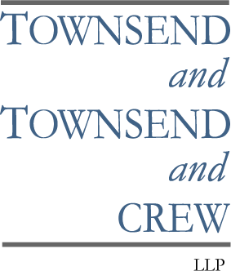




















Notable IntApp Customers
Firms with under 500 attorneys, K-Z

Slide 13
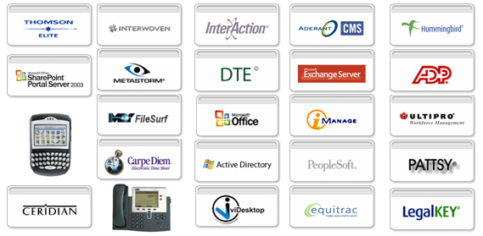
Not Just Intake Risks
Intake
Integration
Security
Time
Confidentiality
Intake Integration
Ethical walls for new business, lateral hires, mergers
Client Requests for Confidentiality
Firm Confidential Matters
Litigation/Legal Holds
Matter propagation across applications
Frequent matter list maintenance
Matter transfer

Slide 14



Conflicts of Interest
Firm wants to take on Coca Cola as a client
  Determines potential adverse parties are
Runs a conflicts check and identifies potential conflicts related to:
  Some work the firm has done for independent bottling association
  Some work an attorney did for a particular bottler at a past job
Consequences for violation:
  Disqualification & Loss of Fees
  Damaging Press

Slide 15



Lateral Hire Conflict
Firm Vader & Sidious LLP wants to hire attorney Obiwan Kenobi
Obiwan discloses all clients and matters he’s worked on in the past
Firm identifies potential clients and matters that conflict with their existing clients
  Client: Alderan Base Construction, Inc.
Vader & Sidious
LLP

Slide 16




Firm Confidential Matters
Firm Lawsuits
Business Restructuring Plans
(The firm or a partner is sued)
(Mergers, expansion, downsizing)
Lateral Hiring Pursuits
Compensation and Shareholder Performance

Slide 17




Client Confidential Matters
High Profile / PR Sensitivity
IP of Utmost Business Value
(People in the public eye, political/government)
(Trade secrets, pharmaceutical/high tech)
Regulatory Controls
Client’s Customer Requirements
(HIPPA, SEC, Sarbanes Oxley, etc.)
(Client obligations such as customer privacy)

Slide 18
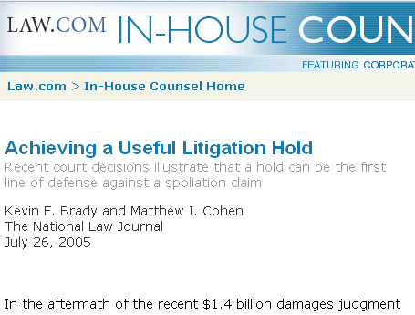
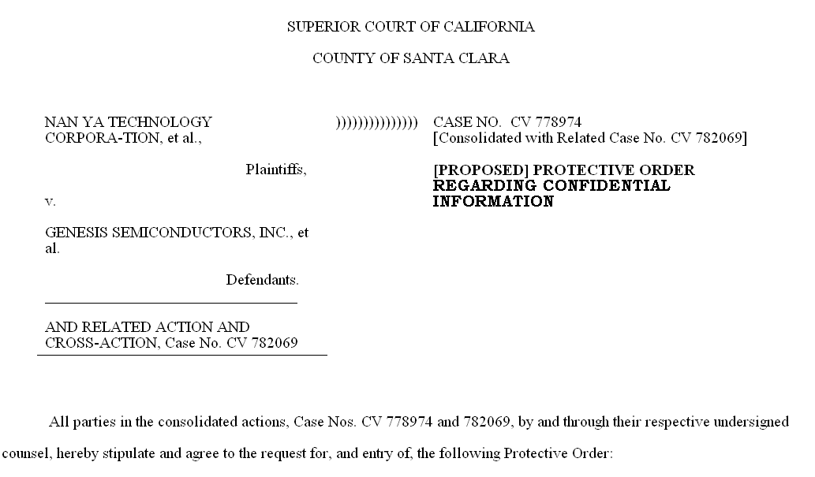
Litigation Issues
Lit / Legal Holds
  Halt records destruction
  Lock-down, read-only
Protective Orders
  Treatment of “Confidential” and “Attorneys Eyes Only” information

Slide 19
Benefits of Confidentiality
Mitigate Risk
Reduces chances of inadvertent internal access
Logging creates audit trail (for court, client or insurance audience)
Increase Revenue Opportunities
Help firm take on new business where conflicts exist
Enable firms to more aggressively pursue experienced lateral hires
Differentiate Firm
Win and satisfy sensitive clients (RFPs)
Litigation weapon – Standard to hold opposition to

Slide 20
IntApp Wall Builder™
Next Generation Legal Industry Best Practice
  Developed by working with your peers (DLA, Hinshaw, Kelley Drye, and others)
Works with your existing conflicts process
  Whether you use Elite, LegalKey, your own system or our conflicts database

Slide 21
IntApp Wall Builder™
Extend security beyond DMS
  Finance, Records, CRM, Time & Billing, Portals, KM and more
Self-Maintaining
  Associative walls react to changes automatically, updating themselves in real time in response to staff activity
Configurable for firm confidentiality and security policies
  Exclusionary and inclusionary walls
  Works with existing conflicts application or provided web application

Slide 22

Types of Security Walls
Exclusionary Walls
  “Keep person X away from Matter Y”
DM Library

Slide 23



Types of Security Walls
Inclusionary Screens
  “Only people A, B and C can access Matter D”
DM Library

Slide 24

Types of Security Walls
Associative Walls
  “Anyone who touches matter 1 is walled from matter 2 moving forward”
DM Library
Time
Tracking

Slide 25






Extensible Security Walls
“Not only are you walled from the DM, but also other relevant systems.”
DM Library
Accounting
Email / Lists
KM Portal
Records
Time Tracking
“It's a state-of-the-art ethical walls solution.”
─ IT Director, DLA Piper

Slide 26

December, 2004
IntApp Product Demonstration

Slide 27
December, 2004
Thank You

