Slide 1
Activity Diagrams
Notes:
Lecture #09
05 October 2007
IT60106: D. Samanta, SIT, IIT Kharagpur

Slide 2
What is an Activity Diagram?
Activity diagrams represent the dynamic (behavioral) view of a system
Activity diagrams are typically used for business (transaction) process modeling and modeling the logic captured by a single use-case or usage scenario
Activity diagram is used to represent the flow across use cases or to represent flow within a particular use case
UML activity diagrams are the object oriented equivalent of flow chart and data flow diagrams in function-oriented design approach
Activity diagram contains activities, transitions between activities, decision points, synchronization bars, swim lanes and many more…

Slide 3
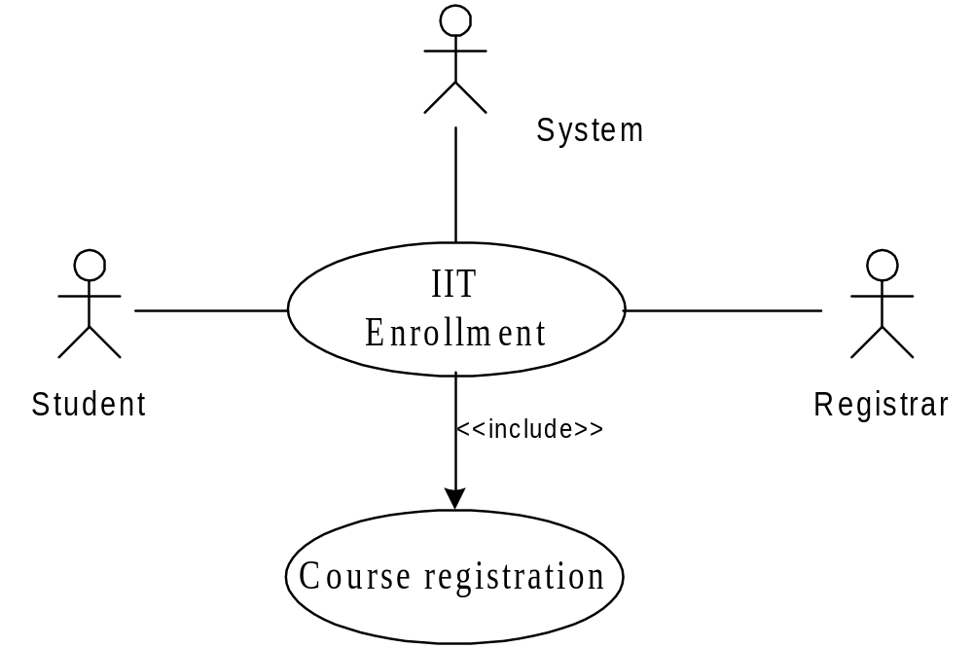
Student Enrollment

Slide 4
SE System
Here different activities are:
  Received enrollment form filled by the student
    Registrar checks the form
    Input data to the system
    System authenticate the environment
  Pay fees by the student
    Registrar checks the amount to be remitted and prepare a bill
    System acknowledge fee receipts and print receipt
  Hostel allotment
    Allot hostel
    Receive hostel charge
    Allot room
  Medical check up
    Create hostel record
    Conduct medical bill
    Enter record
  Issue library card
  Issue identity card

Slide 5
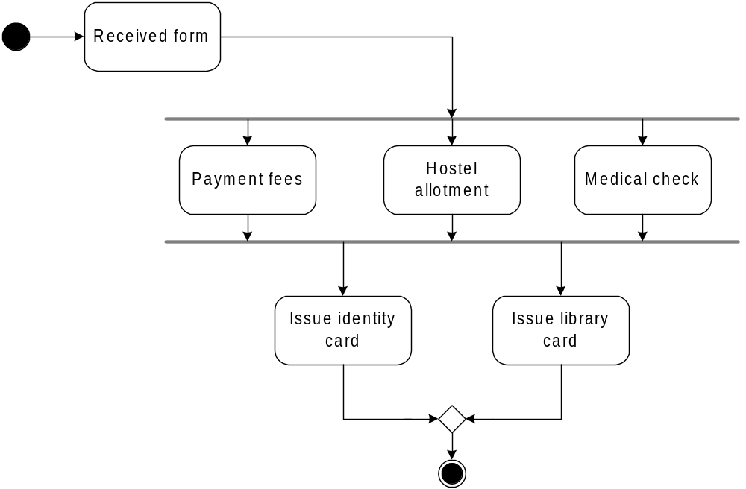
Activity Diagram for the Use Case in SE

Slide 6
Basic Components in an Activity Diagram
Initial node
  The filled circle is the starting point of the diagram
Final node
  The filled circle with a boarder is the ending point. An activity diagram can have zero or more activity final state.
Activity
  The rounded circle represents activities that occur. An activity is not necessarily a program, it may be a manual thing also
Flow/ edge
  The arrows in the diagram. No label is necessary

Slide 7
Basic Components in an Activity Diagram
Fork
  A black bar ( horizontal/vertical ) with one flow going into it and several leaving it. This denotes the beginning of parallel activities
Join
  A block bar with several flows entering it and one leaving it. this denotes the end of parallel activities
Merge
  A diamond with several flows entering and one leaving. The implication is that all incoming flow to reach this point until processing continues

Slide 8
Basic Components in an Activity Diagram
Difference between Join and Merge
  A join is different from a merge in that the join synchronizes two inflows and produces a single outflow. The outflow from a join cannot execute until all inflows have been received
  A merge passes any control flows straight through it. If two or more inflows are received by a merge symbol, the action pointed to by its outflow is executed two or more times

Slide 9
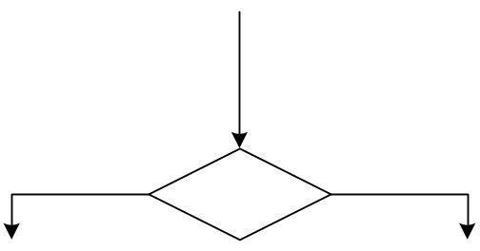

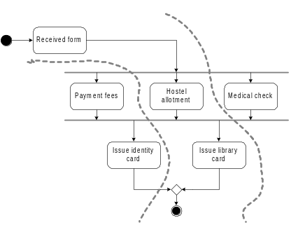
Basic Components in an Activity Diagram
Decision
  A diamond with one flow entering and several leaving. The flow leaving includes conditions as yes/ no state
Flow final
  The circle with X though it. This indicates that Process stop at this point
Swim lane
  A partition in activity diagram by means of dashed line, called swim lane. This swim lane may be horizontal or vertical

Slide 10
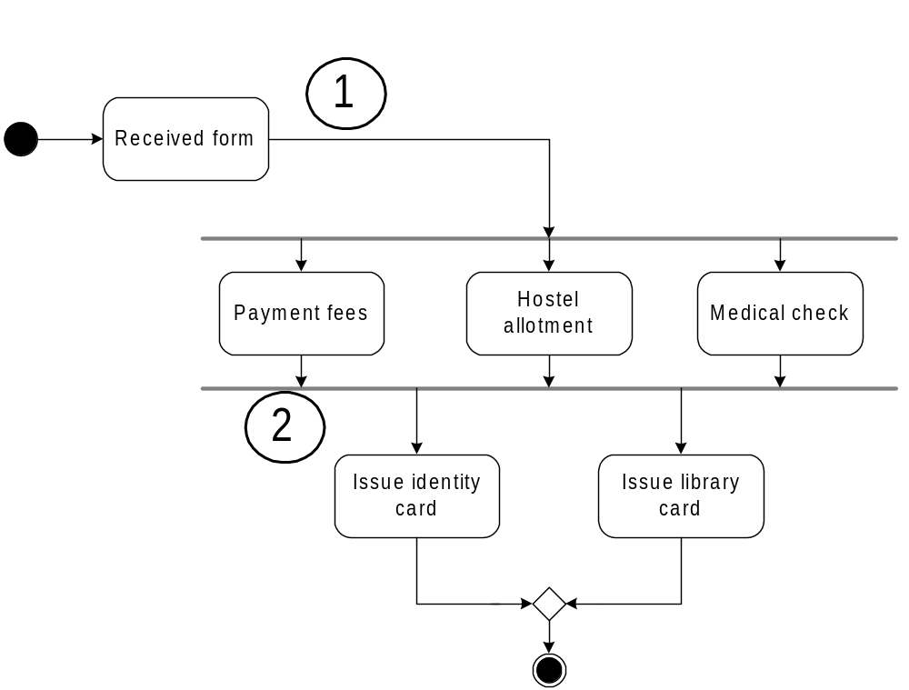
Detailed Activity Diagram of SEIIT

Slide 11
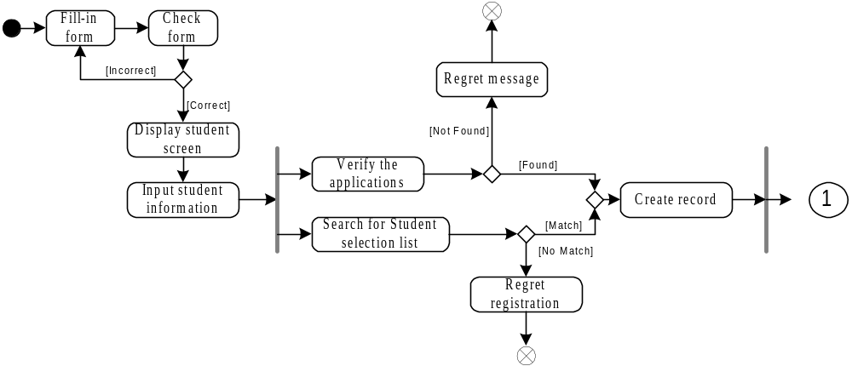
Detailed Activity Diagram of SE

Slide 12
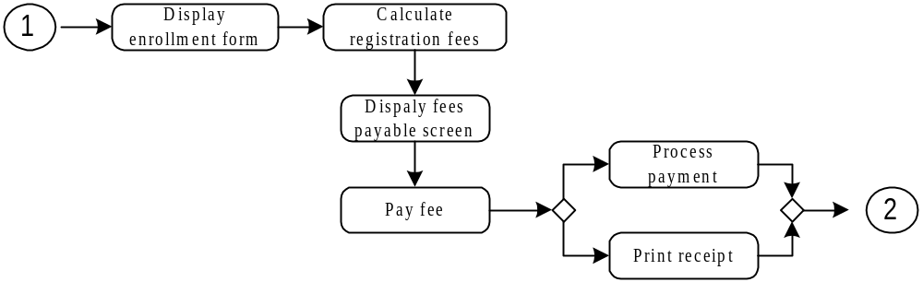
Detailed Activity Diagram of SE

Slide 13
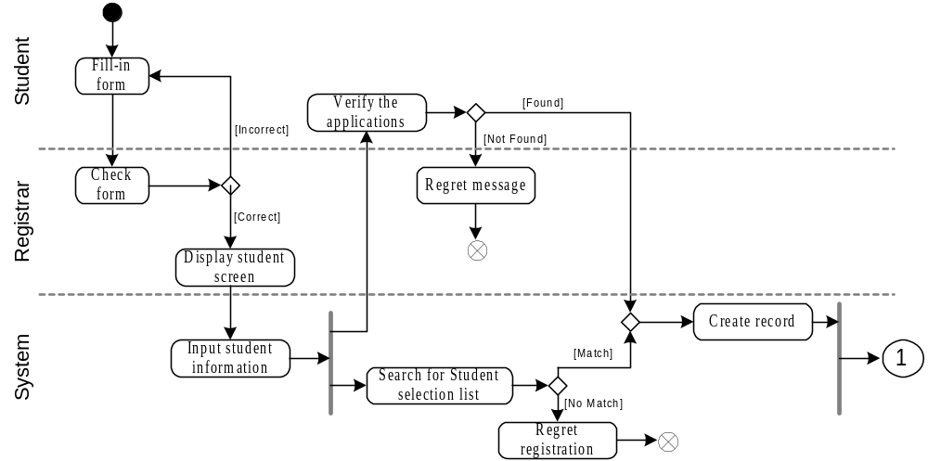
Activity Diagram of SE with Swim Lane

Slide 14
Importance of Activity Diagram
An activity diagram can depict a model in several ways
It can also depicts “Basic course of action” as well as “detailed courses”
Activity diagram can also be drawn that cross several use cases, or that address just a small portion of use case
Activity diagrams are normally employed in business process modeling. This is carried out during the initial stages of requirement analysis and specification
Activity diagrams can be very useful to understand the complex processing activities involving many components
The activity diagram can be used to develop interaction diagrams which help to allocate activities to classes

Slide 15


