Slide 1
Coding & Testing
Code Review
Testing

Slide 2
Coding Review
Good software development organizations normally require their programmers to adhere to some well-defined and standard style of coding called coding standards.

Slide 3
Coding Purpose
The purpose of requiring all engineers of an organization to adhere to a standard style of coding is the following:
A coding standard gives a uniform appearance to the codes written by different engineers.
It enhances code understanding.
It encourages good programming practices.

Slide 4
Coding standards and guidelines
Rules for limiting the use of global.
Contents of the headers preceding codes for different modules.
Naming conventions for global variables, local variables, and constant identifiers.
Error return conventions and exception handling mechanisms.
Do not use a coding style that is too clever or too difficult to understand.
Avoid obscure side effects.
Do not use an identifier for multiple purposes.
The code should be well-documented.
The length of any function should not exceed 10 source lines.
Do not use go to statements.

Slide 5
Code Review
Code review practice is carried out after the module is successfully compiled and the all the syntax errors have been eliminated. Code reviews are extremely cost-effective strategies for reduction in coding errors and to produce high quality code.

Slide 6
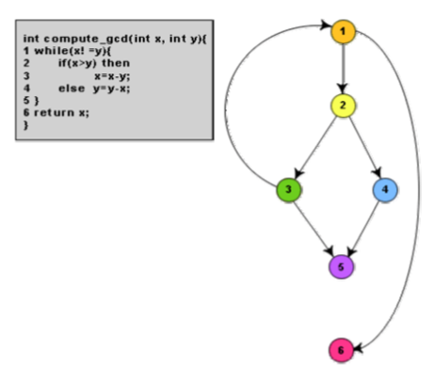
Code walk Through
Code walk through is an informal code analysis technique. In this technique, after a module has been coded, successfully compiled and all syntax errors eliminated.

Slide 7
Code Inspection
Use of uninitialized variables.
Jumps into loops.
Non-terminating loops.
Incompatible assignments.
Array indices out of bounds.
Improper storage allocation and de-allocation.
Mismatches between actual and formal parameter in procedure calls.
Use of incorrect logical operators or incorrect precedence among operators.
Improper modification of loop variables.
Comparison of equally of floating point variables, etc.

Slide 8
Software documentation
Internal
Source code, useful variable names, module and function headers, code indentation, code structuring, use of enumerated types and constant identifiers, use of user-defined data types, etc.
External
users’ manual, software requirements specification document, design document, test documents, etc.

