Slide 1
Cyclomatic
Complexity
This metric was developed by Thomas J. McCabe in 1976
and it based on a control flow representation of the program.
Control flow depicts a program as a graph which consists of Nodes and Edges.

Slide 2
What is cyclomatic complexity
Cyclomatic complexity is a software metric used to measure the complexity of a program. These metric, measures independent paths through program source code.

Slide 3
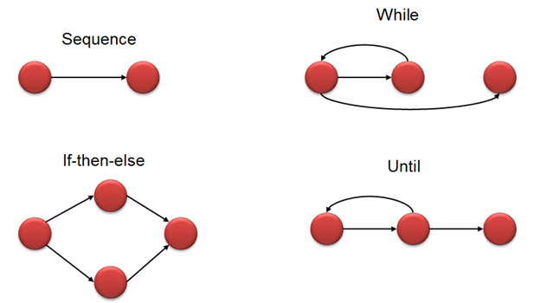
Flow graph notation for a program

Slide 4
Mathematical representation
V(G) = E – N + 2
Where,
E – Number of edges
N – Number of Nodes
V (G) = P + 1
Where P = Number of predicate nodes (node that contains condition)

Slide 5
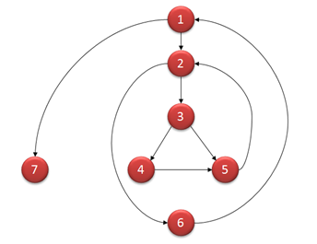
Example
i = 0;
n=4; //N-Number of nodes present in the graph
while (i<n-1) do
j = i + 1;
while (j<n) do
if A[i]>A[j] then
swap(A[i], A[j]);
j = j + 1;
end do;
i = i + 1;
end do;

Slide 6
Computing mathematically
V(G) = 9 – 7 + 2 = 4
V(G) = 3 + 1 = 4 (Condition nodes are 1,2 and 3 nodes)
Basis Set – A set of possible execution path of a program
1, 7
1, 2, 6, 1, 7
1, 2, 3, 4, 5, 2, 6, 1, 7
1, 2, 3, 5, 2, 6, 1, 7

Slide 7
Properties of Cyclomatic complexity
V (G) is the maximum number of independent paths in the graph
V (G) >=1
G will have one path if V (G) = 1
Minimize complexity to 10

Slide 8
How this metric is useful for software testing?
Basis Path testing is one of White box technique and it guarantees to execute at-least one statement during testing. It checks each linearly independent path through the program, which means number test cases, will be equivalent to the cyclomatic complexity of the program.

Slide 9
complexity number and corresponding meaning of v (G)
Complexity Number | Meaning
1-10 | Structured and well written code High Testability Cost and Effort is less
10-20 | Complex Code Medium Testability Cost and effort is Medium
20-40 | Very complex Code Low Testability Cost and Effort are high
>40 | Not at all testable Very high Cost and Effort

Slide 10
Thanks

