Slide 1
Software
PROCESS MODELS
OR
Software Life Cycle Models

Slide 2
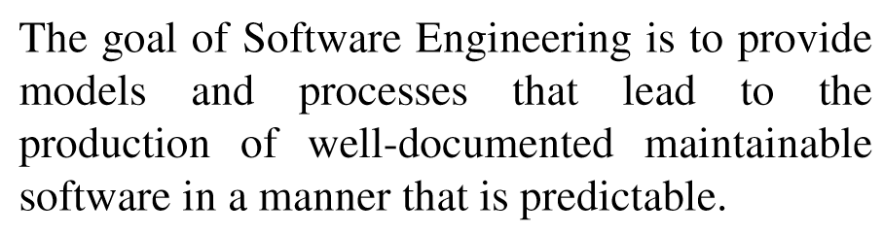
Software Life Cycle Models

Slide 3
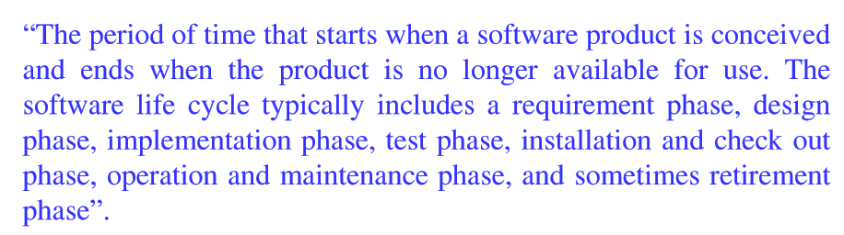
Software Life Cycle Models

Slide 4
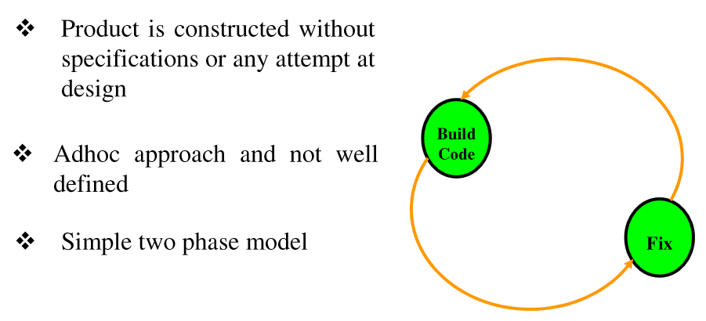
Build & Fix Model

Slide 5
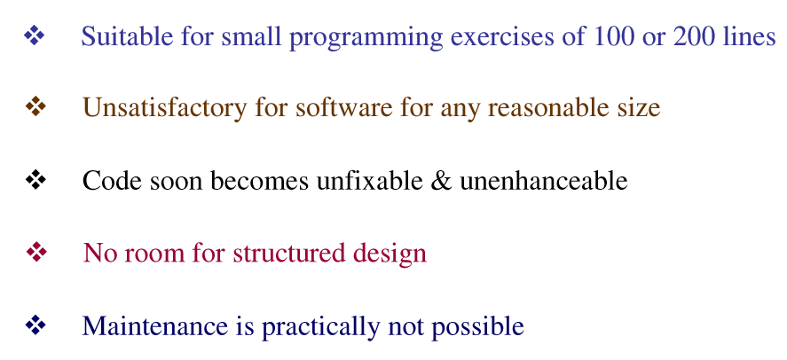
Build & Fix Model

Slide 6
Build & Fix Model

Slide 7
Waterfall Model
Requirement Analysis & Specification
Design
Implementation & Unit testing
Integration & System Testing
Operation & Maintenance

Slide 8
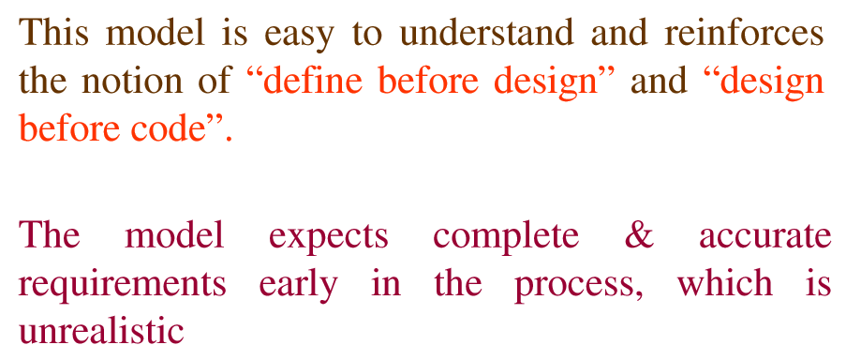
Waterfall Model

Slide 9
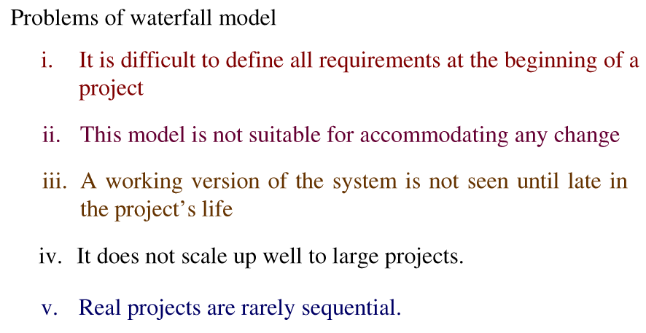
Waterfall Model

Slide 10
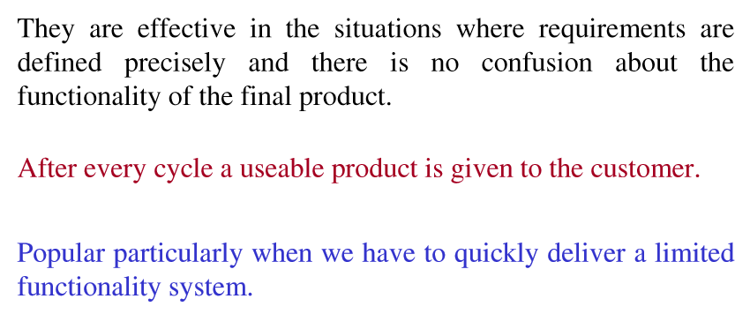
Incremental Process Model

Slide 11
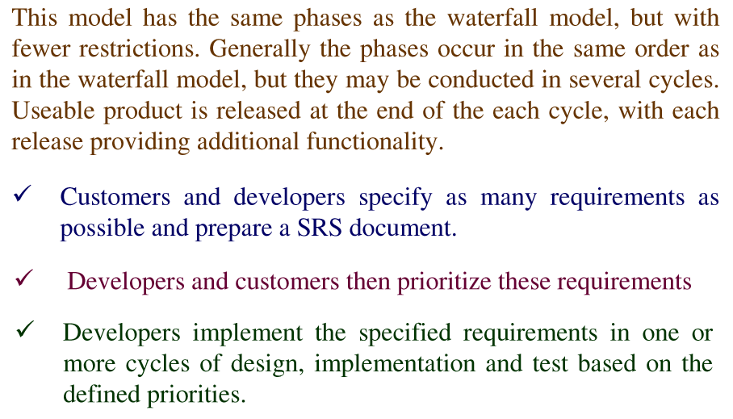
Iterative Enhancement Model

Slide 12
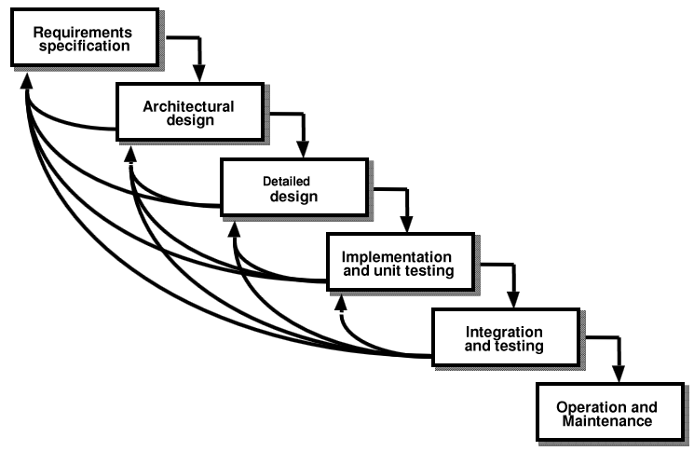
Iterative Enhancement Model

Slide 13
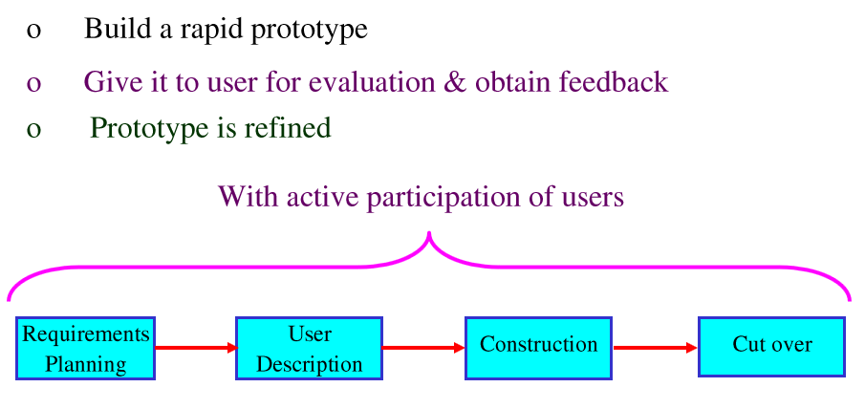
Rapid Application Model

Slide 14
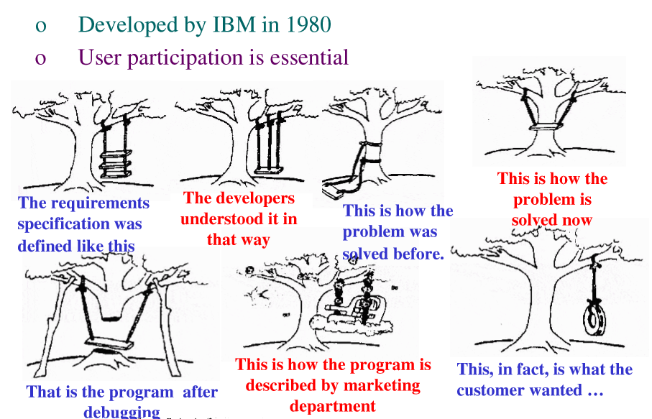
Iterative Enhancement Model

Slide 15
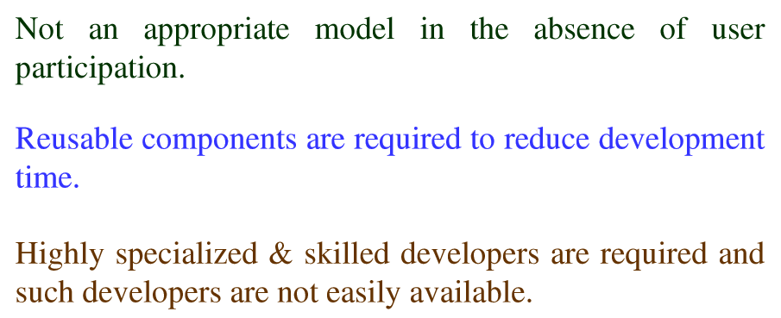
Rapid Application Development

Slide 16
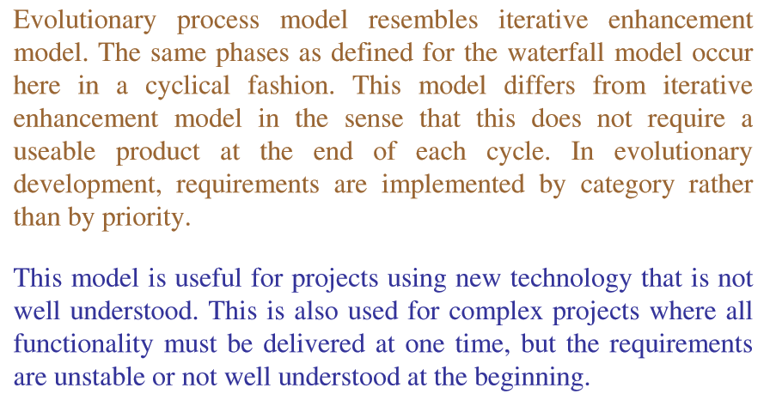
Evolutionary Process model

Slide 17
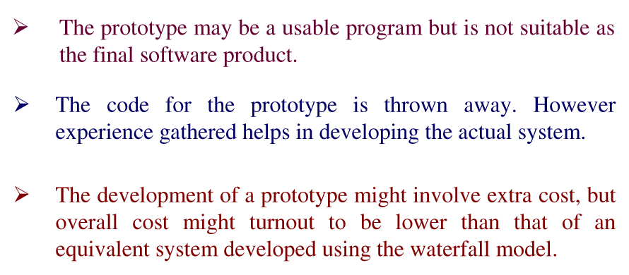
Prototyping Model

Slide 18
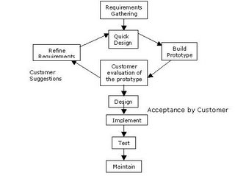
Prototyping Model

Slide 19
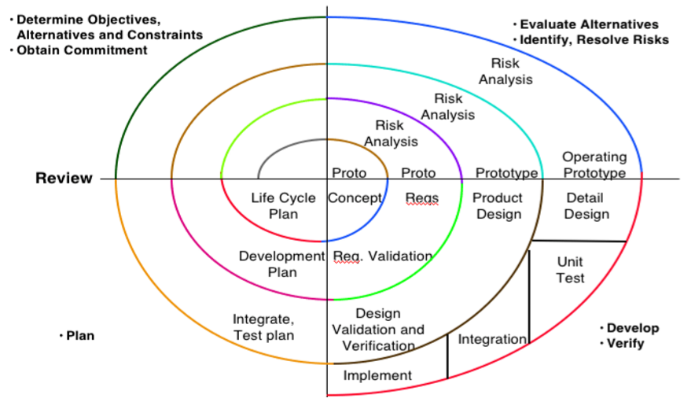
Spiral Model

Slide 20
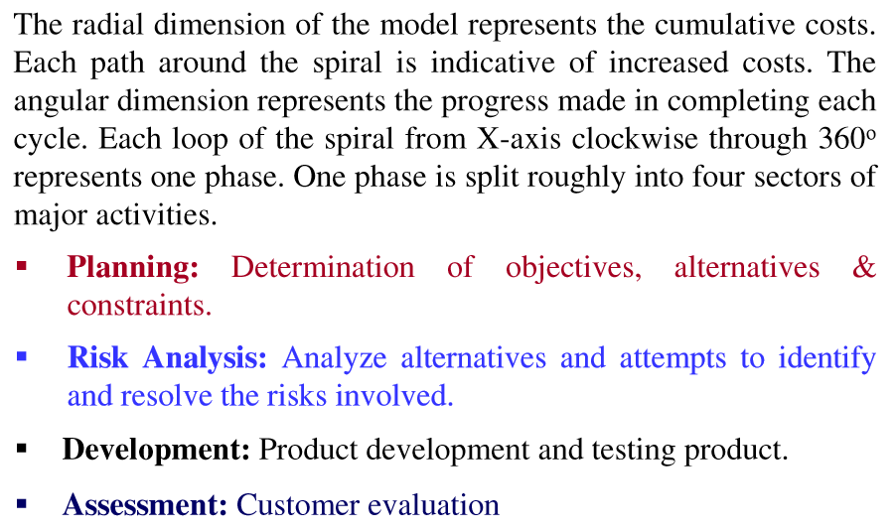
Spiral Model

