Slide 1
Type Checking

Slide 2
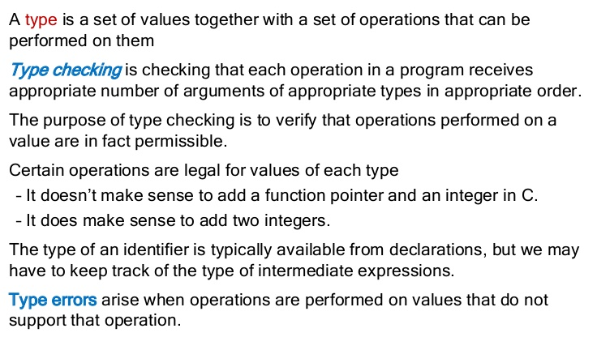
Introduction

Slide 3
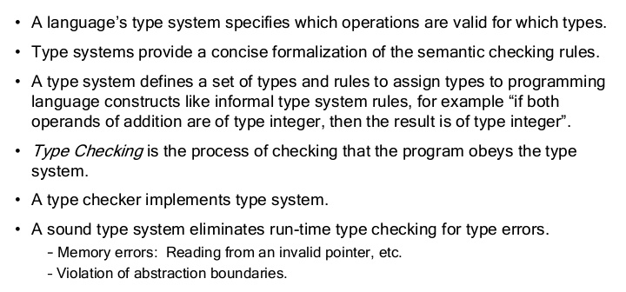
Type Systems

Slide 4
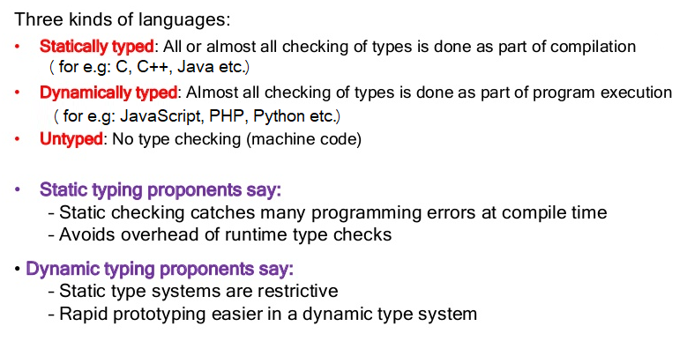
Type checking contd.

