Slide 1
Counting Sort
Linear Sort
Also called Stable Sort

Slide 2
COUNTING-SORT(A, B, k)
1. for i = 0 to k
2. do C[i] = 0
3. for j = 1 to A.length
4. do C[A[j]] = C[A[j]] + 1
5. // C[i] now contains the number of elements equal to i.
6. for i = 1 to k
7. do C[i] = C[i - 1] + C[i]
8. // C[i] now contains the number of elements less than or equal to i.
9. for j = A.length down to 1
10. do B[C[A[j]]] = A[j]
11. C[A[j]] = C[A[j]] - 1

Slide 3
COUNTING-SORT(A, B, k)
1. for i = 0 to k
2. do C[i] = 0
3. for j = 1 to A.length
4. do C[A[j]] = C[A[j]] + 1
5. // C[i] now contains the number of elements equal to i.
6. for i = 1 to k
7. do C[i] = C[i - 1] + C[i]
8. // C[i] now contains the number of elements less than or equal to i.
9. for j = A.length down to 1
10. do B[C[A[j]]] = A[j]
11. C[A[j]] = C[A[j]] - 1
k +2
1
n + 1
1
k + 1
1
n + 1
1
1
θ(k + n)
In practice, we usually use counting sort when we have k = O(n), in which case the running time is
θ(n)

Slide 4
Radix Sort
Linear Sort

Slide 5
1st Pass
2nd Pass
3rd Pass
A
A
A
A
258
880
108
108
158
351
351
158
351
555
555
258
880
258
258
259
555
158
158
351
108
108
259
555
259
259
880
880

Slide 6
RADIX-SORT(A, d)
1. for i = 1 to d
2. do use a stable sort to sort array A on digit i
d + 1
n+k
θ(d(n + k))
θ(n)

Slide 7
Bucket Sort
Linear Sort

Slide 8
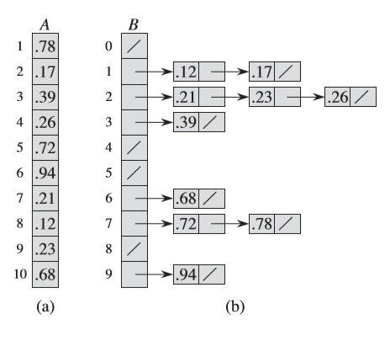

Slide 9
BUCKET-SORT(A)
1. Let B[0…n-1] be the new array
2. n = A.length
3. for i=0 to n – 1
4. make B[i] an empty list
5. for i = 1 to n
6. do insert A[i] into list B[ n . A[i] ]
7. for i = 0 to n -1
8. do sort list B[i] with insertion sort
9. Concatenate the lists B[0], B[1], ……………, B[n-1] together in order
To analyze the running time, observe that all lines except line 8 take O(n) time in the worst case.
We need to analyze the total time taken by the n calls to insertion sort in line 8, because here in this case algorithm insertion-sort never repeats any number for insertion, so if n size takes n time.

