Slide 1
Binomial Heaps

Slide 2
Introduction
Presenting data structure known as mergeable heaps.
MAKE-HEAP() - To creates and return new heap containing no elements
which supports the following five operations:
    INSERT(H, x)
    MINIMUM(H)
    EXTRACT-MIN(H)
    UNION(H₁, H₂)
    DECREASE-KEY(H, x, k)
    DELETE(H, x)

Slide 3
Comparing Running times of operations
Procedure | Binary Heap Worst Case | Binomial Heap Worst Case | Fibonacci Heap Worst Case
MAKE-HEAP | ϴ (1) | ϴ (1) | ϴ (1)
INSERT | ϴ (lg n) | ϴ (lg n) | ϴ (1)
MINIMUM | ϴ (1) | ϴ (lg n) | ϴ (1)
EXTRACT-MIN | ϴ (lg n) | ϴ (lg n) | ϴ (lg n)
UNION | ϴ (n) | ϴ (lg n) | ϴ (1)
DECREASE-KEY | ϴ (lg n) | ϴ (lg n) | ϴ (1)
DELETE | ϴ (lg n) | ϴ (lg n) | ϴ (lg n)

Slide 4
Binomial heap
A binomial heap is a collection of binomial trees.
So lets start learning binomial trees and proving some key properties.

Slide 5
Binomial trees
A binomial tree B_{k} is an ordered tree defined recursively.
Lemma 19.1 (Properties of binomial trees)
For the binomial tree B_{k}
There are 2^{k} nodes,
The height of the tree is k,
There are exactly ( ) nodes at depth i for i = 0, 1, . . . . . . , k, and
The root has degree k, which is greater than that of any other node; moreover if the children of the root are numbered from left to right by k-1, k-2, . . . . , 0, child i is the root of a sub-tree B_{i}.
k
i

Slide 6
Binomial trees
A binomial tree B_{k} is an ordered tree defined recursively.
depth
0
1
2
3
4
B₄
Proof of Prop 4

Slide 7
Binomial trees contd...
Proof: The proof is by induction on k. For each property, the basis is the binomial tree B_{k-1} .
Binomial tree B_{k} consists of two copies of B_{k-1}, and so B_{k} has
2^{k-1} + 2^{k-1} = 2^{k} nodes.
Because of the way in which the two copies of B_{k-1} are linked to form B_{k}, the maximum depth of a node in B_{k} is one greater than the maximum depth in B_{k-1}. By the inductive hypothesis, this maximum depth is (k-1)+1 = k.
Let D(k, i) = D(k-1, i) + D(k-1, i-1) - By the inductive hypothesis
= ( ) + ( ) = ( )
k-1
k-1
k
i
i-1
i

Slide 8
Binomial trees contd...
Proof: The proof is by induction on k. For each property, the basis is the binomial tree B_{k-1}.
4). The only node with greater degree in B_{k} than in B_{k-1} is the root, which has more child than in B_{k-1}. Since the root B_{k-1} has degree k-1, the root of B_{k} has degree k. Now, by the inductive hypothesis, and as figure shows from left to right, the children of the root of B_{k-1} are roots of B_{k-2}, B_{k-3}, . . . , B₀. When B_{k-1} is linked to B_{k-1}, therefore, the children of the resulting root are roots of B_{k-1}, B_{k-2}, . . . , B₀.

Slide 9
Binomial trees
A binomial tree B_{k} is an ordered tree defined recursively.
depth
0
1
2
3
4
B₀
B₁
B₂
B₃
B₄

Slide 10
Binomial heaps
A binomial heap H is a set of binomial trees that satisfies the following binomial-heap properties.
Each binomial tree in H obeys the min-heap property: the key of a node is greater than or equal to the key of its parent. We say that each such tree is min-heap-ordered.
For any non-negative integer k, there is at most one binomial tree in H whose root has degree k.

Slide 11
Representation of Binomial heap
A binomial heap H with n = 13.
head[H]
10
10
1
6
12
25
8
14
29
18
11
17
38
27

Slide 12
/
/
/
10
10
1
6
head[H]
0
2
3
/
/
P
Key
Degree
Child
Sibling
12
25
8
14
29
1
0
2
1
0
/ /
/ /
18
11
17
38
0
1
0
0
/ /
/ /
/ /
27
A more detailed
representation
0
/ /
A Binomial heap H within = 13.

Slide 13
Operations on binomial heap
MAKE-HEAP ()
1. H = NIL
2. return H
MAKE-HEAP-MINIMUM(H)
1. y = NIL
2. x = H
3. min =
4. while x ≠ NIL
5. do if key[x] < min
6. then min = key[x]
7. y = x
8. x = sibling[x]
9. return y
BINOMIAL-LINK (y, z)
1. y.p = z
2. y.sibling = z.child
3. z.child = y
4. z.degree = z.degree + 1

Slide 14
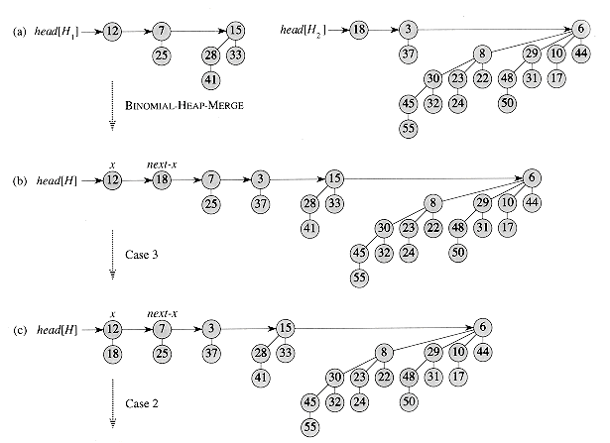
BINOMIAL-HEAP-UNION

Slide 15
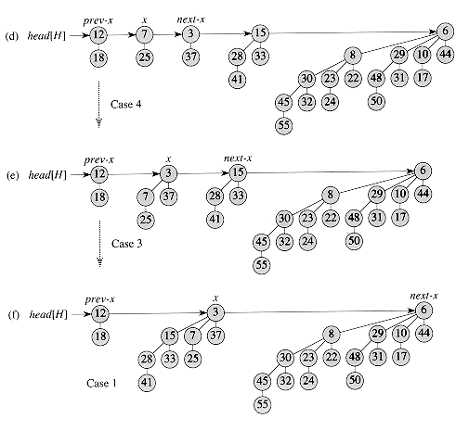
BINOMIAL-HEAP-UNION

Slide 16
BINOMIAL-HEAP-EXTRACT-MIN
H.head
37
10
1
41
28
13
16
12
25
6
77
29
26
23
18
8
14
11
17
38
42
27
x
H.head
37
10
1
41
28
13
16
12
25
6
77
29
26
23
18
8
14
11
17
38
42
27

Slide 17
BINOMIAL-HEAP-EXTRACT-MIN
H.head
37
10
H.head
25
12
16
6
41
28
13
18
26
23
8
14
29
77
42
11
17
38
27
H.head
25
12
6
37
18
8
14
29
10
41
13
11
17
38
16
28
26
23
77
27
42

Slide 18
BINOMIAL-HEAP-DECREASE-KEY
head[H]
25
12
6
37
18
z
14
29
10
8
41
y
13
11
17
38
7
28
16
23
77
27
42
z
head[H]
25
12
6
37
18
y
7
8
14
29
41
13
11
17
38
10
28
16
23
77
27
42

Slide 19
BINOMIAL-HEAP-UNION(H₁, H₂)
1. H = MAKE-BINOMIAL-HEAP()
2. H.head = BINOMIAL-HEAP-MERGE(H₁, H₂)
3. free the objects H1 and H2 but not the lists they point to i.e. H
4. if H.head == NIL
5. then return H
6. x.prev = NIL
7. x = H.head
8. x.next = x.sibling
9. while x.next ≠ NIL
10. do if (x.degree ≠ x.next.degree) or (x.next.sibling ≠ NIL and x.next.sibling == x.degree)
11. then x.prev = x
12. x = x.next
13. else if x.key <= x.next.key
14. then x.sibling = x.next.sibling
15. BINOMIAL-LINK (x.next, x)
16. else if x.prev == NIL
17. then H.head = x.next
18. else x.prev.sibling = x.next
19. BINOMIAL-LINK (x, x.next)
20. x = x.next
21. x.next = x.sibling
22. return H

Slide 20
BINOMIAL-HEAP-INSERT(H, x)
1. H' = MAKE-BINOMIAL-HEAP()
2. x.p = NIL
3. x.child = NIL
4. x.sibling = NIL
5. x.degree = 0
6. H'.head = x
7. H = BINOMIAL-HEAP-UNION(H, H')
BINOMIAL-HEAP-EXTRACT-MIN(H, x)
1. find the root x with the minimum key in the root list of H
and remove x from the root list of H
2. H' = MAKE-BINOMIAL-HEAP()
3. remove the order of the linked list of x's children
and set H'.head to point to the head of the resulting list
4. H = BINOMIAL-HEAP-UNION(H, H')
5. return x

Slide 21
BINOMIAL-HEAP-DECREASE-KEY(H, x, k)
1. if k > key[x]
2. then error “new key is greater than current key”
3. key[x] = k
4. y = x
5. z = y.p
6. while z ≠ NIL and y.key < z.key
7. do exchange y.key ↔ z.key
8. // if y and z have sattelite fields, exchange them, too.
9. y = z
10. z = y.p
BINOMIAL-HEAP-DELETE(H, x)
1. BINOMIAL-HEAP-DECREASE-KEY(H, x, - )
2. BINOMIAL-HEAP-EXTRACT-MIN(H)

Slide 22
THANKS
Rest in Next Class

