Slide 1
Mention the strength of the engineered features and the need to understand the data
- We did this well, which explains the good AUC score for even Log Reg baseline to perform well (0.775)
Spend a decent amount of time explaining the data preprocessing part - it is after all a key aspect of ML projects
Conclude with the 5 level Risk Tiering model - 65% of frauds in 25% of customers
Intro
- Problem
- Data intro
Methodology
- Before Modeling
- Data Exploration
- Feature Engineering
- Modeling
- Stratify
- Baseline Models ()
- Tree based models (RF, XGBoost)
- Advanced Models (LightGBM + Isolation Forest)
- K-fold cross validation
- After Modeling
- Threshold Tuning
- Hyperparameter Tuning
- Ensemble Models
- Evaluation
- Recall, Precision, F1, AUC
- Why AUC chosen as main evaluation method
- Recall as secondary evaluation
Results
- Baseline Model Result / Takeaway
- Top 5 Model
- Best Performer (Voting Ensemble)
- Comparison with other 4
Conclusion
- Business Application
- Model Deployment Suggestion (resource / time required)
- 5 Risk Tier ; Segmentation of Customers
Prasad
Ben
Steph
Nitin
Problem → Data → Model → Results → Insights

Slide 2
IDENTIFYING FRAUD
IN ELECTRICITY &
GAS CONSUMPTION
MSI 5001_TEAM 14

Slide 3
TABLE OF CONTENTS
01
02
03
04
INTRODUCTION
Problem and Dataset
METHODOLOGY
Data Prep, Modeling, Tuning, Evaluation
RESULT
Results and Key Takeaways
CONCLUSION
Business Application, Risk Tiering

Slide 4
01
INTRODUCTION

Slide 5


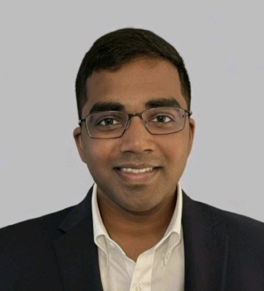
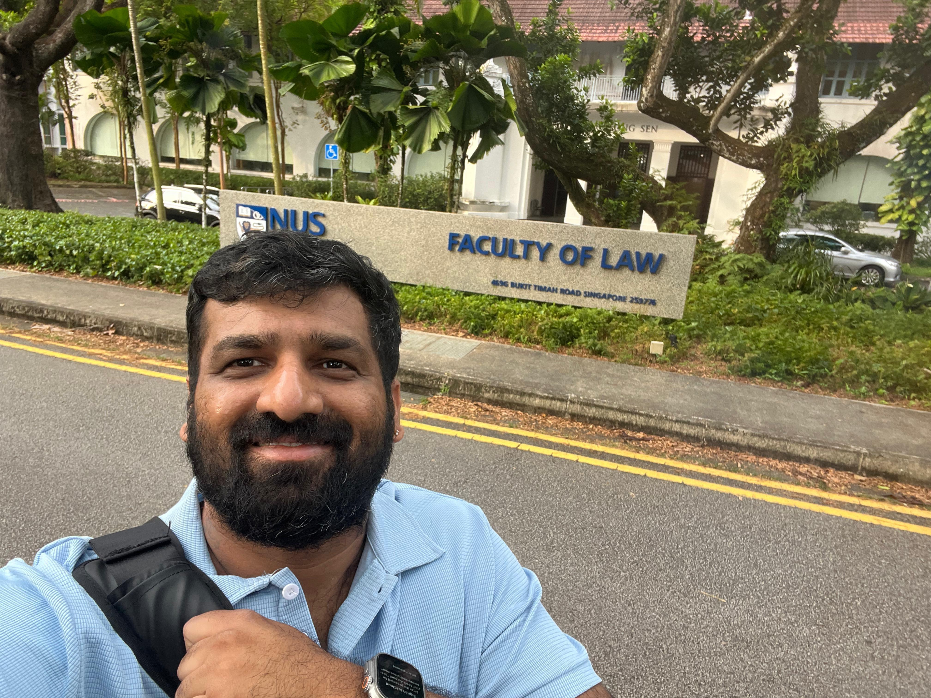
OUR TEAM
PRASAD
XUAN YIN
Senior Software Engineer
Education Officer,
Ministry of Education
BENHUR
NITIN
Container Shipping,
Business Developer
Lead Database Engineer

Slide 6
The Problem
Electricity and Gas Fraud Detection
Business Challenge
Impact of Fraud
Our Goal
Electricity fraud causes significant revenue loss
Manual detection is time-consuming and inefficient
Need automated, scalable detection system
Financial losses for utility company
Increased costs for legitimate customers
Grid instability and safety risks
Build ML model to identify fraudulent consumption patterns
Prioritize high-risk customers for investigation
Optimize resource allocation
Notes:
Electricity and Gas fraud is a critical problem for utility companies worldwide.
Fraudulent consumption leads to revenue losses.
Traditional manual detection methods are inefficient when dealing with hundreds of thousands of customers.
Our goal is to build an automated machine learning system that can identify suspicious patterns and help investigators prioritize their efforts effectively.

Slide 7
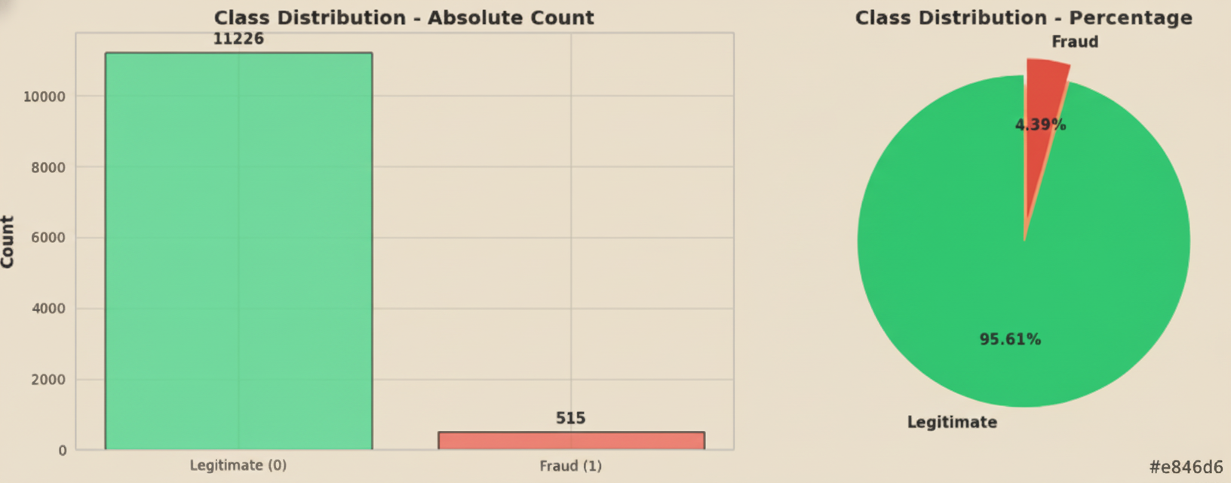
DATASET INTRODUCTION
Dataset Structure
Target Variable
Data Files
Component | Details
Total Customers | 11,741
Total Invoices | 194,512 invoices
Invoices per Customer | 5-30 (mean: 16.56)
Time Period | Multi-year historical data
Fraud Cases: 515 (4.39%)
Legitimate Cases: 11,226 (95.61%)
Class Imbalance Ratio: 21.8:1 ⚠️
client.csv: Customer demographics (5 features)
invoice.csv: Transaction records (12 features)
Notes:
The most significant challenge we faced is the severe class imbalance—with fraud representing only 4.39% of cases.
This creates a critical problem: a model that simply predicts 'legitimate' for everyone would achieve 95.6% accuracy while catching absolutely zero frauds!
Clearly, accuracy is a useless metric here.
To address this, we used several specialized techniques including class weighting, threshold tuning, and carefully selected evaluation metrics like ROC-AUC.

Slide 8
Data Exploration: What We Discovered
1. Category Analysis - Critical Finding:
Category | Total Customers | Fraud Cases | Fraud Rate
Category 11 | 11,406 (97%) | 479 | 4.20%
Category 51 | 118 (1%) | 22 | 18.64% 🔴
Category 12 | 217 (2%) | 14 | 6.48%
Notes:
Our exploratory analysis revealed several crucial patterns.
First, Category 51 customers showed a fraud rate of 18.64%—more than four times the baseline rate.
This became a critical feature for our model.

Slide 9
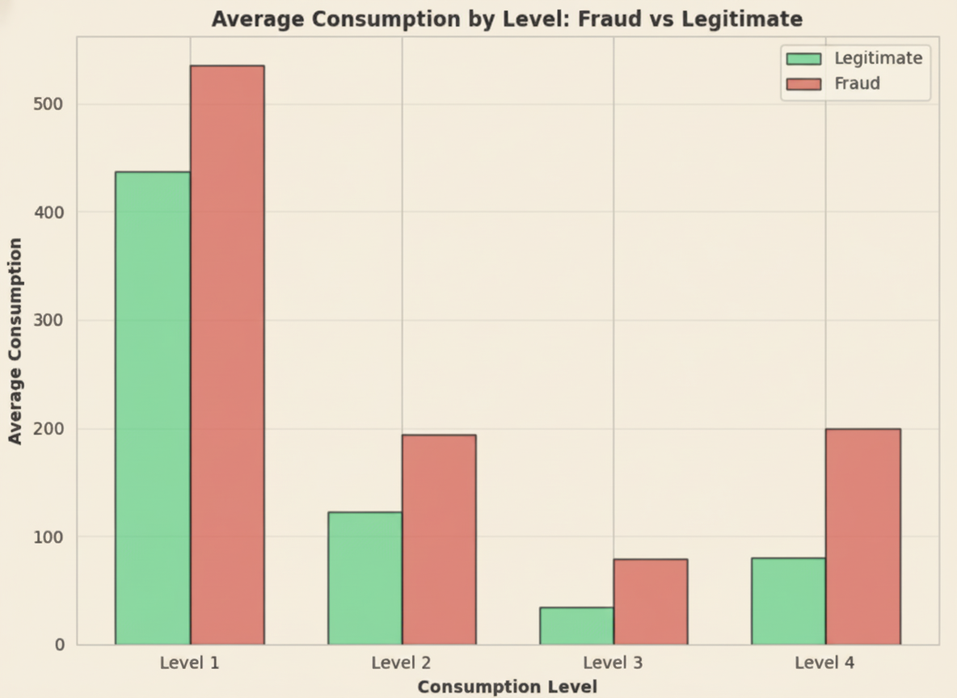
Data Exploration: What We Discovered
2. Consumption Patterns
Fraud: 37% higher mean consumption than legitimate
Fraud: Higher variability (std, CV, IQR all elevated)
Fraud: More usage of high consumption tiers (levels 3-4)
Notes:
Second, fraudulent customers exhibited 37% higher consumption on average with much greater variability,
Suggesting that they have extreme usage patterns.

Slide 10
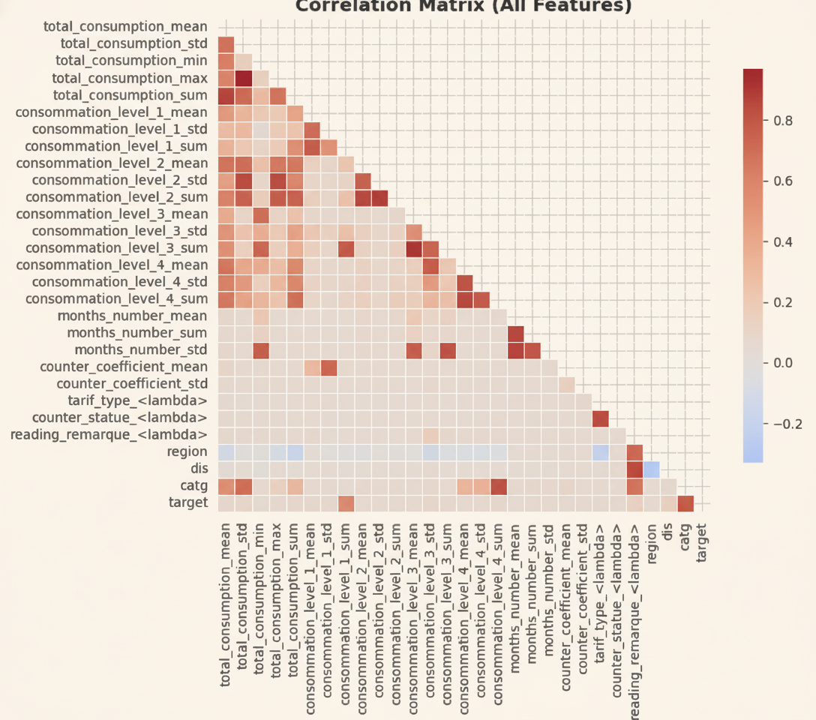
Data Exploration: What We Discovered
3. Weak Feature Correlations
Highest correlation with fraud: 0.105 ⚠️
No single "smoking gun" feature
Solution: Combine multiple weak signals
Notes:
However, we also discovered that no single feature strongly predicts fraud—the highest correlation was only 0.105.
This meant we needed to engineer features that could combine these weak signals effectively.

Slide 11
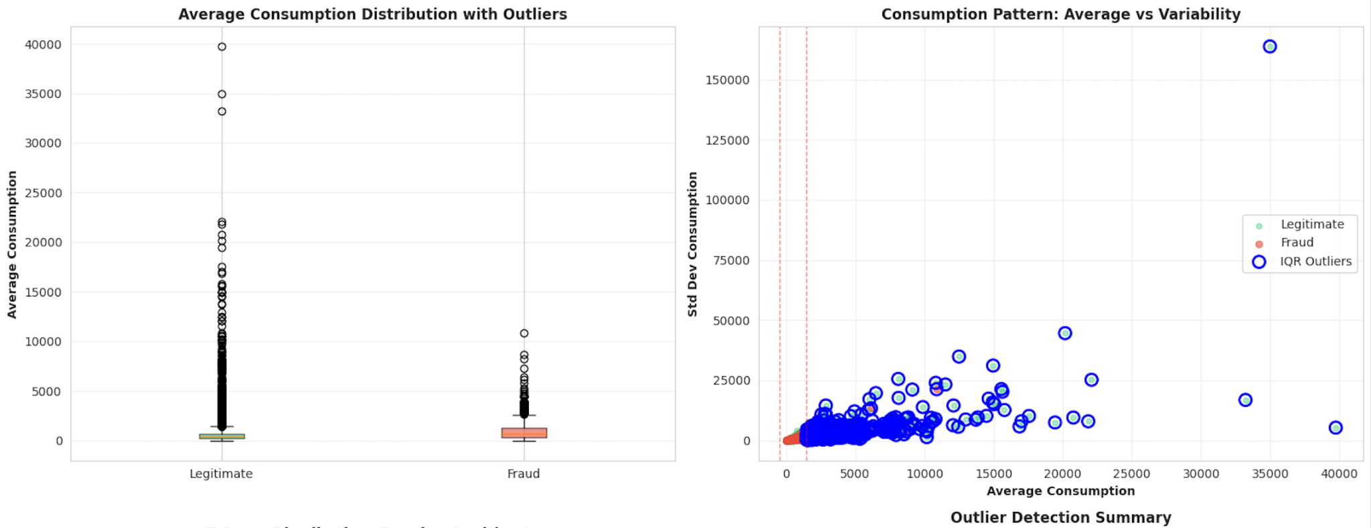
Data Exploration: What We Discovered
4. Outlier Detection
Extreme consumption: Up to 57,495 kWh detected
99th percentile: 6,313 kWh (cap threshold)
Notes:
We also identified extreme outliers, with maximum consumption reaching 57,000 kilowatt-hours, which required special handling.

Slide 12
02
Methodology
Data Prep, Modeling, Tuning, Evaluation

Slide 13
DATA PREPROCESSING PIPELINE
OUTLIER HANDLING
WINSORIZATION
DATA QUALITY CHECKS
- Capped extreme values at 99th percentile (6,313 kWh)
- Preserves high consumption signal without noise
- Applied before feature engineering
✓ Missing values: 0
✓ Infinite values: 0
✓ Duplicate records: Removed
Clean dataset ready for modeling
FEATURE SCALING
TRAIN-TEST SPLIT
- Method: RobustScaler
- Why: Resistant to outliers (uses median & IQR
- Alternative StandardScaler not suitable (mean/std sensitive to outliers)
Ratio: 80% train (9,392) / 20% test (2,349)
Stratified by target AND category
Maintains 4.39% fraud rate in both sets
Critical: Preserves rare Category 51 distribution
Notes:
Before modeling, we implemented a rigorous preprocessing pipeline.
First, we applied winsorization to cap extreme outliers at the 99th percentile, which preserved the signal that high consumption matters while removing noise.
We then verified data quality—zero missing values, zero infinites, perfectly clean.
For scaling, we chose RobustScaler over the standard scaler because it uses median and IQR, making it resistant to the remaining outliers in our data.
Finally, we performed a stratified train-test split, stratifying by both target AND category to ensure our rare but important Category 51 customers appeared in both sets.
This attention to detail in preprocessing proved critical for model performance.

Slide 14
Feature Engineering
From 17 to 110 Features
Statistical Aggregates
40 features
Consumption Patterns
15 features
Consumption Level Features
25 features
Billing Patterns
12 features
Temporal Features
15 features
Categorical Encoding
3 features
Result: 110 Rich Features capturing diverse behavioral patterns
Notes:
Feature engineering was absolutely critical to our success. The fundamental challenge was that each customer has between 5 and 30 invoices—we needed to aggregate this variable-length transaction data into a single customer profile. We created 110 features from the original 17, organized into six categories.
Statistical aggregates like mean and standard deviation captured consumption levels and variability.
Consumption pattern features identified spikes and irregularities.
Billing patterns captured irregularity in payment cycles.
Temporal features tracked customer tenure and activity patterns.
And critically, we created a binary flag for Category 51 customers, which we know have 4x higher fraud rates.
This comprehensive feature engineering transformed weak individual signals into a strong collective predictive power.

Slide 15
Challenges We Overcame
Challenge | Our Solution
Severe class imbalance (22:1) | Class weighting + threshold tuning + ROC-AUC metric
Weak feature correlations (<0.11) | Engineer 110 features to combine weak signals
Variable invoices per customer (5-30) | Statistical aggregation + pattern features
Extreme outliers (57,495 kWh) | Winsorization at 99th percentile
Rare high-risk categories (Category 51: 1%) | Stratified split + binary encoding
Notes:
If asked about challenges: We faced several significant challenges.
The 22-to-1 class imbalance required specialized techniques like class weighting and ROC-AUC evaluation.
Weak correlations meant no easy answers—we had to engineer over 100 features to combine weak signals.
Variable-length transaction histories required creative aggregation strategies.
And extreme outliers needed careful handling to preserve signal without adding noise.
Each challenge was met with a targeted solution that contributed to our final model's success.

Slide 16
MODELING
Goal:
To develop machine learning models that accurately detect fraudulent customers while managing class imbalance.
Key Focus:
Define the problem as binary classification
Establish baseline and advanced models
Notes:
“In this part of the project, our goal was to develop machine learning models that can accurately detect fraudulent customers while managing class imbalance.
As Prasad mentioned just now, fraud detection is challenging because the number of fraud cases is much smaller than legitimate ones. So, our modeling process needed to handle this imbalance carefully while still maintaining good accuracy.
Our key focus areas were:
Defining fraud detection as a binary classification problem, where each case is either fraud or non-fraud
Establishing both baseline models and advanced models to compare different approaches.
In this stage, we tested a wide range of models, starting from simple to more complex techniques.

Slide 17
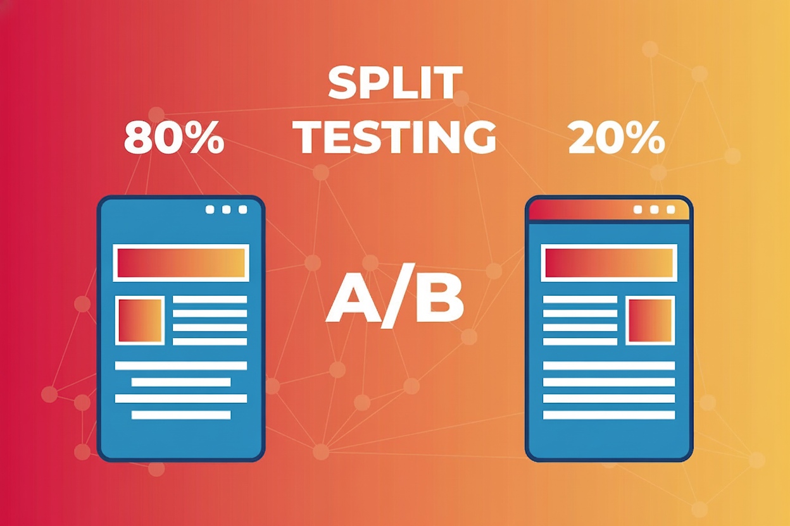
Stratified Data Split
Method:
Used Perfect Stratified Train–Test Split to keep the same fraud-to-non-fraud ratio across datasets.
Why It’s Important:
Prevents bias from uneven data distribution.
Ensures consistent and reliable evaluation between training and testing phases.
Notes:
Before training our models, we used a Perfect Stratified Train–Test Split.This step is really important because our dataset is highly imbalanced — there are far fewer fraud cases compared to normal ones.
By using stratification, we ensure fairness and consistency across both datasets, so the model’s performance is evaluated under realistic and balanced conditions.”

Slide 18

Baseline Models
Models Tested:
Random Classifier (for reference)
Logistic Regression (simple linear baseline)
Purpose:
Establish baseline metrics (AUC, Precision, Recall, F1).
Measure improvement from more complex models later.
Key Point:
→ Baseline key metrics scores helped set a realistic benchmark for model progress.
Notes:
Before testing complex models, we started with two baseline models — the Random Classifier and Logistic Regression.
The Random Classifier, also called the majority class predictor, is a very simple reference model that always predicts the most common class
Next, we used Logistic Regression, which assumes a linear relationship between the features and fraud likelihood. It’s simple, interpretable, and widely used in fraud detection.
Together, these two baselines allowed us to establish key metrics — AUC, Precision, Recall, and F1-score — and set a realistic benchmark for measuring how much improvement our more advanced models achieved later on.

Slide 19
🌳 Tree-Based Models
Models Used:
Random Forest (RF) with class weighting
XGBoost with scale_pos_weight to handle imbalance
Why These Models:
Handle non-linear relationships effectively.
Provide feature importance for interpretability.
Naturally resistant to overfitting with proper tuning.
Notes:
Next, we used two tree-based models — Random Forest and XGBoost.
Random Forest captures non-linear patterns and is resistant to overfitting, especially with class weighting to handle imbalance.
XGBoost uses gradient boosting and scale_pos_weight to improve sensitivity to fraud cases.
provide feature importance, helping us understand which factors influence fraud detection most.
Provide feature importance for interpretability.
Naturally resistant to overfitting with proper tuning.

Slide 20

Advanced Models
Models Used:
LightGBM – optimized gradient boosting for faster training.
High efficiency, handles large datasets quickly.
Isolation Forest – unsupervised anomaly detection to capture rare fraud patterns.
It can detect anomalies without needing labeled data, complementing supervised models.
Combination Approach:
→ Ensemble of LightGBM and Isolation Forest improved detection robustness.
Notes:
We also tested advanced models — LightGBM and Isolation Forest.
LightGBM is an optimized gradient boosting model that’s fast, efficient, and well-suited for large datasets, giving us strong performance with shorter training time.
Isolation Forest works differently — it’s an unsupervised anomaly detection model that identifies rare or unusual patterns without needing labeled data.
By combining both models, we created an ensemble approach that improved detection robustness, capturing both common and rare fraud cases effectively.

Slide 21
K-Fold Cross-Validation
Method:
Used Stratified K-Fold (k=5) to maintain class ratio in every fold.
Why It’s Important:
Ensures reliability and consistency of results.
Reduces overfitting by testing models on multiple data subsets.
Notes:
“To ensure our results were consistent and reliable, we used Stratified K-Fold Cross-Validation with k equals 5.
This means the dataset was split into five parts, each keeping the same fraud-to-non-fraud ratio.
The model was trained and tested five times, with a different fold used for testing each time.
This approach helps reduce overfitting and ensures the model performs well across different data subsets, not just one specific split.”

Slide 22
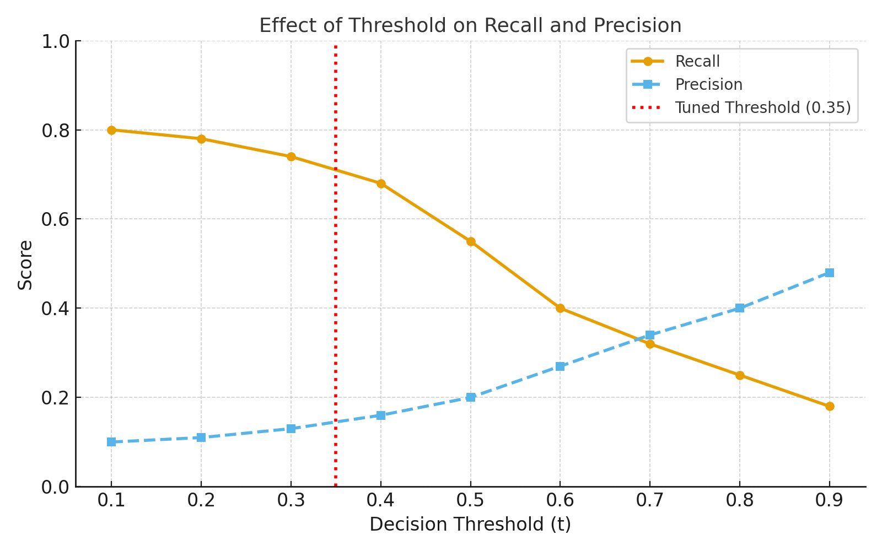
Threshold Tuning
Classification models output probability between 0 and 1
A decision threshold determines the cut-off point above which a client is predicted as fraudulent.
The default threshold (0.5) is not always optimal—especially in imbalanced datasets, where genuine and fraudulent clients are unevenly represented.
Threshold tuning involves selecting a probability cutoff that better aligns with business priorities—
e.g., maximizing Recall to detect more fraud, or maximizing Precision to reduce false alarms.
By analyzing how Precision and Recall trade off at different cut-offs, the ideal threshold can be chosen to balance accuracy and operational cost.
Notes:
Threshold tuning helps convert probabilistic model outputs into actionable decisions.
In fraud detection, it ensures the model catches more genuine fraud cases while keeping investigation costs sustainable.
It bridges the gap between statistical accuracy and operational practicality.

Slide 23
Hyperparameter Tuning
Hyperparameters are configuration settings that govern how a model learns (e.g., tree depth, number of estimators, learning rate).They are not learned from the data but must be set before training.
Tuning is the process of finding the best combination of these parameters to maximize the model’s performance and generalization ability.
In machine-learning pipelines, hyperparameter tuning acts like fine-tuning the “control knobs” that determine model complexity, speed, and accuracy.
Notes:
Hyperparameter tuning is like calibrating an instrument — small adjustments can make a large difference.
By fine-tuning parameters systematically, our models became more generalizable and reliable in identifying fraudulent patterns hidden in noisy utility data.
It bridges the gap between statistical accuracy and operational practicality.

Slide 24
Ensemble Models
Ensemble models combine predictions from multiple base learners to produce a more robust and accurate final output.
Instead of relying on a single model (which may overfit or underperform on certain patterns), ensembles leverage diversity among models to reduce both variance and bias.
Bagging
Boosting
Voting
Notes:
Ensemble models operate on the principle that combining multiple weak or moderately strong models produces a more reliable overall predictor.In our project, this approach minimized overfitting and improved robustness — allowing the model to detect subtle fraud signals across varying client behaviors.
Fraud detection is challenging because the number of fraud cases is much smaller than legitimate ones. So, our modeling process needed to handle this imbalance carefully while still maintaining good accuracy.
Our key focus areas were:
Defining fraud detection as a binary classification problem, where each case is either fraud or non-fraud.
Establishing both baseline models and advanced models to compare different approaches.
We began by framing fraud detection as a two-class problem before testing and refining multiple models to find the most reliable one.”

Slide 25
Model Evaluation Metrics
Precision
Recall
High precision = fewer false alerts
Measures how many of the clients flagged as fraudulent were actually fraud.
High recall = fewer missed frauds
Indicates how many actual fraud cases were correctly detected by the model.
F1-Score
AUC
Useful when false negatives and false positives both carry costs.
Balances Precision and Recall into a single score.
Higher AUC = better discrimination.
Evaluates how well the model separates fraudulent clients from legitimate ones, across all thresholds.

Slide 26
Why AUC and Recall Were Prioritized
AUC chosen as main evaluation metric because it is threshold-independent, reflecting how well the model ranks fraud vs non-fraud clients across all cutoffs.
It measures discrimination power rather than performance at one fixed
threshold.
Recall chosen as secondary metric because missing a fraud is costlier than incorrectly flagging a genuine client.
Prioritizing Recall ensures operational success even if Precision slightly
Decreases.
This combination aligns with business objectives
AUC → model quality,
Recall → practical fraud detection effectiveness.
Notes:
We evaluated our models using four key metrics.
While Precision and F1 give insight into accuracy and balance, AUC and Recall are most critical for business performance.
AUC reflects ranking capability across all thresholds, while Recall ensures that the model catches the majority of frauds — directly tied to operational savings and fraud recovery.
It bridges the gap between statistical accuracy and operational practicality.

Slide 27
03
RESULTS
Notes:
Now we are all sitting at the edge of our seats, wondering which model performed best
But lets look at the result of our baseline models first!

Slide 28
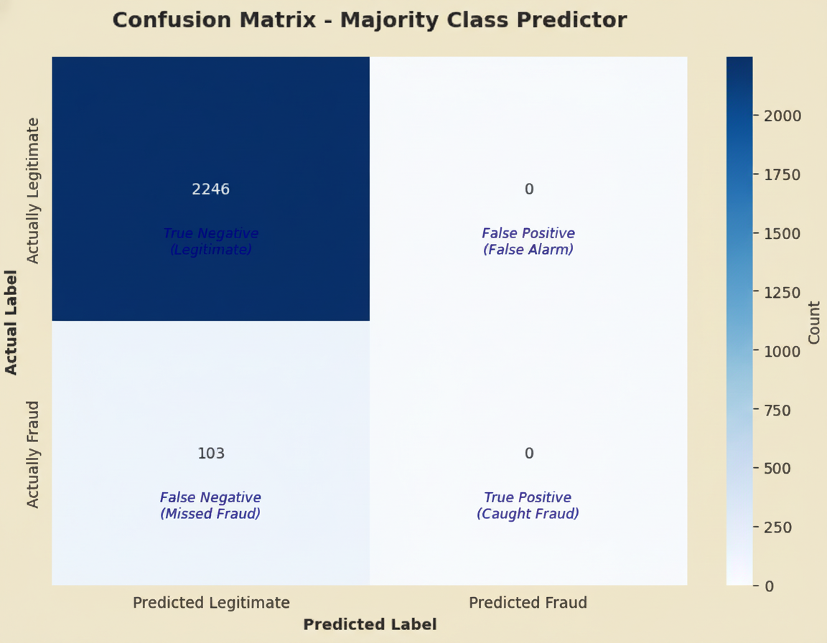
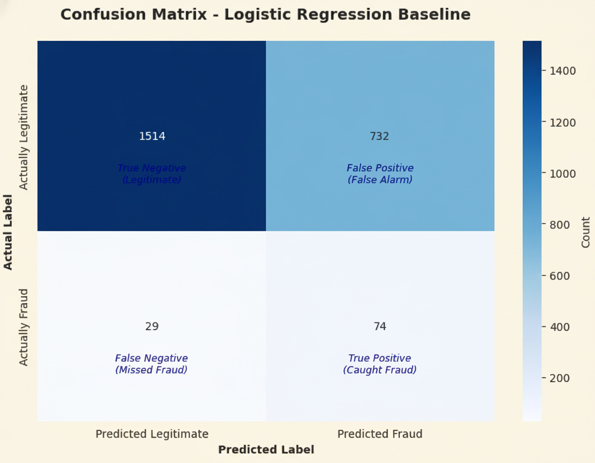
Baseline Models : Good as Silo, Poor as Aggregate
Majority Class Predictor:
Predicts all cases as Not Fraud
High Accuracy, Zero Recall/Precision
Simple Logistic Regression:
Predicts 74% of Frauds, but
Poor Precision at 9%
Notes:
Not a drastic difference in AUC score between the

Slide 29
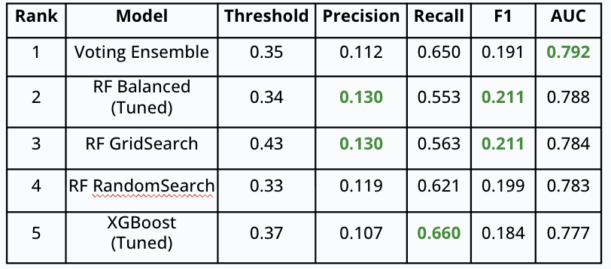
Top 5 Models : Voting Ensemble Wins
XGBoost
(Tuned)
RF Balanced
(Tuned)
RF Grid- Search
RF Random- Search
Voting
Ensemble
Worst performing
Best performing
AUC
0.777
0.783
0.784
0.788
0.792
Recall
0.553
0.563
0.621
0.650
0.660
Precision
0.107
0.112
0.119
0.130
#e8e6d6
F1
0.184
0.191
0.199
0.211
#feb530
#191919
#f46123
#1f8e2e
#2e83c7
Notes:
And the winner is Voting Ensemble - Seems the best of everything is indeed the best

Slide 30
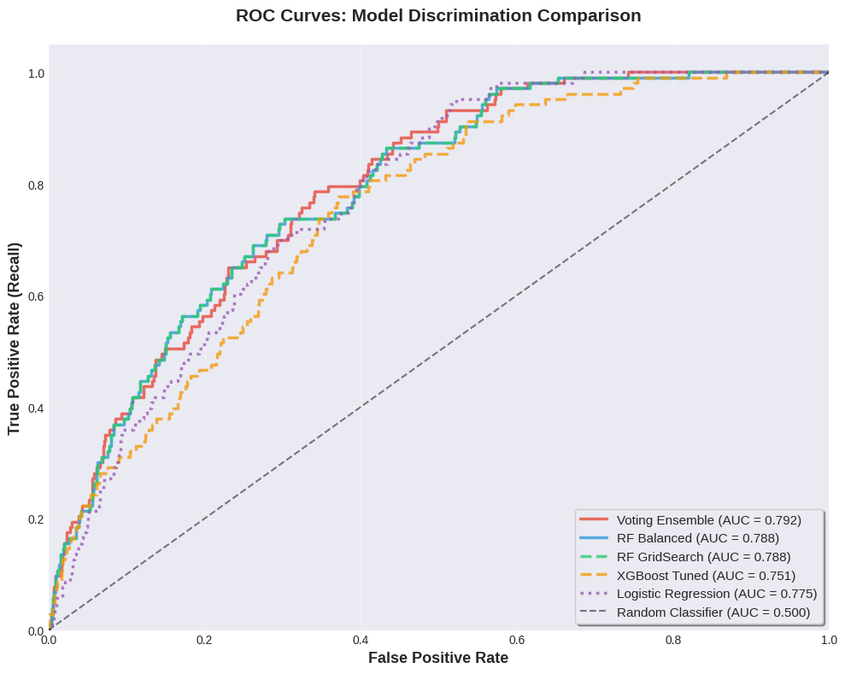
ROC - AUC : Bend it like (Sir) Beckham
Voting Ensemble has the largest area under the curve >> AUC = 0.792
AUC Curves for all models are good, even for Logistic Regression baseline, implying good feature engineering
Notes:
Not a drastic difference in AUC score between the

Slide 31
04
Business Impact
Notes:
All that is good - but what does it mean in the Real World?
Time is Money - but Money is also Money
Lets look at how

Slide 32
Business Impact: Customer Risk Tier
 | Probability of Fraud
CRITICAL | >= 0.5
HIGH | >= 0.35
MEDIUM | >= 0.25
LOW | >= 0.15
VERY LOW | < 0.15
Classify customers based on the risk of them committing Fraud
Risk of Fraud
Threshold can be defined by the Utilities Company themselves.
Trade-off between Risk and Cost

Slide 33
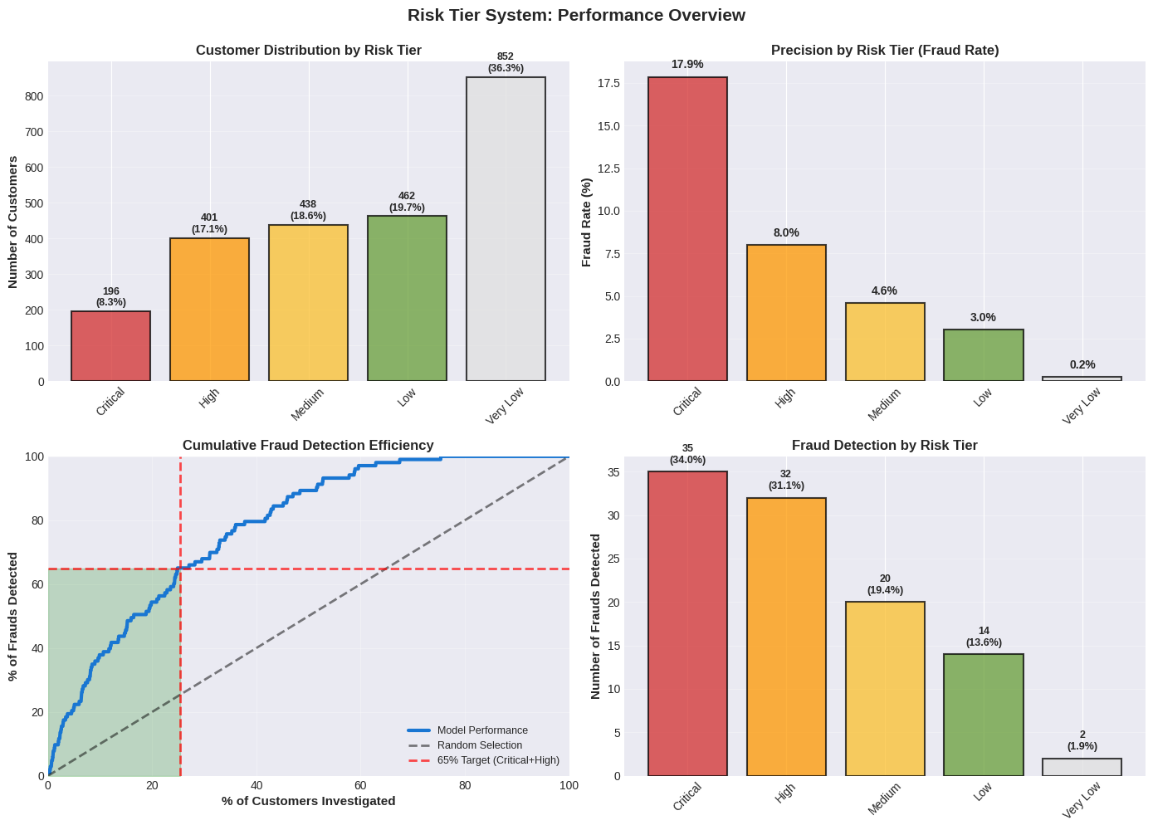
Minimise Cost, Maximize Results
65%
25%
25%
65%
Frauds
Committed
in just
Critical & High Risk Customers

Slide 34
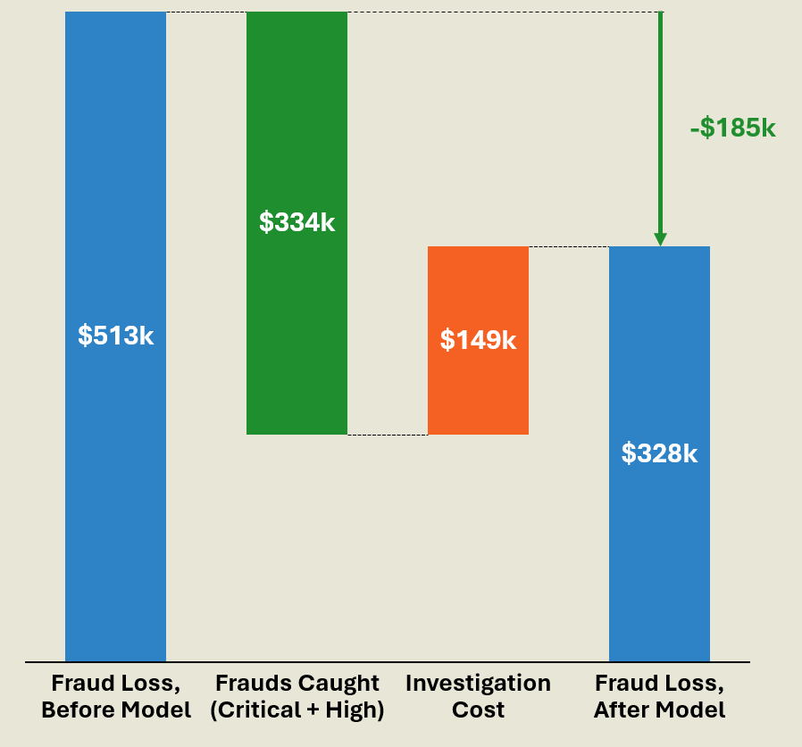
Savings thru Fraud Detection
$185,000
Amount Saved by Implementing Model based on Critical + High Risk Customers alone
Should we Maximise Number of Frauds Detected at all cost?
Diminishing Returns

Slide 35
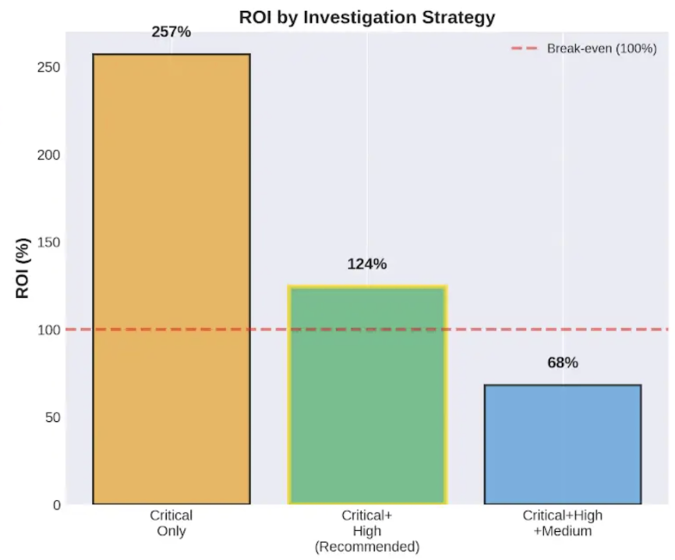
Return of Investment (ROI) - Business Decides

Slide 36
THANKS!
Do you have any questions?
youremail@freepik.com
+91 620 421 838
yourwebsite.com
Please keep this slide for attribution

Slide 37
Instructions for use
If you have a free account, in order to use this template, you must credit Slidesgo by keeping the Thanks slide. Please refer to the next slide to read the instructions for premium users.
As a Free user, you are allowed to:
Modify this template.
Use it for both personal and commercial projects.
You are not allowed to:
Sublicense, sell or rent any of Slidesgo Content (or a modified version of Slidesgo Content).
Distribute Slidesgo Content unless it has been expressly authorized by Slidesgo.
Include Slidesgo Content in an online or offline database or file.
Offer Slidesgo templates (or modified versions of Slidesgo templates) for download.
Acquire the copyright of Slidesgo Content.
For more information about editing slides, please read our FAQs or visit our blog:
https://slidesgo.com/faqs and https://slidesgo.com/slidesgo-school

Slide 38
Instructions for use (premium users)
As a Premium user, you can use this template without attributing Slidesgo or keeping the Thanks slide.
You are allowed to:
Modify this template.
Use it for both personal and commercial purposes.
Hide or delete the “Thanks” slide and the mention to Slidesgo in the credits.
Share this template in an editable format with people who are not part of your team.
You are not allowed to:
Sublicense, sell or rent this Slidesgo Template (or a modified version of this Slidesgo Template).
Distribute this Slidesgo Template (or a modified version of this Slidesgo Template) or include it in a database or in any other product or service that offers downloadable images, icons or presentations that may be subject to distribution or resale.
Use any of the elements that are part of this Slidesgo Template in an isolated and separated way from this Template.
Register any of the elements that are part of this template as a trademark or logo, or register it as a work in an intellectual property registry or similar.
For more information about editing slides, please read our FAQs or visit our blog:
https://slidesgo.com/faqs and https://slidesgo.com/slidesgo-school

Slide 39
Fonts & colors used
This presentation has been made using the following fonts:
Raleway
(https://fonts.google.com/specimen/Raleway)
Open Sans
(https://fonts.google.com/specimen/Open+Sans)
#e8e6d6
#feb530
#f46123
#1f8e2e
#2e83c7
#191919

Slide 40





Storyset
Create your Story with our illustrated concepts. Choose the style you like the most, edit its colors, pick the background and layers you want to show and bring them to life with the animator panel! It will boost your presentation. Check out how it works.
Pana
Amico
Bro
Rafiki
Cuate

Slide 41
Use our editable graphic resources...
You can easily resize these resources without losing quality. To change the color, just ungroup the resource and click on the object you want to change. Then, click on the paint bucket and select the color you want. Group the resource again when you’re done. You can also look for more infographics on Slidesgo.

Slide 44
JANUARY
FEBRUARY
MARCH
APRIL
MAY
JUNE
PHASE 1
Task 1
Task 2
PHASE 2
Task 1
Task 2
JANUARY
FEBRUARY
MARCH
APRIL
PHASE 1
Task 1
Task 2

Slide 47
...and our sets of editable icons
You can resize these icons without losing quality.
You can change the stroke and fill color; just select the icon and click on the paint bucket/pen.
In Google Slides, you can also use Flaticon’s extension, allowing you to customize and add even more icons.

Slide 48
Educational Icons
Medical Icons

Slide 49
Business Icons
Teamwork Icons

Slide 50
Help & Support Icons
Avatar Icons

Slide 51
Creative Process Icons
Performing Arts Icons

Slide 52
Nature Icons

Slide 53
SEO & Marketing Icons

