Slide 1
Retail Sales Analysis: Identifying Top Products and Market Patterns
BY :- Nitin Dukare (Certified Data Analyst)

Slide 2
Bussines Problem :-
A retail company wants to maximize sales and profitability by identifying top-performing products, sub-categories, and categories. It also aims to analyze regional sales trends across regions, states, and cities, and detect seasonal patterns using order and shipping dates. The goal is to optimize inventory, marketing, and overall business strategy based on these insights.

Slide 3
Data Cleaning –
Handled missing values in Gender , Age , Payment Methods and Ratings.
Removed duplicate records to avoid skewed analysis.
Corrected data types and numeric columns to proper number types.
Detected and treated outliers in Sales and Profit using appropriate methods.
Standardized categories and region names for consistency.
Ensured overall data consistency for accurate reporting and insights.

Slide 4
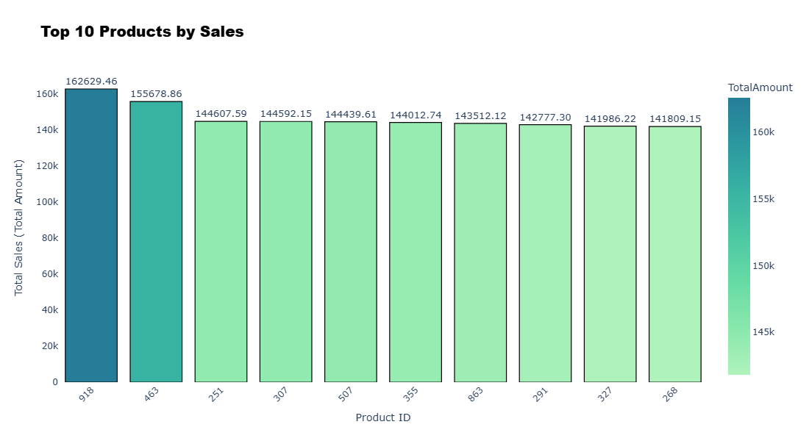
Observation :-
- Product 918 Generated the highest revenue ( ₹162,629 ),followed closely by 463 and 251.
- Sales across the top 10 products are fairly even, showing a balanced performance,It is Good for Bussiness.
- Products 251 and 268 sold in high quantities, likely lower-priced, Popular items.-
Product 918 generated strong revenue with moderate sales, suggesting it’s a premium item.
- Recommendation: Keep a close eye on inventory for these key products to maintain revenue.

Slide 5
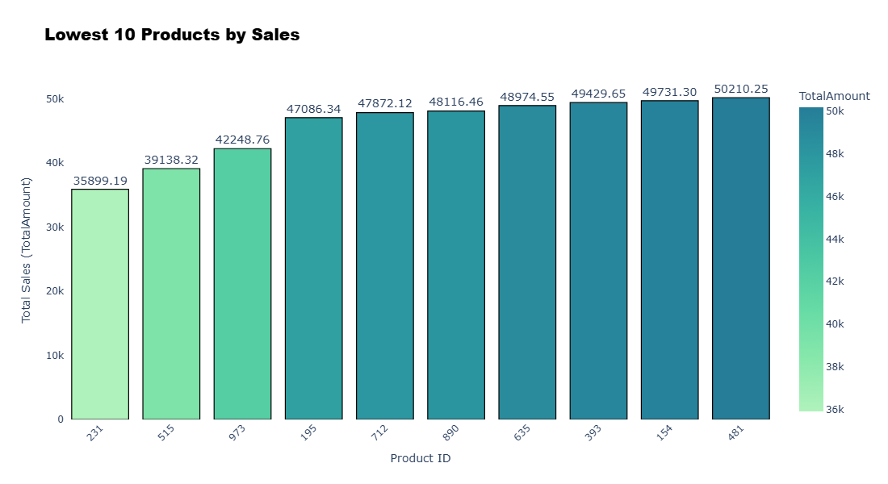
Observation:-
- These products recorded the lowest total sales, indicating limited customer demand or low visibility.
- Sales values are closely clustered, suggesting overall weak performance across all bottom products.
- Some products show low quantity and low revenue, hinting at poor demand or discontinuation potential.
- Focus on identifying pricing, marketing, or stock issues for these products.
- Recommendation: Consider promotional offers or product review to improve sales performance.

Slide 6
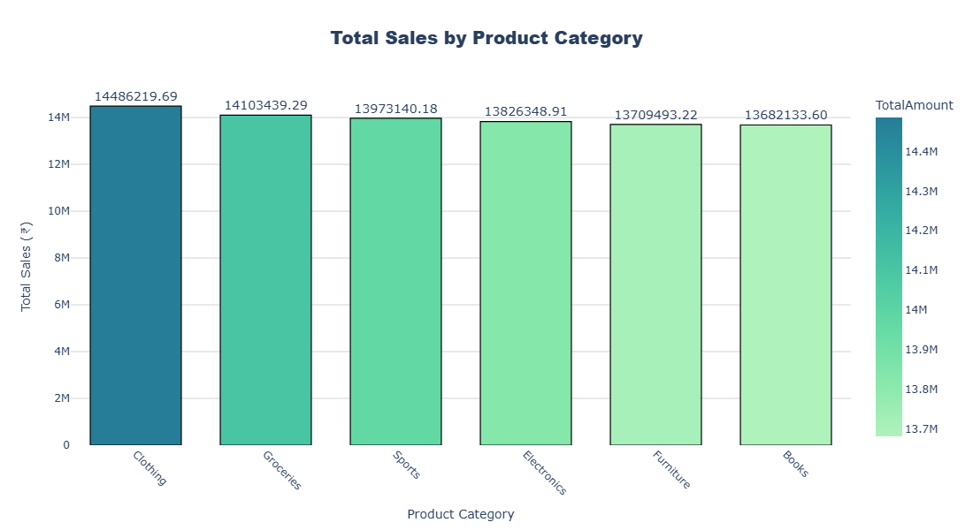
Observation:-
- Clothing leads all categories with the highest sales of ₹14.48M, followed closely by Groceries and Sports.
- The sales gap among all six categories is minimal, showing a well-balanced product mix.
- Clothing and Groceries have both high sales and quantity, reflecting strong, consisten demand.
- Books and Furniture trail slightly but still maintain competitive sales, suggesting steady but moderate performance.
- Overall, the business shows diversified strength across categories, minimizing dependency on any single segment.

Slide 7
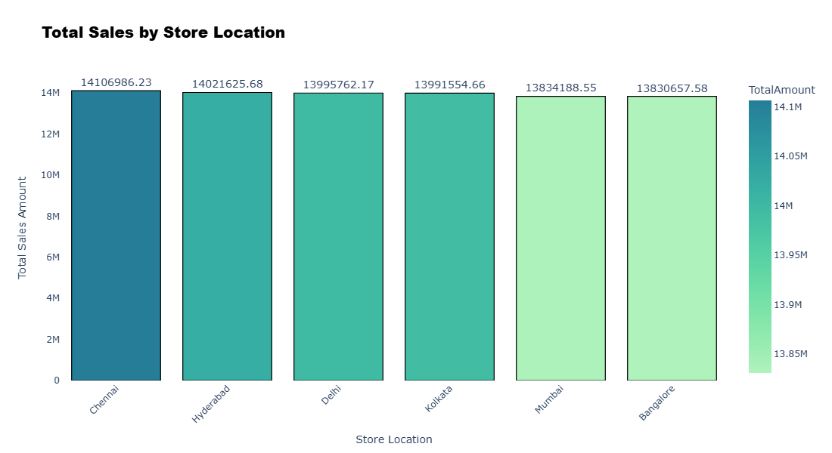
Observation:-
- Chennai leads in total sales and transactions, indicating strong market demand.
- Hyderabad and Delhi closely follow, showing consistent performance across top metros.
- Overall sales across all six cities are very close, reflecting balanced regional distribution.
- Average customer rating is 3 everywhere, suggesting moderate satisfaction and scope for improvement.
- Focus on enhancing customer experience could help boost revenue further in all regions.

Slide 8
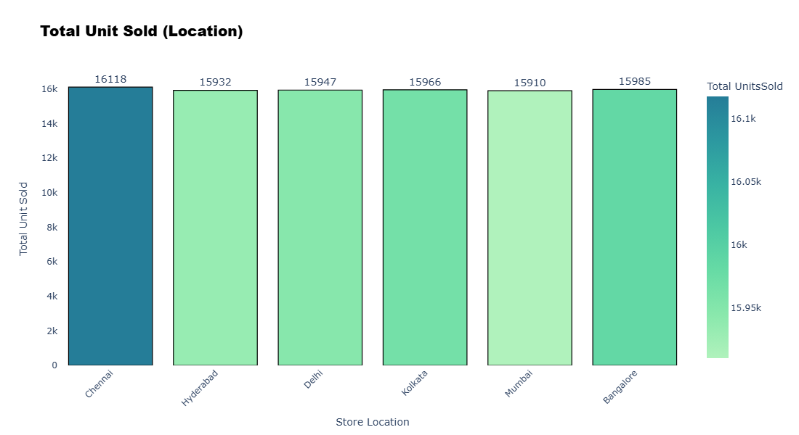
Observation:-
- Chennai leads with the highest units sold (16,118), showing strong product demand.
- Kolkata and Bangalore follow closely, indicating steady customer activity in eastern and southern regions.
- Hyderabad and Delhi show similar sales volumes, reflecting balanced performance across northern and central markets.
- Mumbai has slightly lower units sold, suggesting potential to boost sales with targeted promotions.
- Overall, all cities are performing consistently, highlighting a well-distributed sales network across key metro locations.

Slide 9
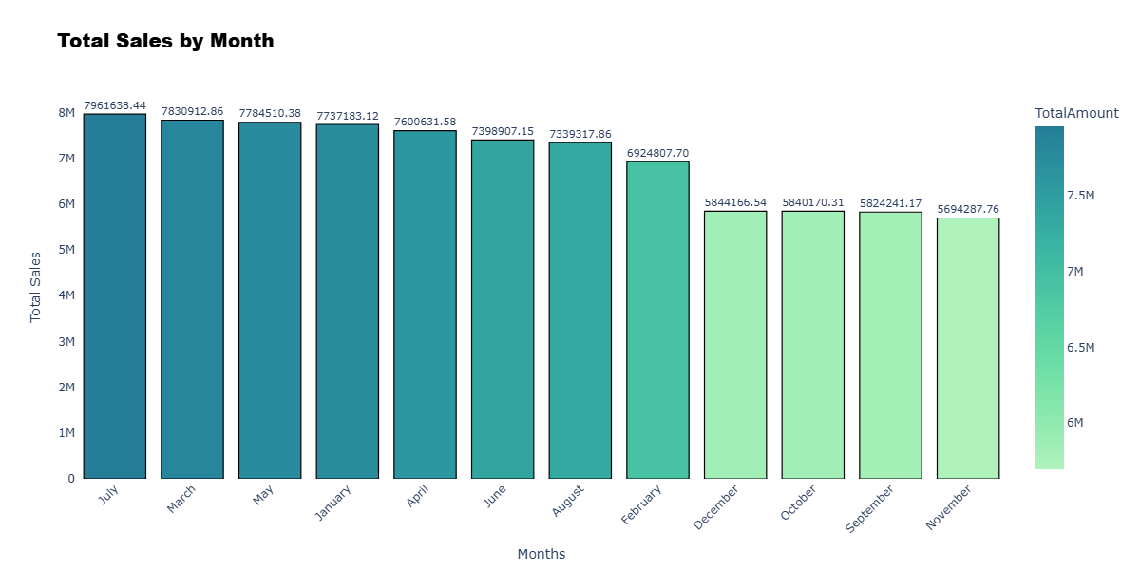
Observation:-
- Peak sales months: July, March, May, and January – strong seasonal demand in the first half of the year.
- Moderate sales months: April, June, and August – stable, mid-range revenue.
- Low sales months: September to December – noticeable decline, with December lower than expected.
- Seasonal trend: Highest revenue occurs in the first half of the year; second half shows slower sales.
- Business insight: Opportunities for targeted promotions, marketing campaigns, and inventory planning during low-performing months.

Slide 10
Business Recommendations :-
1. Product Strategy
Prioritize top products (918, 463, 251) — ensure stock & promote aggressively.
Review bottom 10 products — reprice, bundle, or discontinue low performers.
Maintain mix of premium and high-volume items for balanced growth.
2. Category Focus
Strengthen top categories: Clothing, Groceries, Sports — key revenue drivers.
Revive weak ones (Books, Furniture) via targeted offers or cross-selling.
3. Regional Growth
Chennai, Hyderabad, Delhi: invest in promotions & loyalty programs.
Improve customer experience — ratings of 3 suggest service quality upgrades needed.
4. Seasonal Planning
Stock up & run campaigns in Jan–July (peak months).
Boost Sep–Dec with festive sales and bundle offers to stabilize revenue.
5. Marketing & Operations
Use data-driven promotions & dynamic pricing.
Optimize logistics to ensure fast delivery and consistent stock availability.

