Slide 1
High Volume Updates in Hive
Owen O’Malley
owen@hortonworks.com
@owen_omalley
June 2012

Slide 2
Who Am I?
Was working in Yahoo Search in Jan 2006, when we decided to work on Hadoop.
My first patch went in before it was Hadoop.
Was the first committer added to the project.
Was the first Apache VP of Hadoop.
Won the sort benchmark in 2008 & 2009.
Was the tech lead for:
MapReduce
Security
Now I’m working on Hive

Slide 3
A Data Flood
The customer has:
Business critical
1 TB/day of customer data
Need to keep all historical data
Data size increasing exponentially
Doubles year over year
Lots of derived reports
15% of traffic is updates to old data

Slide 4
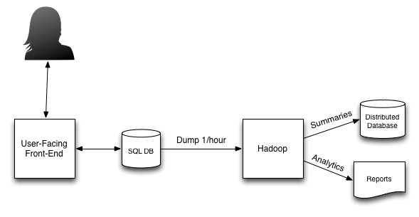
The Dataflow

Slide 5
The Approach
Picked Hive
Wanted a higher-level query language
Hive’s HQL lowers learning curve
Batch processing
But, they have those edits & deletes…
Hive doesn’t update things well
Reflects the capabilities of HDFS
Can add records
Can overwrite partitions

Slide 6
Why not Hbase?
Good
Handles compaction for us
Files are indexed and have Bloom filters
Bad
Push down filters only recently done
Tuned for real-time access
One mapper per a region
HBase has only a single key

Slide 7
Limitations of a Single Key
HBase uses a single key
Stored in sorted order
Divided into regions
For date-based tables
Recent dates are very hot
Hot spot moves
Can Hash to spread load
<10 bit hash><YYYY/MM/DD><id>

Slide 8
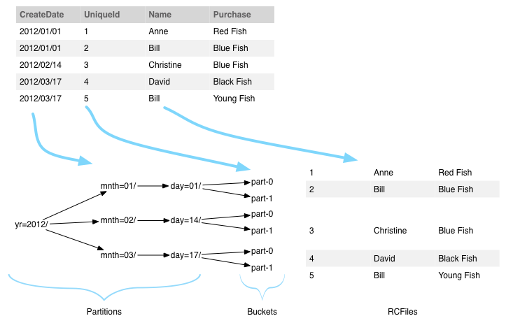
Hive Table Layout

Slide 9
Design
Hive allows tables to specify an InputFormat and OutputFormat
We can store each bucket as a base file and a sequential set of edit files.
To enable efficient reading of a bucket, the base and edits files must be sorted.
Edits must be compacted eventually.

Slide 10
Repeatable Reads
MapReduce handles failures by re-executing failed tasks.
Lost machines also cause re-execution
Some reduces may get output from a different attempt of a lost map.
All queries must only include completed updates.
The update files generated by a single job must contain a consistent timestamp.

Slide 11
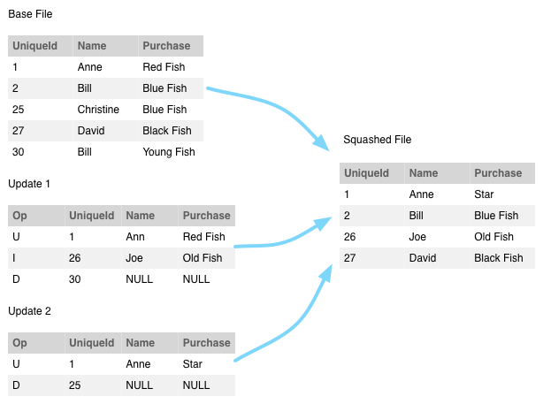
Stitching Buckets Together

Slide 12
Limitations
Requires active component to manage compaction.
Compactions should be scheduled for off-peak hours.
Minor and major compactions
Requires table be sorted.
Must use consistent bucketing.
Only suitable for batch, not real-time

Slide 13
Additional Challenges from Hive
Hive defines its own OutputFormat
Hive serializes before the OutputFormat
Makes inspecting fields difficult
Makes custom serialization difficult
RCFiles compress well, but no index or bloom filters
Supports batch access, but not lookups

Slide 14
Hive’s Output Committer
MapReduce uses OutputCommitters to promote the successful task attempt’s output.
Failure and speculative execution
Hive uses its own OutputCommitter
Runs in submitting process
Uses regex to match task attempts
Picks largest output
Prevents side-files including indexes

Slide 15
Dynamic Partitions
Hive supports updating a lot of partitions dynamically.
Keeps a RecordWriter per a partition.
RecordWriters keep a reference to their compression codec and its buffers.
Updating thousands of partitions uses a lot of RAM.
Snappy codec seems worse than LZO.

Slide 16
Conclusion
Provides scalable read and write access.
Less resource intensive than HBase.
Still in Development
The approach is scalable
Naturally bumps still hidden in the dark
Testing on samples as data loads
Plan to implement an open source version as a library in Hive.

Slide 17
Thank You!
Questions & Answers

