Slide 1

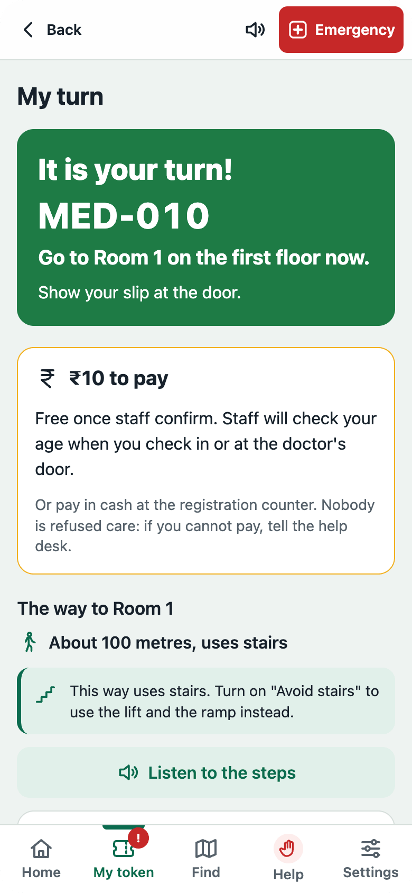
OPD Saathi
Reimagine Government · Hospital queues, sorted
Know your turn. Find your room.
Patients register in Hindi or English, get a token, see how many people are ahead, and are guided to the right room. Staff see the whole OPD live, and the busy days coming.
[Team name] · [Member 1], [Member 2], [Member 3]
Real app screen, sample data
Notes:
WHAT TO SAY (about 15 seconds)
Hi, we are [team name]. This is OPD Saathi, for the "Hospital queues, sorted" problem in Reimagine Government. Saathi means companion: from the gate to the doctor’s door, the patient always knows their turn and the way to their room.
BEFORE YOU SUBMIT
Replace [Team name] and the member names. The phone is a real screenshot of the app (sample hospital data).

Slide 2


Long waits for a five-minute visit
62%
A morning at a busy OPD today
1
Queue at the counter just to get a slip
of patients surveyed at J&K’s big (tertiary) hospitals waited over 30 minutes to see a doctor
2
Wait without knowing how many are ahead
58%
3
Hunt for the room, the lab or the X-ray
of OPD patients in J&K were examined by a doctor for less than five minutes
4
Miss your name being called, and start again
Source: CAG of India, Report No. 2 of 2025 (Jammu & Kashmir), Public Health Infrastructure and Management of Health Services: a survey of 750 outpatients, and OPD records for 2016–22.
Notes:
WHAT TO SAY (about 30 seconds)
Anyone who has taken a parent to a government OPD knows this morning: a queue for the slip, then a long wait with no idea how many people are ahead, then hunting for the room, and if you step away, you miss your name. This is not just a feeling. The CAG audited hospitals here in Jammu and Kashmir. In its survey of 750 outpatients, 62% at the big hospitals waited more than half an hour to see a doctor, and 58% of OPD patients were examined for less than five minutes. Most of the visit is waiting, and the patient cannot tell when their turn is.
SOURCE (have it ready if a judge asks)
CAG of India, Report No. 2 of 2025, Performance Audit on Public Health Infrastructure and Management of Health Services, Government of Jammu & Kashmir (cag.gov.in). Reported in the Daily Excelsior: "CAG flags long waits, short consultations in J&K OPDs". The 62% is patients at tertiary hospitals in the audit’s survey; the 58% is from OPD records, 2016–22.
MAKE IT STRONGER
If you ask 10–20 people yourselves (a WhatsApp poll is enough), add one real quote from someone you asked. Never invent one.

Slide 3
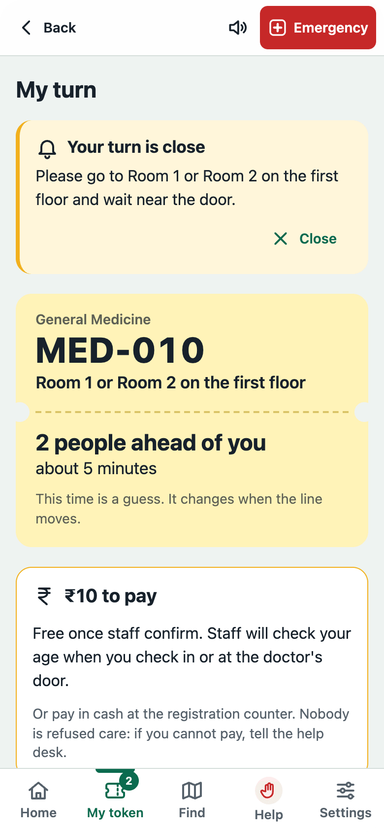

Register once. Know your turn. Find the room.
OPD Saathi gives every patient a token, shows how many people are ahead and about how long it will take, warns them when their turn is close, and gives step-by-step directions to the room.
Hindi or English, by voice or by touch
Works on a basic phone too, by SMS
Emergency is one tap away, and never waits
Real app screen, sample data
Notes:
WHAT TO SAY (about 25 seconds)
OPD Saathi turns the wait into something you can see. You register on your phone and get a token. The phone shows how many people are ahead of you and about how long it will be, and it rings when your turn is close, even with the screen off. Then it walks you to the room, step by step, with landmarks. Point at the phone: this is a real screen. Two people ahead, about five minutes, your turn is close.
It works in Hindi or English, by voice or by touch. Someone with a basic phone can follow the line by SMS. And Emergency is one tap away on every screen: the app never decides whether something is an emergency and never makes anyone wait.

Slide 4
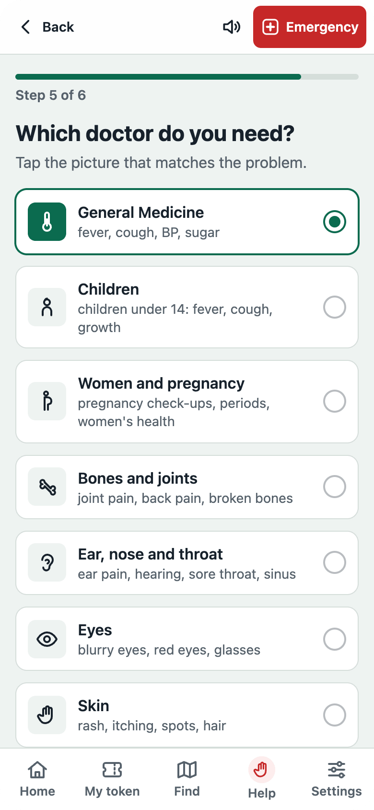
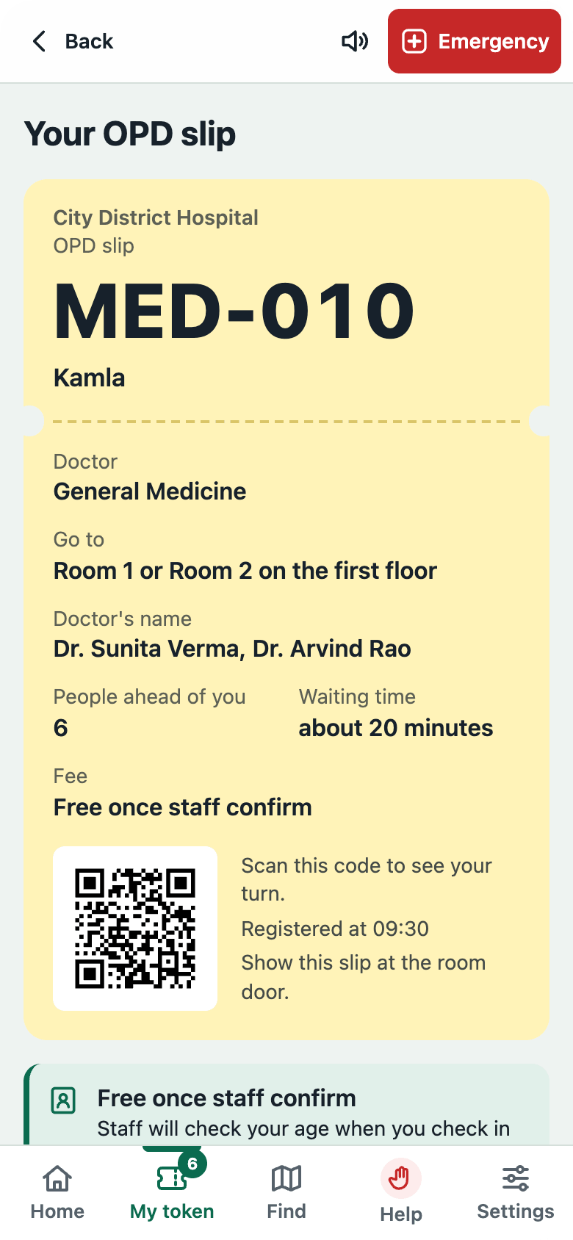
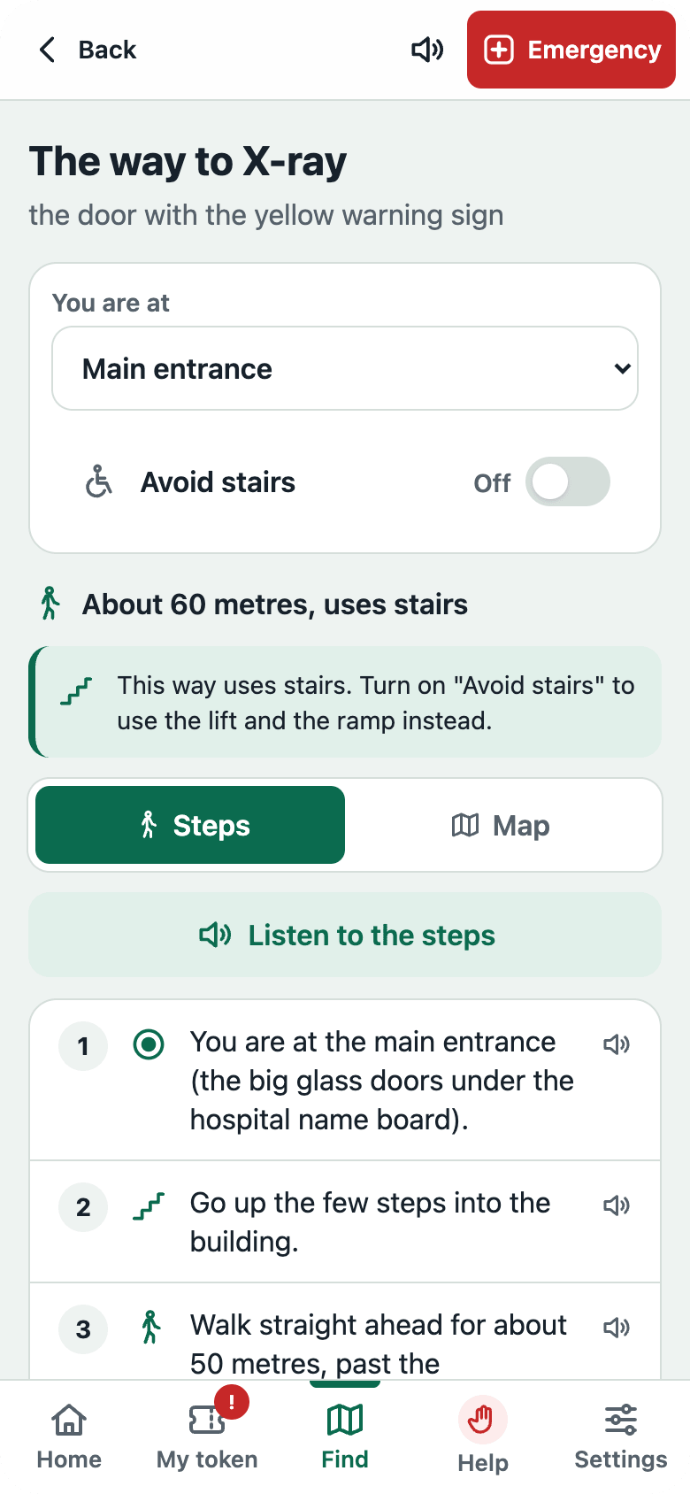
Three steps to the doctor’s door
1
Register in Hindi or English
2
Scan the screen to join the line
3
Get called, then follow the way
Notes:
WHAT TO SAY (about 30 seconds)
One: register in about a minute, in Hindi or English. A quick safety check comes first, so anyone with danger signs goes straight to Emergency. We never ask for Aadhaar or ABHA. A 62-year-old is told her visit should be free, and staff confirm her age at the door.
Two: booking on a phone holds no place. You join the line when you reach the hospital, by scanning the code on the waiting-room screen. The code changes every two minutes, so nobody can hold a place from home, and the line stays fair to people standing in the hospital.
Three: when your turn comes, the phone and the waiting-room TV both call you, and the app shows the way to the room, the lab or the X-ray, with an Avoid stairs option.
All three phones are real screenshots of the app with sample data.

Slide 5
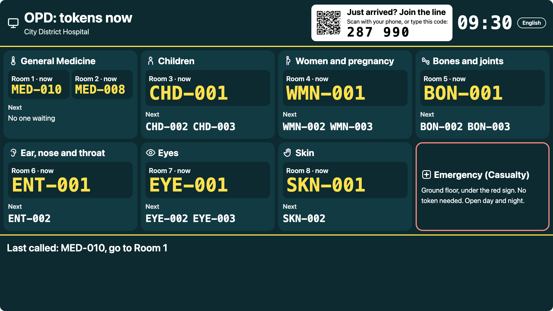
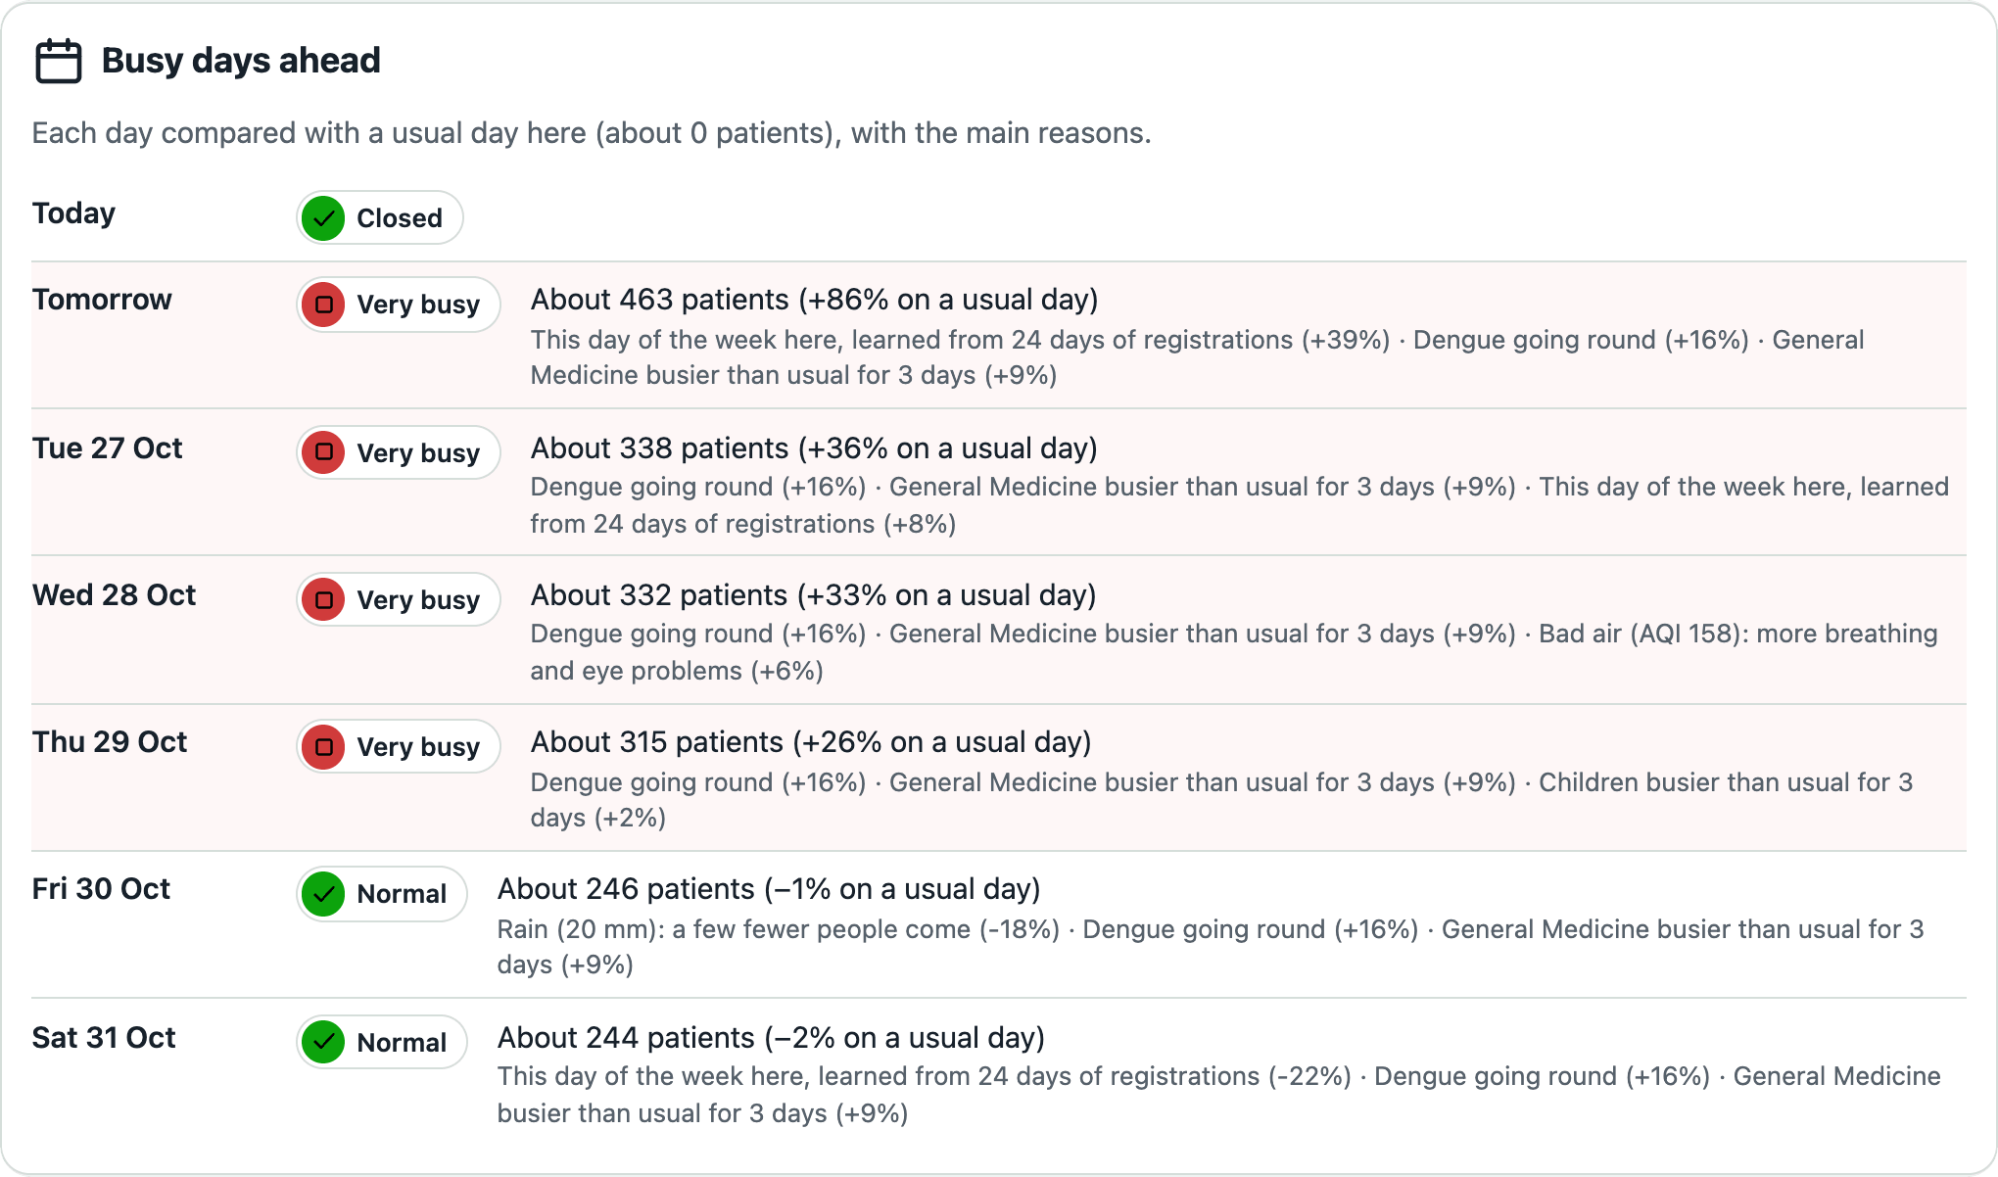


The same live line on every screen
Waiting-room TV
Crowd forecast for staff
Calls each token aloud in Hindi and English. Shows tokens, never names, and the code to join the line.
Learns this hospital’s busy days from weather, air quality, traffic and its own history, so staff can plan ahead.
Notes:
WHAT TO SAY (about 25 seconds)
Patients, the waiting-room TV, the doctors and the front desk all see the same line, live. The TV calls each token aloud in Hindi and English, and shows tokens, never names. On the staff dashboard, an "I need urgent help" request appears in red with an alarm within a second, until someone marks it as seen.
Staff also get a crowd forecast. It uses live weather, air quality and traffic, local alerts such as a dengue outbreak, and this hospital’s own history. It learns, for example, that Mondays are busy and heavy rain keeps people home, so staff know tomorrow will be very busy and can open an extra counter.
Both pictures are real screens from the app with four weeks of sample history.

Slide 6
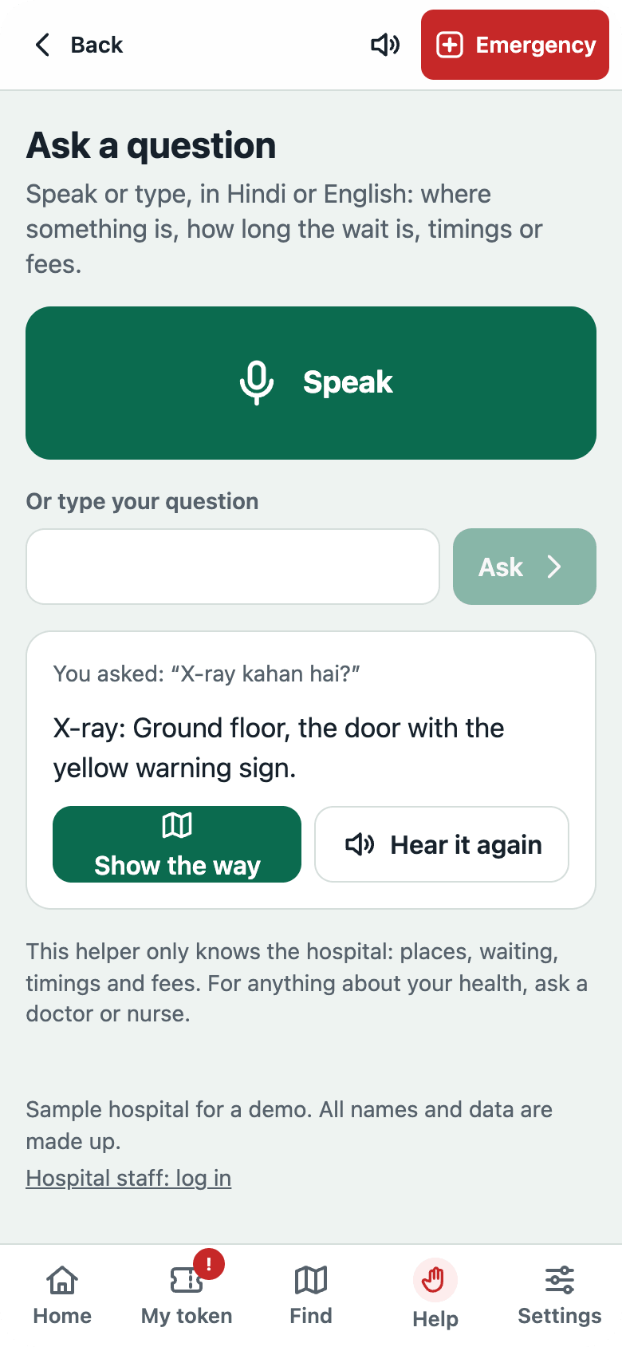
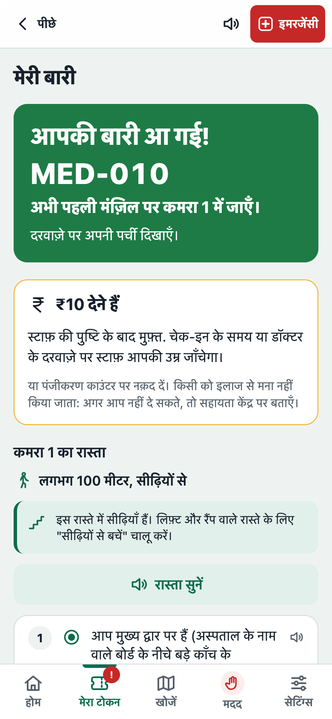
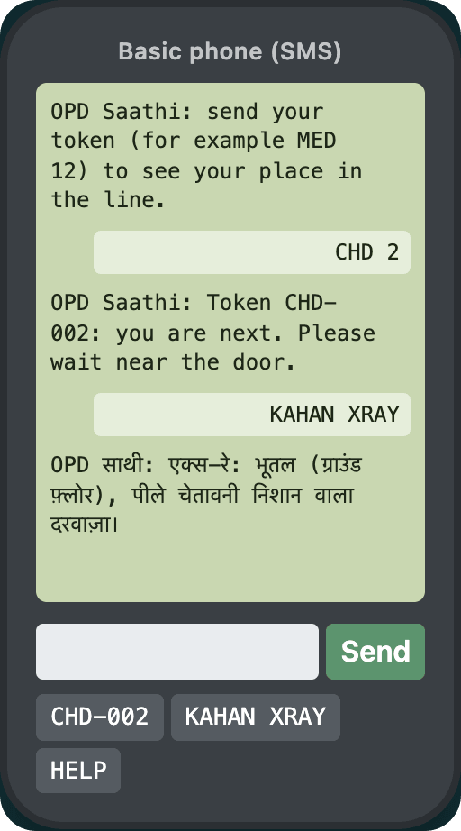
Help by voice, in Hindi, or by SMS
Ask by voice
Hindi on every screen
No smartphone? Use SMS
“X-ray kahan hai?” is answered aloud, with the way there.
Tokens, alerts and directions in Hindi or English.
Text a token, or KAHAN XRAY, from any basic phone.
Notes:
WHAT TO SAY (about 25 seconds)
Many OPD patients are elderly, read Hindi better than English, or do not have a smartphone. So: you can just ask, by voice or by typing, in Hindi, Hinglish or English. "X-ray kahan hai?" is answered aloud, with a Show the way button. Google Gemini understands free-form questions, but urgent words like "chest pain" or "saans nahi" never reach the AI: they go straight to "Go to Emergency now". It never gives medical advice.
Every screen, alert and direction works in Hindi. And with a basic phone, you text your token to see your place, or KAHAN XRAY to find it, and the reply comes back in Hindi.
DEMO TIP
The /stage screen shows the patient phone, the basic phone, the TV board and the dashboard together. Try "X-ray kahan hai?" and an SMS live.

Slide 7




A full MERN app, running on free tools
Built with
MongoDB, Express, React, Node
One queue engine runs on the server and in the browser. Every screen updates live.
Real
Simulated
Live queue on every screen
Made-up hospital and patients
Google Gemini
Understands questions in Hindi, Hinglish or English. Urgent words never reach the AI.
Staff logins and roles
SMS on an on-screen phone
n8n and free data feeds
Forecast from live weather
UPI payments in demo mode
Open-Meteo weather and air, TomTom traffic, and urgent alerts to staff on Telegram.
Gemini helper, phone alerts
PM-JAY portal not linked
Tested: all 12 groups of logic checks pass, and every screen was checked from phone to laptop size, in English and Hindi.
Notes:
WHAT TO SAY (about 25 seconds)
It is a full MERN app. The queue rules live in one engine that runs on the server, and the same file runs in the browser, so if the server goes down the screens keep working between tabs. Every screen updates live. Gemini powers the Ask helper. n8n brings in weather, air quality and live traffic for the forecast, and sends urgent alerts to staff on Telegram. Everything runs on free tiers.
Be straight about what is simulated: the hospital and patients are made up, SMS is shown on an on-screen basic phone because a real SMS gateway costs money, UPI is in demo mode (Razorpay test keys plug straight in), and PM-JAY claims are tracked but not sent to the PM-JAY portal.
Testing: npm run check passes all 12 groups of logic checks (queue, routes between all 1,860 pairs of places, forecast, roles, payments, PM-JAY, check-in, alerts, Emergency, Ask and SMS).
BEFORE YOU SUBMIT
The template asks you to list the tools you actually used, AI included. If you used an AI coding assistant, add it to Built with.

Slide 8


Who it helps, and what comes next
Who it helps
What we would build next
Patients and families
Especially elders, first-time visitors and people more at home in Hindi.
1
A pilot in one district hospital OPD, with its real rooms and timings
People without a smartphone
Can follow the line by SMS from any basic phone.
2
Real SMS through a gateway, and Urdu, Kashmiri and Dogri
Doctors, nurses, front desk
3
Links to the hospital’s records (ABDM) and the PM-JAY portal
See every queue live, get urgent alerts at once, and plan for busy days.
Notes:
WHAT TO SAY (about 20 seconds)
It helps the people who struggle most with today’s OPD: elders, first-time visitors and people more at home in Hindi, people without a smartphone, and the staff who handle hundreds of patients every morning. Next, we would pilot it in one district hospital OPD with its real rooms and timings, send real SMS through a gateway and add Urdu, Kashmiri and Dogri, and connect to the hospital’s records through ABDM and to the PM-JAY portal.
Keep "Next" to the three things you would genuinely build next, in order. Change any that are not yours.

Slide 9



[Team name]
Try OPD Saathi on your phone right now.
[Name]
[Name]
[Name]
[Role]
[Role]
[Role]
Live app
[your-app].onrender.com
Code
github.com/[you]/opd-saathi
Notes:
WHAT TO SAY (about 10 seconds)
We are [team name]. Open the link on your phone and register as a patient: you will have a token in under a minute. Thank you.
BEFORE YOU SUBMIT
Replace the team name, each [Name] and [Role] (delete a card if you are fewer than three), and both links. For a free live link, use Render + MongoDB Atlas (render.yaml is ready), and check each link in a private window. Share the deck as "Anyone with the link: Viewer" and paste that link into Deck URL on your HackCache dashboard.

