Slide 1
JOB-A-THON - September 2021
Submitted by – Nitin Rajput

Slide 2
Introduction
WOMart is a leading nutrition and supplement retail chain. WOMart follows a multi-channel distribution strategy with 350+ retail stores spread across 100+ cities. Effective forecasting for store sales gives essential insight into upcoming cash flow, meaning WOMart can more accurately plan the cashflow at the store level.
Objective : To predict the store sales for each store in the test set for the next two months
Dependent variable : Sales
Independent variables : ID, Store_id, Store_Type, Location_Type, Region_Code Date, Holiday, Discount, #Order

Slide 3
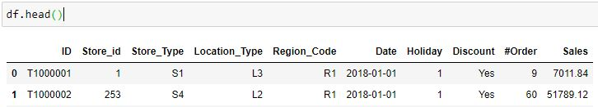

Chapter-1 EDA
Train Data
Test Data
Observations of data at first glance:
ID seems unique as its name suggest
Store_Type, Location_Type, Region_code and Discount are categorical features
Onehot encoding is used as there is no ordinal data and dimensions were also not very high
#Order is only present in Train data so more chances are there to drop this column

Slide 4
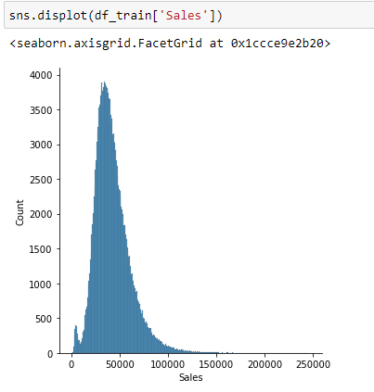
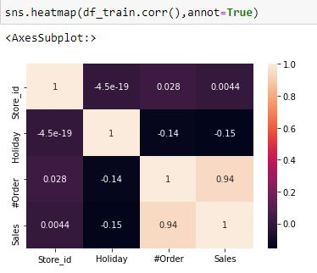
Order column is highly correlated to sales. This is probably due to Data leakage. As without orders there would be no sales, this correlation is quite obvious.
Target distribution is right skewed. If test set is from the similar distribution then predicted sales value should also be right skewed.

Slide 5
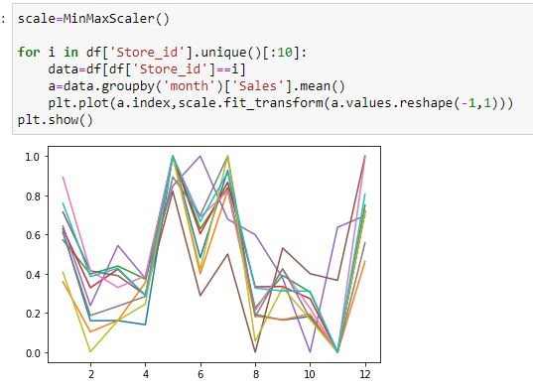
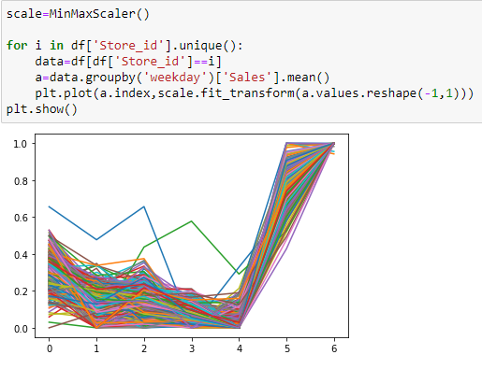
Above graphs are created for different store_ids.
From the first plot, some month wise seasonality pattern can be easily visible.
From the second plot, some weekday wise seasonality pattern is visible. Sales were higher on Sundays(6th day of the week).
So these 2 features were used as they helped to improve the score.

Slide 6
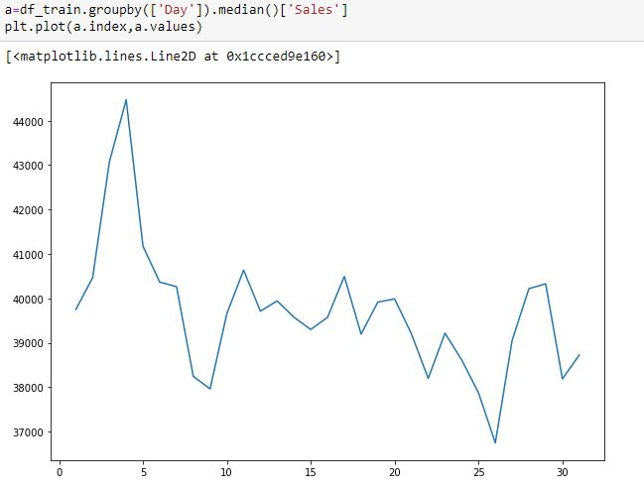
Above plot shows some day wise trend within a month.
So this feature is also considered for final model.

Slide 7
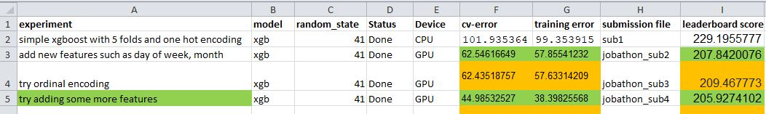
Chapter 2 Problem Approach
Aim was to develop the first model(base model) as quickly as possible to set a benchmark
Then we can iterate over to improve the model with feature engineering and ML techniques.
Xgboost is selected as the basemodel with 5 folds.
Model is run on GPU to save time.
To track the models progression, an excel sheet is maintained as shown below.
In final model, stacking of 4 different models with 5 folds in layer 1 and 1 model in layer2 with 5 folds is used. Onehotencoding is used for categorical data as it gave better results than ordinal encoding.
Layer 1 models (2-xgboost, 1-lightgbm, 1-catboost), layer2 model-LinearRegression.
These models were hypertuned using Optuna.

Slide 8
Chapter 3
Data-preprocessing/feature engineering
As it is a regression problem , chances are there that our model can predict negative values. But sales values cannot be negative so to avoid this, first log transformation of Sales column is done and then predicted values were transformed back to original scale.
Similar method used in a pollution prediction problem on kaggle when I faced the negative prediction problem.

Slide 9
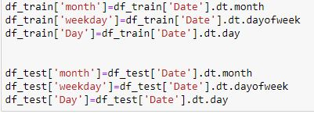
As discussed before, dayofmonth as day, weekday and month features were extracted from the Date column as they showed some trend/seasonality pattern.
Categorical features were one hot encoded using pd.get_dummies
One-hot encoding outperformed label encoding in the model.

Slide 10

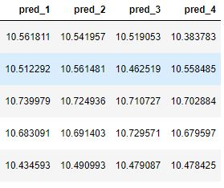
Chapter 4
Final Model
In final model, stacking of 4 different models with 5 folds in layer 1 and 1 model in layer2 with 5 folds is used. Layer 1 models (2-xgboost, 1-lightgbm, 1-catboost), layer2 model-LinearRegression.
These models were hypertuned using Optuna.
Table below shows the top 5 rows of OOF output data of layer 1 in layer 2 as input.
pred_1, pred_2, pred_3 and pred_4 were the OOF outputs of 4 models in layer 1.
These outputs were merged with the original dataset and then pred_1, pred_2, pred_3 and pred_4 were fed to LinearRegression model as label and Sales as Input
note:- here sales are log scaled.

Slide 11
What is Stacking?
The Stacking used here has two levels of regressors, level one regressors and level two regressor and uses a concept called out-of-fold predictions.
It starts by splitting the dataset into k folds in k successive rounds and using k-1 folds to fit the level one regressors. The remaining one fold is then used by the first level regressors to predict. These predictions then flow into the level two regressor as input. Once the training is finished the entire dataset is used to fit the level one regressors.

Slide 12
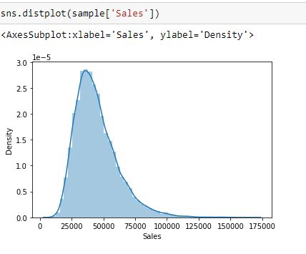
Distribution of final predicted values

Slide 13
THANK YOU!!

