Slide 1
Recipe for Sleep
Neuroscientist Chiara Cirelli: Uncovering Sleep

Slide 2
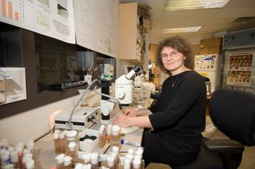
Chiara Cirelli Studies Shuteye
Neuroscientist Cirelli wants to find a recipe for sound sleep.
Sleep
Is necessary for all animals
Varies among animals
Is a powerful restorative
Question:
In what phase of sleep do humans dream?

Slide 3
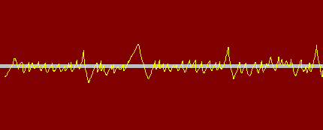
Answer: REM
Fast
Short
Narrowly spaced
Sometimes quite similar to brain waves of wakefulness
During the REM phase of sleep, brain waves are
REM = Rapid Eye Movement

Slide 4
Why Do We Sleep?
To give the body a chance to repair itself?
What some scientists suspect
To give the brain time to organize its thoughts?
So that we can learn more the next day?
What Cirelli suspects

Slide 5
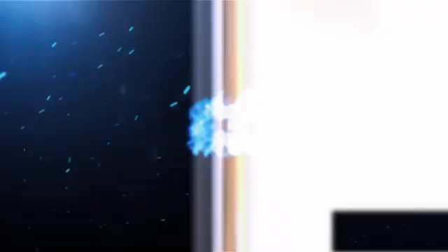
Sample video

Slide 6
Cirelli’s Synaptic-Strength Hypothesis
Wakefulness = Learning new things
Learning = Synapses in the brain (connections between brain neurons) get
Stronger
Bigger
Need more fuel
Brain cannot afford space and energy needs of constantly growing synapses
Slow brain activity during sleep shrinks brain synapses
Smaller synapses result in more efficient learning

Slide 7
Testing Cirelli’s Hypothesis
Compare 2 groups of rats
Average intelligence
Above average intelligence
Measure brain activity during wakefulness while
Average rats lounge
around
Smarter rats get
mental challenges
like grabbing food
pellets from a small
opening
Measure brain activity during sleep
Study sleep patterns
Dissimilarities could point to a connection between learning and sleep
=

Slide 8
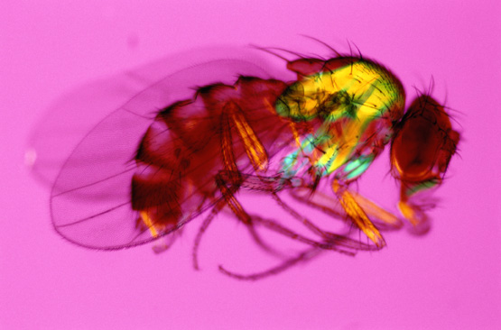
Fruit Flies Are Model Organisms
Fruit flies are perfect tools for studying heredity, or genetics.
Cirelli uses fruit flies to study genes that affect sleep.
Drosophila melanogaster
(fruit fly)

Slide 9
Sleep Genes and Fruit Flies
Fruit flies have a lifespan of a few months, and female fruit flies lay eggs every day
Fruit flies sleep about 12 hours every night
Scientists know almost all the genes for about a dozen species of fruit flies
Why are these traits attractive to scientists who use model organisms in their work?
How do scientists know this information?
How might scientists use this knowledge?

Slide 10
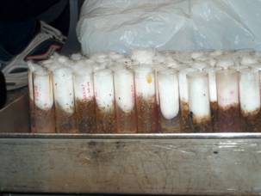
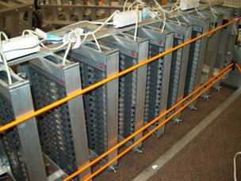
Sleepless in Madison
Cirelli is trying to identify genes that allow some fruit flies to stay awake after sleep deprivation
Previously, Cirelli would awaken sleeping fruit flies by shaking the test tubes where they ate and slept.
Now, Cirelli uses a robotic arm that tilts and drops a frame containing the test tubes of sleeping fruit flies, jolting them awake.

Slide 11
Cirelli Discovers Minisleeper Flies
Minisleeper flies have a genetic mutation that allows them to function on less sleep than normal flies
Minisleeper flies also have “shaker” gene mutation
Humans have a similar gene and protein
Problem: minisleeper flies don’t live as long as sleepier ones

Slide 12
Research Applications
How might Cirelli’s work with fruit fly genes eventually help humans sleep better, and what is the “fly in the ointment” of such an application?

