Slide 1
OVERVIEW OF LARGE LANGUAGE MODELS (LLMS)
Feature | GPT-4 | Llama 2 | Mistral | Gemini Pro | GPT-3.5
Strengths
Creativity & Engagement | Excellent | Good | Strong | Moderate | Good
Text Generation | Diverse formats, high fluency | Factual accuracy, long passages | Efficient, code generation | Strong storytelling, location context | Diverse formats, humor
Knowledge & Reasoning | Broad knowledge base, good summarization | Strong factual reasoning, logical arguments | Limited, but rapidly improving | Access to Google Search, good factual understanding | Strong information retrieval, factual reasoning
Task Completion | Can struggle with specific instructions | Good at following instructions | Efficient, handles complex tasks well | Accurate and reliable for tasks | Good at completing tasks, may lack flexibility
Weaknesses
Factual Accuracy | Prone to biases, factual errors | More reliable than GPT-4 | Still under development | Generally accurate, but limited data access | Can be factually inaccurate, biased
Transparency & Explainability | Limited insights into decision-making | Provides reasoning for conclusions | Less transparent than GPT-4 and Llama 2 | Moderate transparency | Moderate transparency
Cost & Access | Paid subscription | Open-source | Open-source | Paid subscription | Paid access, but cheaper than GPT-4
Technical Expertise | Requires some technical knowledge | Requires technical knowledge | Requires technical knowledge | User-friendly interface | Requires some technical knowledge

Slide 2
RECOMMENDATION
Application | Ideal Model | Reason for Choice | Reference | Cost Estimation
Advanced Scientific Applications | GPT-4 | Superior logical reasoning and inference capabilities, strong NLP for automated workflows. | [1, 2] | High (potentially exceeding $1 per million tokens)
Consumer Product Integration | Gemini Pro | Access to Google ecosystem and services, robust for consumer-oriented applications. | [3, 4] | Moderate (estimated around $0.0008 per million tokens)
High-Performance NLP Tasks | GPT-3.5 | Cost-effective option, easy API access, efficient NLP for specific tasks. | [5, 6] | Low (estimated around $0.0005 per million tokens)
Secure On-Premise Deployment | LLaMA-2, Mistral | Local control over infrastructure, customizable security measures for sensitive data. | [7, 8] | Variable (depends on hardware and cloud setup costs)
Conversational Interfaces & Interactive AI | GPT-4 | Cutting-edge natural language capabilities, ideal for virtual assistants and chatbots. | [9, 10] | High (potentially exceeding $0.0018 per million tokens)
Multilingual Applications | LLaMA-2 | Model diversity and customizability, efficient communication across languages and domains. | [11, 12] | Moderate (estimated around $0.0010 per million tokens)

Slide 3
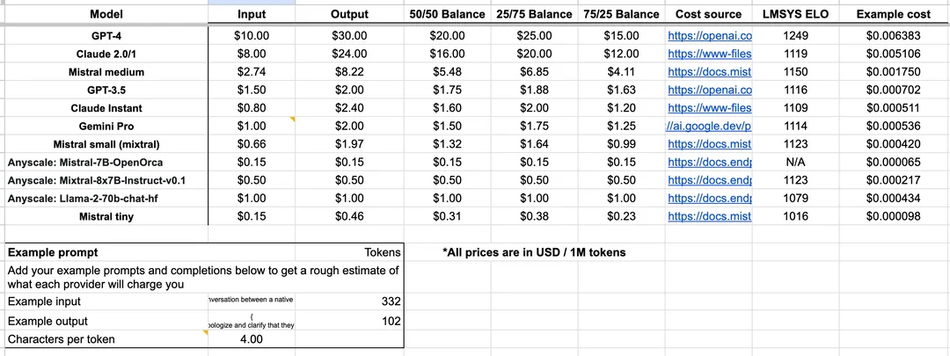
COST ESTIMATES OF VARIOUS LARGE LANGUAGE MODELS

Slide 4
GPT-4 STRENGTHS AND WEAKNESSES:
Feature | Strengths | Weaknesses
Natural Language Capabilities | Unparalleled fluency, coherence, and creativity. Excellent in storytelling, diverse formats, and image generation. | Prone to factual errors and biases depending on training data.
Logical Reasoning & Inference | Superior for scientific applications like hypothesis generation and model building. | Primarily relies on statistical inference, limited explainability compared to models like LLaMA-2.
Knowledge Base & Data Access | Vast internal knowledge base and access to external data, potentially surpassing Google Search in specific contexts. | Transparency and explainability of decision-making process are limited.
Creative Formats | Generates diverse creative formats like poems, code, scripts, musical pieces, emails, and letters with impressive detail. | Cost and access limited as the model is still under development and requires a paid subscription.
Multilingual Potential | Shows promise in handling multiple languages and domain-specific vocabularies. | Security and privacy concerns due to access to vast amounts of data.

Slide 5
GEMINI PRO STRENGTHS AND WEAKNESSES:
Feature | Strengths | Weaknesses
Knowledge Retrieval | Seamless Google Search integration | Limited control over data flow
Contextual Understanding | Location-aware intelligence | Black-box nature of Google Search (potential bias & misinformation)
Engagement & Interaction | Diverse storytelling & dialogue | Transparency & explainability challenges
Google Ecosystem Integration | Gemini Pro seamlessly integrates with other Google services and platforms, like Google Search and Google Cloud. | Data security concerns (user consent & information sharing

Slide 6
LLAMA 2 AND MISTRAL STRENGTHS AND WEAKNESSES:
Feature | LLAMA 2 | Mistral
Strengths | Strong factual accuracy & research | Efficient task handling & complex processing
 | High explainability & transparency | Promising reasoning & music generation
 | Open-source & freely available | Controlled environment & security
 | Diverse language handling | Code generation capabilities
Weaknesses | Limited knowledge base & data access | Limited access & early development stage
 | Limited creative formats | Transparency & explainability challenges
 | Less natural language capabilities | Black-box nature of internal development
 | Accessibility challenges | Limited creative diversity

Slide 7
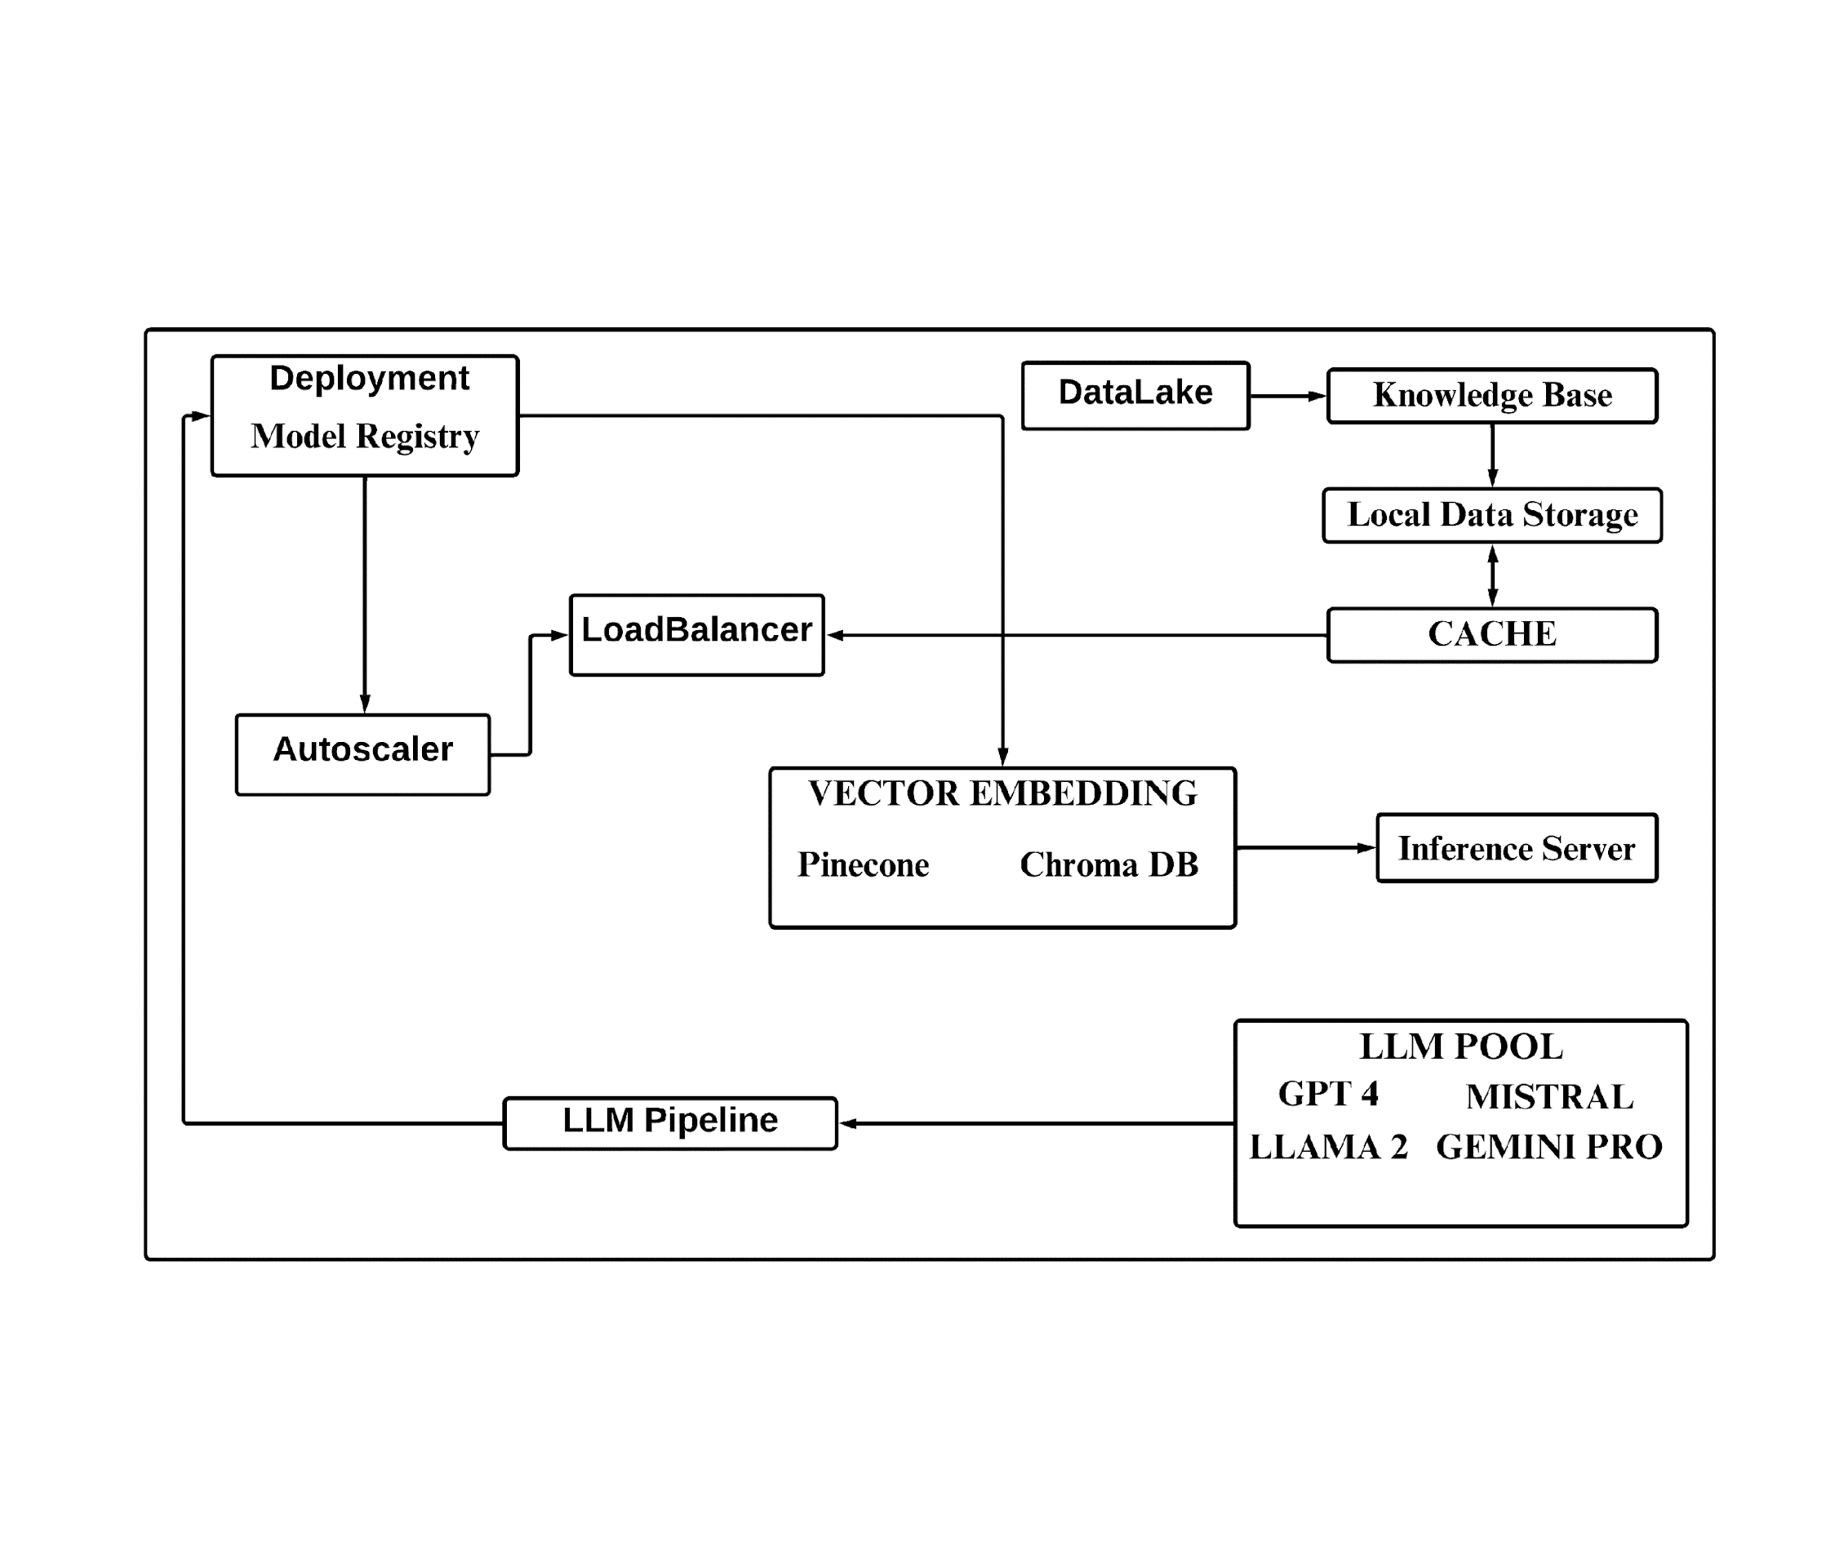
HIGH LEVEL ARCHITECTURE

Slide 8
REFERENCES
https://arxiv.org/abs/2005.14165
https://github.com/AmineDiro/cria
https://medium.com/@rejvi587/google-bard-is-a-large-language-model-llm-chatbot-developed-by-google-ai-f45559b276e9
https://developers.googleblog.com/2023/12/how-its-made-gemini-multimodal-prompting.html
https://platform.openai.com/docs/models
https://techcommunity.microsoft.com/t5/ai-machine-learning-blog/harness-the-power-of-large-language-models-with-azure-machine/ba-p/3828459
https://github.com/facebookresearch/faiss
https://github.com/mistralai
https://arxiv.org/abs/2303.08774
https://arxiv.org/abs/2302.13971
https://github.com/AmineDiro/cria
https://github.com/facebookresearch/faiss

