Slide 1
OPTIMIZING RECOMMENDER SYSTEMS WITH GRAPH NEURAL NETWORKS
NITIN REDDY K
CS21B2028
Dr. Umarani Jayaraman
Dept. of CSE, IIITDM Kancheepuram

Slide 2
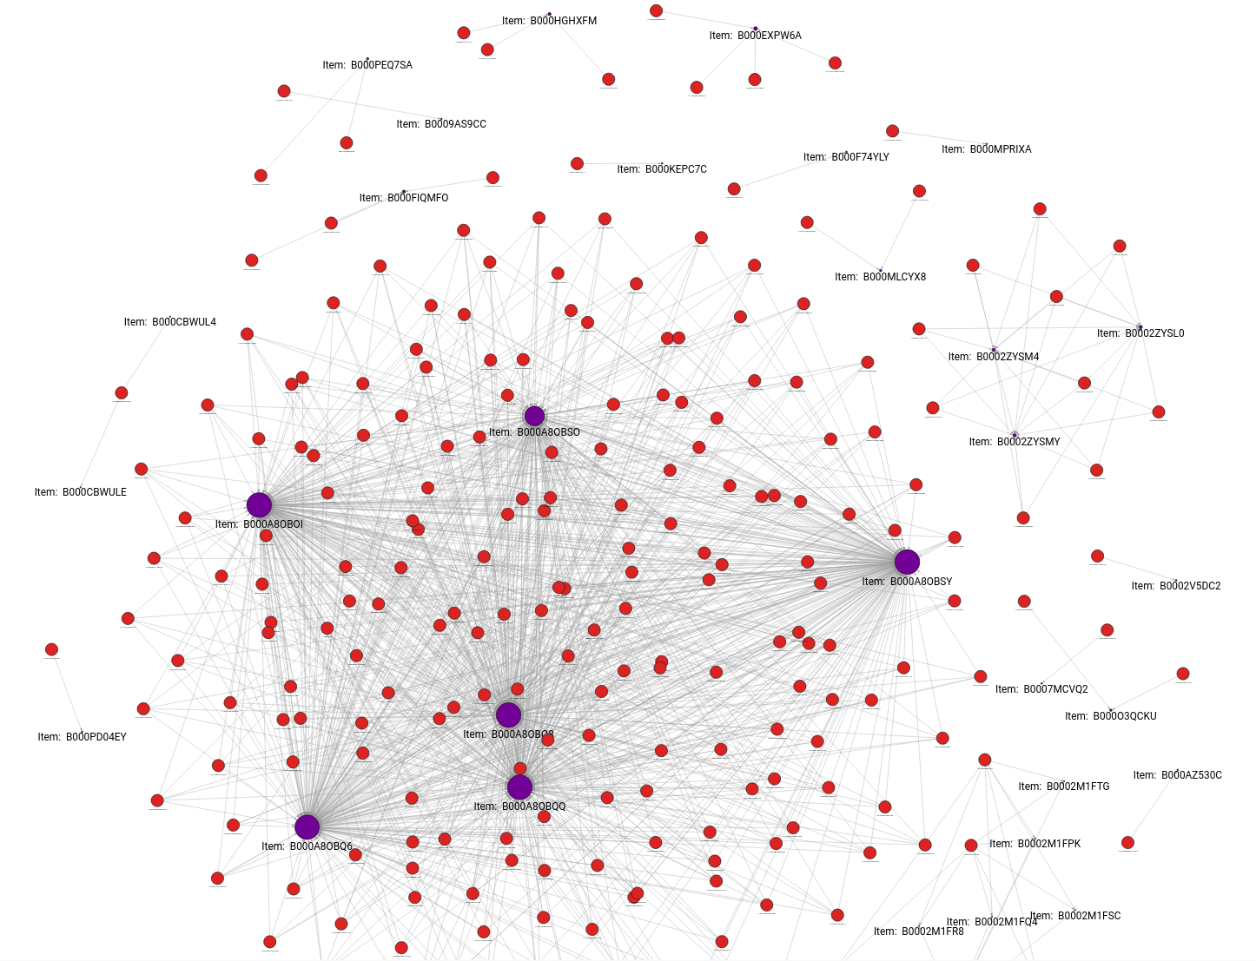
Table of Contents
Introduction
Problem Definition
Literature Survey
Contribution
Progress/ Work done
Results/ Analysis
Prototype/ Products
Conclusion
Future Work

Slide 3
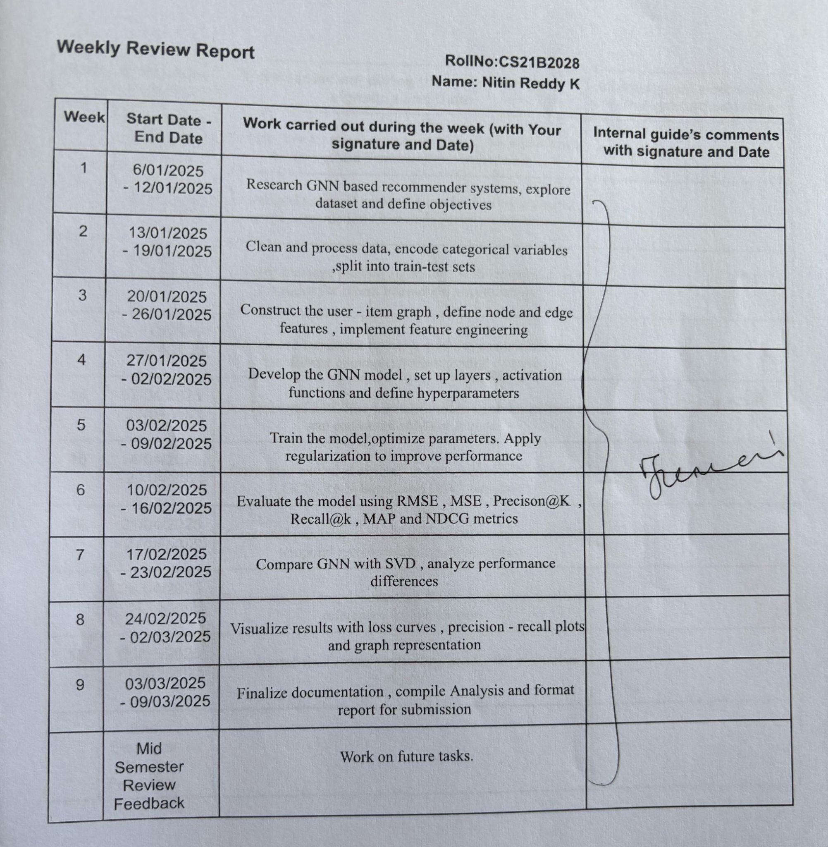
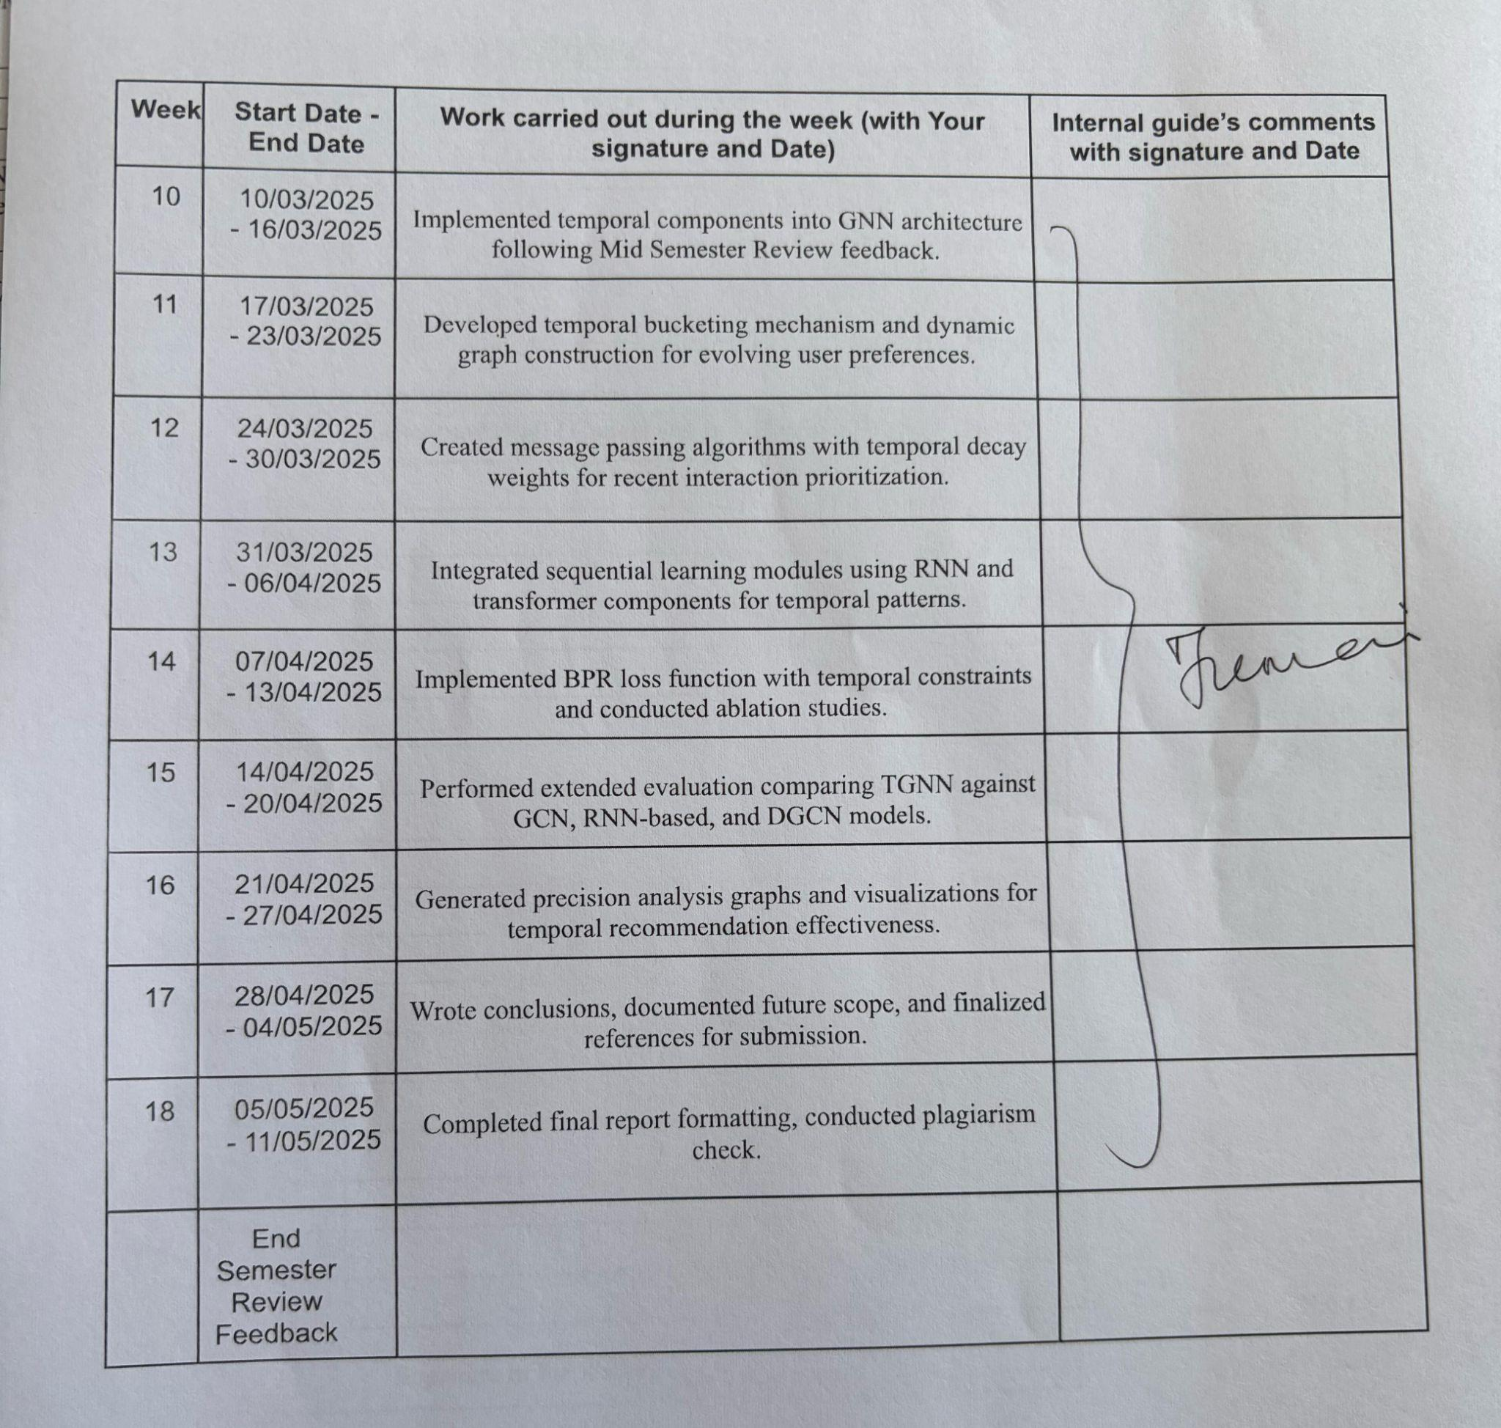
Weekly Review Report

Slide 4
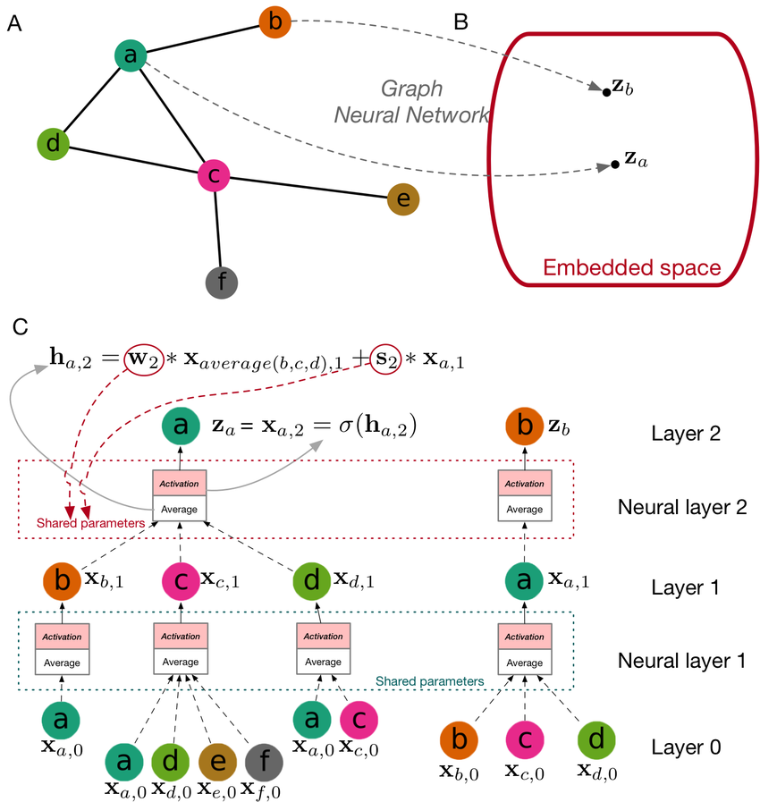
Introduction
Graph Neural Networks (GNNs) have emerged as a powerful tool for recommender systems due to their ability to model complex relationships between users and items. Traditional recommender systems often rely on collaborative filtering or content-based methods, which may overlook higher-order interactions or struggle with sparsity. GNNs, however, can naturally capture these relationships by treating users and items as nodes in a graph, with edges representing interactions such as purchases, ratings, or clicks.

Slide 5
Problem Definition
Problem Statement
Traditional models fail to adapt to changing user preferences.
GNN implemented but lacks temporal awareness.
Need TGNN to capture evolving interactions.
Relevance
User interests change (trends, seasons).
Static models become outdated.
TGNN improves real-time recommendations.
Notes:
1 Hop / Multi Hop

Slide 6
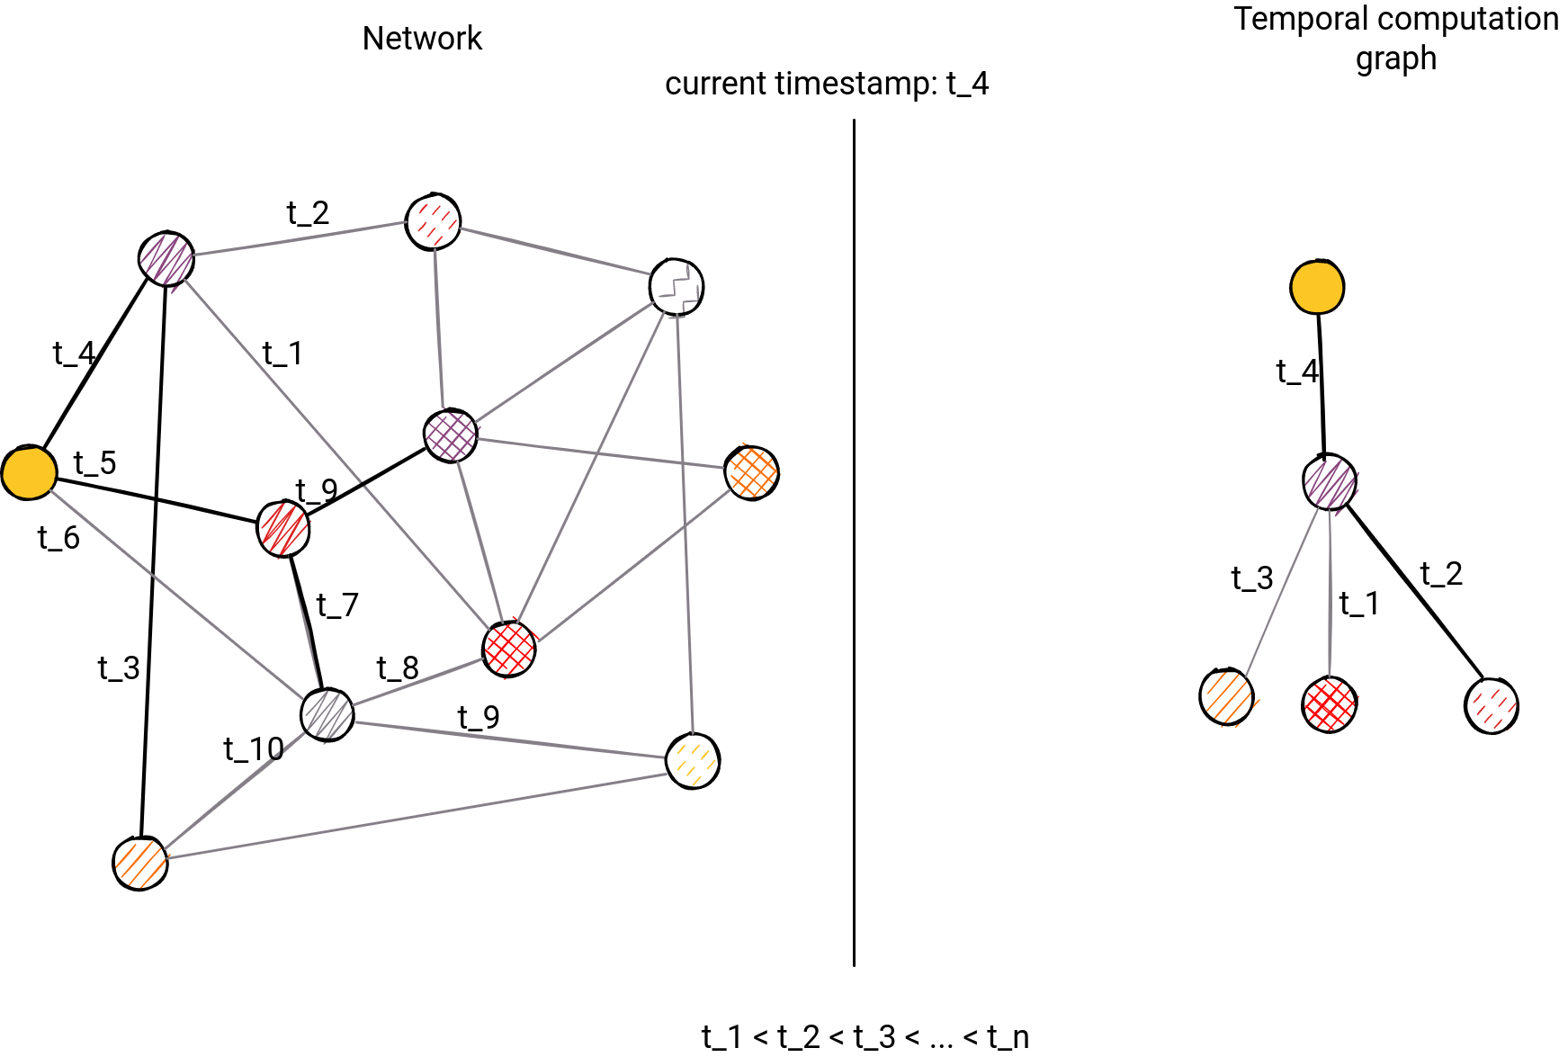
Literature Survey
Data Processing for TGNNs:
Cleaning & Normalization: Removal of duplicates, handling missing values
Temporal Bucketing: Processing timestamps for specific time window
Graph Construction:
Node representation (users, items)
Edge representation (interactions with timestamps)
Dynamic structure that evolves with new data
Data Import Process
JSON conversion for structured representation
Graph database import using Cypher queries
Node and relationship creation with temporal attributes

Slide 7
Title | Authors | Algorithms Used | Key Findings
A Comprehensive Review of Recommender Systems (2024) | Shaina Raza, Mizanur Rahman, Safiullah Kamawal et al. | Collaborative filtering, Content-based, Hybrid | Bridges theory and real-world applications, addressing cold start and interaction bottlenecks.
GPT-Based Chatbots in Recommender Systems (2023) | Various | GPT, GNN, Various | Improves prediction accuracy and personalization, handles sparse datasets better.
Graph Convolutional Matrix Completion (2021) | Rianne van den Berg, Max Welling | GCNs, VGAEs, Matrix Factorization | GCNs enhance rating predictions but lack temporal user interaction modeling.
Graph Neural Networks for Social Recommendation (2019) | Wenqi Fan, Yao Ma, Qing Li et al. | GNN, Collaborative Filtering | Incorporates social connections to improve user-item interaction modeling.

Slide 8
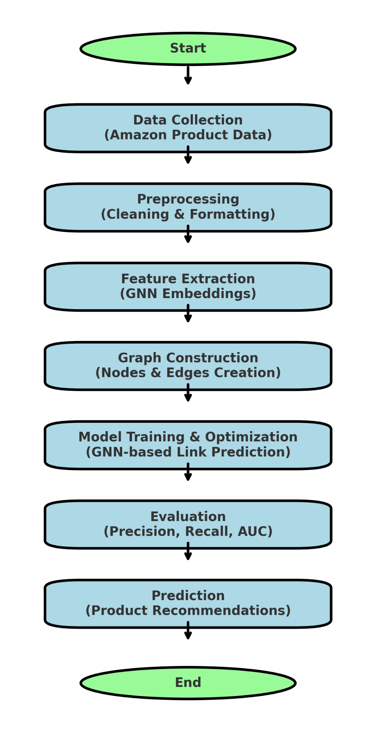
Contributions/ Work Done
Temporal Graph Architecture
Dynamic graph model with time-sensitive edges
Temporal bucketing for efficient processing
Optimization Techniques
Temporal attention mechanisms
Recency weighting and memory decay
Adaptive learning rates

Slide 9
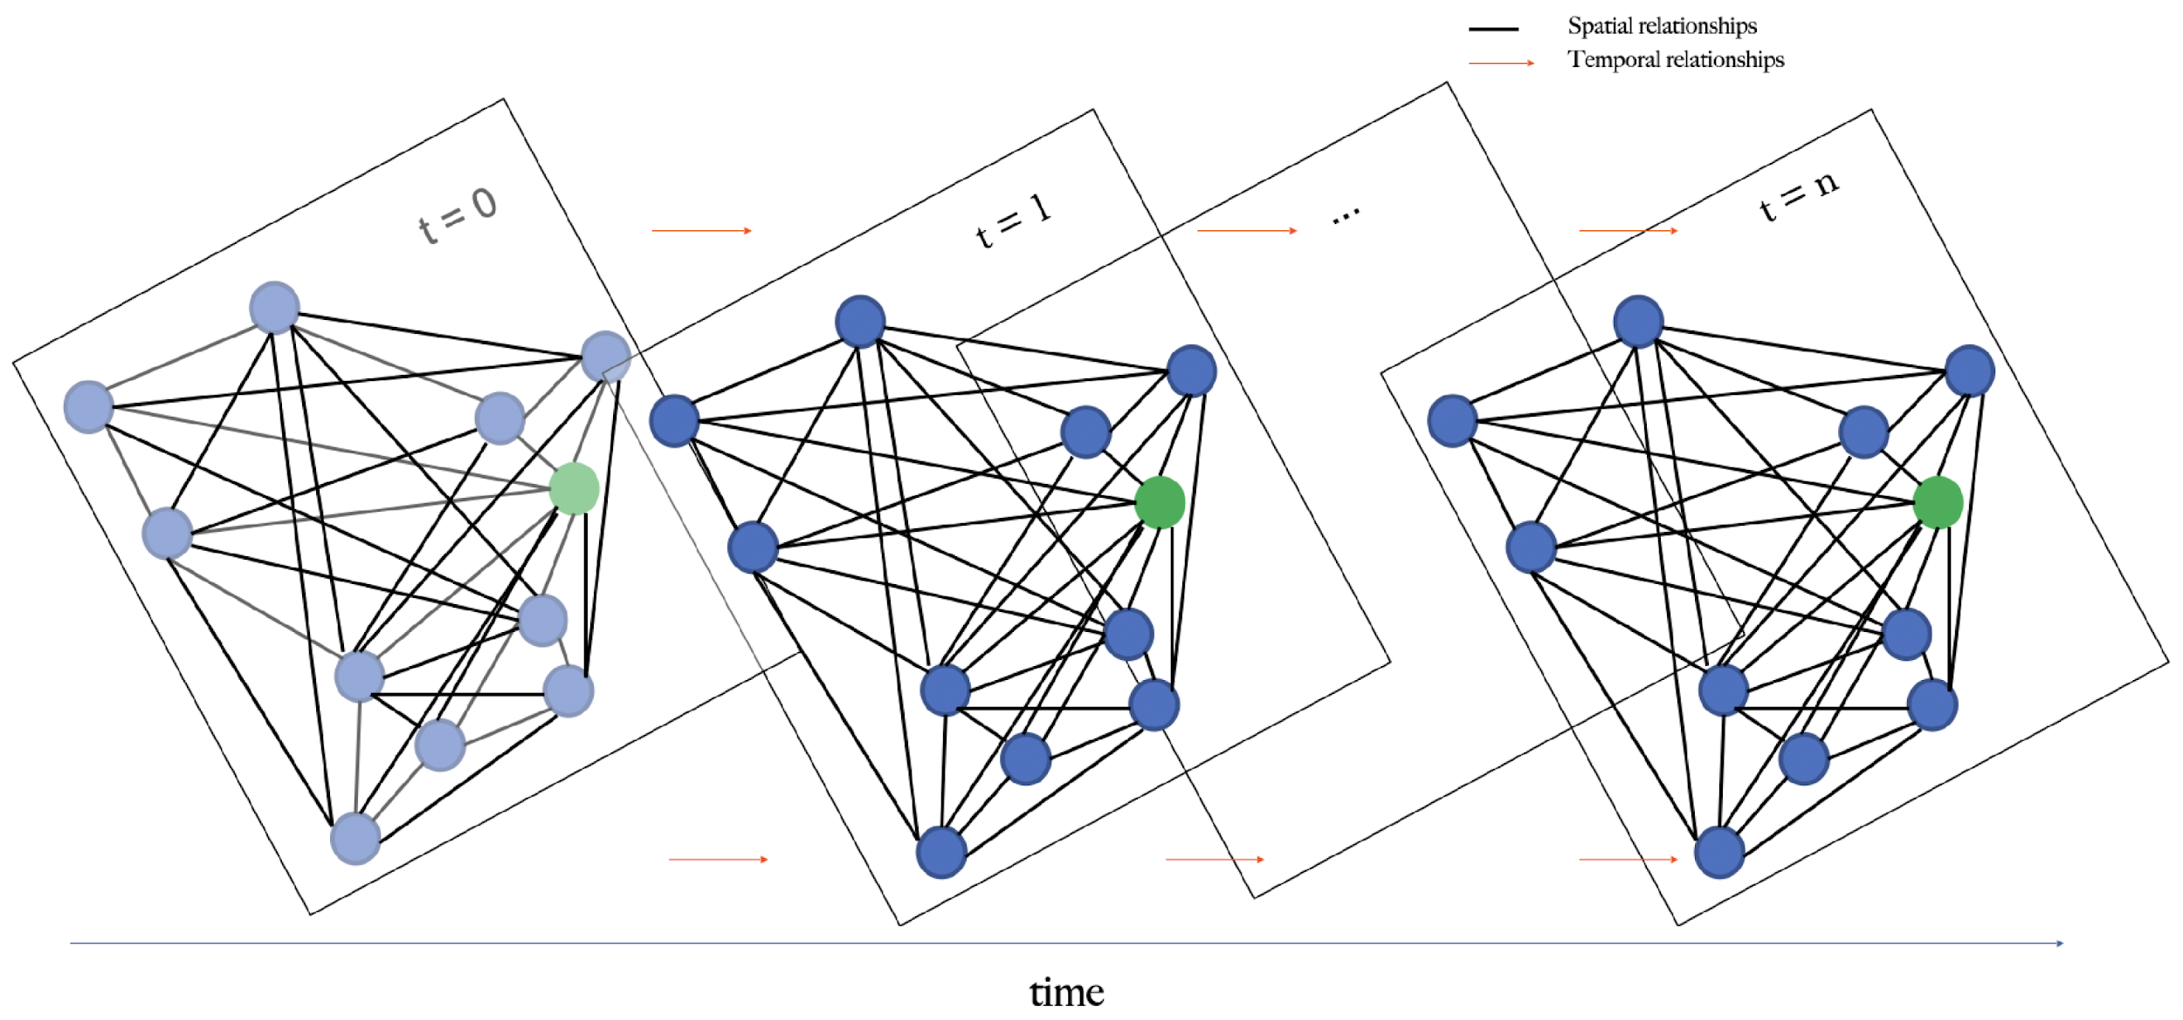
Contributions/ Work Done
Implementation Framework
Integration with Memgraph for efficient graph operations.
PyTorch-based TGNN implementation.
Real-time recommendation pipeline.
Evaluation Methodology
Comparative assessment with traditional models.
Temporal precision metrics.
Performance analysis under varying conditions.

Slide 10
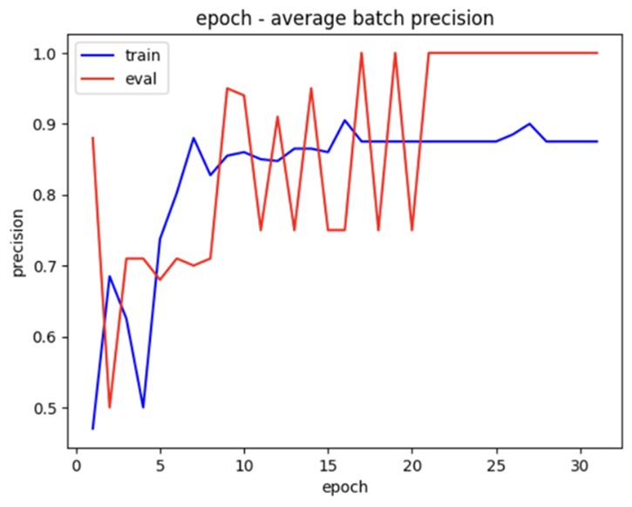
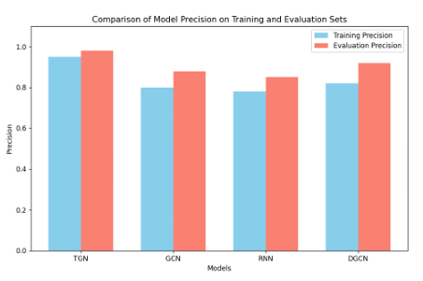
Analysis/ Results
METRIC | TGNN | GNN
Precision | 0.98 | 0.85
Recall | 0.89 | 0.79
NACG | 0.93 | 0.82

Slide 11
Conclusion
Successfully implemented a TGNN-based recommender system with high precision (0.98).
Effectively modeled temporal dynamics in user-item interactions.
Demonstrated superior performance compared to traditional approaches
Created a scalable architecture for real-time recommendations.
Impact:
Enables more personalized and timely recommendations
Addresses fundamental challenges in recommendation systems
Provides framework for integrating temporal awareness in user modeling
Enhances user experience through context-aware suggestions

Slide 12
Future Work
Testing on Larger Datasets: Evaluate scalability and robustness on industry-scale data.
Hyperparameter Optimization: Fine-tune memory dimensions and temporal encodings.
Negative Interaction Modeling: Incorporate negative feedback for balanced recommendations.
Explainable Recommendations: Develop mechanisms to explain why items are recommended and also improve transparency of the recommendation process.

Slide 13
References
R. Ying et al., "Graph convolutional neural networks for web-scale recommender systems," KDD, 2018.
X. He et al., "LightGCN: Simplifying and powering graph convolution network for recommendation," SIGIR, 2020.
D. Xu et al., "Inductive representation learning on temporal graphs," arXiv, 2020.
S. Kumar et al., "Predicting dynamic embedding trajectory in temporal interaction networks," KDD, 2019.
H. Liu et al., "An inter-sequence enhanced framework for personalized sequential recommendation," CIKM, 2020.
J. Ma et al., "Memory-augmented graph neural networks for sequential recommendation," SIGIR, 2020.
S. Lim et al., "STP-UDGAT: A spatial-temporal user dimensional graph attention network for poi recommendation," CIKM, 2020.

Slide 14
Thank You Any Questions?

