Slide 1
SATURDAY
Sentiment-Aware Textual Understanding and Response Dialogue Assistant
Team Members:
Nitin Sampath Rohan Bheemavarapu
Naga Jagadeeshwari Kari
Kumar Datta Tummula

Slide 2
Agenda
Introduction to the Project
Purpose and Importance
Objectives and Methodology
Implementation Details
Evaluation and Testing
Results and Analysis
Challenges and Future Work
Conclusion and Q&A

Slide 3
Introduction
In the rapidly evolving fields of Human-Computer Interaction (HCI) and Artificial Intelligence (AI), the need for emotionally intelligent conversational agents has become more crucial than ever.
Traditional chatbots often fail to connect with users on an emotional or humanistic level, providing transactional rather than relational experiences.
SATURDAY — Sentiment-Aware Textual Understanding and Response Dialogue Assistant — was conceptualized to build meaningful, emotion-sensitive dialogues, acknowledging how users feel and responding empathetically.

Slide 4
Purpose and Relevance
In today's digital landscape, AI-driven chatbots are often the first point of interaction for users seeking support, advice, or companionship.
A critical limitation of most chatbot systems is their lack of emotional intelligence, which leads to impersonal and unsatisfying user experiences.
SATURDAY addresses this gap by offering emotionally aware conversations that comfort, engage, and support users.
The goal is to create a human-like conversational experience where emotional understanding is prioritized alongside factual correctness.

Slide 5
Project Objectives
Train a BERT-based sentiment classification model using a diverse emotional text dataset such as GoEmotions.
Develop a visually friendly, responsive web-based chatbot interface accessible across smartphones, tablets, and desktops.
Integrate real-time emotion detection with a curated library of empathetic responses tailored to different emotional states.
Ensure the chatbot dynamically adapts to the user’s emotional context, maintaining a natural, supportive dialogue flow.
Optimize performance for fast, seamless interactions without lag, enhancing user satisfaction across all platforms.

Slide 6
Tools and Technologies
Backend Development: Flask (Python) for building a lightweight, scalable REST API server.
Frontend Development: HTML, CSS, and JavaScript for creating a responsive, mobile-friendly chatbot interface.
Model Training: Hugging Face Transformers library with PyTorch for fine-tuning the BERT-Base-Uncased model.
Data Handling: pandas and scikit-learn for dataset preprocessing, cleaning, and evaluation metrics.
Version Control and Collaboration: Git and GitHub for smooth development and codebase management.
Design and Presentation: Canva for project banner design and documentation visuals.

Slide 7
Methodology Overview
Combined Human-Computer Interaction (HCI) principles with advanced Natural Language Processing (NLP) techniques to create an empathetic chatbot.
Focused on user-centered design by conducting early user research to understand emotional needs and expectations from conversational AI.
Fine-tuned a pre-trained BERT model for emotion detection, ensuring real-time emotional analysis during conversations.
Followed an iterative development approach with continuous feedback loops to refine both user interface design and conversational quality.

Slide 8
User Research
Conducted user research to identify key emotional needs and expectations from conversational AI systems.
Findings revealed that users valued not just fast or correct responses, but conversations where they felt heard, validated, and emotionally supported.
Emotional moments — such as sadness, anger, or excitement — highlighted a strong desire for empathetic engagement rather than robotic replies.
These insights heavily influenced the design of SATURDAY’s personality, response styles, and user experience flow.

Slide 9
Persona Development
Designed SATURDAY’s persona to be supportive, friendly, and non-judgmental, ensuring users feel safe sharing both positive and negative emotions.
Focused on maintaining an encouraging, empathetic tone across all conversations, avoiding robotic or overly formal language.
Built the chatbot’s communication style to promote emotional openness, validation, and comfort, aligning with HCI principles of user-centered emotional design.
Carefully crafted response templates to reflect understanding, positivity, and emotional sensitivity without sounding scripted.

Slide 10
Wireframing and UI Design
Developed early wireframes focusing on simplicity, emotional accessibility, and ease of use across different devices.
Chose a soft, friendly color palette with calm tones like blue-violet and light greys to create a welcoming, non-intimidating atmosphere.
Designed large, readable input fields and clean conversational flows to accommodate users with varied technical backgrounds.
Implemented a mobile-responsive layout to ensure smooth, seamless interactions across smartphones, tablets, and desktops.

Slide 11
Affective Computing
Integrated emotional intelligence by detecting user emotions dynamically and adjusting responses empathetically.
Developed contextually relevant emotional replies tailored to specific detected sentiment states like joy, sadness, anger, or curiosity.
Focused on adaptive tone management, ensuring the chatbot’s replies matched the emotional depth of the conversation without feeling scripted.
Aimed to create emotionally supportive dialogues that feel human, comforting, and naturally flowing rather than mechanical or generic.

Slide 12
Interface Implementation
Developed a lightweight, responsive frontend using HTML, CSS, and JavaScript to ensure fast performance across devices.
Implemented smooth auto-scrolling and dynamic resizing to maintain conversation continuity during user interactions.
Clearly distinguished user and bot messages with aligned layouts and contrasting soft backgrounds for readability.
Applied rounded corners, soft shadows, and friendly visual elements based on HCI best practices to enhance emotional accessibility.

Slide 13

Sentiment Analysis Development
Selected the GoEmotions dataset by Google Research, containing around 58,000 Reddit comments labeled across 27 fine-grained emotional categories.
Fine-tuned a pre-trained BERT-Base-Uncased model using Hugging Face Transformers to classify emotional states accurately.
Applied tokenization, data cleaning, and normalization processes to prepare the dataset for effective model training.
Trained the model for 3 epochs with a batch size of 16, achieving balanced performance across emotions and minimizing overfitting.

Slide 14

System Integration
Built a lightweight backend server using Flask to handle user input, process emotion detection, and generate empathetic responses.
Established communication between the frontend and backend via fetch() API calls, sending user messages as JSON to the server.
Upon receiving input, the Flask server tokenizes the message, runs emotion inference through the fine-tuned BERT model, and maps the result to an empathetic response.
Ensured real-time response generation and dynamic frontend updates for smooth, human-like conversation flow without noticeable lag.

Slide 15
Model Evaluation
Achieved an accuracy of approximately 85% on the held-out test set, demonstrating strong sentiment detection capability.
Macro F1-Score reached around 0.84, indicating balanced performance across all 27 emotional categories, even those with lower representation.
Addressed challenges such as simplifying multi-label data to single-label classification for real-time response generation.
Noted occasional misclassifications in subtle, overlapping emotions like pride versus admiration, with minimal impact on overall chatbot empathy.

Slide 16

Chatbot Evaluation (HCI)
Conducted usability testing with diverse participants interacting freely with SATURDAY across emotional and casual scenarios.
Users described the chatbot as friendly, comforting, and notably more human-like compared to traditional rigid systems.
Positive feedback highlighted emotional acknowledgment, natural conversation flow, and personalized empathetic responses.
Suggestions for improvement included increasing conversational variety and deeper follow-up branching for repeated emotional expressions.

Slide 17

Results and Analysis
Training Performance: Fine-tuning the BERT-Base-Uncased model on GoEmotions took approximately 2 hours on a T4 GPU, achieving efficient convergence.
Inference Speed: Average response generation time was around 0.5 seconds per user message, enabling near-instantaneous conversations.
Mobile Responsiveness: Chrome Developer Tools testing confirmed 100% responsiveness across smartphones, tablets, and desktops.
Emotional Connection: User feedback consistently highlighted SATURDAY’s ability to deliver comforting, emotionally intelligent interactions, enhancing user satisfaction and trust.

Slide 18
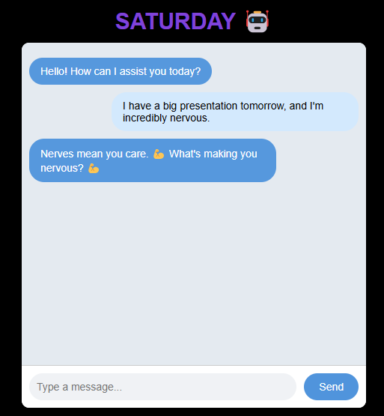
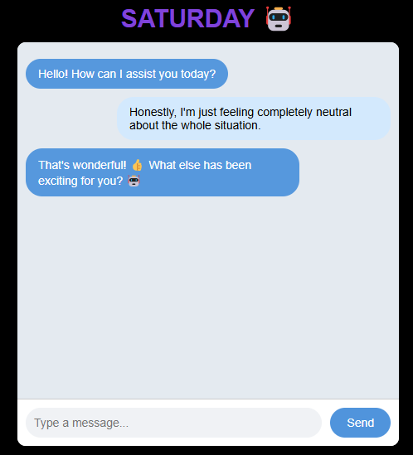
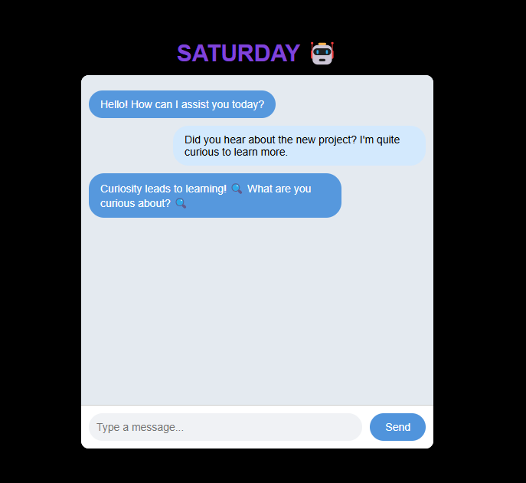
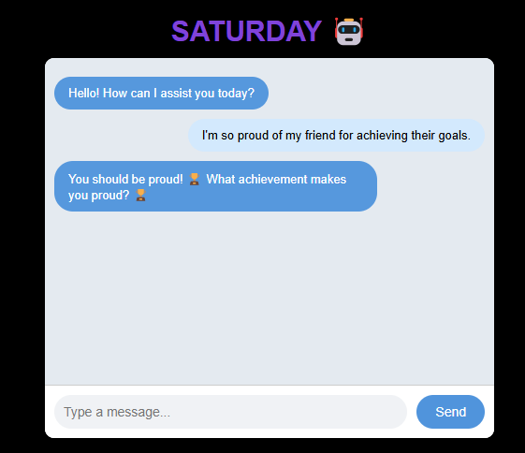

Slide 19
Strengths and Limitations
Strengths:
Delivered fast, human-like conversational replies with minimal inference delay (~0.5 seconds).
Deep integration of sentiment detection and user-centered design principles created emotionally supportive interactions.
Positive user feedback emphasized emotional intelligence, empathy, and natural dialogue flow.
Limitations:
Subtle emotion overlaps (e.g., pride vs. admiration) occasionally led to misclassifications.
Extended conversations sometimes revealed repetitive responses, indicating a need for greater conversational branching and diversity.

Slide 20
Future Work
Memory Integration: Introduce conversational memory to allow SATURDAY to recall past user interactions and maintain long-term dialogue context.
Expanded Emotion Detection: Train models to capture more nuanced emotions like sarcasm, embarrassment, and mixed feelings, enhancing emotional intelligence.
Multimodal Interaction: Add voice input/output functionality to create richer, hands-free conversational experiences and improve accessibility.
Scalable Deployment: Package the application using Docker and deploy it to AWS cloud servers for production-grade, globally accessible chatbot services.

Slide 21
Conclusion
SATURDAY successfully demonstrates that combining Human-Computer Interaction (HCI) principles with Natural Language Processing (NLP) can create emotionally intelligent conversational agents.
By prioritizing empathy, emotional understanding, and user-centered design, SATURDAY moves beyond task completion to offer meaningful human-like dialogues.
The project highlights the potential of AI to provide not just factual answers, but also emotional support, enhancing trust and satisfaction in digital interactions.

Slide 22
Thank You!

