Slide 1
Customer Segmentation in Online Retail Industry
S.No | Reg.No | Name of the Student | Branch & Section
1 | BL.EN.U4CSE20092 | Majji Nitin Sai | CSE-B
2 | BL.EN.U4CSE20105 | Mutta Kalyan | CSE-B
3 | BL.EN.U4CSE20110 | Nagavarapu Ravi kiran | CSE-B

Slide 2
Problem Definition
Internet retailers find it difficult to classify a wide range of customer profiles and behaviors. To comprehend a variety of demographics, adjust in real time to market changes, and utilize a vast amount of customer data for customized marketing, a sophisticated segmentation system is required. The industry's expansion necessitates a solution that guarantees real-time adaptability to shifting customer preferences in addition to analyzing purchasing patterns.

Slide 3
Introduction
Success in the dynamic world of online retail requires a thorough understanding of and ability to effectively serve the wide range of needs of consumers. Online retailers are finding that customer segmentation a strategic approach that divides a large customer base into discrete groups based on shared traits, actions, and preferences is an indispensable tool. Businesses can customize their marketing strategies, allocate resources more efficiently, and improve overall customer experiences through this segmentation process.

Slide 4
Challenges
Real-time Adaptability
Data Integration and Analysis
Resource Optimization
Customer Engagement and Retention
Privacy and Ethical Concerns

Slide 5
Literature Survey
S.No. | Authors name(s) | Full title of the paper with year | Inference from the paper | Open Problem (For proposed work)
1. | Jinfeng Zhou, Jinliang Wei , Bugao Xu | Customer segmentation by web content mining | The study used an agglomerative clustering algorithm for hierarchical clustering analysis and determined that the optimal cluster number for customer segmentation was 7. The paper introduces a new dimension, Interpurchase Time (T), into the existing RFM model to form an expanded RFMT model for customer segmentation based on online purchase sequences. | Exploring the use of advanced machine learning techniques or algorithms to improve the clustering process and identify more nuanced customer segments.

Slide 6
S.No | Authors name(s) | Full title of the paper with year | Inference from the paper | Open Problem (For proposed work)
2. | Asmat Ullah, MuhammadIsmail Mohmand, HameedHussain ,SumairaJohar Shafiq Ahmad, , Haitham A. Mahmoud andShamsulHuda | Customer Analysis Using Machine Learning-Based Classification Algorithms for Effective Segmentation Using Recency, Frequency, Monetary, and Time | The paper highlights the importance of including time (T) in the RFMT model to better understand customer loyalty and behavior, as the RFM analysis alone does not consider this factor The paper discusses the use of machine learning-based classification algorithms for customer analysis and segmentation using the RFMT model. It introduces k-means, Gaussian, and DBSCAN algorithms alongside agglomerative algorithms for segmentation . | Further research could also focus on evaluating the proposed approach on different datasets and industries to assess its generalizability and effectiveness in various contexts.

Slide 7
S.No | Authors name(s) | Full title of the paper with year | Inference from the paper | Open Problem (For proposed work)
3. | Junegak Joung, Harrison Kim b | Interpretable machine learning-based approach for customer segmentation for new product development from online product reviews | The paper addresses the technical challenges of determining the importance of product features in each review and interpreting the nonlinear relations between satisfaction with product features and overall customer satisfaction. The method includes a VADER sentiment analysis to estimate the sentiments of product features in each review, which scores sentiments from -1 (very negative) to 1 (very positive) | The proposed approach for customer segmentation based on online product reviews using interpretable machine learning (IML) addresses the challenge of determining the importance of product features in each review and interpreting the nonlinear relations between satisfaction with product features and overall customer satisfaction

Slide 8
S.No | Authors name(s) | Full title of the paper with year | Inference from the paper | Open Problem (For proposed work)
4. | Hafidh Rizkyanto, Ford Lumban Gao | Customer Segmentation of Personal Credit using Recency, Frequency, Monetary (RFM) and K-means on Financial Industry | The paper mentions a previous study that investigates customer value based on cross-selling probability, current value, and customer loyalty using a neural network approach with a Self Organization Map (SOM) to form clusters for banking. The paper also refers to the Calinski-Harabasz index as a metric to measure the quality of the clusters formed by the K-means algorithm. Additionally, the paper presents a clustering analysis that ranks variables such as recency, monetary monthly credit, and current balance based on their association with different clusters | One potential open problem for the proposed work of customer segmentation using RFM and K-means in the context of credit customers and potential defaulting could be the identification and inclusion of additional relevant variables that can enhance the accuracy and effectiveness of the segmentation model

Slide 9
Data Set
Source of data set:
https://www.kaggle.com/datasets/yasserh/customer-segmentation-dataset/
A company that sells some of the product, where the dataset contains the detailos of the customers like Invoice No, CustomerID,Country,

Slide 10
Proposed Method
I. RFM Analysis
II. K-Means Clustering
III. Metrics for Evaluating K-Means Clustering
Elbow Method
B. Silhouette Score

Slide 11
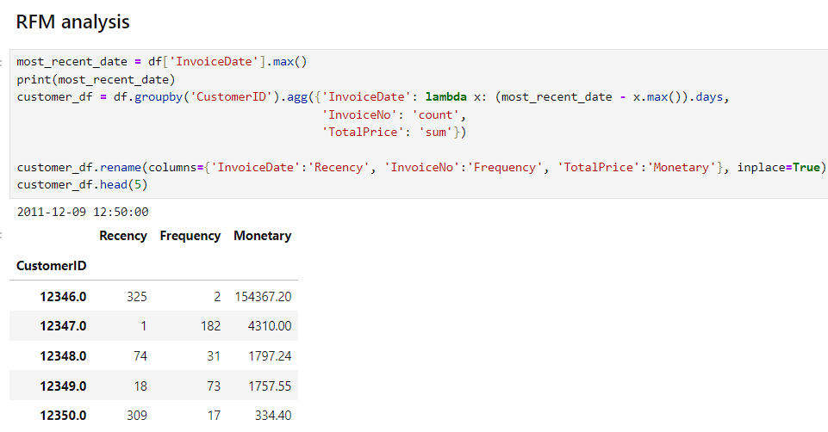
Implementation

Slide 12
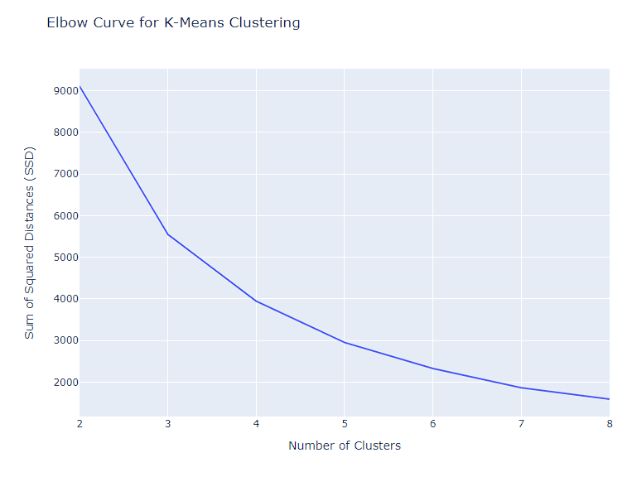
Implementation

Slide 13
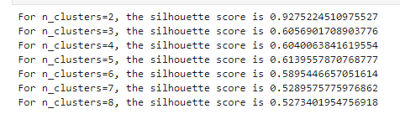

Implementation
Silhouette analysis :

Slide 14
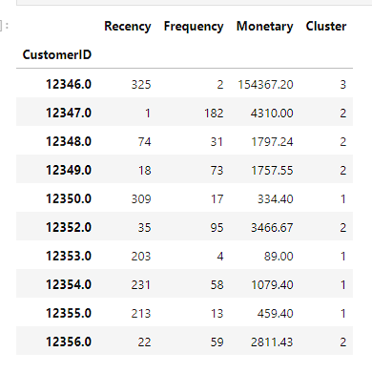
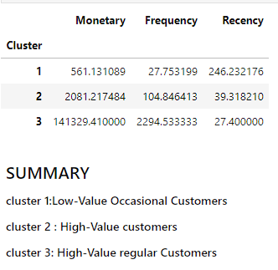
Implementation

Slide 15
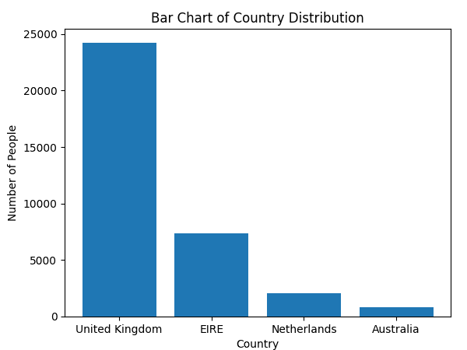
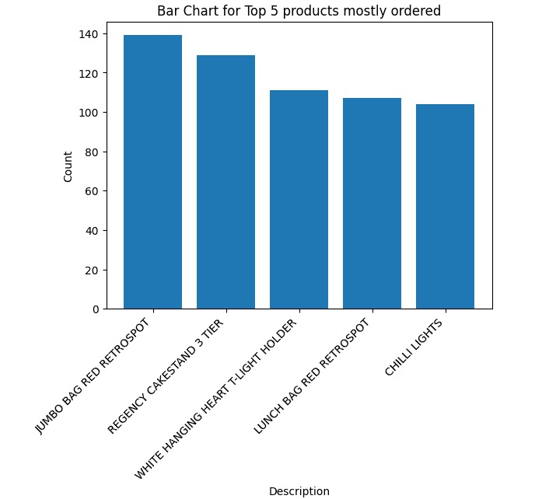
ANALYSING HIGH VALUE REGULAR CUSTOMERS
Results and Analysis

Slide 16
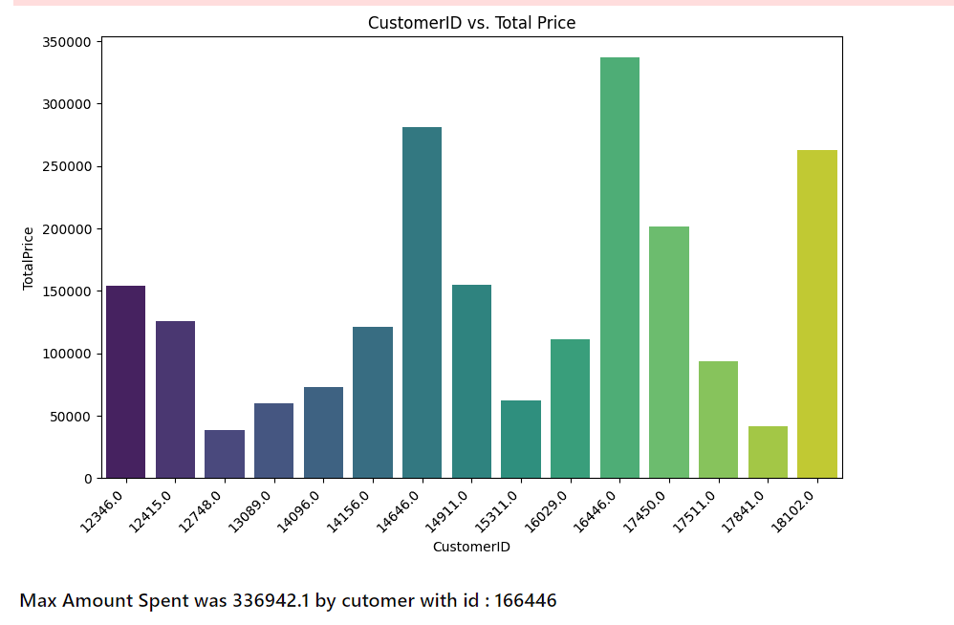
Results and Analysis

Slide 17
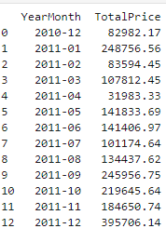
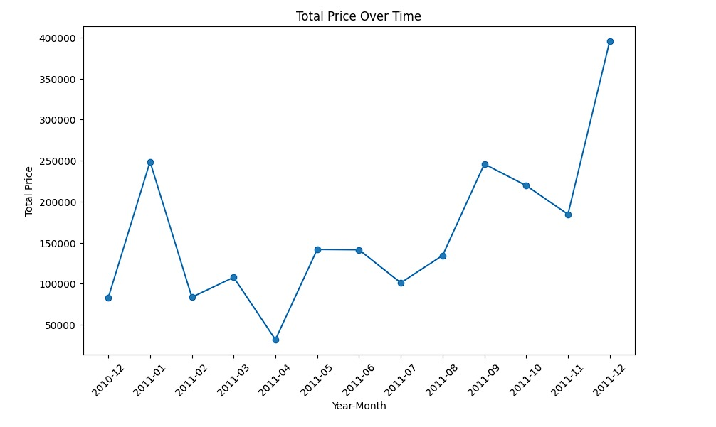
Results and Analysis
Monthly Sales :

Slide 18
THANK YOU

