Slide 1
Shielding against SMS spam and Cyberbullying Final Team ID: P-122 Panel No.:
Amrita School of Computing, Bangalore Campus
Department of Computer Science and Engineering
19CSE499 – Project Phase – 2
S.No | Reg.No | Name of the Student | Branch & Section
1 | BL.EN.U4CSE20092 | M. Nitin Sai | CSE-B
2 | BL.EN.U4CSE20109 | N N V Siva Sai Raghu | CSE-B
3 | BL.EN.U4CSE20113 | N.Chakravarthi | CSE-B
4 | BL.EN.U4CSE20114 | N.Leeladhar Royal | CSE-B
Project Guide: Dr.Deepa Gupta, Professor
Amrita School of Computing, Bengaluru

Slide 2
Problem Definition
“ The extensive use of online messaging platforms like WhatsApp has brought immense convenience, but it has also opened doors to malicious activities like cyberbullying and spam messages. These issues disrupt communication and can have severe psychological consequences for individuals.
This project aims to address these challenges using deep learning and natural language processing (NLP) techniques.”
Notes:
So basically our model filterers unwanted messages, so it works like a moderator

Slide 3
Literature Survey
Paper Title and year | Authors and paper details | Description | Gaps
Investigating Evasive Techniques in SMS Spam Filtering: A Comparative Analysis of Machine Learning Models Published Year-2023 | Muhammad Salman, Muhammad Ikram, Mohamed Ali Kaafar Published in: Proceedings of the 2023 International Conference on Computing, Communication, and Security (ICCECS 2023) | The study compared the performance of various machine learning models, including shallow models like Support Vector Machines (SVMs) and Naive Bayes, and deep learning models for SMS spam classification, assessing their robustness against spammers' evasive tactics. | The study found current SMS spam filters to be inadequate, with both shallow machine learning models and existing anti-spam services struggling against spammers evasive tactics. This highlights the need for more robust models, exploration of advanced techniques like transfer learning, and potentially combining machine learning with NLP to address the limitations and enhance spam detection.

Slide 4
Literature Survey
Paper Title and year | Authors And paper details | Description | Gaps
SMS Spam Detection Using Deep Learning Techniques: A Comparative Analysis of DNN Vs LSTM Vs Bi-LSTM Published Year-2023 | C. Gandhi P. Kumar Sarangi M. Saxena AK. Sahoo International Conference on Computational Intelligence and Sustainable Engineering Solutions (CISES) Location: Greater Noida, India | This paper compares the performance of three deep learning techniques, namely Deep Neural Network (DNN), Long Short-Term Memory (LSTM), and Bi-directional LSTM (Bi-LSTM), for SMS spam detection. | This paper do not address real world issues such as hyperparameter tuning and preprocessing, which are essential . There was no in analysis done on application of transfer learning, where a pre-trained model is fine-tuned for SMS spam detection .

Slide 5
Literature Survey
Paper Title and year | Authors and paper details | Description | Gaps
SpotSpam: Intention Analysis–driven SMS Spam Detection Using BERT Embeddings Published Year- 2022 | C. Oswald, Sona Elza Simon, and Arnab Bhattacharya. ACM Trans. Web 16, 3, Article 14 (August 2022), 27 pages. DOI: 10.1145/3538491 | The paper addresses the challenge of accurately filtering spam SMS messages, which are increasingly prevalent in Short Message Service (SMS) communication. It proposes an intention-based approach utilizing semantic and textual features of SMS messages, leveraging pre-defined intention labels and contextual embeddings generated by pre-trained NLP models. | It lacks critical analysis regarding the scalability, robustness, and generalizability of the method across diverse SMS spam datasets and real-world scenarios. Additionally, the paper could benefit from addressing the computational complexity and resource requirements of employing BERT embeddings in SMS spam detection systems.

Slide 6
Literature Survey
Paper Title and year | Authors and paper details | Description | Gaps
Improving Cyberbullying Detection with User Interaction Published year- 2021 | Suyu Ge, Lu Cheng, and Huan Liu. In Proceedings of the Web Conference 2021 (WWW '21). ACM, New York, NY, USA [DOI: 10.1145/3442381.3449828](https://doi.org/10.1145/3442381.3449828) | | The paper addresses limitations in existing cyberbullying detection methods by considering temporal correlations among comments, topic coherence across comments, and user interactions. Highlights the necessity of modeling temporal correlations, topic coherence, and user interactions to enhance cyberbullying detection accuracy and effectiveness. | The paper does not fully account for contextual nuances, multimodal data analysis, and real-time detection challenges in cyberbullying detection. These factors are essential for achieving more comprehensive and robust performance in identifying and addressing online bullying behavior.

Slide 7
Literature Survey
Paper Title and year | Authors and paper details | Description | Gaps
MTBullyGNN: A Graph Neural Network-Based Multitask Framework for Cyberbullying Detection Published Year-2022 | Kaushik Maity, Soumya Saha, Pabitra Bhattacharyya Published in Ieee transactions on computational social systems, vol. 11, no. 1, february 2022. | This paper proposes a novel framework, MTBullyGNN, that utilizes Graph Neural Networks (GNNs) for multi-task learning in cyberbullying detection. It leverages user interactions and content information to perform three tasks: identifying cyberbullying posts, classifying their severity levels, and detecting the targets of the bullying. The models used include GNNs for capturing user relationships and various sub-modules for different tasks like sentiment analysis and target identification. | While effective, the study acknowledges limitations like the model's dependence on the quality and size of the training data. Future research areas include exploring additional social network features, incorporating explainability techniques, and evaluating the framework on diverse datasets across different languages and cultures..

Slide 8
Literature Survey
Paper Title and year | Authors and paper details | Description | Gaps
Cyber Bullying Detection using Natural Language Processing (NLP) and Text Analytics Published Year-2022 | Y. Khang Hsien, Z. Arabee Abdul Salam V. Kasinathan Proceedings of the 2022 IEEE International Conference on Distributed Computing and Electrical Circuits and Electronics (ICDCECE) | This paper Employs NLP techniques like sentiment analysis, part-of-speech (POS) tagging, and negation handling to extract features from text data. Utilizes text analytics methods to identify patterns and relationships within the extracted features.Classifies text data as cyberbullying or non-bullying using a machine learning model. | We need more reliable and effective feature selection techniques for classifying text and strategies for selecting features by taking into account how they interact.

Slide 9
Literature Survey
Paper Title and year | Authors and paper details | Description | Gaps
Rapid Cyber-bullying detection method using Compact BERT Models Published Year-2021 | M. Behzadi, I. G. Harris, A. Derakhshan Presented at the 2021 IEEE 15th International Conference on Semantic Computing (ICSC) held in Laguna Hills, CA, USA. | This paper proposes a method for rapidly detecting cyberbullying using compact versions of the Bidirectional Encoder Representations from Transformers (BERT) model. The method is evaluated on a benchmark dataset and achieves promising result. | The paper mentions achieving "promising results" but doesn't provide detailed information on specific metrics like precision, recall, F1-score, or comparative performance against other cyberbullying detection methods. More comprehensive evaluation is necessary for a thorough understanding of the method's effectiveness.

Slide 10
Literature Survey
Paper Title and year | Authors and paper details | Description | Gaps
Can Bullying Detection Systems Help in School Violence Scenarios?: A Teachers' Perspective Published Year- 2020 | Jaeyoung Kim, Thanh Dung Ho, Jihwan Kim, Youngki Lee, and Jinwook Seo. In Extended Abstracts of the 2020 CHI Conference on Human Factors in Computing Systems (CHI EA '20). ACM, New York, NY, USA, 1–7. DOI: 10.1145/3334480.3382929 | The paper investigates the potential of technology-driven school violence detection and intervention systems from the teachers’ perspective. It discusses teachers' concerns and design implications derived from interviews with 35 teachers. Identifies the gap between existing research on school violence detection systems and the perspectives and needs of teachers, highlighting concerns such as privacy, algorithm accuracy, and the burden on teachers. Provides design implications to address these concerns and better align technology with teachers' needs. | The paper lacks consideration for the viewpoints of students, who are directly affected by these systems. Incorporating student perspectives would provide a more comprehensive understanding of the benefits and drawbacks of technology-driven interventions in addressing school violence.

Slide 11
Literature Survey
Paper Title and year | Authors and paper details | Description | Gaps
Bullying Hurts: A Survey on Non-Supervised Techniques for Cyber-bullying Detection Published Year- 2019 | Nadine Farag, Samir Abou El-Seoud, Gerard McKee, and Ghada Hassan. In Proceedings of the 8th International Conference on Software and Information Engineering (ICSIE '19). ACM, New York, NY, USA, 85–90. DOI: 10.1145/3328833.3328869 | The paper discusses the prevalence of cyber-bullying and the need for effective detection methods. It surveys recent research on non-supervised techniques for cyber-bullying detection and suggests future research directions, including detecting roles, emotional states, automated annotation, and stylometric methods. | The paper lacks comprehensive coverage of non-supervised techniques, potentially overlooking innovative approaches. It also falls short in evaluating and comparing the effectiveness of different techniques, neglecting practical implementation challenges such as scalability and integration, and overlooking user perspectives crucial for system adoption.

Slide 12
Literature Survey
Paper Title and year | Authors and paper details | Description | Gaps
Optimized Twitter Cyberbullying Detection based on Deep Learning Published year- 2018 | M. A. Al-Ajlan and M. Ykhlef, "Optimized Twitter Cyberbullying Detection based on Deep Learning," 2018 21st Saudi Computer Society National Computer Conference (NCC), Riyadh, Saudi Arabia, | The paper addresses the challenge of cyberbullying detection on Twitter, highlighting the limitations of existing approaches based on textual and user features. It proposes an optimized approach, OCDD, which represents tweets as word vectors to preserve semantics and eliminates the need for feature extraction and selection. Deep learning techniques are employed for classification, along with a metaheuristic optimization algorithm for parameter tuning. | The paper could provide more comprehensive validation of its effectiveness by conducting rigorous experiments and benchmarking against state-of-the-art cyberbullying detection techniques. This would enhance confidence in the proposed method and its potential applicability in real-world scenarios

Slide 13
Literature Survey
Paper Title and year | Authors and paper details | Description | Gaps
Detection of Cyberbullying Using Deep Neural Network Published Year- 2019 | V. Banerjee, J. Telavane, P. Gaikwad and P. Vartak, "Detection of Cyberbullying Using Deep Neural Network," 2019 5th International Conference on Advanced Computing & Communication Systems (ICACCS), Coimbatore, India. | The paper proposes a novel cyberbullying detection method based on deep neural networks, specifically Convolutional Neural Networks (CNNs). It addresses the growing concern of cyberbullying, highlighting its adverse effects on individuals, and suggests using CNNs for improved detection compared to existing methods. | While the paper introduces a novel approach for cyberbullying detection using deep neural networks, it lacks detailed discussion on the specific architecture and training methodology of the CNN model, as well as comprehensive evaluation against existing techniques to demonstrate its superiority. Further exploration of these aspects would enhance the paper's contribution to the field.

Slide 14
Justification for the Proposed Problem
Justification:To address this challenge, we propose a model that can effectively find and detect cyberbullying and spam messages. This project will involve a comparative study of different Deep Learning (DL) models, including Deep Neural Networks (DNNs), Long Short-Term Memory (LSTM) networks, Bidirectional LSTMs (BiLSTMs), and pre-trained transformer models like BERT.
Overall Goal: This approach ultimately aims to safeguard users in the digital landscape by effectively combating online threats.
Notes:
We cant use traditional ml methods becoz they struggle with complexities of nlp.

Slide 15
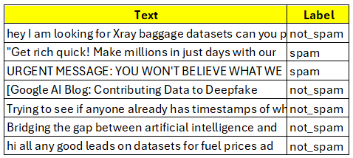
Data Set
Source of Dataset: The datasets utilized for this project were obtained from Hugging Face (2023) .
SMS Spam Filtering Dataset
Training Data: The SMS spam filtering model will be trained on a dataset consisting of 8194 rows. Each row contains two columns - "text," containing the SMS message, and "label," indicating whether the message is classified as spam or not-spam.
Testing Data: The model's performance will be evaluated on a separate dataset with 2725 rows, maintaining the same structure of columns as the training set.

Slide 16
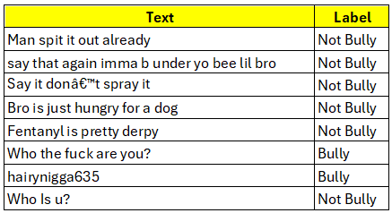
Data Set
Source of Dataset: The datasets utilized for this project were obtained from Hugging Face (2024) .
Cyberbullying Detection Dataset
Training Data: The cyberbullying detection model will be trained on a dataset comprising 902 rows. Like the SMS spam filtering dataset, it contains two columns - "text" for the message and "label" to denote whether the content is classified as cyberbullying (bully) or not (not-bully).
Testing Data: To assess the effectiveness of the cyberbullying detection model, it will be tested on another dataset containing 202 rows, structured with the same "text" and "label" columns.

Slide 17
Software/Tools Requirements
Natural Language Processing (NLP) Libraries:
Sklearn: A machine learning library
NLTK : It's a popular open-source library for Python that provides tools for working with human language data. This includes tasks like tokenization, stemming, lemmatization, and various tasks in natural language processing (NLP)
Deep Learning Libraries:
TensorFlow , spellchecker , transformers , scikeras , sklearn
Data Visualization Library:
Matplotlib: A library for creating plots and charts.
Other Libraries:
Torch: A library for tensor computation and deep learning.
NumPy: A library for numerical computation and data manipulation.

Slide 18
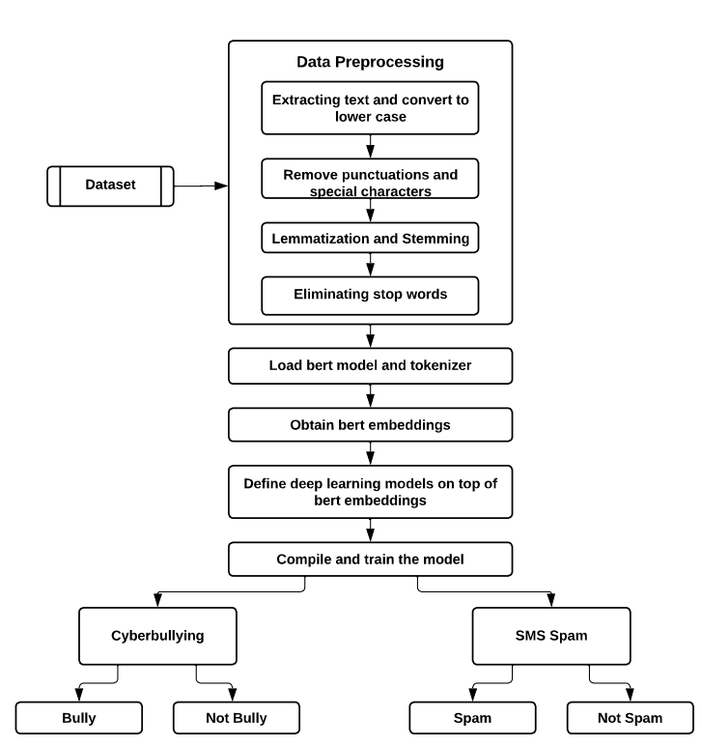
Architecture

Slide 19
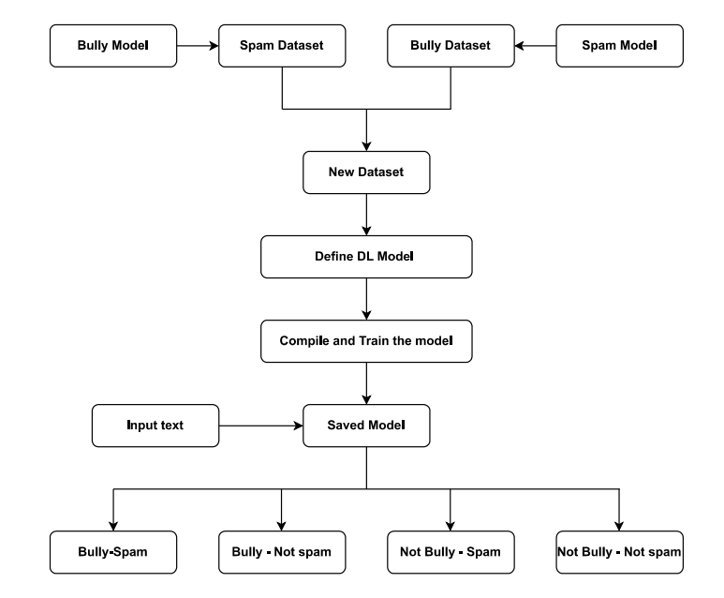
Architecture(Cont)

Slide 20
Models Used
1. DNN (Deep Neural Network): A class of artificial neural networks with multiple layers between the input and output layers, allowing them to learn complex representations of data through hierarchical abstraction.
2. LSTM (Long Short-Term Memory): A type of recurrent neural network (RNN) architecture designed to capture long-term dependencies in sequential data by maintaining a memory cell that can store information for long periods.
3. Bi-LSTM (Bidirectional Long Short-Term Memory): An extension of LSTM that processes input data in both forward and backward directions, enabling the model to capture dependencies from both past and future contexts.
4. BERT (Bidirectional Encoder Representations from Transformers): A transformer-based model designed for natural language understanding tasks, trained on large amounts of text data using a masked language modelling objective. BERT can capture bidirectional context and has set benchmarks in various NLP tasks.
Notes:
Think of DNN as a multi-layered brain-inspired network that can understand complex patterns in data by breaking them down into simpler pieces through layers. LSTM is like a smart memory unit in a network, helping it remember important information from the past for a long time, which is crucial for understanding sequences like text or speech. , allowing the network to look both forward and backward in a sequence, which helps it understand context better for tasks like language translation or sentiment analysis. expert trained on tons of books, learning to predict missing words in sentences. It can understand context from both directions, setting new standards for understanding human language in various tasks like question answering or text classification.

Slide 21
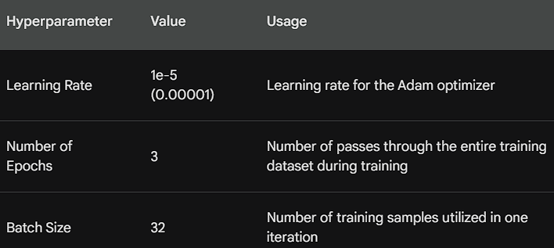
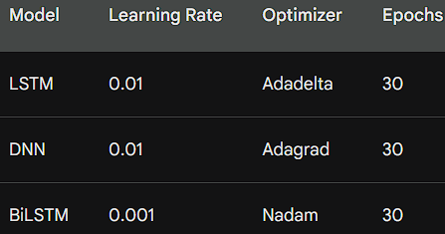
Hyper Parameters used
Hyper Parameters used for bert models
Hyper Parameters used for DL models
Notes:
Hyperparameters are predefined parameters governing the learning process
The model will run efficiently

Slide 22
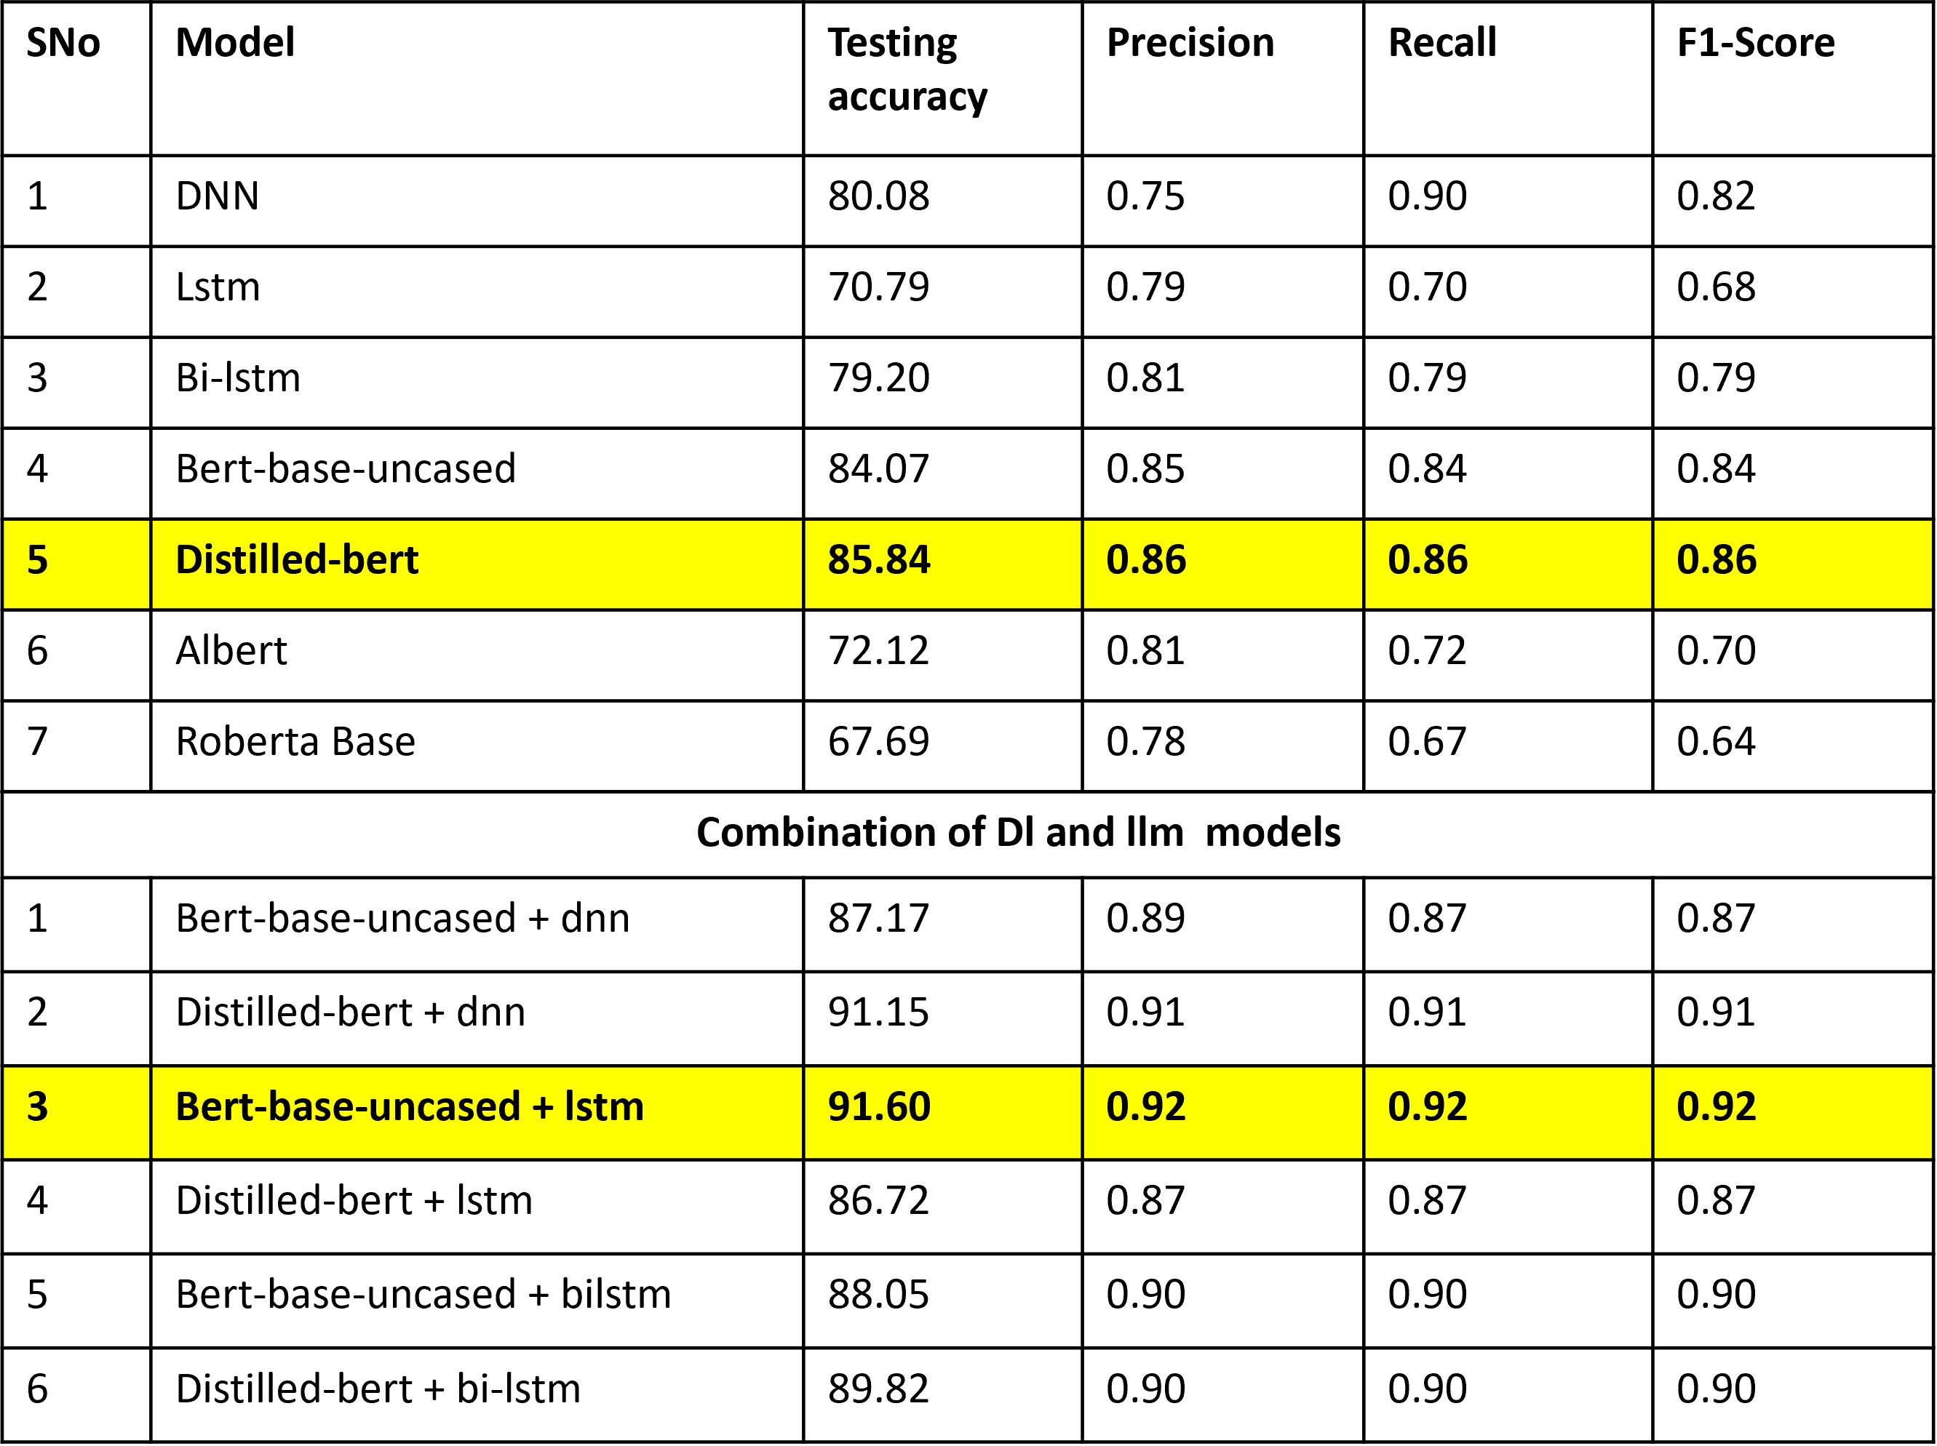
Cyber bullying Results

Slide 23
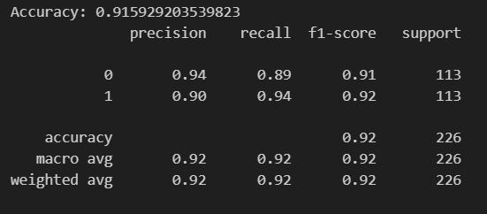
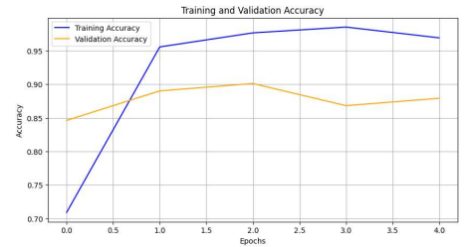
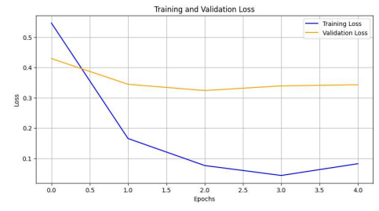
Class Wise result for Bert-base-uncased + lstm model is :
Bert-base-uncased + lstm is giving the
best testing accuracy.
Where 0 is bully and 1 is not_bully
Hence corresponding classification report , Accuracy loss curves are shown :

Slide 24

SMS SPAM DETECTION
S.No | Model | Testing Accuracy | Precision | Recall | F1-score
1 | DNN | 97.60 | 0.98 | 0.98 | 0.98
2 | LSTM | 97.80 | 0.97 | 0.98 | 0.97
3 | BI-LSTM | 97.20 | 0.98 | 0.96 | 0.97
4 | BERT | 0.93 | 0.93 | 0.93 | 0.93
Class | Precision | Recall | F1-score
Spam | 0.98 | 0.97 | 0.97
Not-spam | 0.97 | 0.98 | 0.97

Slide 25
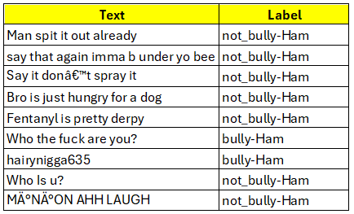
Leveraging Trained Models for Cross-Domain Prediction
We have taken a proactive approach to enhance the efficiency of both cyber-bullying and spam detection. By training separate models for each task initially, we ensured that they were optimized for their specific purposes.
We leveraged the pre-trained model to make predictions on the datasets opposite to their original training data, creating a concatenated dataset. By doing so, we effectively diversified and expanded your training data, enriching the learning process for newer models.

Slide 26
Leveraging Trained Models for Cross-Domain Prediction
Results for DNN:
S.No | Optimizer | Testing Accuracy | Precision | Recall | F1-score
1 | Rmsprop | 81.00 | 0.83 | 0.83 | 0.83
2 | Adam | 84.00 | 0.85 | 0.87 | 0.86
3 | Adadelta | 76.00 | 0.82 | 0.66 | 0.69
4 | Nadam | 78.00 | 0.83 | 0.83 | 0.82
Results for Bi-lstm:
S.No | Optimizer | Testing Accuracy | Precision | Recall | F1-score
1 | Rmsprop | 83.00 | 0.88 | 0.71 | 0.75
2 | Adam | 86.00 | 0.89 | 0.87 | 0.88
3 | Adadelta | 82.00 | 0.87 | 0.67 | 0.70
4 | Nadam | 84.00 | 0.80 | 0.85 | 0.82

Slide 27
Leveraging Trained Models for Cross-Domain Prediction
S.No | Model | Testing Accuracy | Precision | Recall | F1-score
1 | DNN | 83.00 | 0.85 | 0.87 | 0.86
2 | Bi-LSTM | 85.00 | 0.83 | 0.86 | 0.84
Class | Precision | Recall | F1-score
bully-Spam | 0.75 | 0.90 | 0.82
not_bully-Spam | 0.91 | 0.83 | 0.87
bully-Ham | 0.79 | 0.86 | 0.83
not_bully-Ham | 0.85 | 0.84 | 0.85

Slide 28
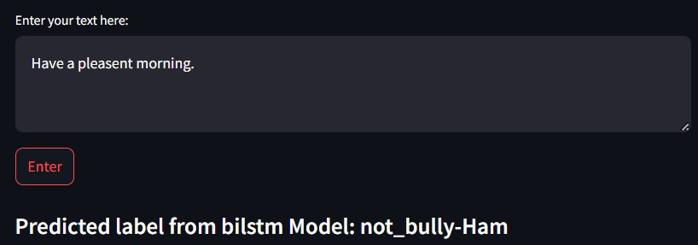
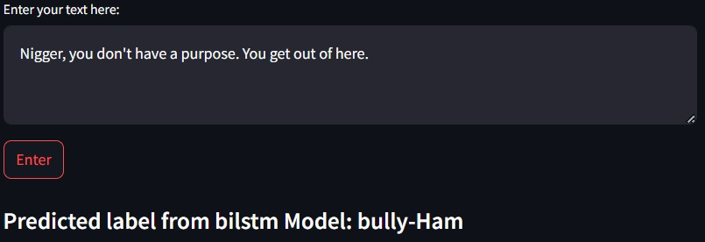
User Interface
The app utilizes 4 models out of two of them are base model and the remaining two models are tailored for cross-domain prediction.

Slide 29
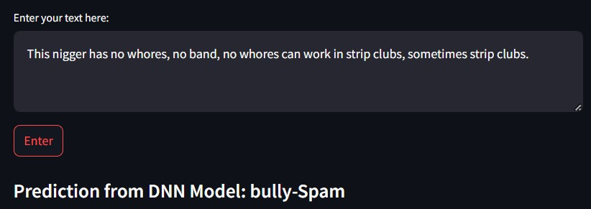
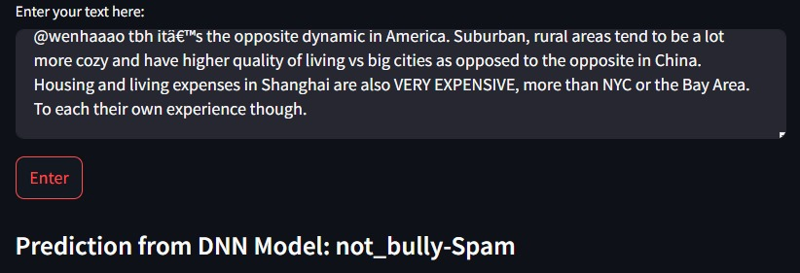

Slide 30
Conclusion
Comprehensive Model: Our approach integrates various Deep Learning architectures, including DNNs, LSTM networks, BiLSTMs, and pre-trained transformer models like BERT, to effectively combat cyberbullying and spam messages.
Innovative Fusion: Leveraging pre-trained models, we expanded our analysis by predicting on datasets opposite to their training domains, creating a concatenated dataset. This novel fusion of insights empowered us to train newer models, such as DNNs and BiLSTMs, with augmented data.
Commitment to Safety: Our holistic approach reflects our unwavering dedication to safeguarding users in the digital realm. By staying at the forefront of technological advancements, we are poised to make significant strides in combating online threats and ensuring a safer online experience for all.
Future Directions: As we continue to refine and adapt our model, we envision further enhancements in its performance and scalability. Our journey towards a safer digital landscape is ongoing, and we remain committed to pioneering solutions that prioritize user safety and security.

Slide 31
References
[1] C. Gandhi, P. Kumar Sarangi, M. Saxena and A. K. Sahoo, "SMS Spam Detection Using Deep Learning Techniques: A Comparative Analysis of DNN Vs LSTM Vs Bi-LSTM," 2023
International Conference on Computational Intelligence and Sustainable Engineering
Solutions (CISES), Greater Noida, India, 2023, pp. 189-194, doi:
10.1109/CISES58720.2023.10183634.
[2] M. Salman, M. Ikram and M. A. Kaafar, "Investigating Evasive Techniques in SMS Spam Filtering: A Comparative Analysis of Machine Learning Models," in IEEE Access, vol. 12, pp. 24306-24324, 2024, doi: 10.1109/ACCESS.2024.3364671
[3] M. Behzadi, I. G. Harris, and A. Derakhshan, "Rapid Cyber-bullying detection method using
Compact BERT Models," 2021 IEEE 15th International Conference on Semantic Computing
(ICSC), Laguna Hills, CA, USA, 2021, pp. 199-202, doi: 10.1109/ICSC50631.2021.00042
[4] K. Maity, T. Sen, S. Saha and P. Bhattacharyya, "MTBullyGNN: A Graph Neural Network-Based Multitask Framework for Cyberbullying Detection," in IEEE Transactions on Computational Social Systems, vol. 11, no. 1, pp. 849-858, Feb. 2024, doi: 10.1109/TCSS.2022.3230974
[5] Y. Khang Hsien, Z. Arabee Abdul Salam and V. Kasinathan, "Cyber Bullying Detection using Natural Language Processing (NLP) and Text Analytics," 2022 IEEE International Conference on Distributed Computing and Electrical Circuits and Electronics (ICDCECE), Ballari, India, 2022, pp. 1-4, doi: 10.1109/ICDCECE53908.2022.9792931

Slide 32
References
[6] V. Banerjee, J. Telavane, P. Gaikwad and P. Vartak, "Detection of Cyberbullying Using Deep Neural Network," 2019 5th International Conference on Advanced Computing & Communication Systems (ICACCS), Coimbatore, India, 2019, pp. 604-607, doi: 10.1109/ICACCS.2019.8728378.
[7] School Violence Scenarios?: A Teachers' Perspective. In Extended Abstracts of the 2020 CHI Conference on Human Factors in Computing Systems (CHI EA '20). Association for Computing Machinery, New York, NY, USA, 1–7. https://doi.org/10.1145/3334480.3382929 -
[8] Ghada Hassan. 2019. Bullying Hurts: A Survey on Non-Supervised Techniques for Cyber-bullying Detection. In Proceedings of the 8th International Conference on Software and Information Engineering (ICSIE '19). Association for Computing Machinery, New York, NY, USA, 85–90. https://doi.org/10.1145/3328833.3328869
[9] C. Oswald, Sona Elza Simon, and Arnab Bhattacharya. 2022. SpotSpam: Intention Analysis–driven SMS Spam Detection Using BERT Embeddings. ACM Trans. Web 16, 3, Article 14 (August 2022), 27 pages. https://doi.org/10.1145/3538491
[10] M. A. Al-Ajlan and M. Ykhlef, "Optimized Twitter Cyberbullying Detection based on Deep Learning," 2018 21st Saudi Computer Society National Computer Conference (NCC), Riyadh, Saudi Arabia, 2018, pp. 1-5, doi: 10.1109/NCG.2018.8593146.
[11] Suyu Ge, Lu Cheng, and Huan Liu. In Proceedings of the Web Conference 2021 (WWW '21). ACM, New York, NY, USA [DOI: 10.1145/3442381.3449828](https://doi.org/10.1145/3442381.3449828) |

Slide 33
THANK YOU

