Slide 1


RepoPulse
Explainable health and risk scoring for GitHub repositories
[Team member names and roll numbers]
[Course name] | Faculty: [Faculty name] | 2 November 2026
Notes:
Good morning. We are presenting RepoPulse, a tool that tells you how healthy a GitHub repository is before you depend on it. It turns public data into a score from 0 to 100 and a Low, Medium or High risk rating. The important word on this slide is explainable. Every number can be traced by hand back to a raw measurement. In the next ten minutes we will cover the problem, how the score is built, one real worked example, our results, and the limits we found when we tested it.

Slide 2
Stars do not show a safe dependency
46%
left-pad, 2016
Removing one small npm package broke builds across JavaScript projects.
of 133 popular GitHub systems had a truck factor of 1
xz Utils, 2024
Malicious code reached upstream tarballs (CVE-2024-3094).
Avelino et al., ICPC 2016
A repository page shows popularity. It does not say who maintains the project, whether issues get answers, or whether flaws are known.
Notes:
Every project depends on open source code that nobody on the team has read. Choosing a dependency is a risk decision, but the repository page mostly shows popularity. In 2016 the removal of one small package, left-pad, broke builds across the JavaScript world. In 2024 malicious code reached the upstream release tarballs of xz Utils. Research backs this up. Avelino and colleagues studied 133 popular GitHub systems, and 46 percent had a truck factor of one. So one person leaving could stall the project. Developers can check all this by hand, but it is slow and hard to repeat. That is the gap we address.

Slide 3
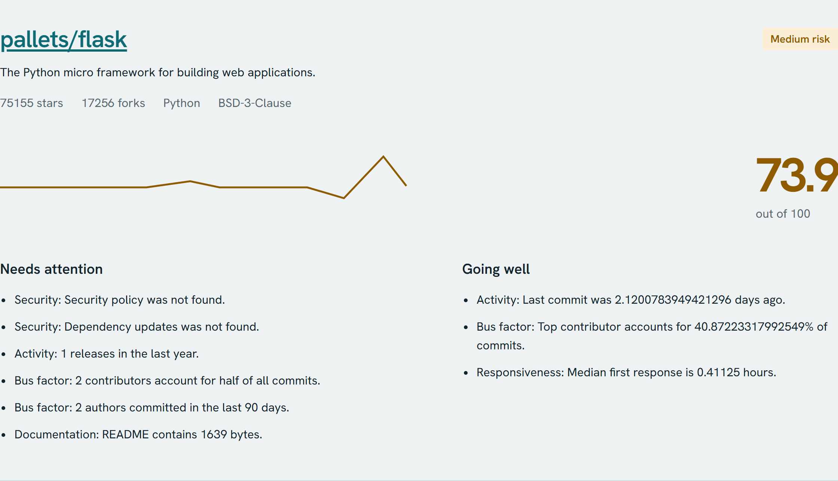
One score you can check by hand
1
25 metrics, 5 areas
Activity, bus factor, responsiveness, documentation and security
2
Every value explained
Raw value, score and a plain sentence for each metric
3
No machine learning
Fixed, published formulas give repeatable results
4
Several ways to use it
Check, compare, scan, PDF, CSV, badge and CI gate
Live result for pallets/flask, 1 November 2026
Notes:
RepoPulse takes any public repository. It collects 25 metrics in five areas: activity, bus factor, responsiveness, documentation and security. The result is a score, a risk rating, and a plain list of what needs attention and what is going well. This screenshot is real output for Flask. We deliberately did not use machine learning. A trained model would be harder to explain, and the aim is that you can challenge any number. Beyond checking one repository, users can compare up to four, scan a dependency file, download PDF and CSV reports, embed a badge, and block a CI pipeline on risk.

Slide 4
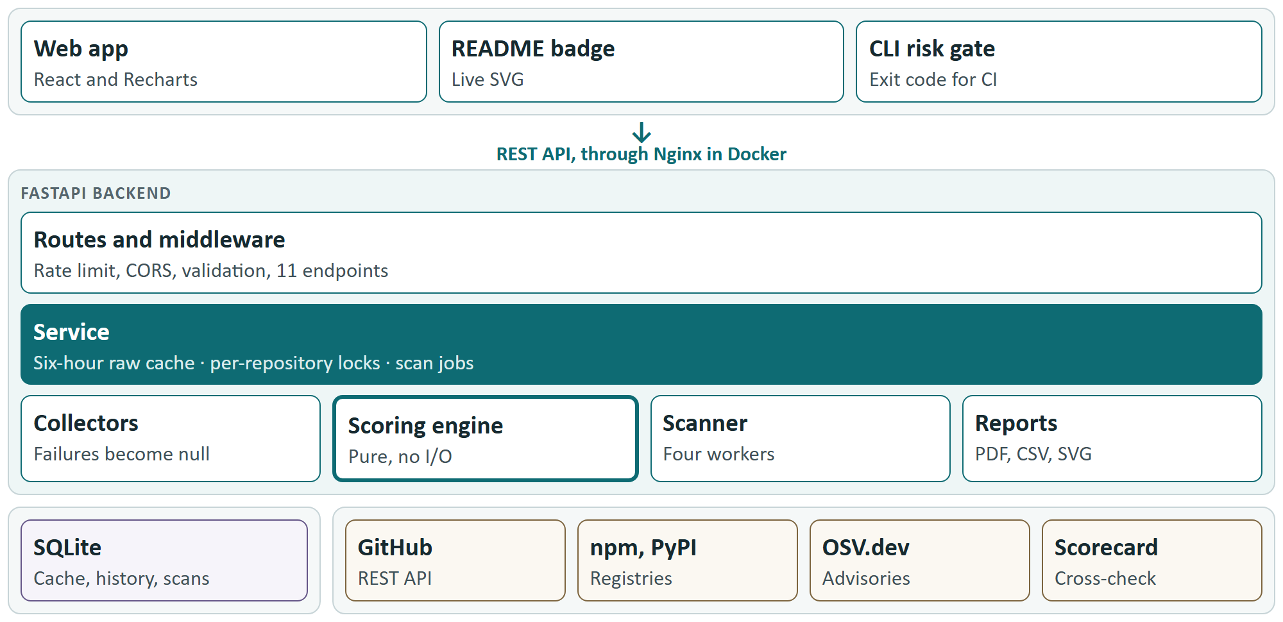
Scoring is separate from data collection
Notes:
This is the architecture. A React frontend calls a FastAPI backend, through Nginx when running in Docker. The service layer in the middle owns caching, locks and background scan jobs. Below it are collectors, the scoring engine, the dependency scanner and report generators. SQLite stores the data, and the external sources are GitHub, npm, PyPI, OSV and OpenSSF Scorecard. The key decision is that the scoring engine has no input or output at all. It is pure functions with an injected clock. Because of that we can test it with fixed data, and we can rerun it on stored data at any time. The GitHub token stays on the backend and never reaches the browser.

Slide 5
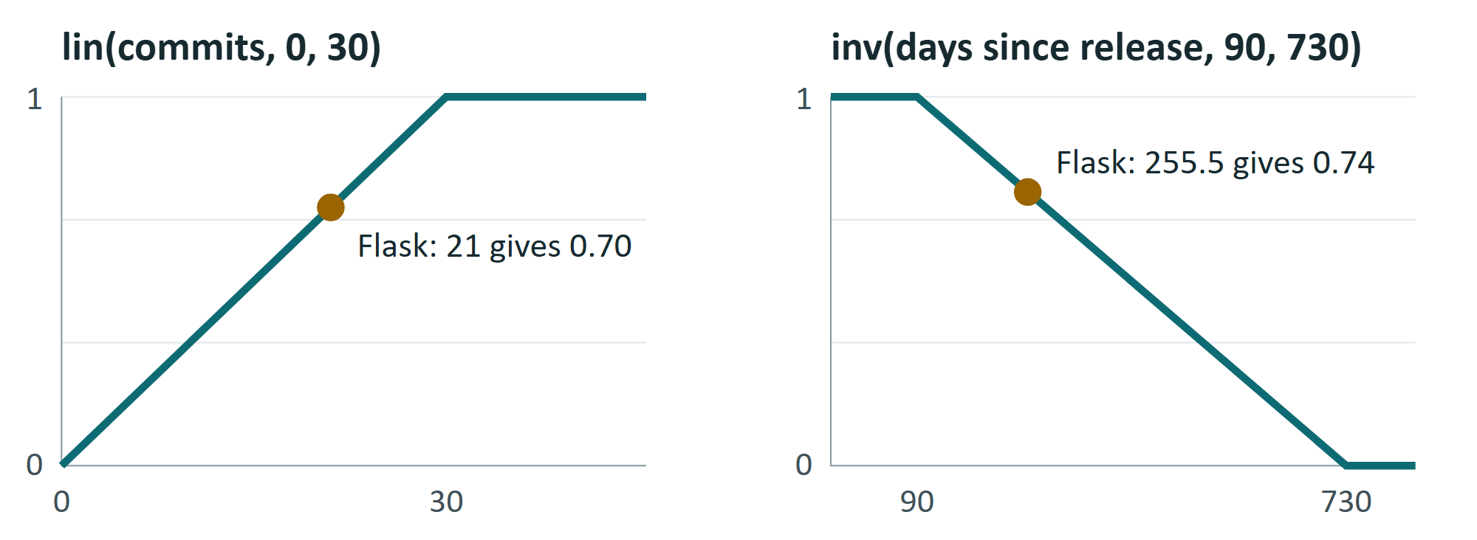
From raw measurement to risk rating
1. Measure
25 raw values, null if unavailable
2. Ramp
Map each value to 0..1
3. Average
Mean of available metrics
4. Adjust
Mature project: Activity at least 60
5. Weight
Weighted mean of categories
6. Rate
80+ Low, 50+ Medium, else High
Category | Default weight
Activity | 25%
Bus factor | 20%
Responsiveness | 20%
Documentation | 15%
Security | 20%
Missing data is left out. Archived, or no commit for 730 days, forces High.
Notes:
Here is the method in six steps. First we measure. Anything unavailable stays null, which is different from zero. Second, a ramp maps each value to between 0 and 1. For example, 30 commits in 90 days or more scores 1, and Flask's 21 commits scores 0.7. Third, each category is the average of its available metrics. Fourth, a mature, stable project with low activity is raised to 60, so finished libraries are not punished. Fifth, we take a weighted average. Sixth, the score maps to a risk band: 80 and above is Low, 50 and above is Medium, otherwise High. Overrides can only raise the risk. An archived repository is always High, however good its average looks.

Slide 6
Worked example: Flask scores 73.9
Category | Score | Weight | Contribution
Activity | 73.8 | 25% | 18.450
Bus factor | 62.5 | 20% | 12.500
Responsiveness | 96.4 | 20% | 19.280
Documentation | 90.9 | 15% | 13.635
Security | 50.0 | 20% | 10.000
Total |  |  | 73.865
73.9
Medium risk
Between 50 and 79.9. No override applies.
Trace one value: 21 commits in 90 days gives lin(21, 0, 30) = 0.70. The five Activity metrics average 0.738, so Activity is 73.8.
Security is the drag: no repository-level policy or update tool was found.
Notes:
This is one real result you can verify on paper. Multiply each category by its weight and add them up: 18.45, 12.5, 19.28, 13.635 and 10 give 73.865, which rounds to 73.9. That falls between 50 and 79.9, so Flask is Medium. To trace one value: Flask had 21 commits in the last 90 days, and the ramp gives 0.7. Averaging the five Activity metrics gives 73.8. The lowest category is Security at 50, because the check found no security policy or dependency update tool in the repository itself. Flask actually has an organisation-level policy that this check cannot see. So the score is explainable, and the explanation also shows us where the method falls short.

Slide 7
Caching raw data makes rescoring cheap
1
One lock per repository
Simultaneous requests collect only once
First collection
Cached rescore
5.2 s
2.5 ms
2
At most 8 GitHub calls
A semaphore protects the quota
Typically about 23 GitHub requests
0 GitHub requests, tested with new weights
3
Null is not zero
A failed call is left out, not counted as 0
At 23 requests each, GitHub allows 2 or 3 fresh repositories an hour without a token and about 217 with one.
Notes:
Collecting one repository is expensive. We measured 23 GitHub requests for pallets/click, and 5.2 seconds for Flask. GitHub allows only 60 requests an hour without a token, so that is two or three repositories. So we cache the raw measurements, not the scores, for six hours. Changing a slider just reruns the pure scoring function, which took 2.5 milliseconds and zero requests. Two more decisions matter here. A separate lock per repository means two users asking at the same moment trigger only one collection. And a semaphore limits us to eight GitHub calls at once. A failed sub-request becomes null, so it is left out of the average instead of counting as zero, and it cannot break the whole analysis.

Slide 8
We test whether a ranking really holds
1
Django: first in 300 of 300
No tested weighting changes first place
2
Flask: last in 300 of 300
Last place also holds
3
Requests and click swap
Second place splits 58% to 42%, so the ranking is flagged unstable
Each of the 300 trials multiplies every weight by 0.5 to 1.5, with a fixed seed of 7.
Notes:
Weights are a judgement call, so we should not trust a ranking that one small change can reverse. For any comparison, RepoPulse runs 300 trials. Each trial multiplies every weight by a random factor between 0.5 and 1.5. The seed is fixed at 7, so results repeat exactly. In this comparison Django came first in every trial and Flask came last in every trial. But requests and click swapped: requests was second 58 percent of the time. They are only 0.8 points apart, and RepoPulse correctly reports that this ranking depends on the weights. It tells you when not to read too much into a small difference.

Slide 9
Scanning finds risk in pinned versions
Package | Pinned | Score | Advisories | Risk
flask | 0.12.2 | 73.9 | 8 (3) | Medium
requests | 2.19.0 | 83.0 | 10 (1) | Medium
django | 3.2 | 91.2 | 66 (22) | Medium
click | 8.1.7 | 82.2 | 0 | Low
(fake package) | - | n/a | - | Not found
1
Uses the declared version
OSV is queried for the version you actually pinned
2
A high advisory raises risk
Any high or critical finding moves Low to Medium
3
Health is not patching
Django scores 91.2, yet version 3.2 has 66 advisories reported
Advisories as reported, with high or critical in brackets. Live scan of a test requirements.txt, 1 November 2026.
4
Ready for CI
The same scan with --max-risk low returned exit code 1
Notes:
Upload a package.json or requirements.txt and RepoPulse checks each dependency. It finds the GitHub repository through npm or PyPI, scores it, and asks OSV for known vulnerabilities at the version you declared. We tested old pinned versions of Flask, requests and Django, plus a package that does not exist. This slide shows an important idea. Django has a very healthy repository at 91.2, but the old version 3.2 has 66 advisories reported. A healthy project does not mean your pinned version is patched, so the tool reports both. The same scan runs from the command line, and with max risk set to low it returned exit code 1, which would stop a CI pipeline.

Slide 10
181 tests pass on CI; live scores hold up
181
tests pass on Linux CI: 163 backend, 18 frontend
Repository | Today | README | Risk
django/django | 91.2 | 91.2 | Low
psf/requests | 83.0 | 83.2 | Low
pallets/click | 82.2 | 82.2 | Low
pallets/flask | 73.9 | 73.9 | Medium
atom/atom (archived) | 41.2 | n/a | High
94%
backend line coverage; scoring.py at 100%
Tests run offline, using mocked HTTP and in-memory SQLite. A guard fails any test that opens a real connection.
3 of 4
recorded scores matched exactly; the other moved 0.2
Notes:
All 181 automated tests pass on the project's GitHub Actions run: 163 backend and 18 frontend. Backend line coverage is 94 percent, and the scoring module is at 100. Tests run entirely offline with mocked HTTP and an in-memory database, and a guard fails any test that tries to reach the network. We also ran the real system live. Three of the four recorded scores matched exactly, and requests moved by 0.2, because elapsed time feeds into the metrics. The archived Atom repository scored 41.2 and was rated High, as expected. One practical note: on Windows the test guard needs a small change, because it also blocks a connection that asyncio makes internally. Linux CI is not affected.

Slide 11
Limits we confirmed, and what comes next
Confirmed limits
Next steps
OSV lists one flaw twice: 8 reported, 4 real
The CI gate passes if nothing was scored
An OSV outage looks like a clean result
Thresholds are reasoned, not yet validated
Remove duplicates by OSV alias
Fail the gate on unscored packages
Return null when a lookup fails
Calibrate against abandoned projects
A score is evidence for a decision, not a guarantee. Thank you. Questions?
Notes:
We tested our own project hard, and these are the limits we confirmed. OSV lists one flaw under two identifiers, so Flask 0.12.2 shows 8 vulnerabilities when there are really 4. If GitHub's rate limit stops a scan, the CI gate can pass with nothing scored. An OSV outage looks the same as a clean result. And our thresholds are reasoned choices that nobody has validated against real failures yet. Each of these has a clear fix, listed on the right, and the report gives the evidence. To conclude: RepoPulse makes repository health checkable. A score is evidence for a decision, not a guarantee. Thank you, and we welcome your questions.

