Slide 1
Market Mix Modelling

Slide 2
Presented By:
Nitin
Bishnu
Chandrakanth
Abhijeet

Slide 3
Objective
Understanding of the business problem and data. Overall structure to solve the problem.
Engineering the KPIs and results of the initial linear model.
Results of the models (variables, KPIs and validation results), suggestions to improve the models. The final choice of model to be deployed.
Presentation of results to the business - important variables, results (in simple terms) etc.

Slide 4
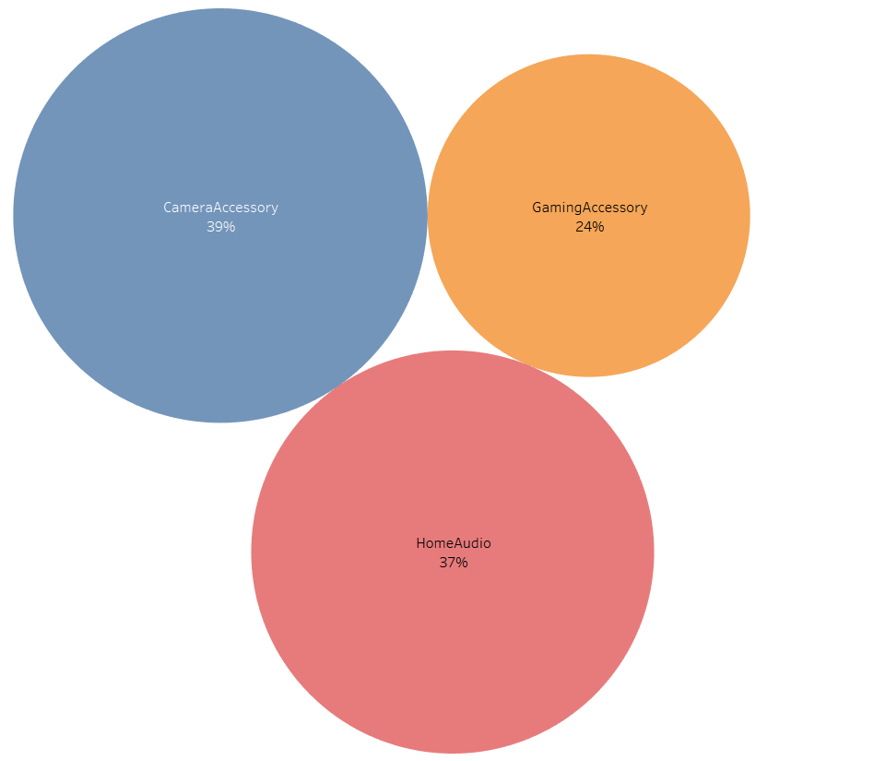
Percentage contribution to GMV

Slide 5
Gaming Accessories

Slide 6
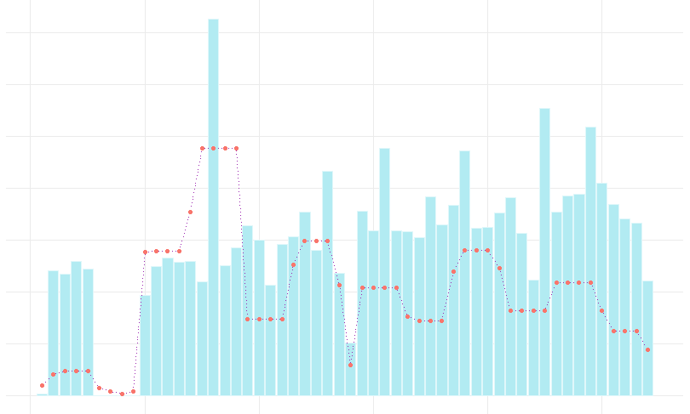
Weekly GMV vs Total Investment Trend
GMV
Investment
The values are scaled differently. This graph is only meant to observe trend.

Slide 7
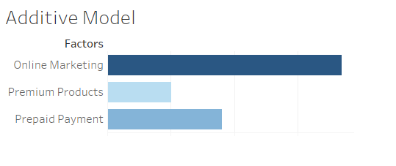
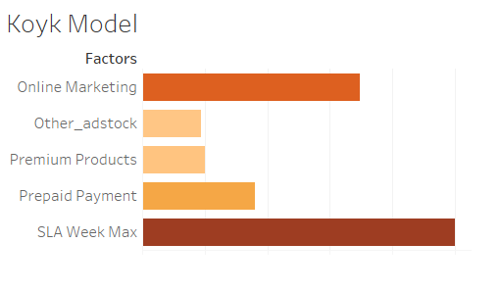
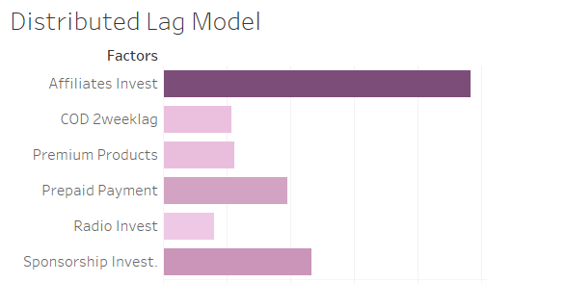
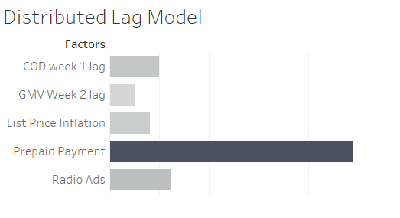
Outcomes of the models

Slide 8
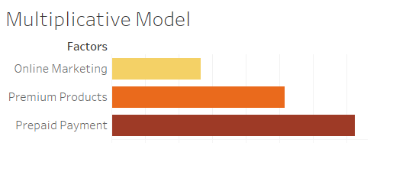
Most Efficient Model
0.8001232
R-squared

Slide 9
Observations
Additive, Koyk and Distributed Lag model showed TV Ads to be one of the negative influencers
Online Marketing is positive influencer in 3 of the models
Sale of premium products (priced above Rs. 6990) is also a primary influencer in 3 of the models
Affiliates Marketing also tops the influencer list in a lag model
Prepaid Payment orders is the common factor in all influencers; it is the biggest influencer in the main Multiplicative model
More ways to enable Prepaid Payments should be introduced.

Slide 10
Suggestions
Invest in Online Marketing and Affiliates marketing
Market about the premium range of products more
Increase Prepaid Payment modes like wallets, virtual currencies etc.
Stock more premium products and market them

Slide 11
Home Audio

Slide 12
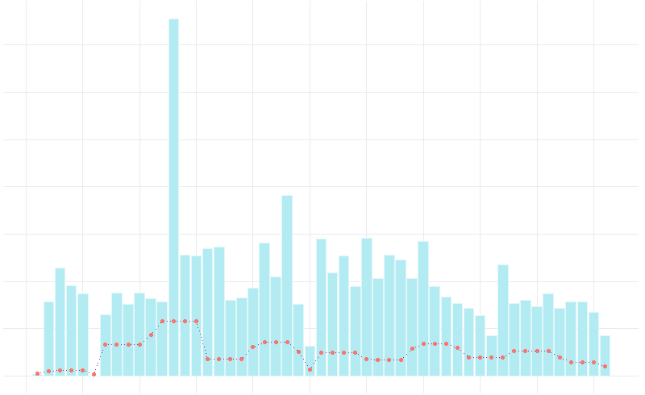
Weekly GMV vs Total Investment Trend
GMV
Investment
The values are scaled differently. This graph is only meant to observe trend.

Slide 13
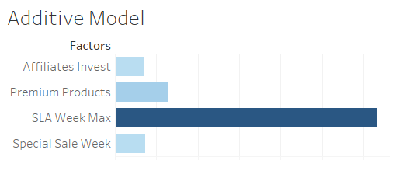
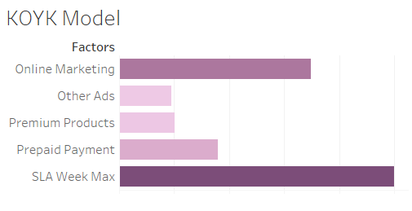
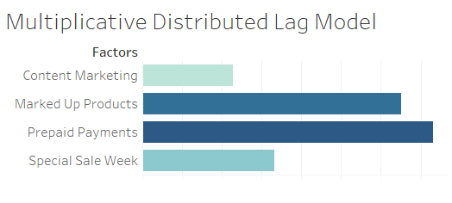
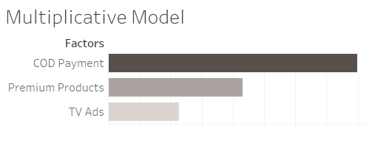
Outcomes of the models

Slide 14
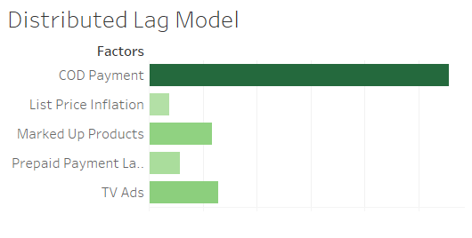
Most Efficient Model
0.8686173
CV Rsquared

Slide 15
Observations
Cash On Delivery orders are helpful in driving the sales for Home Audio, this means logistic process has to be made for reliable
Marked up products are selling well. People want to buy seemingly premium products for Home Audio
Sale of premium products (priced above Rs. 10500) is also a primary influencer in 3 of the models
TV Ads are the driver for sales in Home Audio
Special sale weeks is a primary driver in 2 models
Online, Affiliate and Content marketing are other influencers in the models

Slide 16
Suggestions
TV Ads coupled with Online Marketing during Special Sale week will give a boost to Home Audio Sales
Premium product should be stocked and marketed
Logistics for heavier products must be improved so that customer can rely and choose Prepaid payment facilities

Slide 17
Camera Accessories

Slide 18
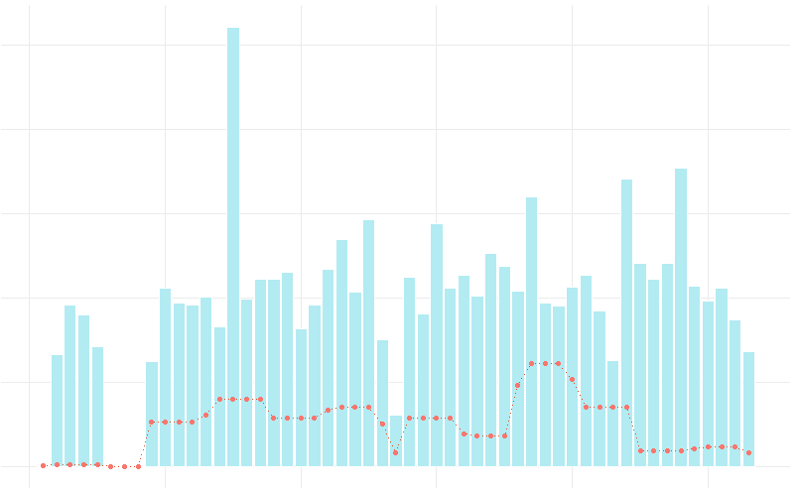
Weekly GMV vs Total Investment Trend
GMV
Investment
The values are scaled differently. This graph is only meant to observe trend.

Slide 19
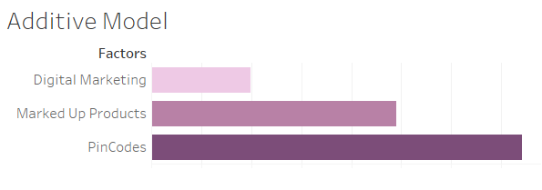
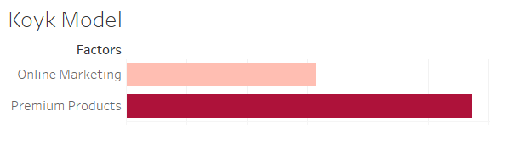
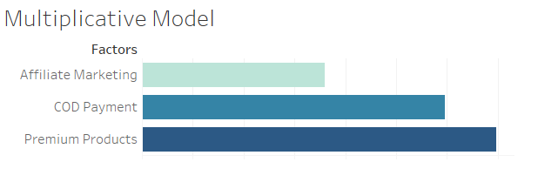
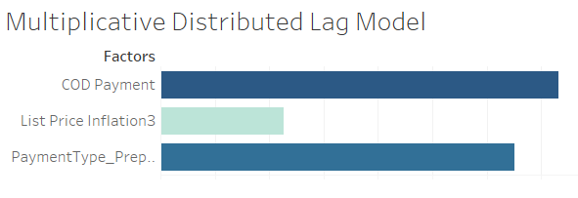
Outcomes of the models

Slide 20
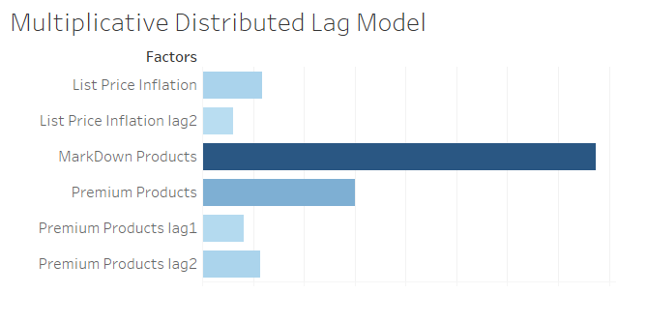
Most Efficient Model
0.9604432
CV Rsquared

Slide 21
Observations
Most of the model pushed out the marketing variables
Pin codes (distinct buyer locations) was one of the primary influencer a model
Premium products(Priced above Rs.19500) are the drivers for Camera Accessories
Lag variables as far as 3 weeks before are influencers, means people take some time to plan and keep visiting the products
Online, digital and affiliate marketing might have some, though not much influence on the sales
COD Payments were driving influencers for Camera Accessory Sales

Slide 22
Suggestions
Re-define the marketing strategy to have better influence, concentrating on Online, Digital and affiliate sales
Improve logistics to enable more prepaid payments and gain buyer trust
Target more locations as buyer seem to come from a various locations
Follow the list price changes to get better understanding the conversion visit/time of one customer
Provide additional combo offers to increase up-sell and cross-sell

Slide 23
Thank You!

