Slide 1
Vaccine Response
Intern Project
By: Nitin Subramanian
Mentored by Zicheng Hu

Slide 2
What are we trying to solve?
Overarching goal:
Understand why people have different responses to vaccines
Understand the immunology impact of each vaccine
My research:
Analyzing the data we have in ImmPort
Understanding the structure of each study and the what type of data they are collecting

Slide 3
The Data
Immport Database
All studies that analyze direct responses to vaccines
Humans only
117 Total Studies

Slide 4
Identifying Diseases
Disease Type
Number of Studies
1
Influenza
73
2
Varicella
7
3
Hepatitis, Tuberculosis
5
5
Smallpox, Yellow Fever
4
7
Malaria
3
8
Anthrax, Eczema Herpeticum,
West Nile, Meningococcal
2
12
Other*
7
*Other: 'Diabetes', 'Ebola', 'HIV', 'Newcastle','Palmoplantar Pustulosis’, 'Pneumococcal’, and 'Pneumovax’
all had one study in the database
Notes:
View(count(diseases, DISEASE_TYPE))

Slide 6
Measurements
62 total Measurement Techniques
Most were associated with only a few studies
Clustering
Found the most prevalent measurement techniques
Simplified the corrplot

Slide 7
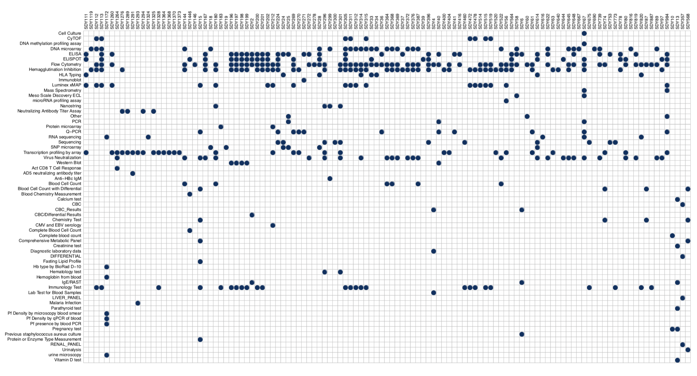

Slide 8
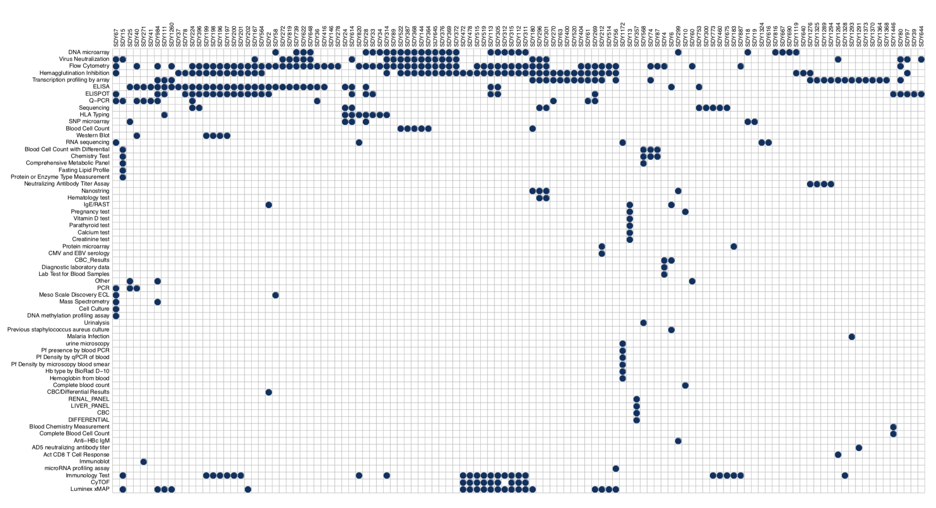

Slide 9
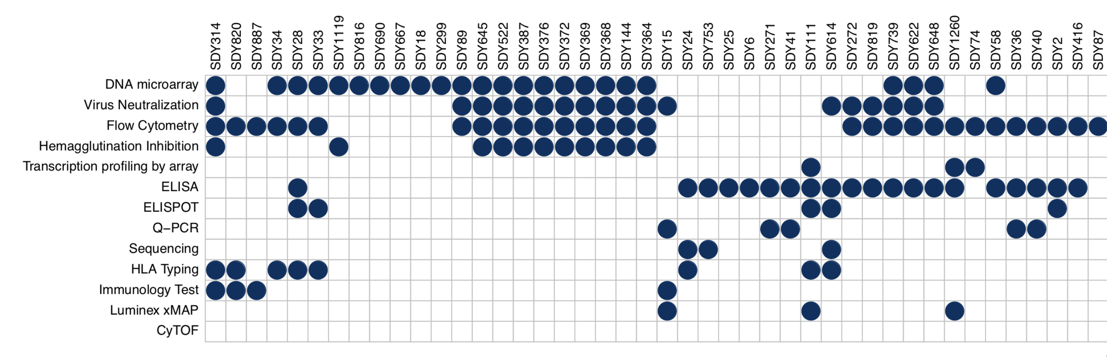

Slide 10
Measurement Type
Number of Studies
1
Flow Cytometry
63
2
Hemagglutination Inhibition (HAI)
51
3
ELISA
36
4
DNA Microarray
30
5
Transcription Profiling by Array
29
6
ELISPOT, Virus Neutralization
27
8
Immunology Test
25
9
Luminex xMAP
20
10
Q-PCR, Sequencing
11
12
CyTOF
9
13
HLA Typing
8
Notes:
View(count(arms%>%select(STUDY_ACCESSION, MEASUREMENT_TECHNIQUE) %>% unique(), MEASUREMENT_TECHNIQUE))

Slide 11
Outcome Measurements
Outcome Measurement Type
Used to measure the effectiveness of the applied vaccine
Most Influenza Cases had their outcomes tested with HAI
Hemagglutination Inhibition (HAI)
Transcription profiling by array
Microarray
Virus Neutralization
Flow Cytometry
Elisa

Slide 12
Case Studies

Slide 13
Influenza Case Study - SDY269
Design - 2 arms - Healthy Adults
TIV Vaccine (Trivalent Inactivated Influenza Vaccine)
LAIV (Live Attenuated Influenza Vaccine)
T₀ - Transcription profiling by array, Gene Expression in PBMC
T₁ - Flow Cytometry, Analysis of IgA, IgG and IgM Plasmablasts
Outcome - Hemagglutination Inhibition, Antibody Responses
Antibody responses induced by 2008 TIV and LAIV
Notes:
peripheral blood mononuclear cell

Slide 14
Outcome
(Day 28)
Time:
Measurement Technique:
Measurement:
T₀
T₁
T₀
Transcription profiling by array
T₁
Flow Cytometry
Outcome
Hemagglutination Inhibition
Gene Expression in PBMC
Analysis of IgA, IgG and IgM Plasmablasts
Antibody responses induced by 2008 TIV and LAIV

Slide 15
Malaria Case Study - SDY1293
Design - 2 arms
No Vaccine - Control
Adjuvanted RTS,S Malaria Vaccine
T₀ - Transcription profiling by array, Gene Expression
T₁ - Transcription profiling by array, Gene Expression
Outcome - Malaria Infection, Challenge
Tests the efficacy of the vaccine

Slide 16
Outcome
(Day 74)
Time:
Measurement Technique:
Measurement:
T₀
T₁
T₀
Transcription profiling by array
T₁
Transcription profiling by array
Outcome
Controlled Malaria Infection
Test whether or not the subjects was protected from infection
Gene Expression
Gene Expression

Slide 17
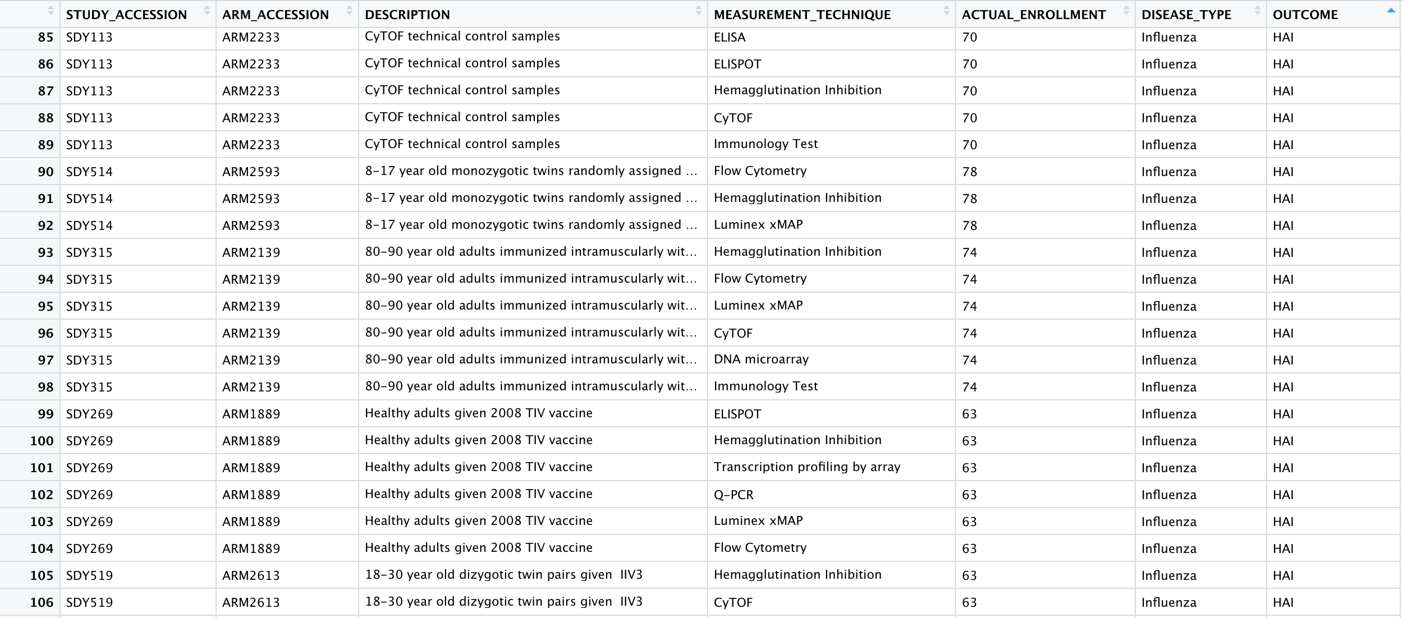

Slide 18
The Data in R
STUDY_ACCESSION: Unique to each study
ARM_ACCESSION: Unique to each arm
DESCRIPTION: Describes the criteria for each arm
MEASUREMENT_TECHNIQUE: Measurement Technique for the arm
ACTUAL_ENROLLMENT: Number of subjects
DISEASE_TYPE: Disease Studied
OUTCOME: Outcome Measurement

Slide 19
Data Cont.
1214 Total Rows of Data
Average Study takes 10.28 different types of measurements
Flow Cytometry and HAI are most popular

Slide 20
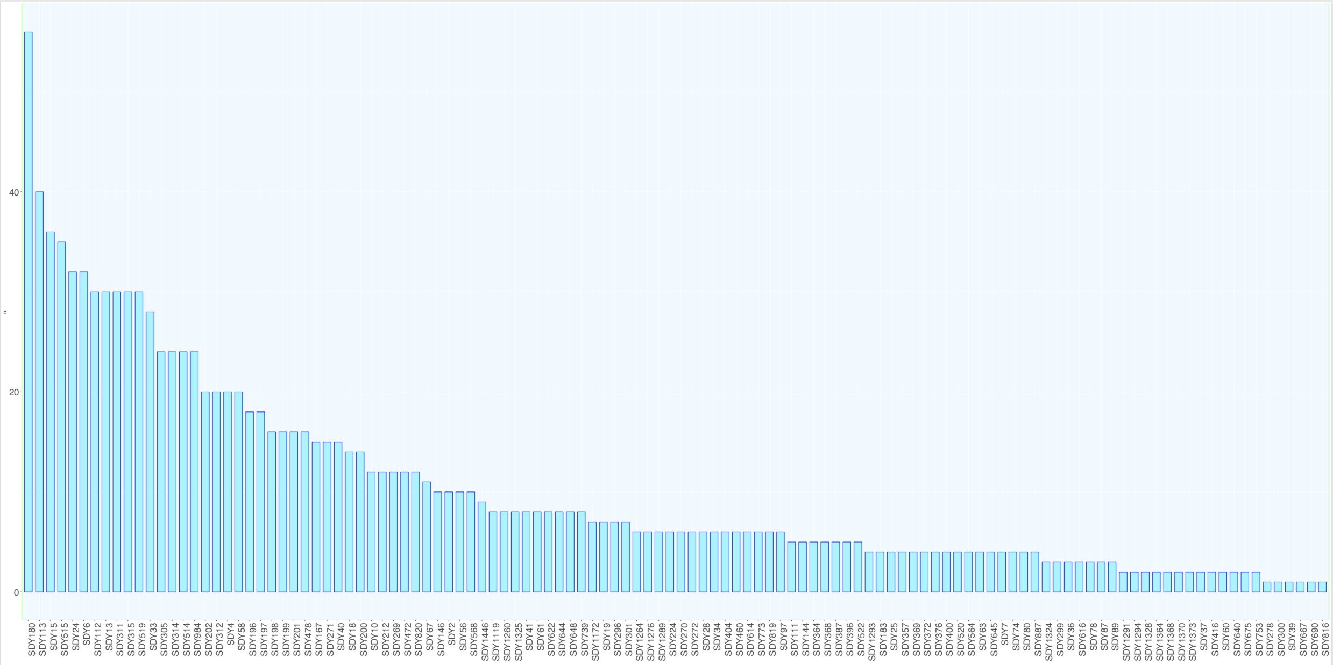

Slide 21
Reflection on my experience
Interning here was an amazing experience
So much fun with R
Experimenting with new packages and libraries
Sparked my interest in Computation Biology
Applying Computational Biology to most Universities
Lab Meetings were my favorite part
Collaboration and discussion

Slide 22
Thank you
Zicheng Hu
Professor Butte
Everyone in the Butte Lab

