Slide 1
Name : Nitin C Valwekar
Project Name : Python Calculator ( Tkinter)
Organization Name : Next Hikes IT Solution
Date : 08.5.2025

Slide 2
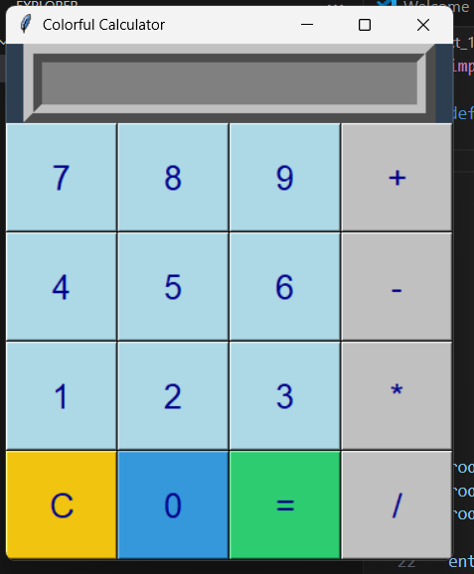
Introduction : Calculator
Features : Colorful calculator

Slide 3
Used Libraries : Tkinter

Slide 4
Challenges : Due to non technical background its little bit challenging for us, It is learning phase and nice experience

Slide 5
Thank you

