Slide 1
Docker
Roll No: 21071A7250

Slide 2
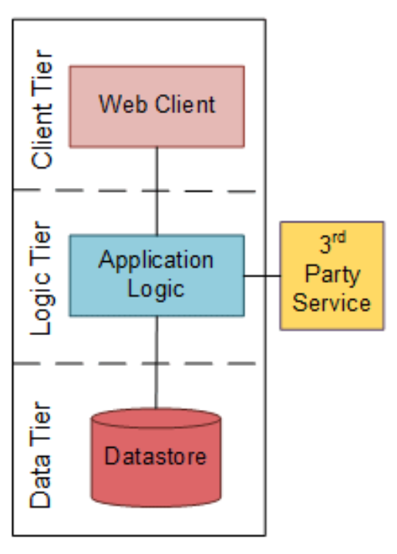
Monolithic
A monolithic architecture is a singular, large computing network with one code base that couples all of the business concerns together.
Advantages:
Simple and Performant - easily build small applications
Disadvantages:
Vertical Scaling.
Technology lock in - hard to find people with proficiency in the same tech stack.

Slide 3
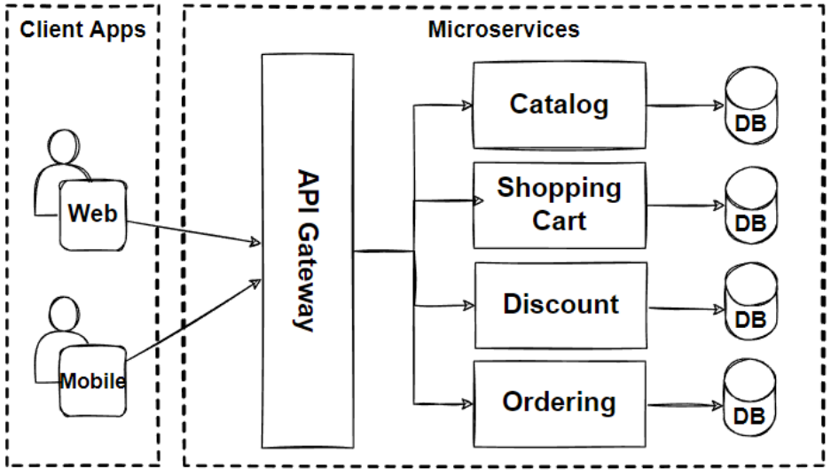
Microservices
Collection of small, independent, and loosely coupled services.
Advantages:
Easy horizontal scalability
Technology Diversification
Disadvantages:
Increases Complexity - deployment, monitoring, communication
Operational overhead - operations like load balancing, fault tolerance beomce critical

Slide 4
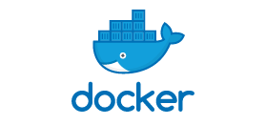
Docker
Docker is a platform for developing, shipping, and running applications in containers.
Docker helps in portability, scaling, deployment, development and isolation of microservices.
Containerization of microservices is the main motive of docker.

Slide 5
Docker Components
Docker client
Docker daemon server
Docker engine - lightweight runtime and packaging tool
Docker CLI
Docker images
Docker containers
Dockerfile
Docker Hub - used to create docker images
Docker compose - helps you define and share multi-container applications.
Docker registry - local storage for docker images.

Slide 6
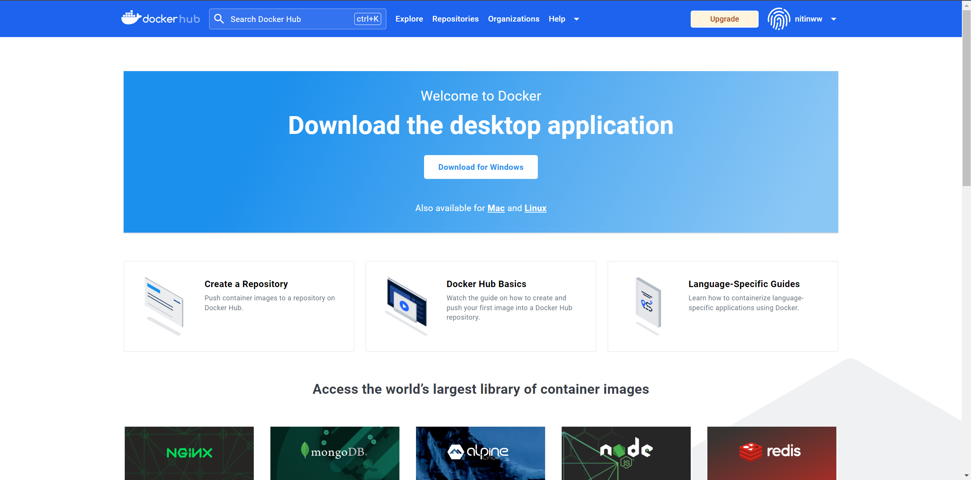
Docker Images and Docker Containers
A Docker image is a lightweight, standalone, and executable package that includes everything needed to run a software application, including the code, runtime, libraries, and system tools. A Docker image is just a blueprint, a docker container is essentially the instantiated and running form of the blueprint.
Docker Hub is similar to docker registry, but is a cloud-based registry service provided by Docker for sharing and managing Docker images. There is a huge community who share their docker images.

Slide 7
Docker CLI Basic Commands
docker pull [IMAGE] - pull a docker image from docker hub
docker ps - list all running containers
docker ps -a - list all containers, stopped and running
docker create - create a new container
docker run [OPTIONS] [IMAGE] [COMMAND] [ARG...] - run a docker image
docker exec -t [CONTAINER] [COMMAND] - execute a command inside a container
docker stop [CONTAINER] - stop a docker container
docker rm [CONTAINER] - remove a docker container
docker rmi [IMAGE] - remove a docker image
docker build [OPTIONS] -t [TAG] [PATH] - used to build a docker image using the dockerfile

Slide 8
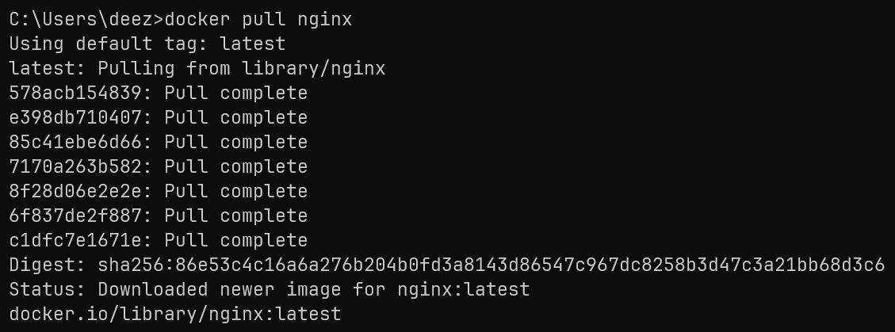
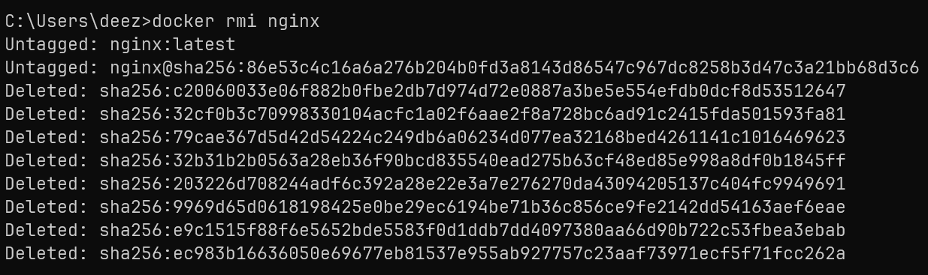

Slide 9
Dockerfile
A Dockerfile is a script that contains a set of instructions for building a Docker image.
FROM node:14 # base image
WORKDIR /usr/src/app # sets the working directory for the container
COPY package*.json ./ # copy package.json and package-lock.json to working directory
RUN npm install # install dependencies
COPY . . # copy application code to working directory
EXPOSE 3000 # expose port 3000 for the application
CMD ["npm", "start"] # run the application

Slide 10
Docker Architecture
The Docker architecture follows a client-server model where the Docker client and Docker daemon communicate with each other. The Docker client sends requests to the Docker daemon, and the daemon processes those requests, managing the creation, execution, and maintenance of Docker containers. The communication is typically done through the Docker API, and it involves sending requests from the client to the daemon and receiving responses back.

Slide 11
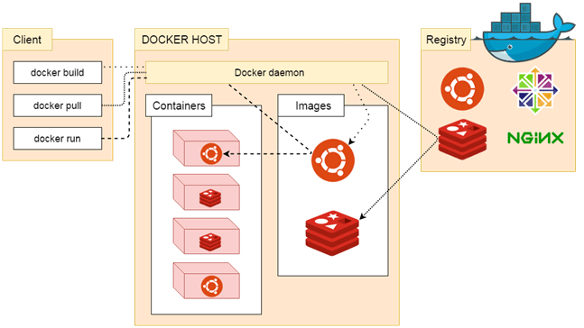
Docker Architecture

Slide 12
Docker vs Virtual Machines
Docker utilizes the native OS files, enabling each container to share the host OS resources. In contrast, VMs maintain separate OS files, contributing to a higher resource overhead.
Docker optimizes resource allocation by allowing each container to use only the necessary resources. VMs, on the other hand, may allocate resources that are not fully utilized, resulting in resource wastage.
Docker employs a Docker engine to manage images and containers, simplifying the process by focusing on individual containers. VMs utilize a hypervisor for managing all VMs collectively, introducing additional layers of abstraction.
Docker is well-suited for simpler processes, rapidly spinning up services with minimal overhead. However, for heavier workloads, VMs may be more suitable due to the higher orchestration overhead associated with containers.

Slide 13
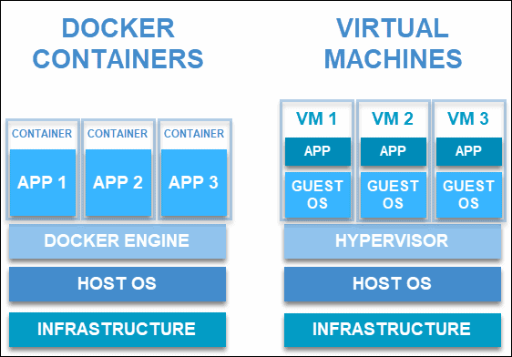
Docker vs Virtual Machiness

Slide 14
Advantages of Docker
Isolation
Portability
Resource efficiency
Rapid development and deployment of microservices
Version control and rollback of docker images
Horizontal Scalability
Security isolation - run docker containers in ioslated environments.
Ecosystem and compatibility
Facilitating CI/CD
Enables DevOps

Slide 15
Disadvantages of Docker
High complexity and high overhead - Docker introduces additional complexity, and while containers are lighter than virtual machines, there is still some overhead associated with running containers.
Steeper learning curve.
Orchestration complexity – Even with orchestration softwares like kubernetes are present, when managing a large number of containers in a production environment, orchestrating and coordinating these containers can become complex.
Image sizes - while docker image size are smaller than vms but they can still be large when image is an entire OS, so it is better to use vms in that situation.

Slide 16
THANK YOU

