Slide 1
Graph Neural Network Based Network Intrusion Detection System
Fully completed project presentation
Purpose: Automatically detect malicious network behavior
Core Idea: Convert traffic into a graph and classify suspicious nodes
Built With: Python, PyTorch Geometric, Streamlit, Matplotlib
Nodes = IPs Edges = Communication Output = Suspicious Hosts
Final Year Project | GNN-Based Intrusion Detection

Slide 2
Problem Statement
Why this project is needed
Large networks generate huge traffic and manual monitoring is difficult
Traditional methods often inspect each traffic row independently
Connected attacks like botnets and scans spread across multiple hosts
Security teams need faster and more intelligent automatic detection
Final Year Project | GNN-Based Intrusion Detection

Slide 3
Project Overview
What the system does
Converts traffic logs into a communication graph
Represents IP addresses or hosts as nodes
Represents communication between hosts as edges
Uses a Graph Neural Network to predict suspicious behavior
Final Year Project | GNN-Based Intrusion Detection

Slide 4
Real Problem Solved
Practical cybersecurity impact
Detects suspicious communication bursts and DDoS-like behavior
Finds scanning and reconnaissance patterns
Helps identify compromised or malicious hosts
Reduces analyst workload by ranking risky nodes automatically
Final Year Project | GNN-Based Intrusion Detection

Slide 5
Why Graph Neural Networks
Why GNN is better here
Normal neural networks work on flat or sequential data
Network traffic is relational and naturally graph-shaped
GNN learns from both host features and neighbor behavior
This makes it strong for multi-host and structural attack detection
Final Year Project | GNN-Based Intrusion Detection

Slide 6
System Workflow
End-to-end pipeline
Collect traffic data from CSV or monitoring tools
Normalize fields like source IP, destination IP, bytes, packets, duration, and label
Build graph edges from host-to-host communication
Aggregate incoming and outgoing node features
Train GCN, GraphSAGE, or GAT
Evaluate metrics and run inference for suspicious node ranking
Final Year Project | GNN-Based Intrusion Detection

Slide 7
Dataset Used
Training and demonstration data
Synthetic dataset is used for guaranteed demo and testing
Real CSV support is available for CICIDS-style traffic exports
Logical fields required: src_ip, dst_ip, bytes, packets, duration, label
Benign labels are mapped to 0 and attack labels are mapped to 1
Final Year Project | GNN-Based Intrusion Detection

Slide 8
Technology Stack
Tools and their roles
Python: complete project implementation
PyTorch: tensor operations and model training
PyTorch Geometric: graph neural network layers and graph data handling
Pandas and scikit-learn: preprocessing, splits, metrics, scaling
Matplotlib and Seaborn: charts and evaluation visuals
Streamlit: dashboard for visual demo and inference
Final Year Project | GNN-Based Intrusion Detection

Slide 9
Models and Their Roles
What each model contributes
GCN: baseline graph convolution model for node classification
GraphSAGE: scalable neighborhood aggregation for graph learning
GAT: attention-based model that weighs important neighbors
Training exports checkpoints, reports, plots, and ranked predictions
Final Year Project | GNN-Based Intrusion Detection

Slide 10
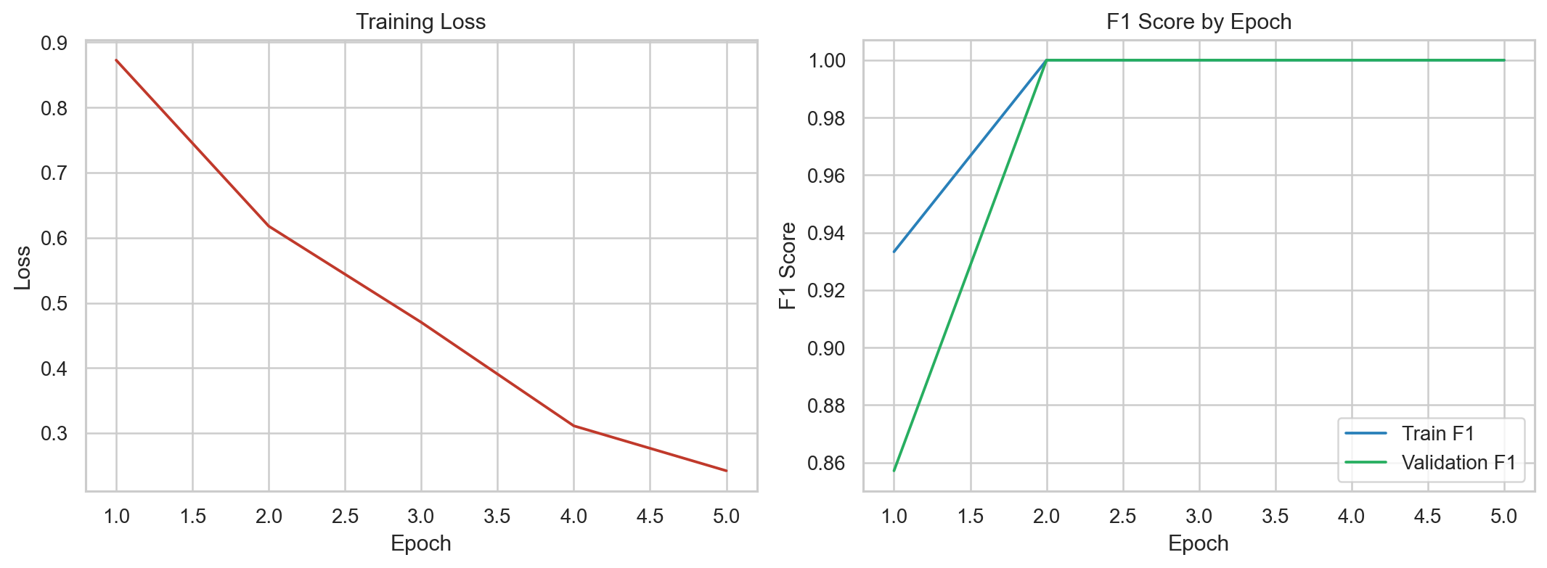
Results from Tested Run
Synthetic test execution results
Model used: graphsage
Accuracy: 1.000
Precision: 1.000
Recall: 1.000
F1 Score: 1.000
ROC-AUC: N/A
Training run completed successfully in the tested environment
Model checkpoint and reports were generated
Inference produced ranked suspicious nodes
The project is ready for demo through the Streamlit dashboard
Final Year Project | GNN-Based Intrusion Detection

Slide 11
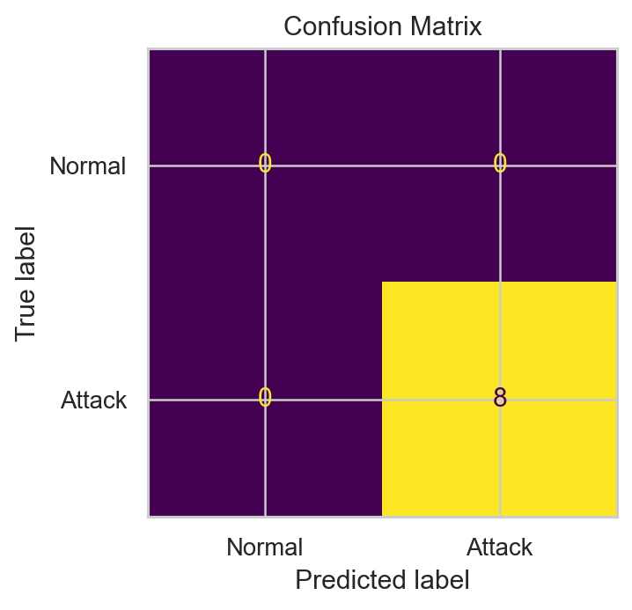
Visual Outputs
Generated project artifacts
Confusion matrix shows classification quality
ROC curve shows discrimination ability when both classes are present
Training curves show how loss and F1 evolved during training
Final Year Project | GNN-Based Intrusion Detection

Slide 12
Conclusion and Future Scope
What this project delivers
The project provides a complete graph-based intrusion detection prototype
It explains network attacks using structure, not only flat traffic rows
It is useful for academic demonstration and can be extended for real deployments
Future work: real-time capture, temporal GNNs, explainable AI, SOC integration
Final Year Project | GNN-Based Intrusion Detection

