Slide 1
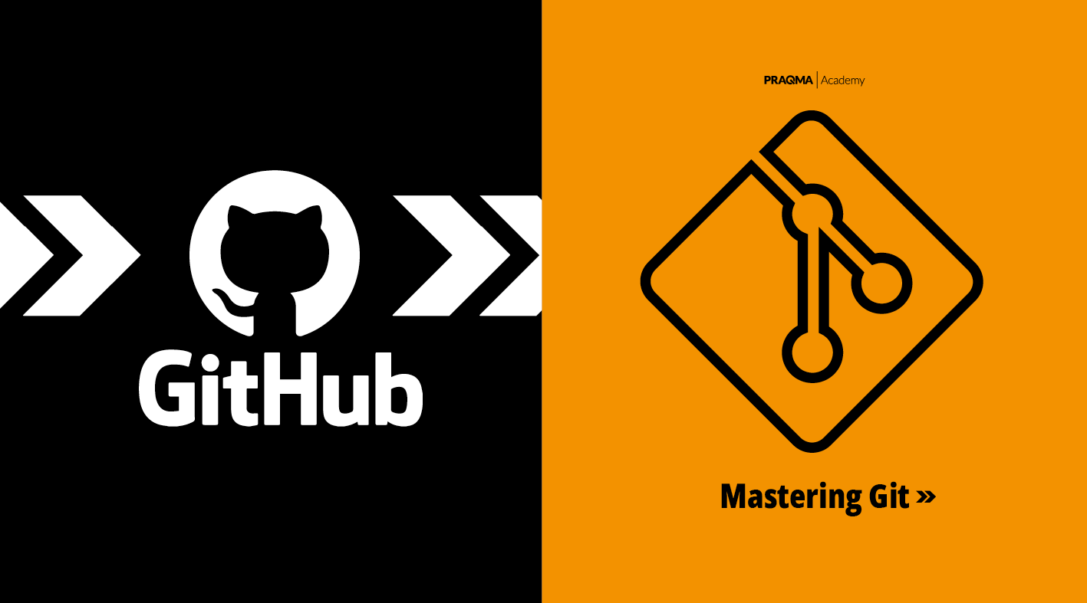


Slide 2

Course Content Version Control Managing educational content using Git and GitHub
Project Guide
Ms. Ishita Tandon
Assistant Professor, Data & Infra
GROUP-9 | payal911tech
(SoCS)

Slide 3
Team Members & Role
S.No. | Team Members | Role
1. | Nitin Yadav | Developer
2. | Parth Saraswat | Documentation
3. | Payal Yadav | Presentation
4. | Prisha Singh | Tester
5. | Rachit | Documentation

Slide 4
Introduction
What is this project?
This project applies version control to educational course content using Git and GitHub.
Why it matters?
Course content changes frequently. Without version control, it is hard to track who changed what or collaborate with other instructors.
Tools used: Git, GitHub, VS Code

Slide 5
Problem Statement
The Problem:
Educational institutions create and update course content regularly, but there is no structured system to track these changes, manage multiple versions, or allow safe collaboration between instructors.
Specific Challenges:
- No way to see what changed between versions of a lesson
- Accidental overwrites with no way to recover old content
- Difficulty collaborating with multiple instructors
- No audit trail of who made which changes and when

Slide 6
Objectives
Project Objectives:
1. Demonstrate how Git can be used to manage course content versions
2. Create a structured repository with modules, lessons, and a changelog
3. Apply core Git operations: init, add, commit, push, branch, merge
4. Use GitHub as a remote platform for hosting and collaboration
5. Show a meaningful commit history that reflects real content updates
6. Use branching to safely develop and merge new content features

Slide 7
Research Methodology
How we built this project:
Phase 1 - Setup: Installed Git, created GitHub repository, configured user settings
Phase 2 - Structure: Designed hierarchy with courses, modules, lessons, and changelog
Phase 3 - Content: Created Markdown lesson files for some modules
Phase 4 - Version Control: Committed changes regularly, created feature branches, merged to main
Phase 5 - Collaboration: Pushed to GitHub, verified public repository with full commit history

Slide 8
PERT Chart
Study period
Duration: 2 days
Start date: Feb 4, 2026
End date: Feb 5, 2026
Assigned to: Group 9
Project Design
Duration: 2 days
Start date: Feb 6, 2026
End date: Feb 7, 2026
Assigned to: Payal Yadav
Coding & Implementation
Duration: 3 days
Start date: Feb 8, 2026
End date: Feb 10, 2026
Assigned to: Payal Yadav
Start
Publish report
Duration: 1 day
Start date: Feb 13, 2026
End date: Feb 13, 2026
Assigned to: Group 9
Testing & Debugging
Duration: 2 days
Start date: Feb 11, 2026
End date: Feb 12, 2026
Assigned to: Group 9
End

Slide 9
References
Books & Documentation:
1. Chacon, S. & Straub, B. - Pro Git (2nd Edition) - Apress, 2014
2. Official Git Documentation - https://git-scm.com/doc
3. GitHub Docs - https://docs.github.com
Online Resources:
4. Atlassian Git Tutorials - https://www.atlassian.com/git/tutorials
5. W3Schools Git Tutorial - https://www.w3schools.com/git
6. Project Repository - https://github.com/nitinyi/vcs-project.git

Slide 10
Thankyou

