Slide 1
Hive view
performance statistics

Slide 2
Test Case
Number of Users : 3 *
Number of query executed by each user in loop : 10
Total queries fired : 30
Query : select * from table1 as t1 join table2 as t2 on t1.col1 = t2.col1;
This query invokes tez job.
* This can also be interpreted as number of threads / browser sessions / concurrency

Slide 3
Results
All queries executed successfully without error.
Total time taken to run all 30 queries : 37 mins
Time taken to submit job, poll and get results for a job
Max Time : ~ 400 secs = 6.5 mins
Min Time : ~ 31 secs = 0.5 mins
Avg Time : ~ 207 secs = 3.5 mins
Average times for different API calls
Job submission (/jobs) : 8 secs
Job status (/jobs/id) : 10.7 secs
Job Result (/jobs/id/results) : 7.1 secs

Slide 4
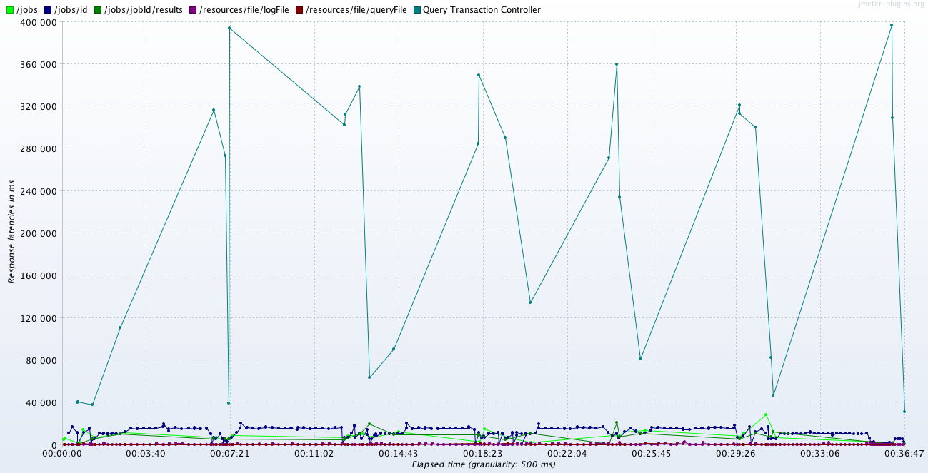
Response Latencies in milisecs
Query Transaction Controller represents the total time taken for submit, poll and fetch result for one query. Height of each green dot represent this time.
Time elapsed from the start of the test

Slide 5
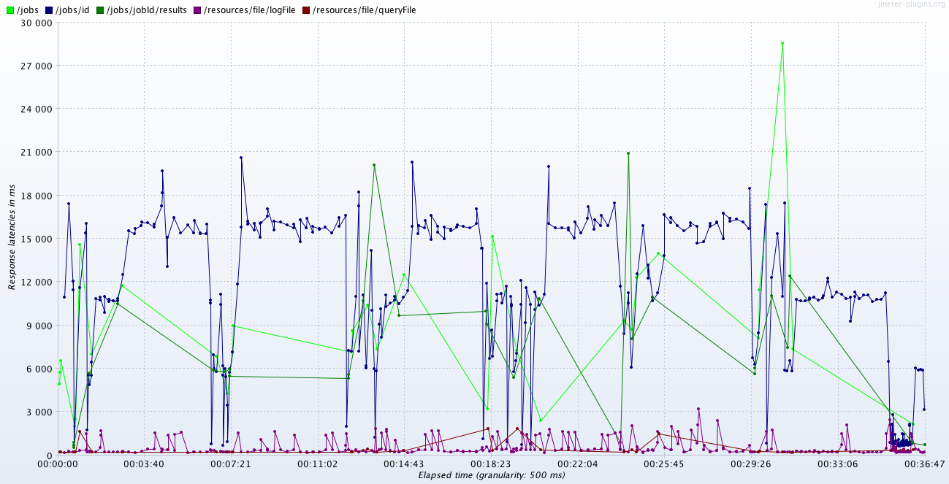

Slide 6
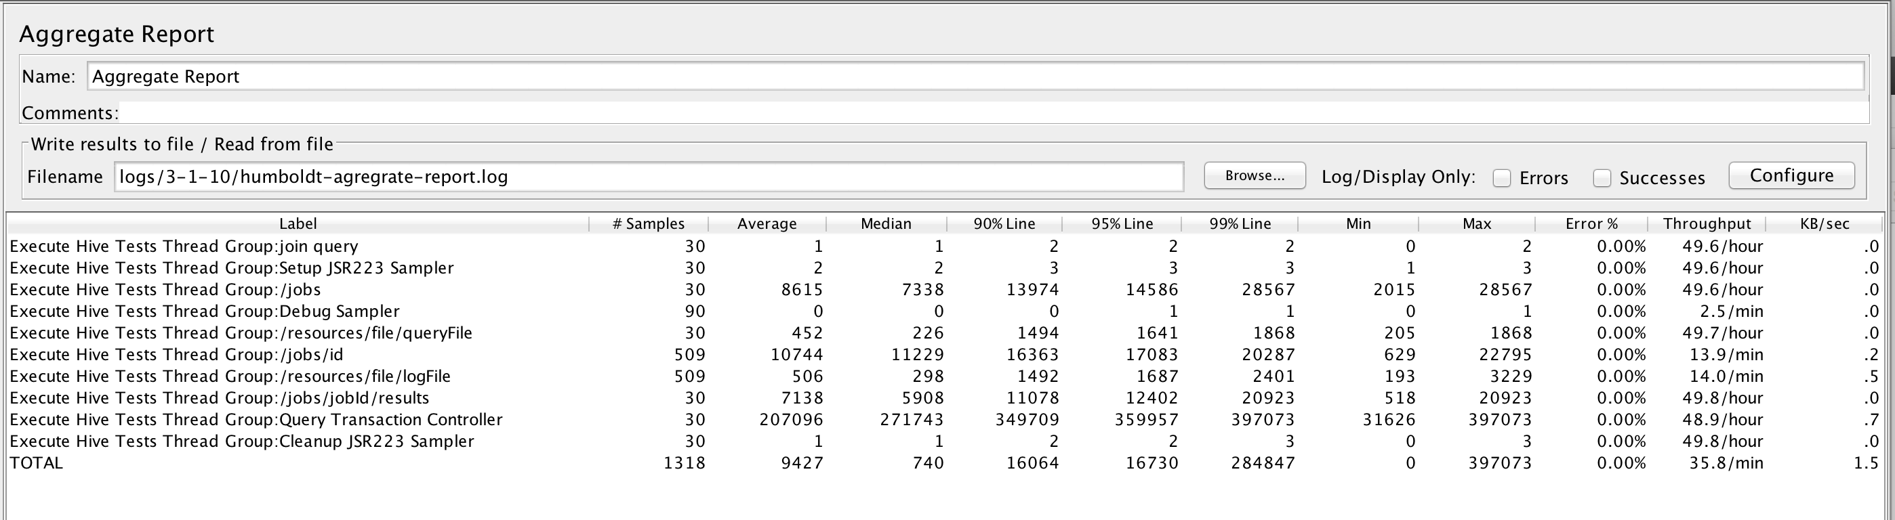
Detailed tables

