Slide 1


ActionForge AI
ActionForge AI
Turning Meeting Notes into Actionable Strategy
From raw discussions to clear tasks, owners, deadlines & follow-up communication
TEAM
J.Pranav Krishna
R.Sai Nitish
D.Chaitanya Raju
A.Teja Manoj & D. Sandeep
Faculty Guide: Prof. [Rithvik Konakala]

Slide 2






02
Problem Statement
Unstructured Meeting Notes
Poor Follow-up Communication
Raw discussions are scattered, hard to parse, and lose context quickly
Teams fail to send timely updates, leaving stakeholders uninformed
Missed Action Items
No Automated Structured Planning
Critical tasks buried in conversation are overlooked and never completed
Manual effort required to convert notes to plans wastes valuable time
Lack of Ownership & Deadlines
No clear assignment of who owns what task or when it must be done

Slide 3



03
Literature Survey
EXISTING TOOLS
IDENTIFIED GAPS
Manual Notes & Spreadsheets
No task extraction pipeline
Basic Note-Taking Apps
No role assignment mechanism
Speech-to-Text Tools
No continuity between meetings
AI Summarizers
Weak collaboration features

Slide 4

04
Key Insight
"End-to-end workflow > simple summarization"
Traditional Tools
ActionForge AI
📝 Manual note-taking
🤖 AI-powered pipeline
🔍 Keyword search
VS
📋 Auto task extraction
❌ No task extraction
✅ Smart role assignment
❌ No role assignment
⏰ Deadline detection
❌ No email generation
📧 Auto email generation

Slide 5


05
Proposed Solution
INPUT
SUMMARY
TASKS
DEADLINES
ROLES
EMAILS
Text Notes / Transcripts
AI Generation
Extraction
Detection
Assignment
Generation
OUTPUT: Structured Action Plan
✅ Task List with Owners
⏰ Clear Deadlines
📧 Follow-up Emails
📄 PDF / CSV Export
🤝 Team Collaboration

Slide 6

06
System Architecture
INPUT
PROCESSING
PROCESSING
STORAGE
FRONTEND (UI)
BACKEND API
AI MODULES
MEMORY & STORAGE
React + Tailwind CSS
FastAPI
LLM Pipeline + NLP
Vector DB + SQL
OUTPUT
EXPORT SERVICES
📄 PDF Export
📊 CSV Export
📧 Email Dispatch
🔗 Calendar Sync

Slide 7





07
Key Features
User Authentication
Shared Collaboration
Session Memory
Secure login, role-based access and session management
Multiple users work on the same session in real time
AI retains context across meetings for continuity
PDF & CSV Export
Follow-up Emails
AI Pipeline
Download structured action plans in multiple formats
Auto-generate and send professional follow-up emails
End-to-end NLP pipeline for intelligent task extraction

Slide 8



08
Results & Evaluation
94%
< 3s
TEST COVERAGE
Backend Testing
PASSED
Task Extraction Accuracy
Response Time
End-to-End Workflow
PASSED
97%
100%
UI Functionality
PASSED
Workflow Success Rate
Export Reliability
Auth & Collaboration
PASSED
Export Testing
PASSED

Slide 9
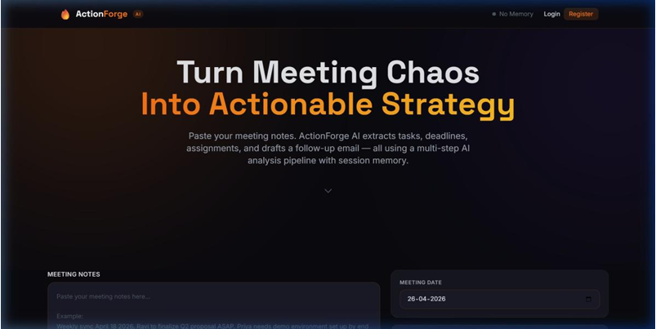
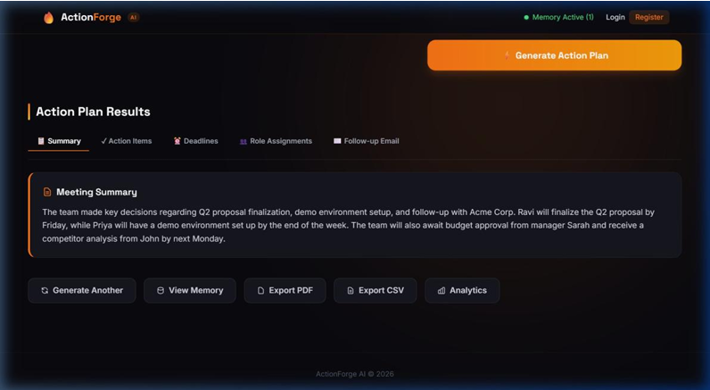
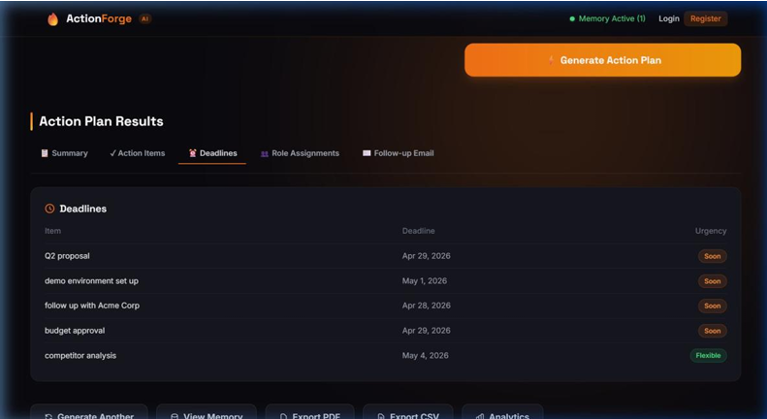
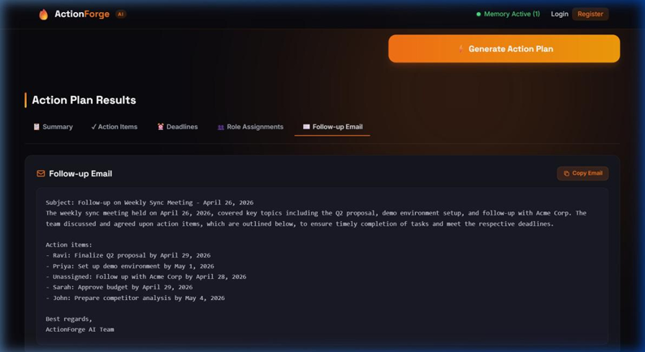
09
Results — App Screenshots
Homepage Screenshot
Generated Plan Output
[ Insert Screenshot Here ]
[ Insert Screenshot Here ]
Deadlines & Tasks View
Follow-up Email
[ Insert Screenshot Here ]
[ Insert Screenshot Here ]

Slide 10






10
Conclusion & Future Scope
CONCLUSION
FUTURE SCOPE
Converts raw discussions into structured action plans
Calendar Integration
AI Priority Scoring
Improves team productivity & accountability
Multi-language Support
Team Analytics Dashboard
Reduces manual effort through full AI automation
Mobile App Support
ActionForge AI • Turning Meetings into Action

