Slide 1
TELEPHONY MANAGER
Online Sanity Testing Platform
A modern web-based tool for remote telephony sanity testing — replacing heavyweight
Remote PC sessions with a lightweight, multi-user, real-time browser experience.
LG Electronics | Connected Service Unit
Nitish Kumar | Release version v1.0

Slide 2
THE PROBLEM — Remote PC Limitations
Remote PC (Current Method)
Our Solution (Telephony Automation)
● Only ONE user can connect at a time (exclusive session)
● Requires full desktop streaming — high bandwidth needed
● Slow & laggy UI — screen refresh delays up to 2-3 seconds
● If connection drops, session is lost entirely
● No parallel testing — team waits for one person to finish
● Device physical access required to troubleshoot
● No automated regression — everything is manual
● DLT logs require separate setup on each PC
● No real-time device status dashboard
● No test history / export capability
● IP conflicts when multiple users try to access
● Multi-user access — unlimited tabs, zero conflicts
● Lightweight browser UI — no screen streaming needed
● Instant command execution — sub-second response
● Session persists even if browser tab is refreshed
● Parallel testing — team works simultaneously
● Remote device access via ADB over network
● Built-in automated regression with CSV export
● DLT bridge auto-configures per user session
● Live device dashboard (IMEI, SIM, Radio, Region)
● Full test history with PASS/FAIL export
● Per-user isolation — no IP or port conflicts

Slide 3
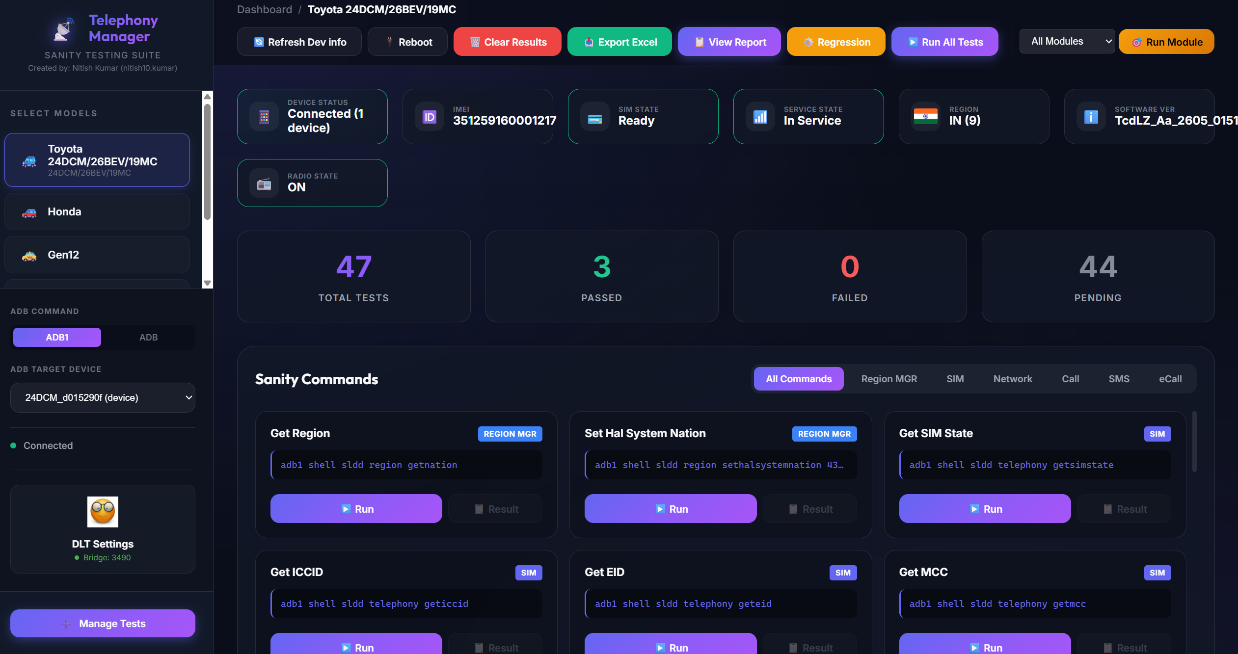
Dashboard:

Slide 4
KEY FEATURES
1
Live Device Dashboard
2
One-Click Commands
3
Automated Regression
4
DLT Bridge
Real-time status bar showing IMEI, SIM State,
Service State, Radio State, Region, SW Version
Execute 50+ telephony commands with pass/fail
validation using pattern matching
Configure test sequences, set iterations, pause/
resume, and export CSV reports
Auto-configures TCP proxy per user for DLT log
forwarding — no manual setup needed
5
Multi-User Support
6
Global Notifications
7
Multi-Model Support
8
Admin Panel
Each user gets unique client ID, isolated config,
separate DLT ports — zero conflicts
Real-time popups for ADB changes, IMEI writes,
and system events across all users
Toyota, JLR, BMW WAVE LOW/HIGH with auto-
detection based on device software version
Add/remove models, commands, categories
dynamically without code changes

Slide 5
TECHNOLOGY STACK
FRONTEND
BACKEND
TOOLING & DEPLOYMENT
HTML5 + CSS3 + JavaScript
Modern responsive UI with dark theme
Node.js + Express.js
Lightweight, event-driven server
pkg (by Vercel)
Compiles to standalone .exe — no Node.js needed
Vanilla JS (No frameworks)
Zero dependencies, fast load, easy maintenance
ADB (Android Debug Bridge)
Device communication via USB/TCP
Single Binary Distribution
TelephonyManager.exe — just double-click to run
CSS Variables & Glassmorphism
Premium dark-mode design system
net (TCP Module)
DLT proxy bridge for log forwarding
sessionStorage + localStorage
Client-side state persistence per tab
Fetch API + Async/Await
Non-blocking server communication
child_process (execAsync)
Shell command execution with timeout
JSON-based Config
Dynamic model/command management via JSON files

Slide 6
ARCHITECTURE — How the Server Connects
BROWSER CLIENTS
EXPRESS.JS SERVER (Port 3000)
TARGET DEVICES
User A (Tab 1)
1. Request Router
Device A (Toyota)
clientId: client_a_1xxx
──►
Maps X-Client-ID header to per-user config
(userConfigs Map: clientId -> {serial, adb, model})
──►
adb1 -s SERIAL_A
USB / TCP-IP Connected
User B (Tab 2)
2. Command Engine
clientId: client_b_2xxx
──►
Executes ADB commands via child_process
with timeout, caching & pattern validation
Device B (BMW)
User C (Tab 3)
3. Device Cache
──►
10s TTL cache with Promise.allSettled
Stale-cache fallback prevents UI flickering
adb1 -s SERIAL_B
clientId: client_c_3xxx
──►
USB / TCP-IP Connected
4. Notification Bus
Global notification array polled by all clients
ADB changes, IMEI writes broadcast to everyone
KEY: Per-User Isolation via X-Client-ID Header
Every browser tab generates a unique clientId (stored in sessionStorage). All API calls include this ID as an HTTP header.
The server maintains a Map<clientId, {serial, adbBinary, model}> so each user independently targets their own device.

Slide 7
DLT BRIDGE — How Each User Gets Isolated Logs
DLT VIEWER
(User's PC)
PUBLIC PORT
(Unique per user)
TCP PROXY
(Node.js net)
ADB FORWARD
(Internal port)
DEVICE
(Target)
User A
TCP Proxy
0.0.0.0:3490
ADB Forward
localhost:4490
Device A
tcp:3490
DLT Viewer
Port 3490
►
►
►
client_a_1xxx
User B
TCP Proxy
0.0.0.0:3491
ADB Forward
localhost:4491
Device B
tcp:3490
DLT Viewer
Port 3491
►
►
►
client_b_2xxx
User C
TCP Proxy
0.0.0.0:3492
ADB Forward
localhost:4492
Device A
tcp:3490
DLT Viewer
Port 3492
►
►
►
client_c_3xxx
Auto Cleanup
Tab closes ->
Proxy destroyed +
ADB forward removed
How Isolation Works
Each user picks a UNIQUE public port (e.g., 3490, 3491, 3492)
Server creates an independent TCP proxy per port, tracked by clientId
When a tab closes (beforeunload), the proxy is auto-destroyed using sendBeacon

Slide 8
GLOBAL NOTIFICATION SYSTEM
Real-time cross-user notifications — when one user makes a system change, ALL users are alerted instantly.
How It Works
Notification Types
1. EVENT TRIGGER
A user performs an action that affects all users
(e.g., switches ADB binary, writes IMEI, etc.)
ADB Binary Change
When any user switches between
adb1 / adb2 / custom binary
-> All clients auto-sync their binary
2. SERVER STORES
Server calls addGlobalNotification(type, user, message)
Stored in globalNotifications array (last 10 kept)
IMEI Write Event
3. CLIENT POLLS
Every 5s, checkDeviceStatus() fetches /api/device-status
Response includes notifications[] array
When IMEI is written to device
-> All users see updated IMEI
immediately on their dashboard
4. NEW? -> POPUP!
Client checks seenNotifIds (localStorage)
If new -> shows animated system popup with icon
System Announcements
Server-push messages for
maintenance, updates, or
critical device state changes

Slide 9
MULTI-MODEL SUPPORT & AUTO-DETECTION
Toyota
(Multiple Models)
Honda
(Multiple Models)
Gen12
Standard sldd path
50+ commands
Region support: IN, AE, SA, JP, ETC
50+ commands
Extended telephony
Gen12-specific commands
50+ commands
Custom validation
JLR
(VCM, TCUA)
BMW
(WAVE LOW/HIGH)
BMW
(ICONICC)
JLR platform
Full command set
50+ commands
Dual SIM BMW
50+ commands
Path: /usr/bin/factory/sldd
Auto-detected via SW ver
Standard sldd path
50+ commands
AUTO-DETECTION: Server reads 'cat etc/version' -> If output contains 'WAVE' -> auto-switches to BMW model
Also uses sticky version cache: if version read fails temporarily, the model doesn't flip back. Smooth experience.

Slide 10
AUTOMATED REGRESSION ENGINE
Regression Features
CSV Export Report
● Configure test sequences — drag & drop command ordering
● Set iteration count (1 to 1000+ cycles)
● Per-step configurable delay (e.g., 5s between commands)
● Custom parameters for Dial / SMS steps
● Pause / Resume mid-regression without losing progress
● Stop at any time — results preserved
● Live progress bar with current iteration / total
● Real-time PASS / FAIL count on screen
● Module-based quick selection (add all SIM, Network, Call commands)
● Detailed timestamped log for every step
One-click export generates a CSV with:
Iteration # | Step # | Timestamp
Command Name | Command ID
Full Output | PASS / FAIL Status
File: regression_report_{model}_{timestamp}.csv
Smart PASS/FAIL Validation
Commands are auto-validated using regex patterns:
SIM State -> expects numeric state value
Network Type -> accepts ANY numeric type (not hardcoded)
EID -> passes even if empty (eUICC optional)
Radio State -> supports both Toyota & BMW formats
Custom patterns per command ID

Slide 11
DEPLOYMENT & SUMMARY
How to Deploy
● 1. Copy TelephonyManager.exe to setup PC
● 2. Connect device via USB (or ADB over TCP/IP)
● 3. Double-click TelephonyManager.exe to start
● 4. Open browser: http://localhost:3000
● 5. Share IP with team: http://<PC-IP>:3000
● 6. Each user opens their own tab — done!
THANK YOU
Questions & Live Demo
Developed by:
Nitish Kumar
Connected Service Unit | LG Electronics
nitish10.kumar@lge.com
http://si-nitishk:3000
Remote PC v/s Our Web-App
Setup Time
30+ min -> 10 seconds
Concurrent Users
1 (single session) -> Unlimited
Bandwidth Required
High (screen streaming) -> Minimal (JSON API)
Regression Testing
Fully manual -> Fully automated
DLT Setup
Manual per-PC config -> Auto per-user

