Slide 1

Healthcare Analytics for Doctor Visits
Panipat Institute of Engineering and Technology
Nitish Bhardwaj
ID: STU6a26a9143d65f1780918548

Slide 2

PROBLEM STATEMENT
Doctor visit frequency varies widely across patients, and the reasons behind that variation are not well understood by providers.
Without data-driven insight, hospitals and insurers struggle to identify which patient groups need more preventive care or support.
This project analyzes patient data to uncover how age, income, insurance, illness severity, and chronic conditions relate to visit frequency.

Slide 3
Project Description
Exploring what drives doctor-visit frequency using patient health & demographic data
▸ Dataset: 5,190 patient records with 12 variables — demographics, income, insurance coverage, illness score, chronic condition flags, and number of doctor visits.
▸ Objective: identify which factors most strongly influence how often patients visit a doctor.
▸ Approach: data cleaning and quality checks, followed by univariate, bivariate, and multivariate exploratory analysis using Python.
▸ Outcome: a set of practical insights healthcare providers and insurers can use to target outreach and plan resources.

Slide 4

WHO ARE THE END USERS?
Hospital & clinic administrators — for staffing and resource planning around expected patient volume.
Health insurance providers — to assess risk and design coverage plans around visit patterns.
Public health policymakers — to identify underserved or high-need patient populations.
Healthcare researchers & data analysts — studying access to care and utilization trends.

Slide 5

Technology Used
  Python 3 — core programming language
  Pandas & NumPy — data cleaning and manipulation
  Matplotlib & Seaborn — data visualization
  Jupyter Notebook / Google Colab — analysis environment
  CSV dataset — 5,190 patient records

Slide 6
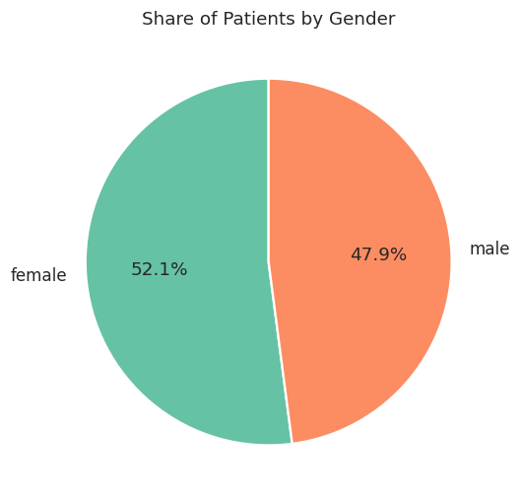
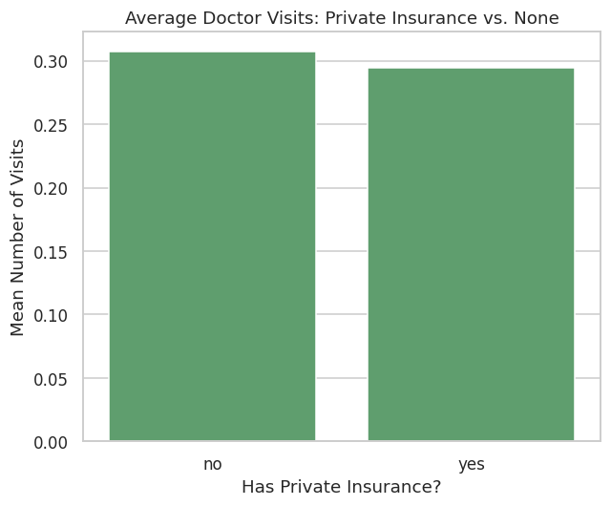
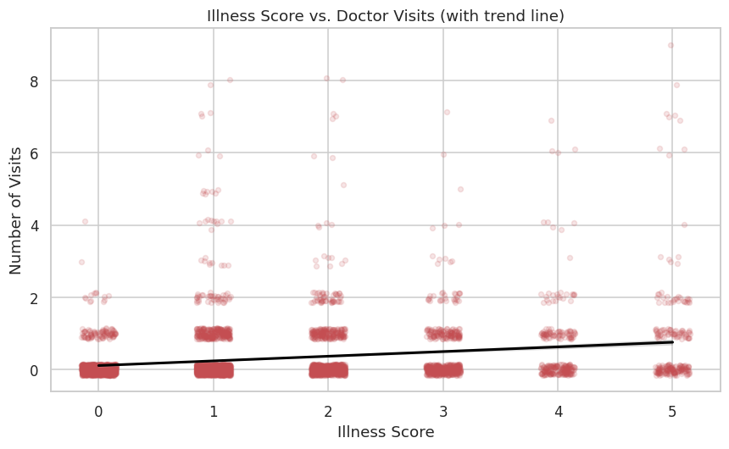
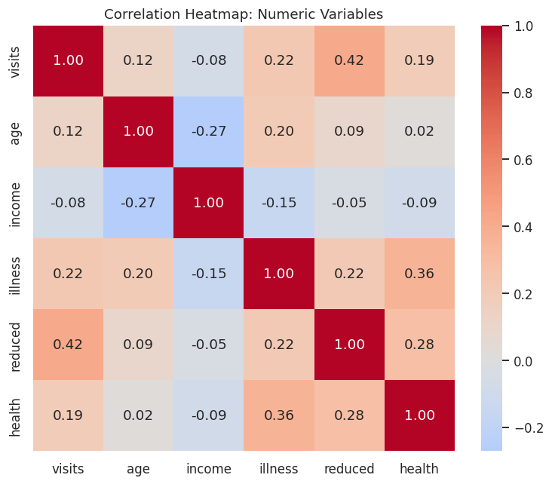
RESULTS
Patient Gender Split
Insurance & Visit Frequency
Full code & charts: see attached Jupyter notebook

Slide 7
Thank you
Thank you for your time and attention!
Healthcare Analytics for Doctor Visits — Python, Pandas, Matplotlib & Seaborn EDA on 5,190 patient records
Questions & feedback welcome.
GitHub: github.com/nitish-sharma06
LinkedIn: linkedin.com/in/nitish-sharma-6294913ab
.
.

