Slide 1

CAP444 OBJECT ORIENTED PROGRAMMING USING C++

Slide 2

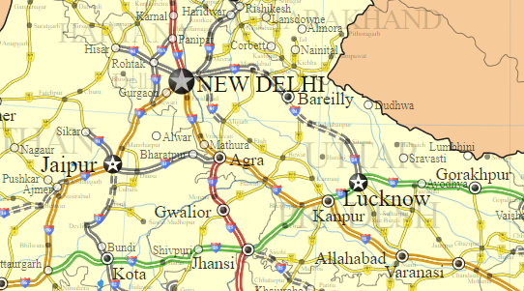




PB081234
HP014567
KA023333
BR012345

Slide 3
Transportation:
Vehicle_Registration()
Himachal_Transport
Vehicle_Registration()
Karnataka_Transport
Vehicle_Registration()
Bihar_Transport
Vehicle_Registration()
Punjab_Transport
Vehicle_Registration()
PB081234
HP014567
KA023333
BR012345

Slide 4





List of Movies

Slide 5
Movie
PlayMovie()
PlaySong()
Punjabi Movie
Telugu Movie
Hindi Movie
PlayMovie()
PlaySong()
PlayMovie()
PlaySong()
PlayMovie()
PlaySong()

Slide 6
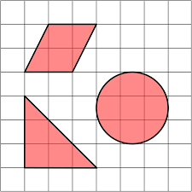
Area
getArea()
getArea()
getArea()
Area = w × h w = width h = height
Area = π × r²

Slide 7
Abstract Class
Sometimes implementation of function is not required in a base class such a class is called abstract class.
In such cases we have to make function as abstract function by using virtual keyword that is also called pure virtual function.
A pure virtual function is declared by assigning 0 in declaration.

Slide 8
Which is also called as abstract class? a) virtual function b) pure virtual function c) derived class d) base class

Slide 9
Important points:
A class is abstract if it has at least one pure virtual function.
If we do not override the pure virtual function in derived class, then derived class also becomes abstract class.
An abstract class can have constructors.
We cannot create objects of abstract classes.

Slide 10
Pick the correct statement.
a) Pure virtual functions and virtual functions are the same b) Both Pure virtual function and virtual function have an implementation in the base class c) Pure virtual function has no implementation in the base class whereas virtual function may have an implementation in the base class d) The base class has no pure virtual function

Slide 11
Any Query?

